Slide 1

Saint Francis Satyr (SFS)
Spatially Explicit Individual-Based Model (SEIBM)
Gina Himes Boor
Montana State University
Other Contributors:
Dave Pavlik, Heather Cayton, Nick Haddad, Erik Aschehoug

Slide 2
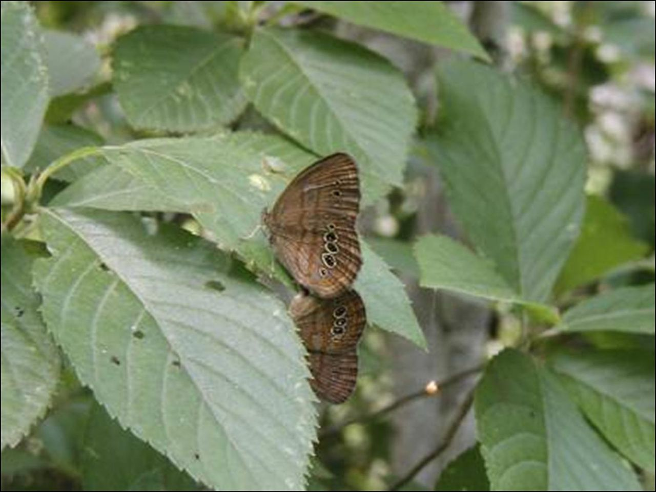
SEIBM SFS Questions
Optimal restoration strategies
Corridor or stepping stone strategies
USFWS/Flickr (CC BY 2.0)
Notes:
The two big question we want to address

Slide 3
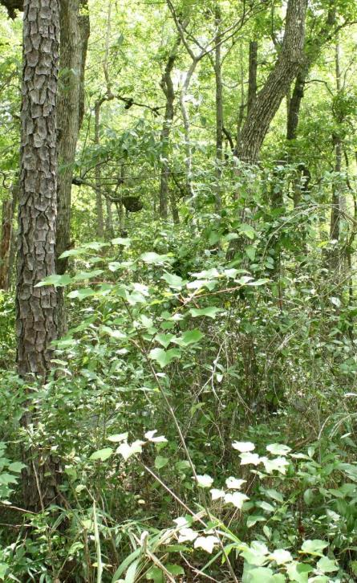
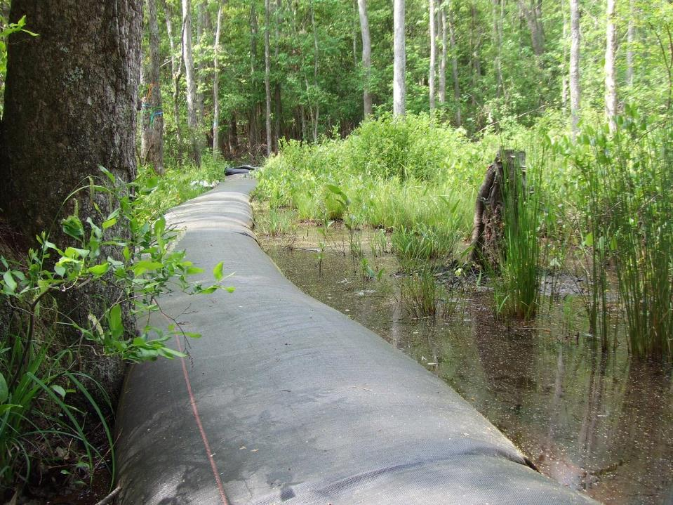
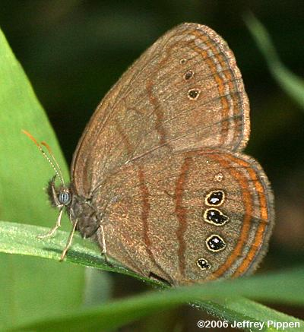
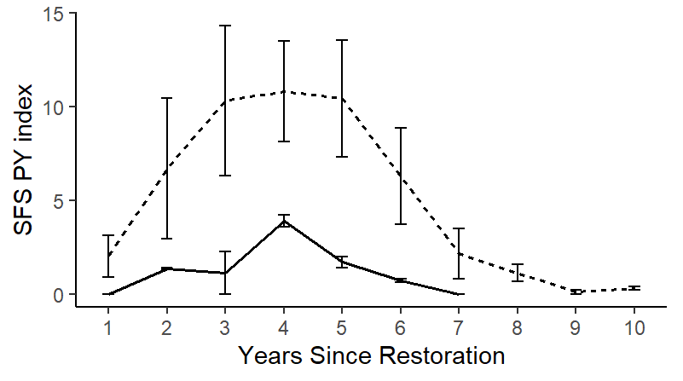
Question 1:
Optimal Restoration

Slide 4
Question 1:
Optimal Restoration
Spatial arrangement
Timing
Frequency of re-restoration

Slide 5
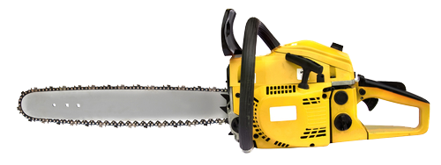

Question 1:
Optimal Restoration
Spatial arrangement
Timing
Frequency of re-restoration

Slide 6
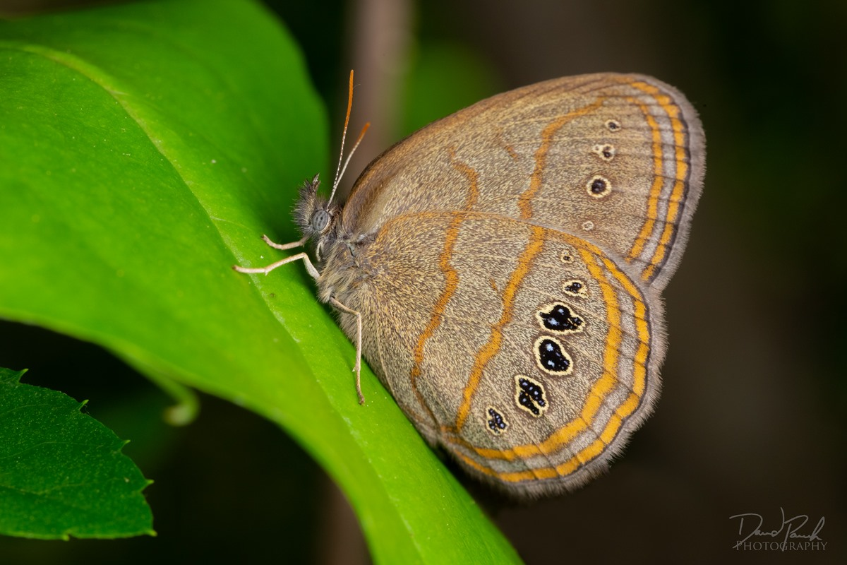
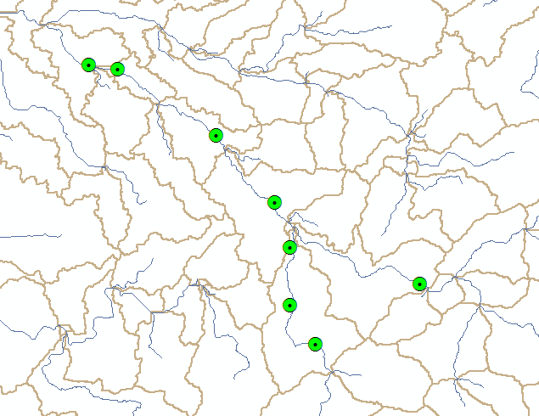
Question 2:
Corridors &
Stepping Stones
?
Feasible?
  Number
  Distance
  Maintenance frequency
Notes:
The second question is a little more theoretical in that we want to understand if it’s feasible to put stepping stones or corridors on the landscape to facilitate an expansion of the species range to reduce the possibility of catastrophic events and possible to spread out the cost and effort of maintaining this species, given that beavers are not abundant enough on the landscape to facilitate natural range shifts.

Slide 7
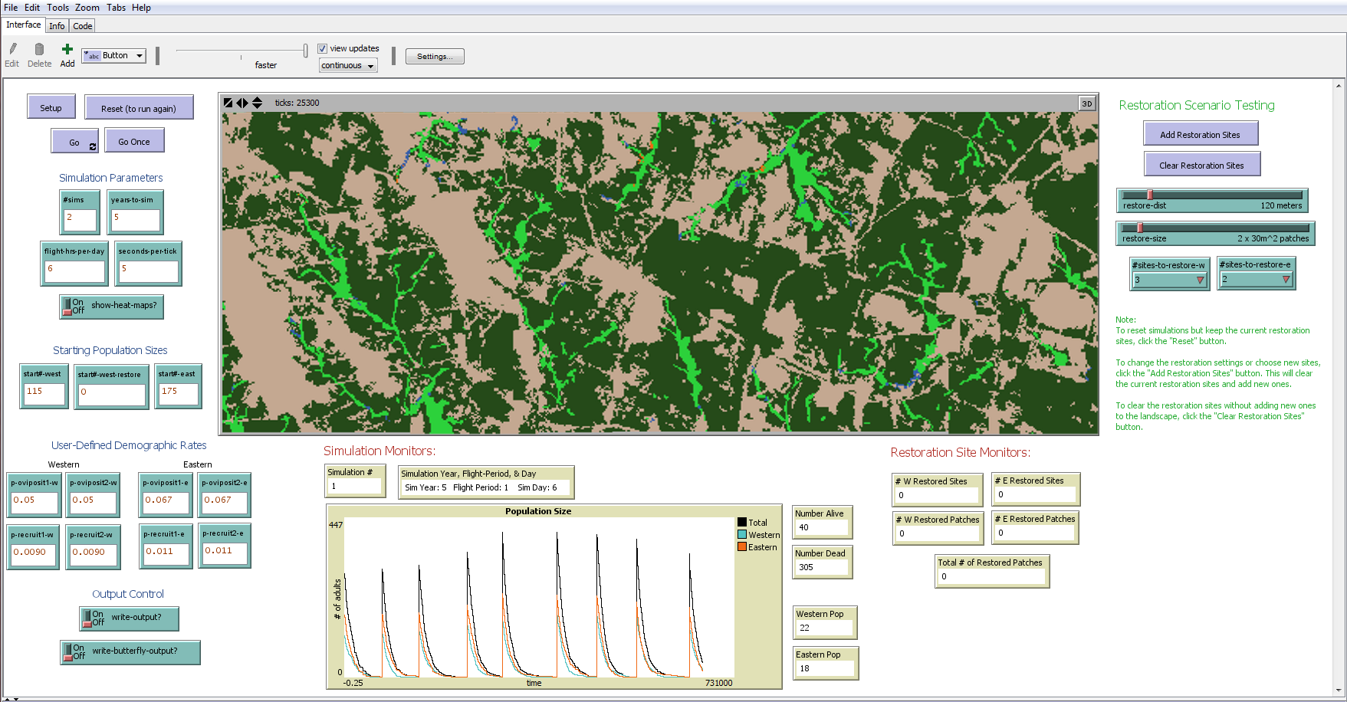
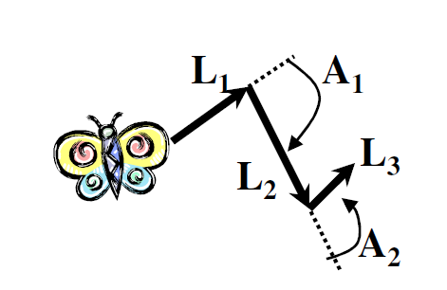
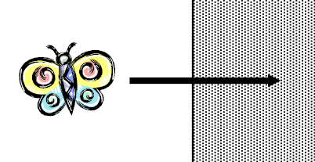
Previous SEIBM
Used data from a surrogate species:
Appalachian brown butterfly
Time-step = 5 seconds
APPALACHIAN BROWN
NOT A GOOD SURROGATE FOR SFS!!
Henry et al. (2019)
Notes:
To give you a little history – we previously developed an SEIBM for the St. Francis satyr, but because we didn’t have a lot of data on it’s behaviors or demography at the time, we used data from a surrogate species (the Appalachian brown to parameterize the data based on initial observations that seemed to indicate that the two species had a lot of overlapping behaviors and habitat needs and demography. But based on work done by Erica Henry and others, we subsequently found out that subtle differences in habitat use patterns between the App Brown and SFS resulted in pretty significant differences between the two species rendering the App Brown butterfly a poor surrogate species for the St. Francis satyr. As a result, we abandoned this original SEIBM.

Slide 8
New SFS SEIBM
Notes:
Fortunately, we were able to use some of the structure of that first model to build our new model, including the landscape and a lot of the user-interface. And this time we are only using data from St. Francis. and based on the data that we’ve been able to collect as part of this SERDP project, we

Slide 9
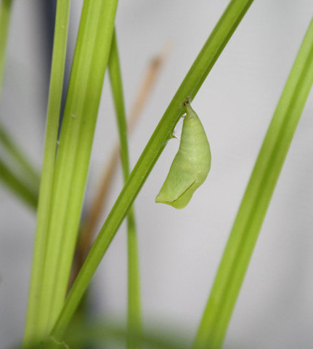
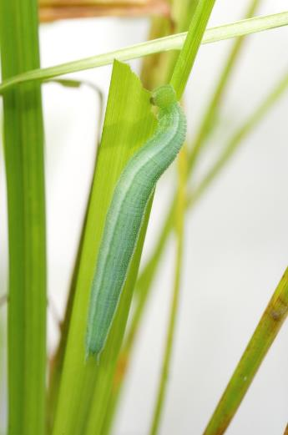
New SFS SEIBM
Dave Pavlik
Time Step = 1 day
One Time Step
= weeks
One Time Step
= months
Dave Pavlik
Time Step = 1 day
Notes:
Fortunately, we were able to use some of the structure of that first model to build our new model, including the landscape and a lot of the user-interface. And this time we are only using data from St. Francis. and based on the data that we’ve been able to collect as part of this SERDP project, we

Slide 10
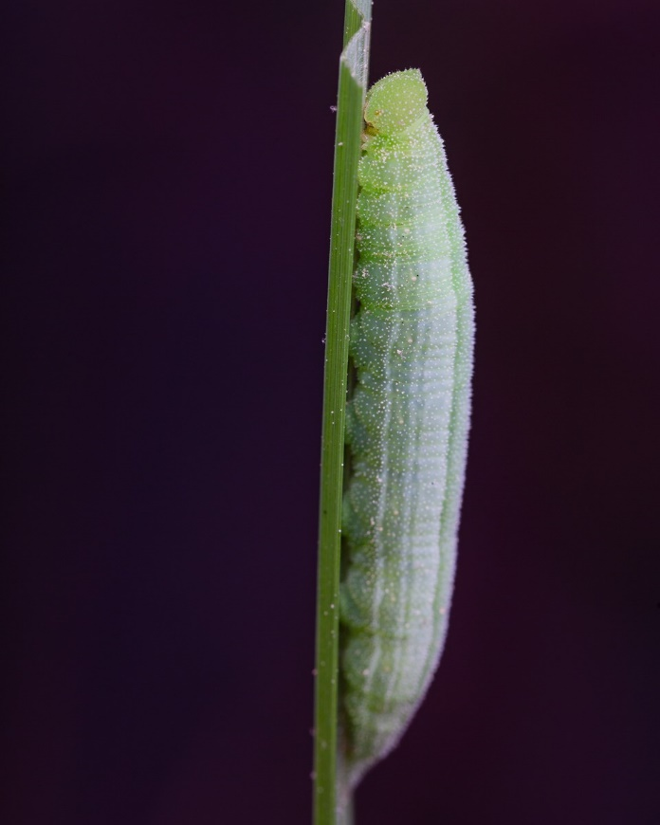
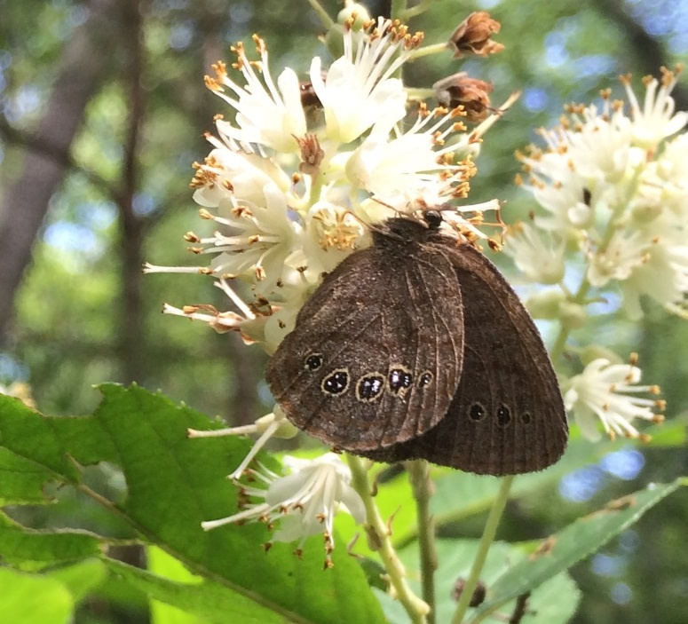
SFS SEIBM Inputs
Egg & Larval Survival
Dave Pavlik
Adult Survival
Corral eggs & larvae
survival experiments
Mark-recapture studies

Slide 11
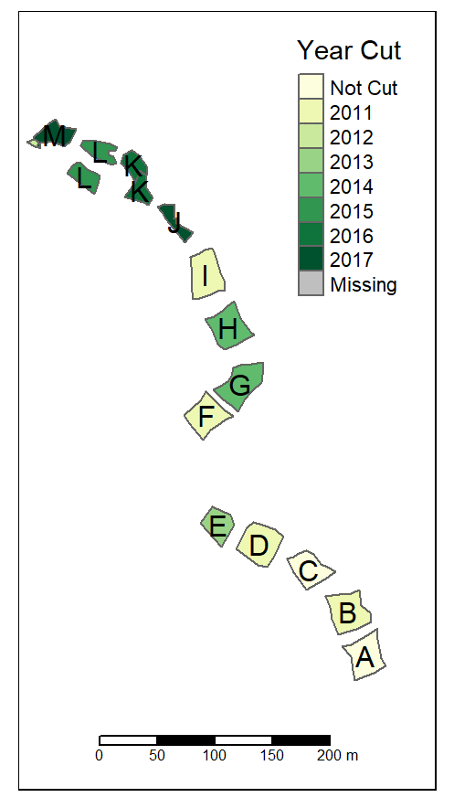

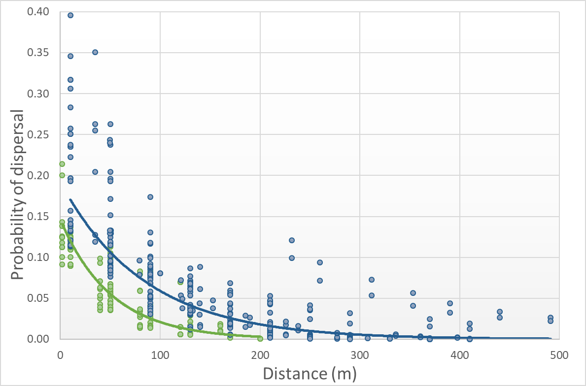
SFS SEIBM Inputs
Movement Probabilities
Movement as function of Distance
Mark-recapture studies

Slide 12
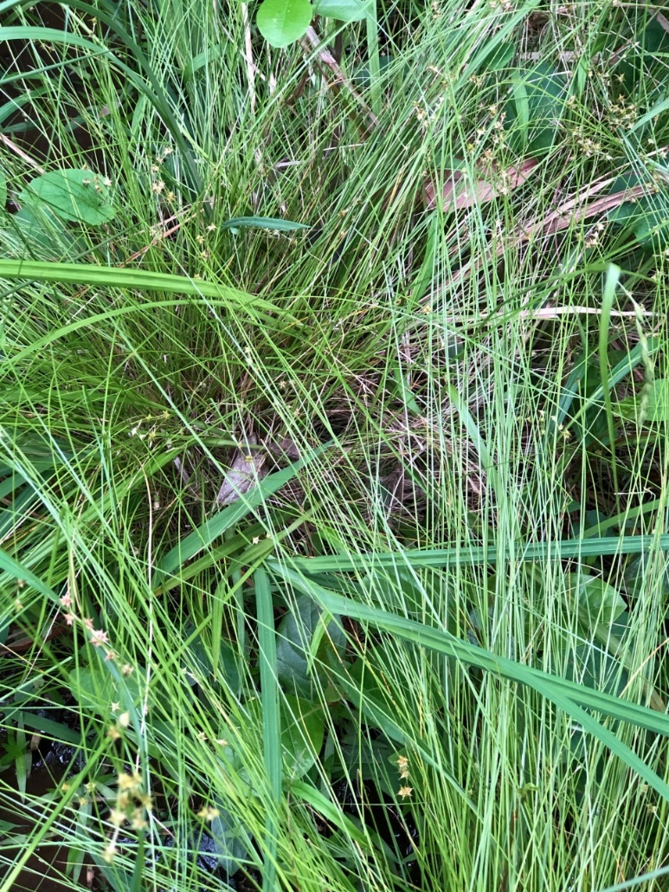
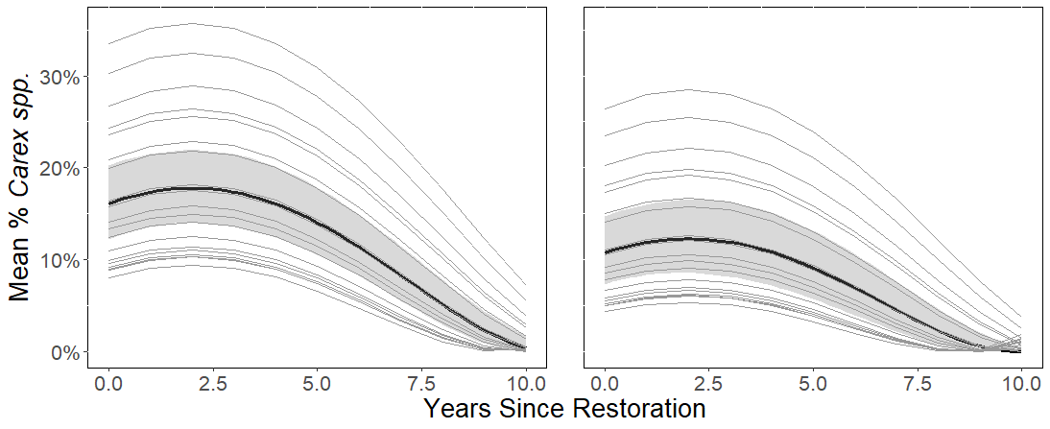
SFS SEIBM Inputs
Vegetation Surveys
Sedge Cover
Following Restoration
SFS Response to Sedge Cover
Restored Habitat
Re-restored Habitat
SFS Surveys

Slide 13


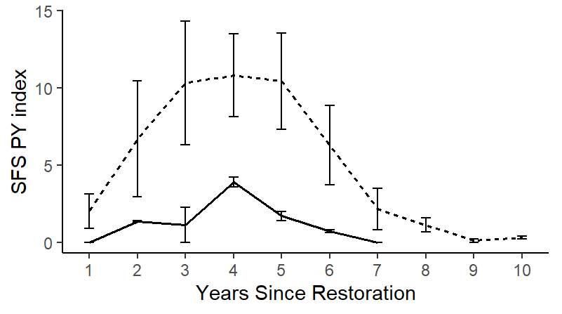

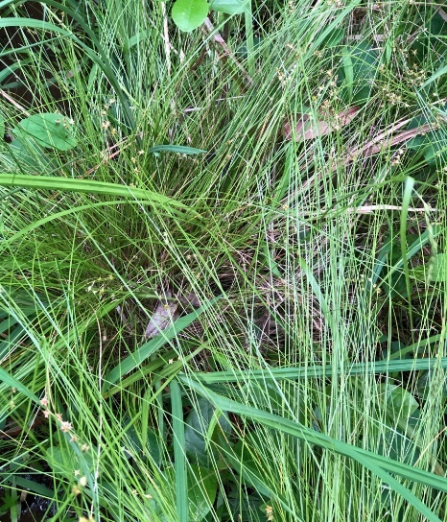
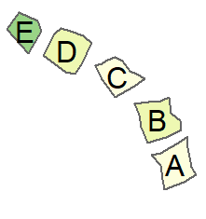
All Inputs for the SFS SEIBM
Egg & Larval Survival
Butterfly Response
Adult Survival
Sedge Dynamics
Movement

Slide 14
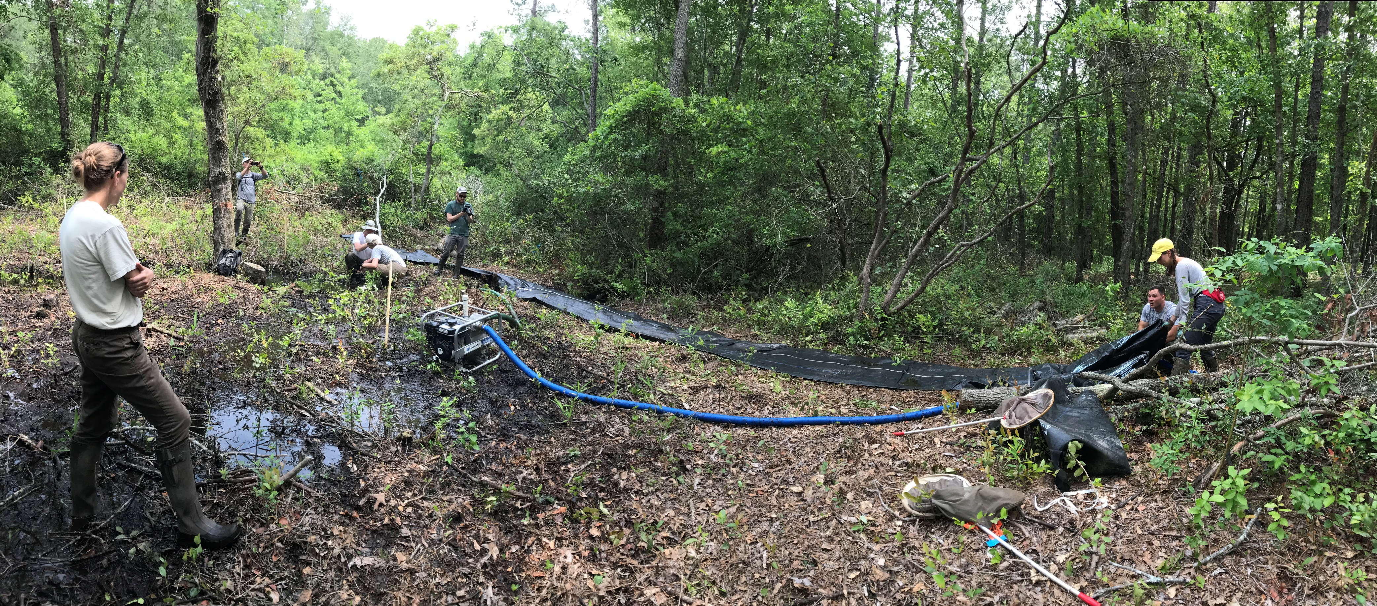
Output from the SFS SEIBM:
Dave Pavlik
Where & When
Notes:
Taking all of those inputs, what we get out is where and when to do more of this….to get more of these...in individual colonies and across the landscape.

Slide 15
Output from the SFS SEIBM:
Dave Pavlik
Thank you!
Notes:
Taking all of those inputs, what we get out is where and when to do more of this….to get more of these...in individual colonies and across the landscape.

