Slide 1
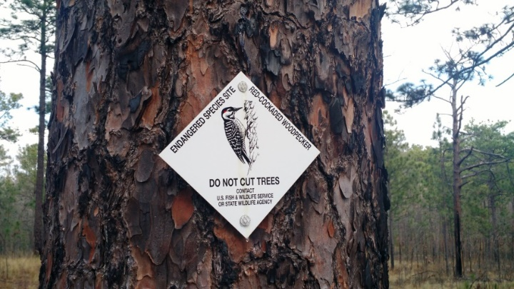
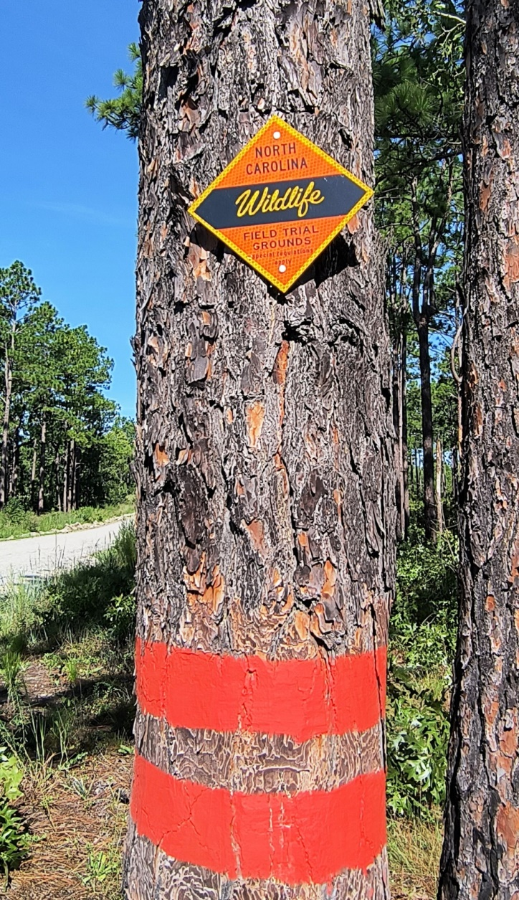
NC SANDHILLS RCW STATUS
Private Lands
State Lands
Ties to Federal Recovery
Avian Keratin Disorder

Slide 2
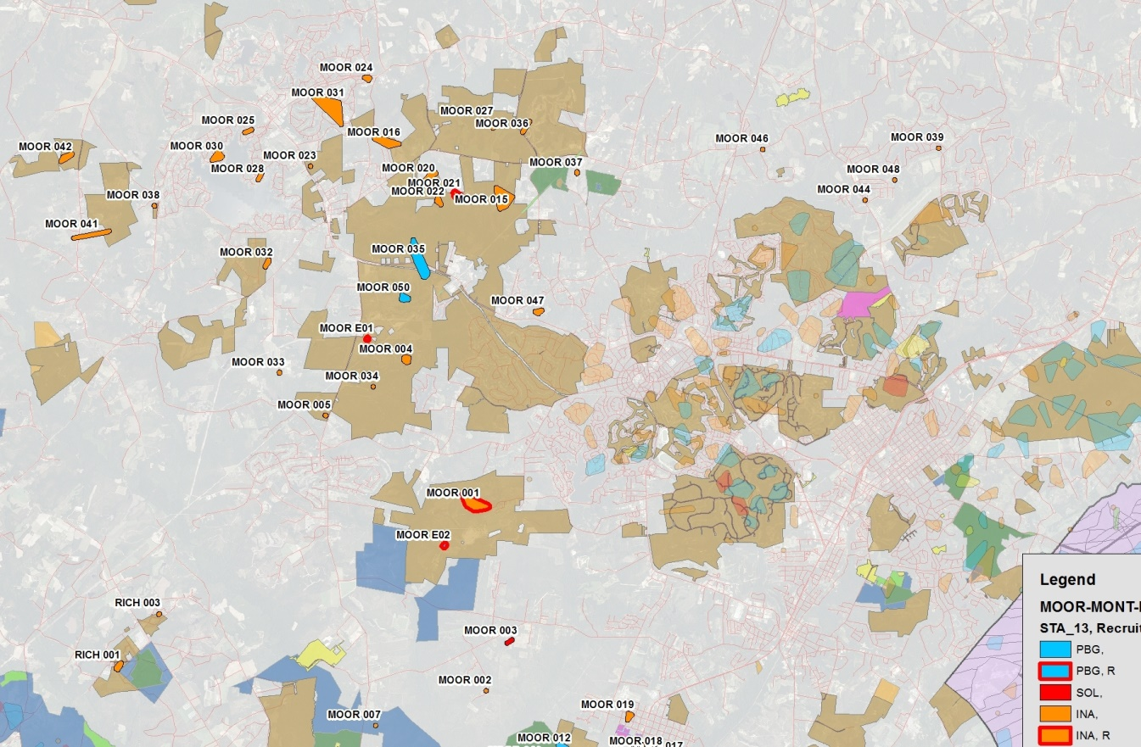
PRIVATE LANDS 2000-2025
Fort Bragg
Sandhills GL
Safe Harbor Properties (~65,000 ac)
------------------------ MOOR ------------------I I------------------- SOPI -------------------------
MOSS
CCNC
SGL
FB
SGL

Slide 3
PRIVATE LANDS 2000-2025

Slide 4
PRIVATE LANDS 2000-2025
Safe Harbor Properties
2009 FB ‘jumper’
MOOR
SOPI
MOSS
CCNC
FB
SGL
SGL
Moore County NC

Slide 5
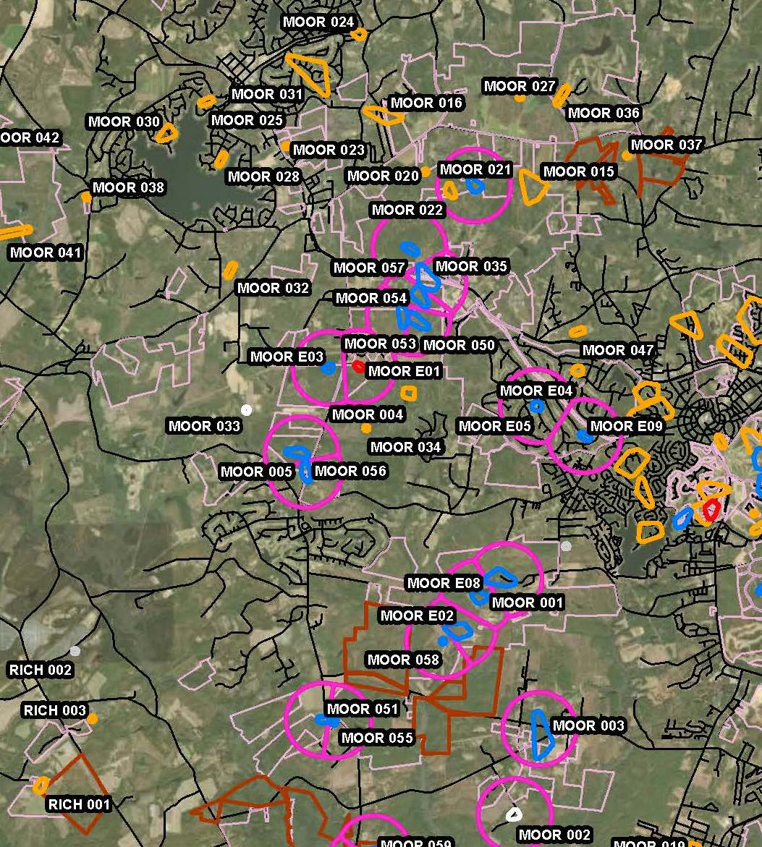
Present day
Spatial Configuration
RCW Groups
Western Moore County
2026 Recruitment
Clusters
Nick’s Creek LL Preserve
Plant Cons. Program
Wimberley
Sweeney
Rose (NW off map)

Slide 6
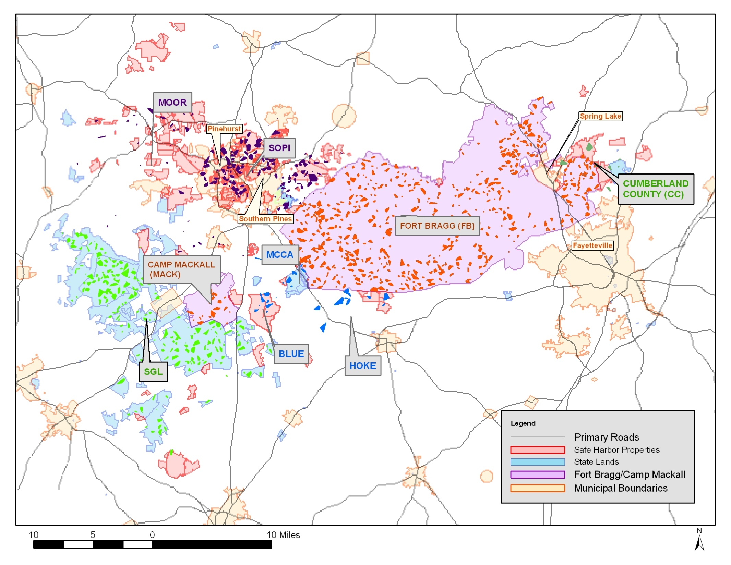

Slide 7
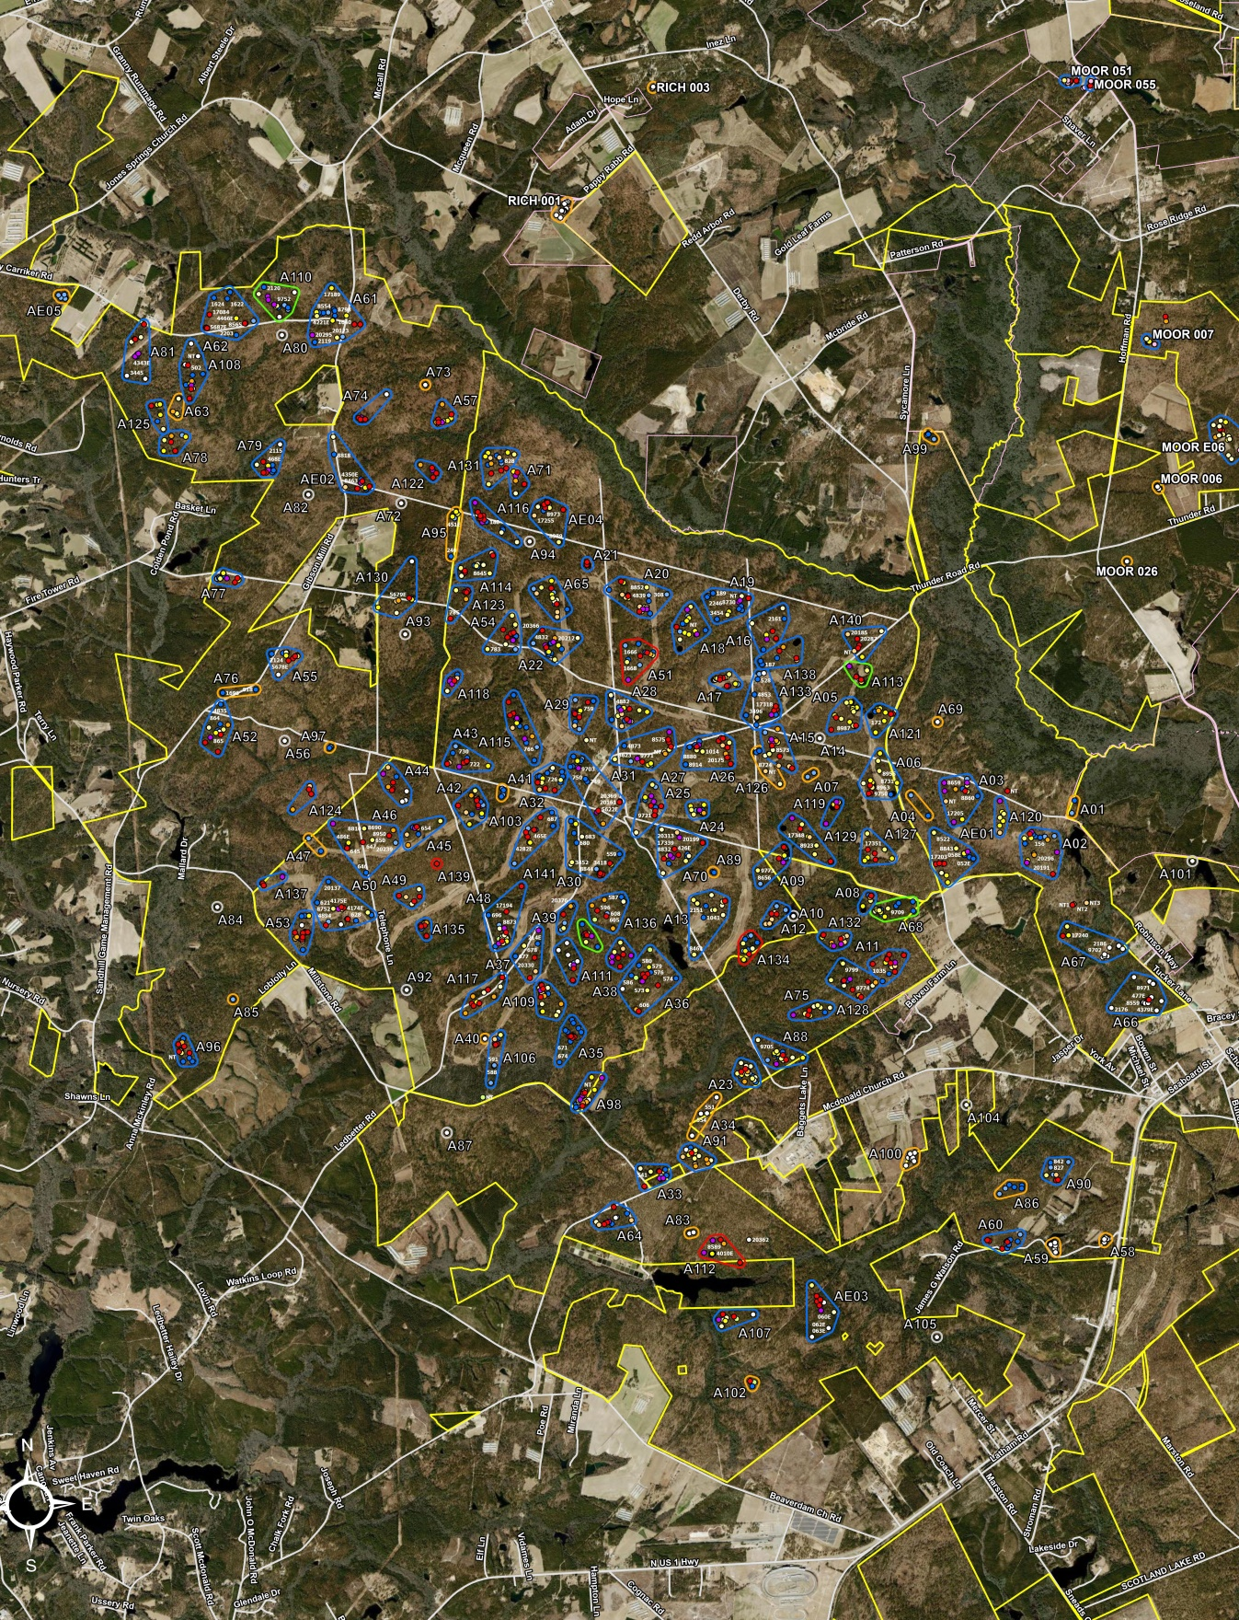
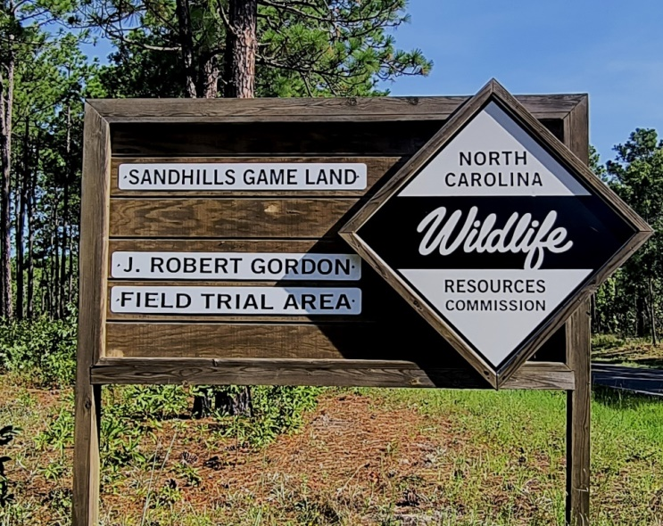
SGL A-Block (~ 19,000 ac.)
Field Trial Area
Initial RCW Growth within
Field Trial Footprint
Room for Expansion
Western + Southern edges
Strengthen NE w/ Y-Block MOOR private lands groups

Slide 8
# RCW PBG 2000-2025 Partnership Properties
Notes:
Partnership props that played an important supporting role in recovery:
TNC Calloway is a mitigation back for NCDOT projects and that subpop has doubled in 25 years from 5 to 12. TNC excellent job restoring this parcel that was raked intensively for pinestraw production for years
McCain state property managed by NC Dept of Agriculture that while seeing some gains levelled off in recent years. Rob Ross hardwood midstory project in the works
WeWo difficutly maintaining group stability due to challenges with burning , especially on super fire surpressed Boyd Tract. Acquisition of Ives Property boosted their acreage
Carvers Creek SP has expanded in response to cavity installation and foraging habitat enhancement. In 2025 we no longer have group data for Carver’s Creek due to federal funding cuts to a JCA contract

Slide 9
Est. RCW PBGs NC Sandhills 2005-2024

Slide 10
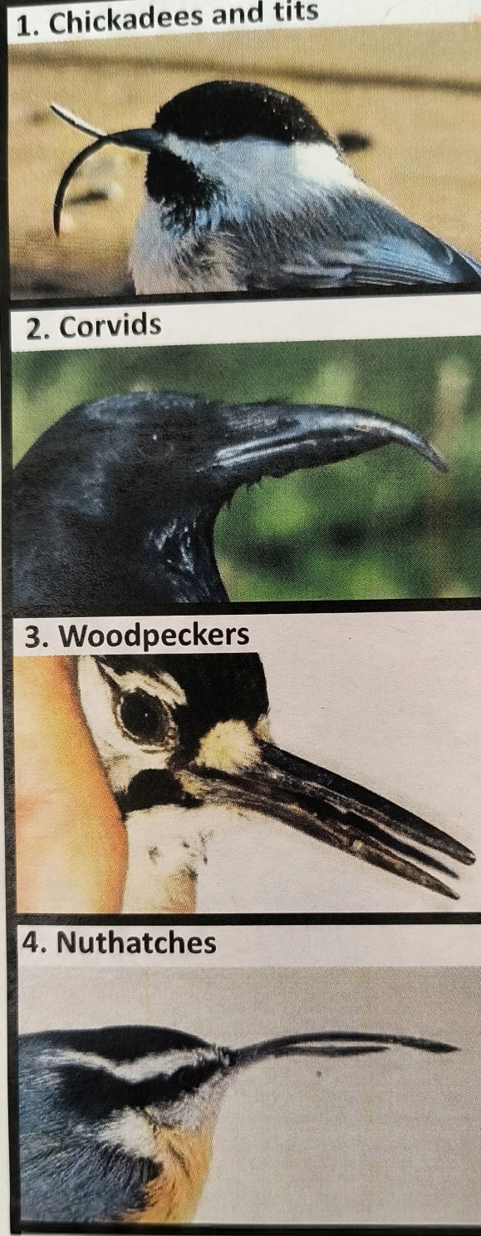
Avian Keratin Disorder (AKD)
1990s
AKD first described in Alaskan Black-capped Chickadee (BCCH) by USGS Alaska Science Center
~ 2007/2008
SEI began to see abnormally long / thick billed RCW during routine monitoring activities (FB only, few cases)
2018
SEI documented rise in FB cases, began investigation and collab with USGS group
Zylberberg et al 2018*
USGS Alaska researchers isolated a Picornavirus in afflicted chickadees: Poecivirus
Van Hemert et al. in prep

Slide 11
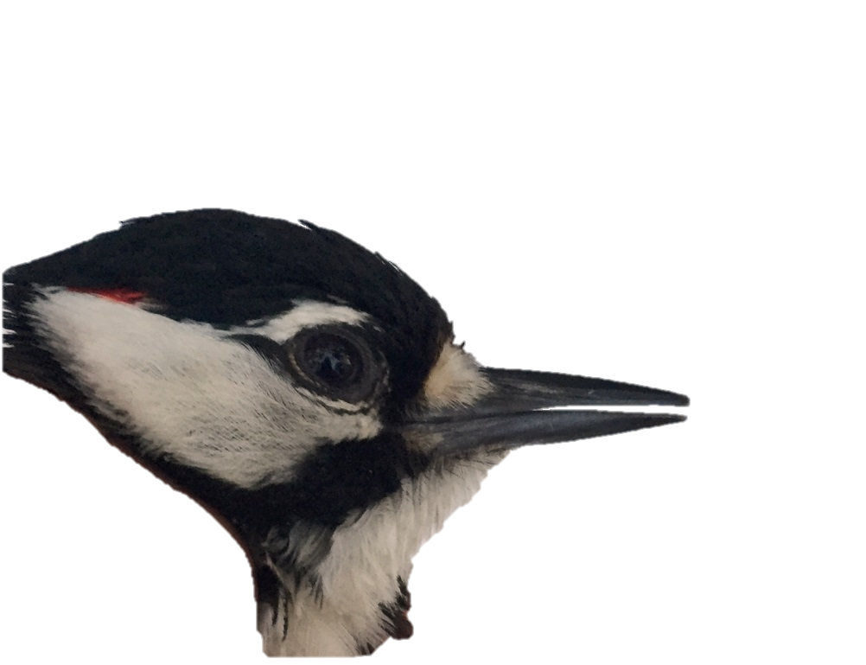
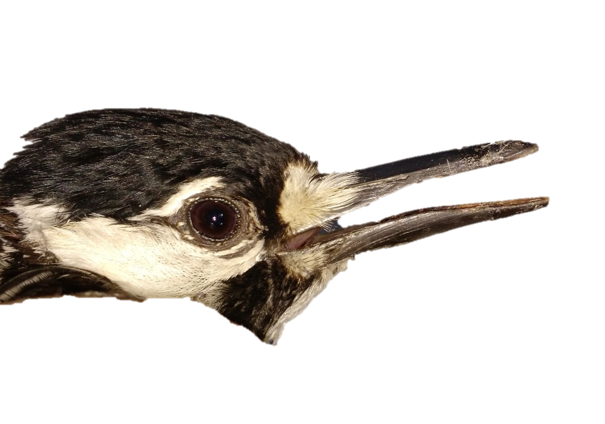
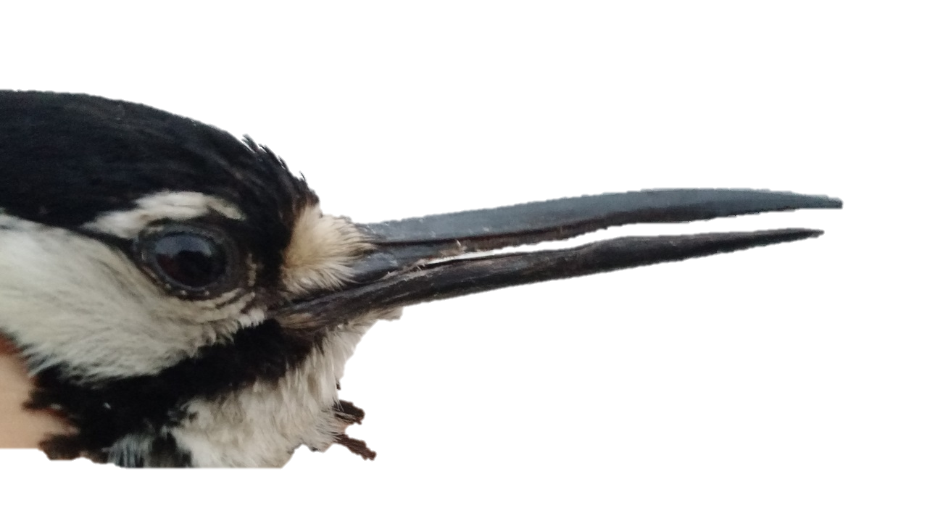
Normal
Avian Keratin Disorder (AKD)
in Red-Cockaded Woodpeckers
Longbill
Severe Longbill

Slide 12
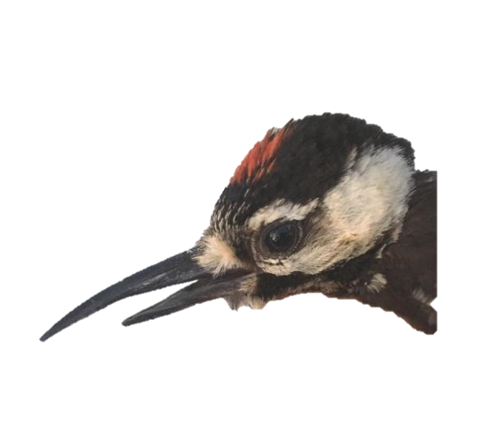
Condition present in Central NC and Midlands SC
Absent coastal Carolinas populations
  Camp Lejeune, Sunny Point, Low Country SC
Seasonal: late June peak; subside by fall
Center outbreak on Ft Bragg + adj properties
since expanded to SOPI and SGL
AKD Prevalence 2019 – 2021
  + 5% across FB, SGL and SOPI
  + 9% within FB alone
Photo J. Schillaci
Juvenile male RCW
MANUSCRIPT IN PREP
BEAK DEFORMITIES IN WILD BIRDS: USING CITIZEN SCIENCE
TO TRACK AN ISSUE OF GLOBAL CONCERN
C. Van Hemert, C.M. Handel, D.E. Gerik, B. Lawson, K. Brust, C. Gorosito, V.R. Cueto,
A. Van Lanen, A. Prinz, J. Schillaci, J.R. Walters, S. Cottrell, C. Anderson

Slide 13
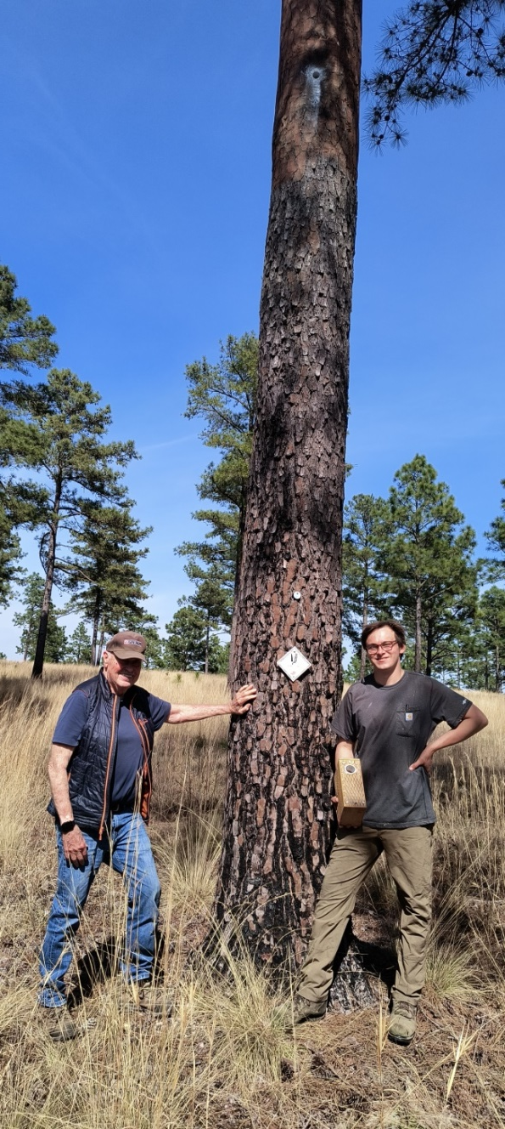
SEI maintain RCW monitoring
SOPI and SGL
Increase outreach as people move to Sandhills region
Expand to Uwharries NF
Identify drivers of AKD
RCW cavity insert install Mar 2026
Safe Harbor Land, Moore Co., NC

