Slide 1

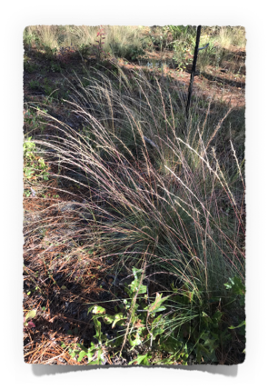
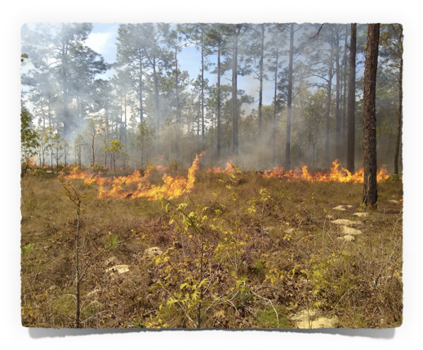
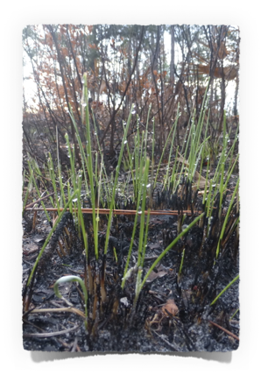



Fundamental fuel: Wiregrass ecology in fire-prone pine savannas
Jennifer Fill
Research Assistant Scientist
jfill@ufl.edu
Raelene M. Crandall, University of Florida

Slide 2
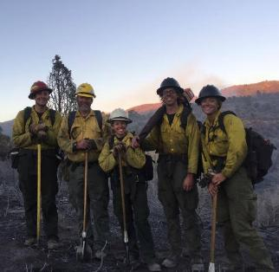
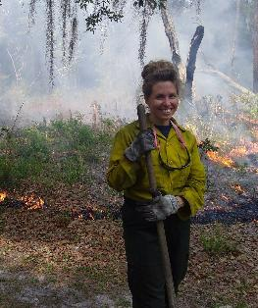
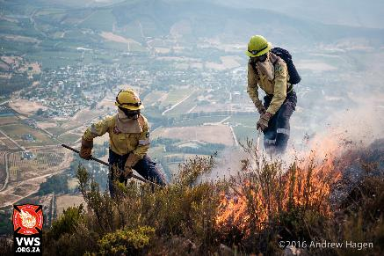
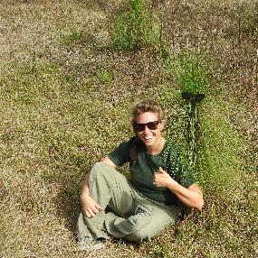
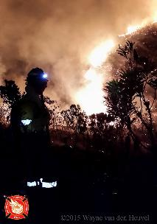
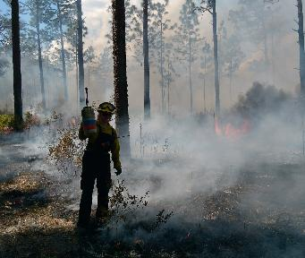
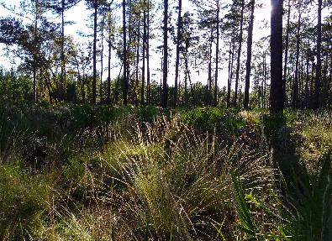
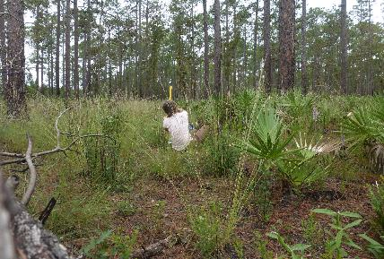
Fire and plants, everywhere

Slide 3
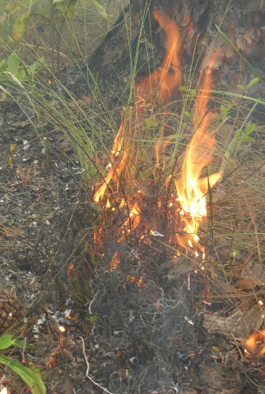
Acknowledgements
Damian Adams
Mary Nell Armstrong
Carolina Baruzzi
Raelene Crandall
Javier Castro Salazar
John Davis
Susanna Goewey
Jessica Hong
Chris Kinslow
Natalia Izarry-Medina
Gary Johns
Hope Miller
Milo Neelands
Andy Rappe
Scott Sager
Andres Susaeta
Jason Vogel
Cesar Zamora
April Zee

Slide 4
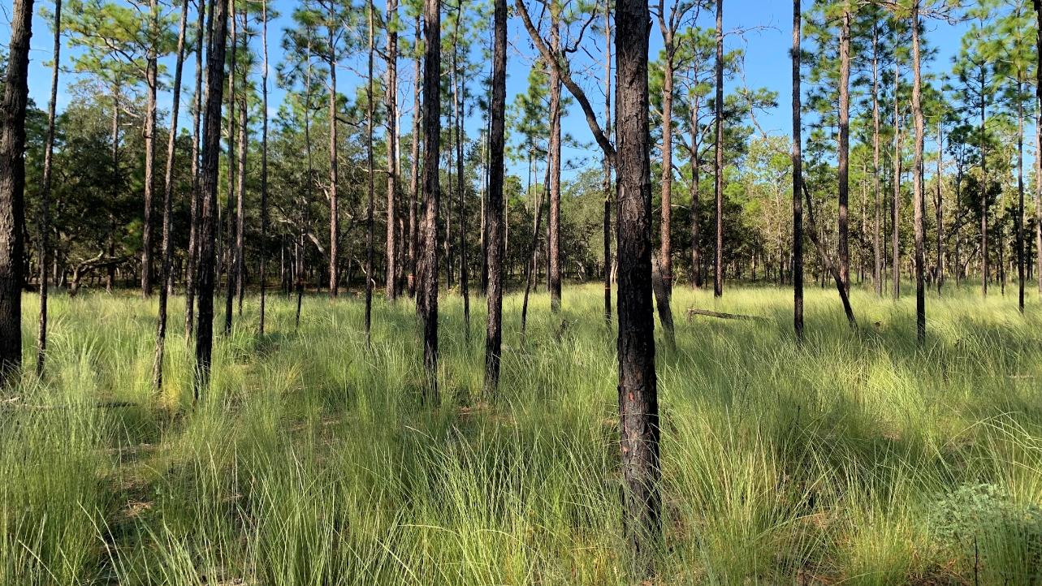
Southeastern savannas have old-growth understories

Slide 5
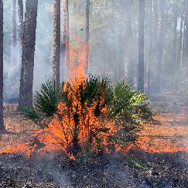
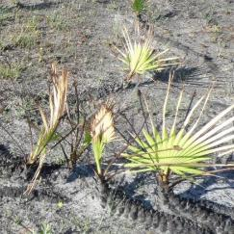
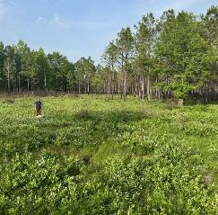
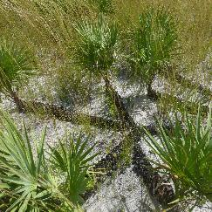
Species have “old-growth” life histories
High adult survival with fire
  Resprouting
  Underground storage organs/protected buds
Reproduction tied to fire
  Fire stimulated flowering
  Low seedling establishment
Saw palmetto, Runner oak
Veldman et al. (2015); Pereira & Crandall (2024)

Slide 6
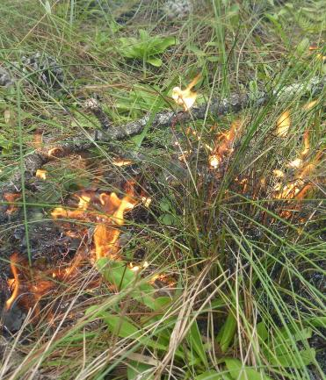
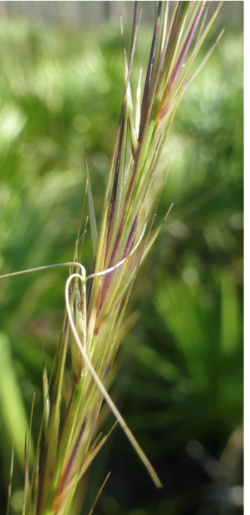
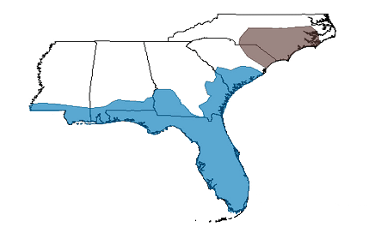
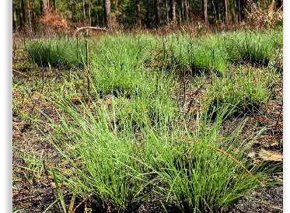
Wiregrass
Aristida beyrichiana (Aristida stricta)
Aristida
stricta
Aristida
beyrichiana

Slide 7
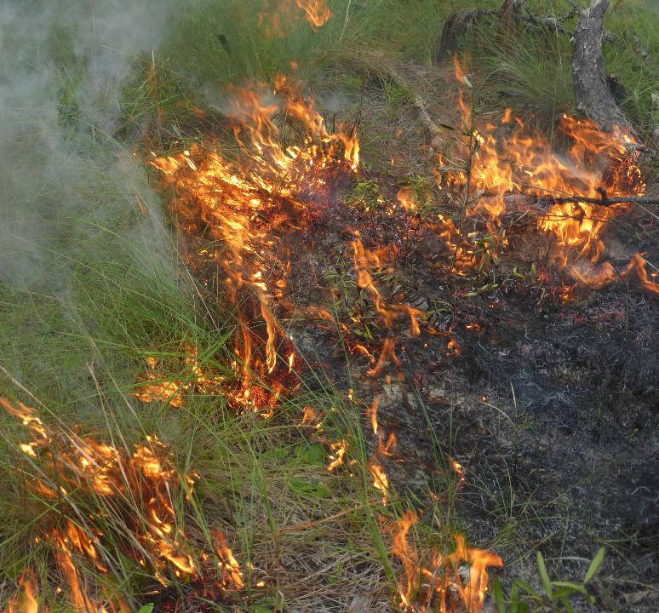
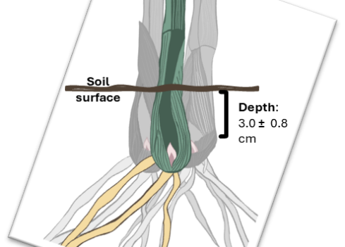
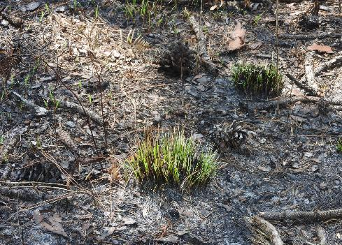

Slide 8
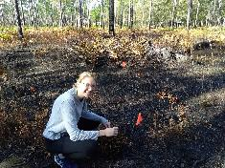
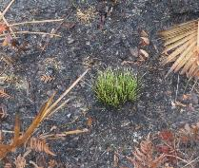
Wiregrass regrows quickly after fire
WINTER
WINTER
SUMMER
SUMMER
AVG TILLER LENGTH
WEEKS SINCE FIRE
Notes:
Jen

Slide 9
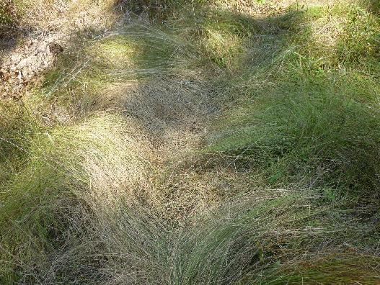
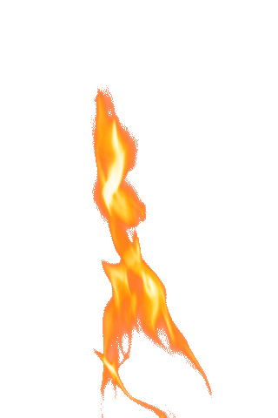
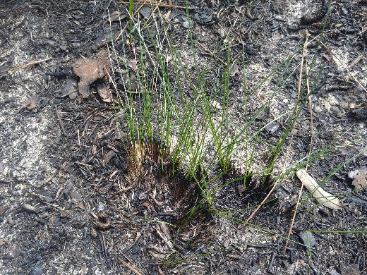
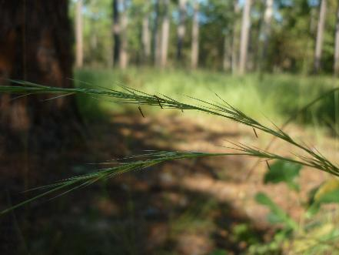
Recently burned
Unburned
Flowering

Slide 10
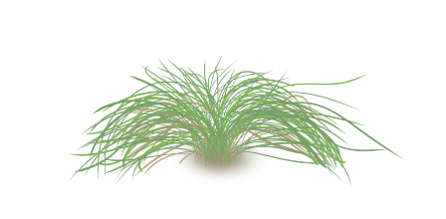
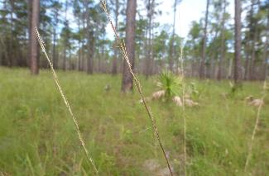

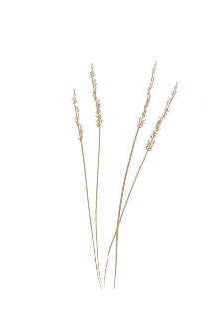

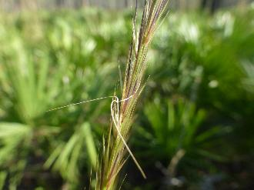
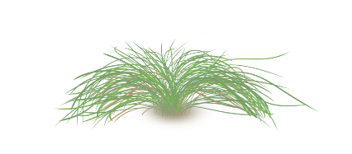

Fire regimes affect wiregrass reproduction
Fire regime seasonality
Fire regime frequency
Winter/January
Annual
Summer/June
Triennial

Slide 11
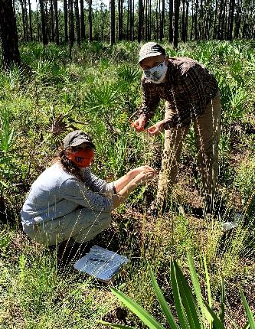
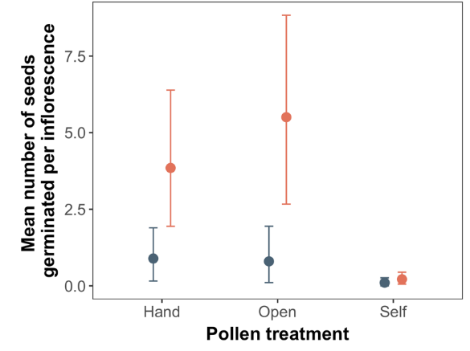

Outcrossing is required for germinable seeds
Crandall, R.M., C. Baruzzi, and O.A. Adedoja. Pollen incompatibility of an ecologically important grass is revealed by examining germination, not seed production. In review.

Slide 12
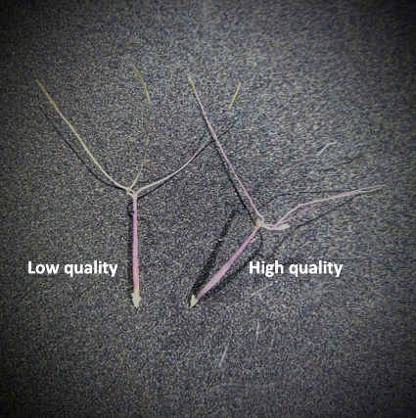
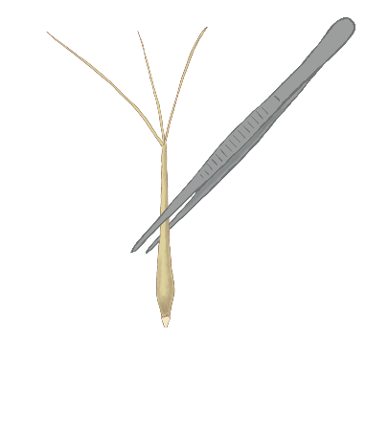
High- and low-quality seeds have similar appearance
Pérez, H. E., & Norcini, J. G. (2010). A new method of wiregrass (Aristida stricta Michaux.) viability testing using an enhanced forceps press test. Natural Areas Journal, 30(4), 387-391.

Slide 13
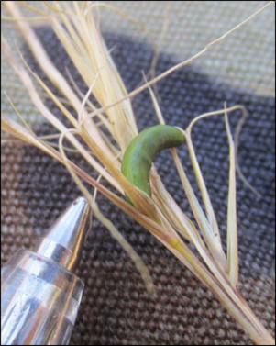
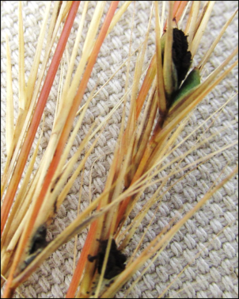
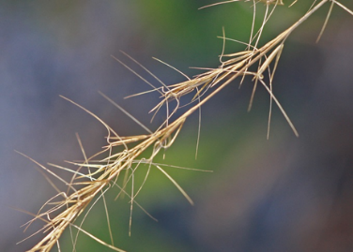
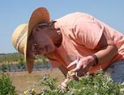
Wiregrass can produce seeds and pickles
Fill, J.M., I. Meadows, J.L. Walker, R.M. Crandall, and J.L. Kerrigan. Smut fungus (Langdonia walkerae) incidence is lower in two bunchgrass species (Aristida stricta and A. beyrichiana) after winter and spring prescribed burning.
Notes:
Northern had greater numbers of seeds infected

Slide 14
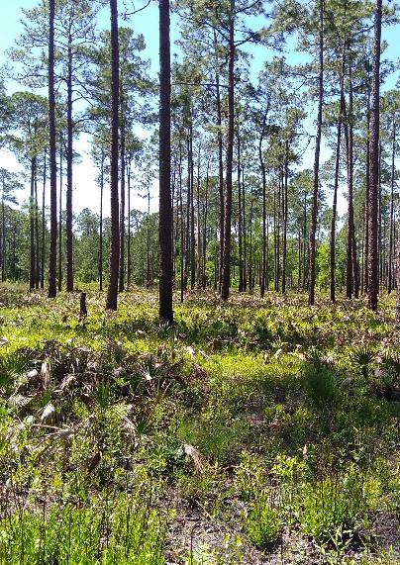
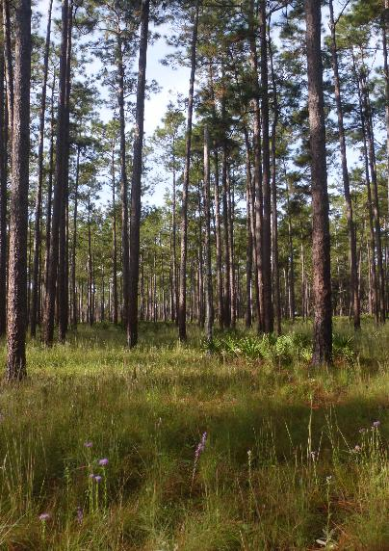
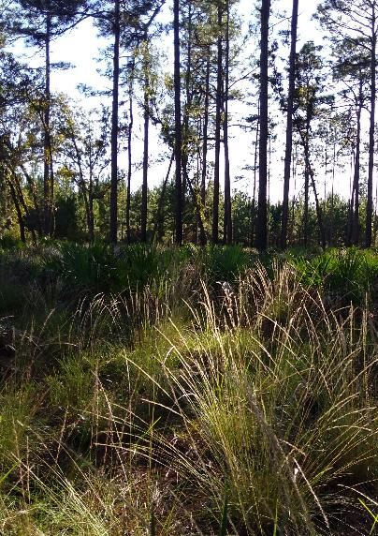
Annual Winter Fire
Mesic
Annual Summer Fire
Xeric
Triennial Summer Fire
Xeric

Slide 15






Wiregrass populations are stable regardless of fire regime
Xeric
Mesic
Growing
3
Stable
2
3
V
1
1
2
3
V
Declining
Dormant
Growing
Fill & Crandall (2024)

Slide 16
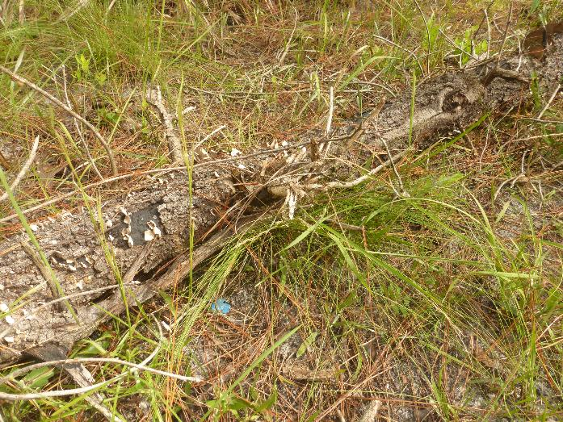
Stability results from high survival

Slide 17
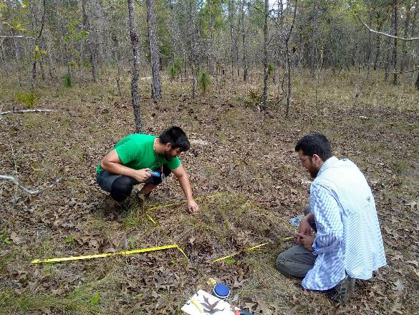
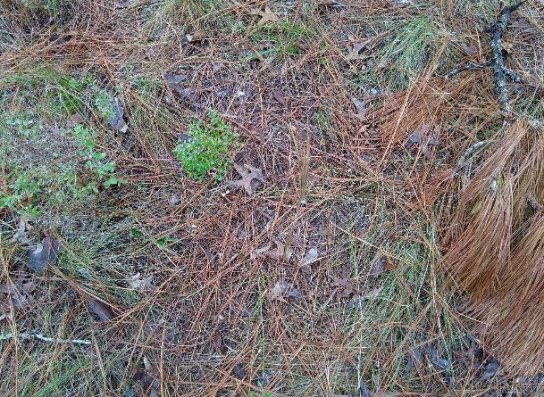
Wiregrass persists in long unburned sites
Fill et al. (2021)

Slide 18
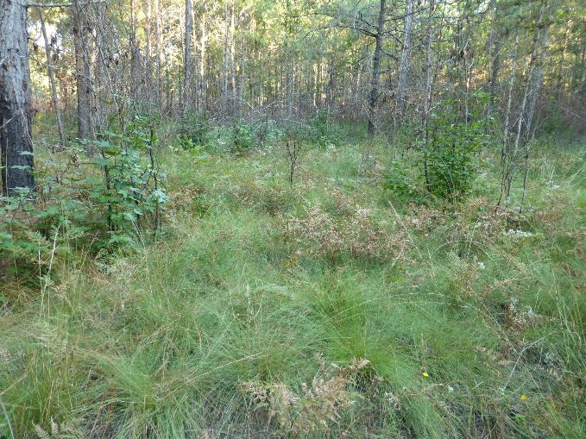

Wiregrass persists in long unburned sites
Fill et al. (2017)

Slide 19


Long-unburned plants can produce good quality seed

Slide 20


Young plants also produce good quality seed

Slide 21


Contact us!
www.ecologyonfire.com

