Slide 1
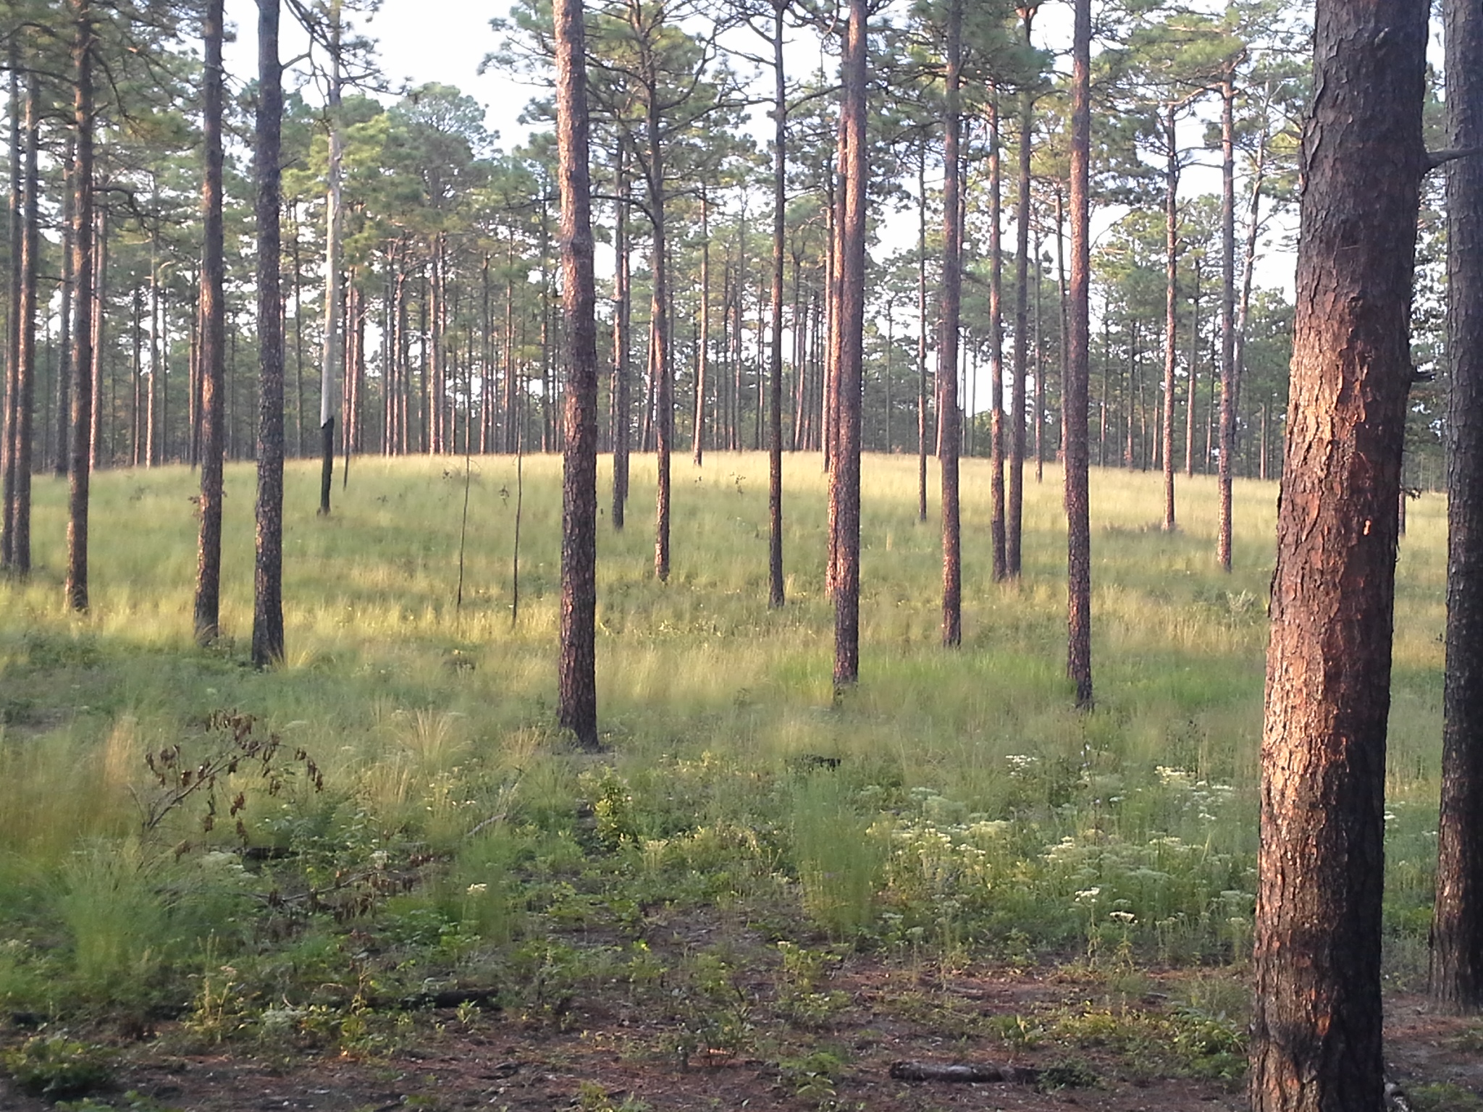
Sandhills Conservation Partnership updates
September 10, 2025

Slide 2

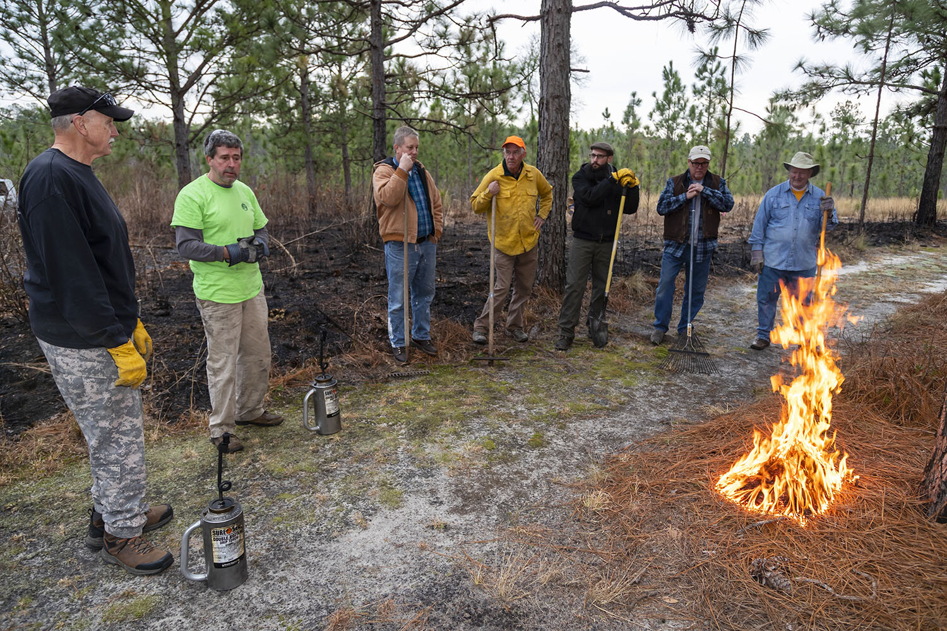
National Fish and Wildlife Foundation Funding
Quail Forever received $500k in 2025 cycle to support Sandhills PBA and technical assistance
  SPBA Coordinator
  SPBA Fire Mentor
TNC received additional $500k added to 2024 award
TNC plans to apply in 2026 cycle-
partner projects welcome

Slide 3

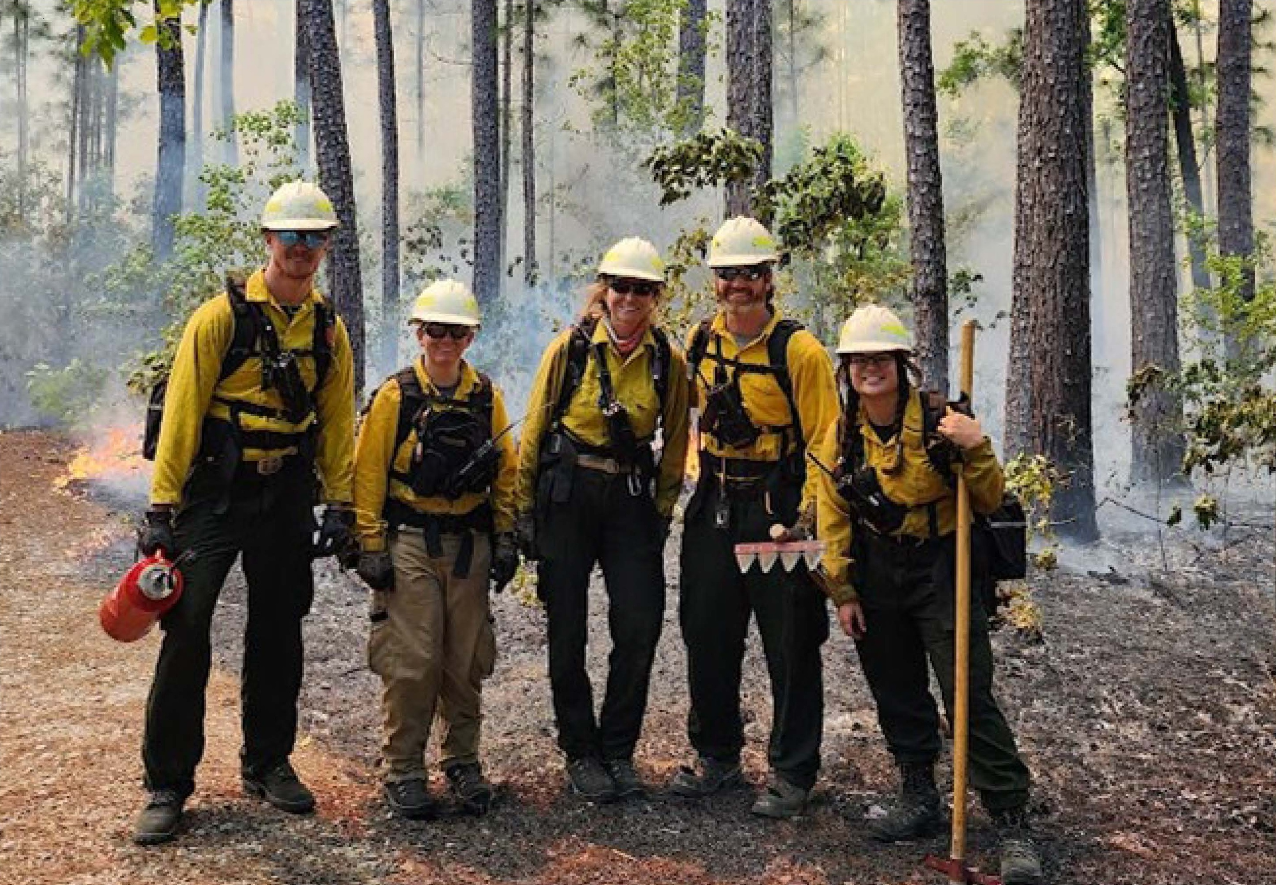
Joint Chiefs - Uwharries to Sandhills Phase 2
$3.3M over 3 years (NRCS & USFS)
The Ember Alliance shared burn crew
Dedicated EQIP cost share
Fire training with Catawba nation

Slide 4

Land Use Planning
Harnett County comprehensive plan update completed
  Military corridor overlay district
  Stream buffers
  Open space requirements
Moore County land use plan update
  Steering committee offered recommendations that could address conservation and military interests, if adopted
  County linking Water Use and Land Use planning
Hoke County starting land use plan update

Slide 5
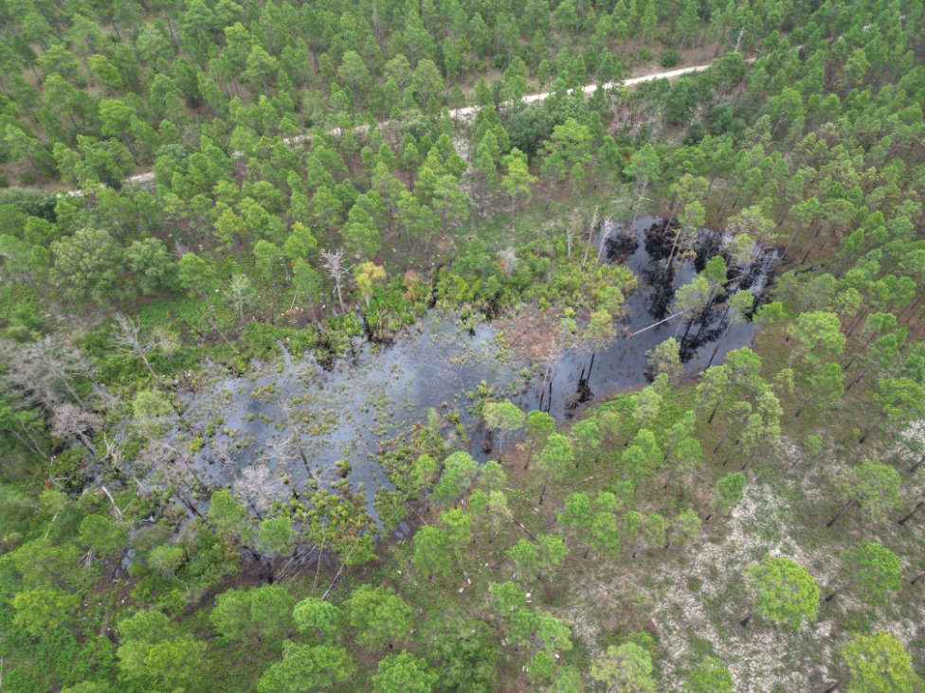
Wetland Restoration
Conservation Corps NC 5 person crew
2 weeks in 2024 and 3 weeks in 2025
Support from The Ember Alliance crew in 2025
6 wetlands enhanced
Plans to continue in 2026

