Slide 1
Reserve Design in the Sandhills
Matthew Moskwik

Slide 2
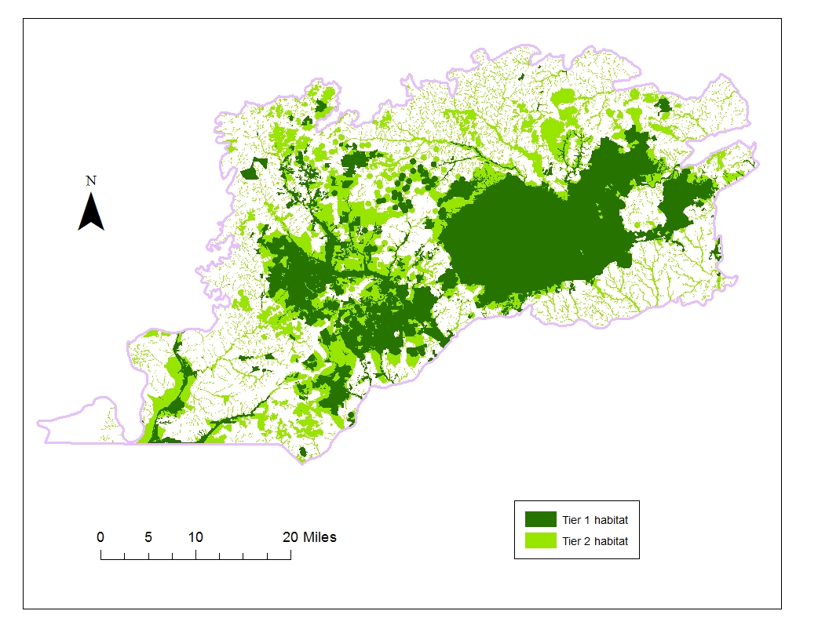
Our Current Reserve Design

Slide 3
Advantages of Utilizing Conservation Planning Software
Combine all important features
  Create targets for each
  Assign weights/rankings to inputs
Use county parcel data as selection units
  Assign costs and/or size limits
Create boundary penalty
  Produces more compact reserve
Result: Prioritizes landscape for conservation action with known constraints

Slide 4
Setup for a Simple Purchase-only Model
Set targets for features

Slide 5
1. Set Targets for Features
Name | Amount | Ratio | Target
Other Element Occurrence | 23914.93 | 0.75 | 17936.2
Other Managed Area | 143065.5 | 0 | 0
NHPNA | 905491.3 | 0.95 | 860216.8
NHPNA Candidate | 14609.19 | 0.75 | 10956.89
RCW Active Foraging Area | 515708.6 | 0.95 | 489923.2
Floodplain | 273679.7 | 0.25 | 68419.94
RCW Inactive Foraging | 176481.6 | 0.5 | 88240.82
Potential Upland | 348139.8 | 0 | 0
Restoration Area | 66780.55 | 0.5 | 33390.28
Smoke Awareness | 181236.6 | 0.25 | 45309.15
Stream Buffer | 573330.7 | 0.25 | 143332.7
Wildlife Connector | 135024.1 | 0.75 | 101268
Brownwater Levee Hardwood Forests | 173.9058 | 0.5 | 86.9529
Cypress-Gum Swamp Forests | 23549.59 | 0.5 | 11774.79
Dry-Wet Hardwood and Mixed Forests | 150467 | 0.5 | 75233.5
Dry-Hydric Hardwood and Mixed Forests | 23721.96 | 0.5 | 11860.98
Forest Canebrakes | 156487.6 | 0.5 | 78243.81
Forested Floodplains | 161191.9 | 0.5 | 80595.97
Forested Floodplains and Non-Riverine Wet Flats | 9274.43 | 0.5 | 4637.215
Pitcher Plant Meadows and General Wet | 500.592 | 0.5 | 250.296

Slide 6
Setup for a Simple Purchase-only Model
Set targets for features
Format parcel data
  Identify protected areas

Slide 7
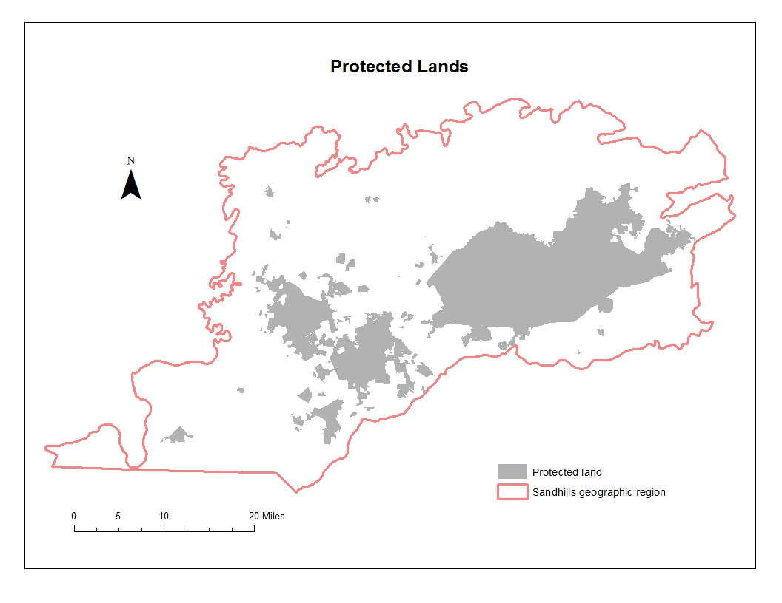

Slide 8
Setup for a Simple Purchase-only Model
Set targets for features
Format parcel data
  Identify protected areas
  Exclude areas from analysis (i.e., cities, sand mines)
  Establish costs: number of acres

Slide 9
Setup for a Simple Purchase-only Model
Set targets for features
Format parcel data
  Identify protected areas
  Exclude areas from analysis (i.e., cities, sand mines)
  Establish costs: number of acres
3. Create boundary penalty
  Moderate penalty assigned for this example

Slide 10
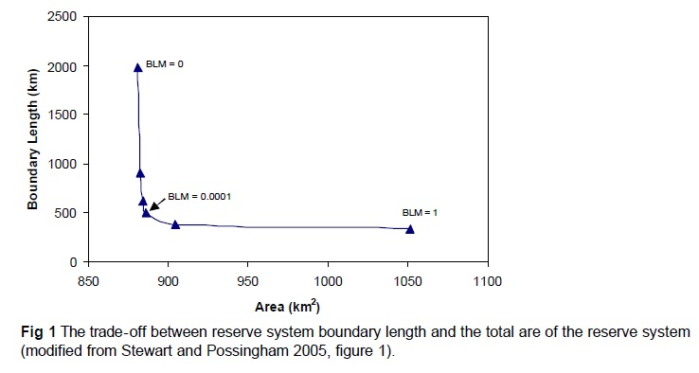
Trade-off between Reserve System Boundary Length and the Total Area of the Reserve System

Slide 11
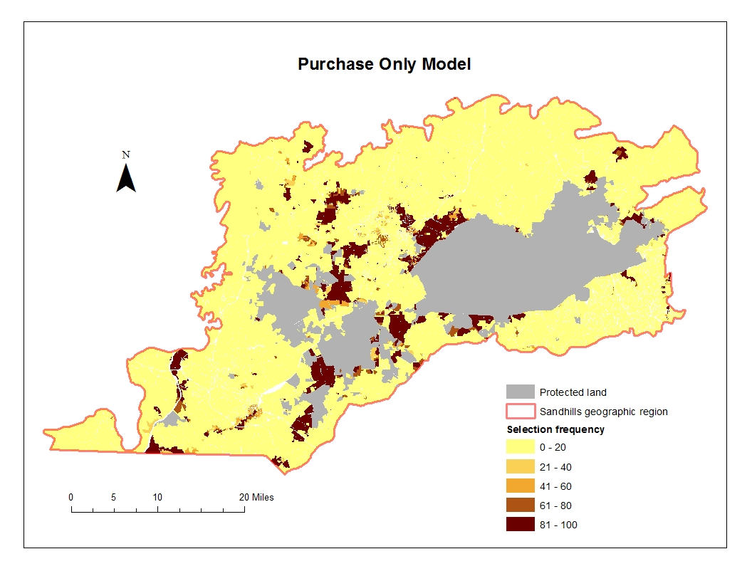

Slide 12
Advanced Setups
Protection can have multiple categories (aka zones)
  Different costs and conservation values assigned to each zone
  Lock-in properties to specific zones
  Properties can move between zones
    Assign costs when movement occurs

Slide 13
Example: Purchase or Easement
Easement ¼ the cost of purchase
Only ½ of conservation value in easement
Current easements can be purchased at full cost to reach targets or remain at no cost, but remain at ½ conservation value

Slide 14
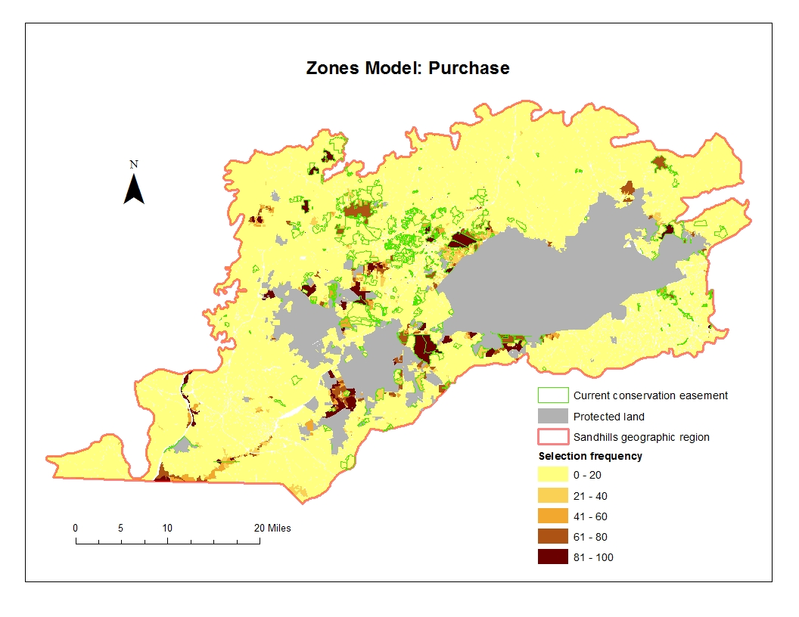

Slide 15
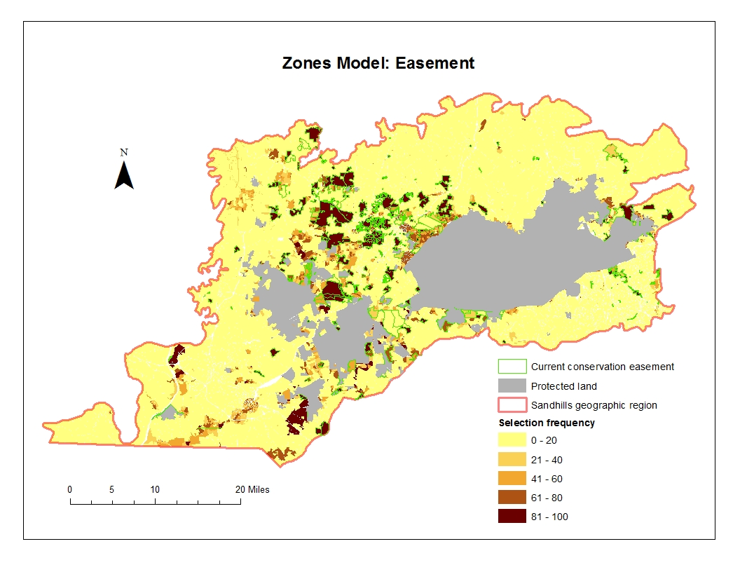

Slide 16
Interest in Implementing?
Decide upon simple or advanced setup
One meeting to decide upon values for model parameters
A second meeting to review results

