Slide 1



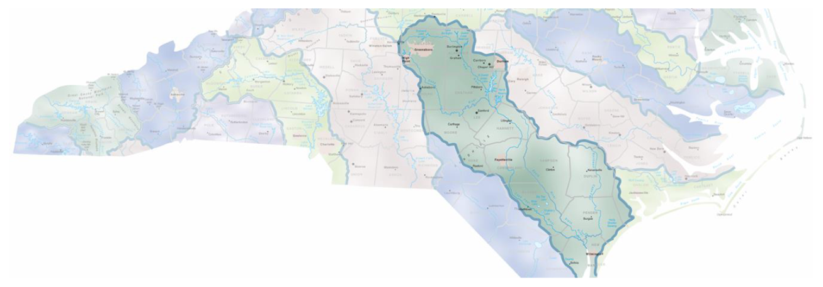
A Holistic Approach to Enhancing Ecosystem Function and Flood Resilience in the Cape Fear River Basin
Notes:
Size
Population
Biodiversity
Drinking
Flooding

Slide 2
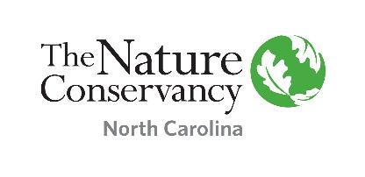
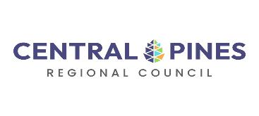
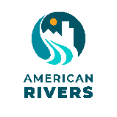

A Holistic Approach to Enhancing Ecosystem Function and Flood Resilience in the Cape Fear River Basin
Transformational Restoration Goals:
Building enduring capacity within partnering, governmental institutions to achieve conservation and restoration projects with flood mitigation benefits at scales beyond what TNC can do alone!
Science, mapping, and modeling inform habitat restoration and flood resilience projects
TNC, TLC, and AR demonstrate projects on the ground to COGs and local governments
COGs provide leadership to identify and enable restoration and resilience projects with local governments and communities
Cross-jurisdictional work at most critical places
Notes:
Transformational Restoration Goals:
25,000 acres of restored Pocosin, Carolina Bay, and flood-prone landscapes
Enhanced wetland habitat for quintessential North Carolina ecosystems and species
Enhanced water storage during wet weather in naturally flood-prone landscapes

Slide 3

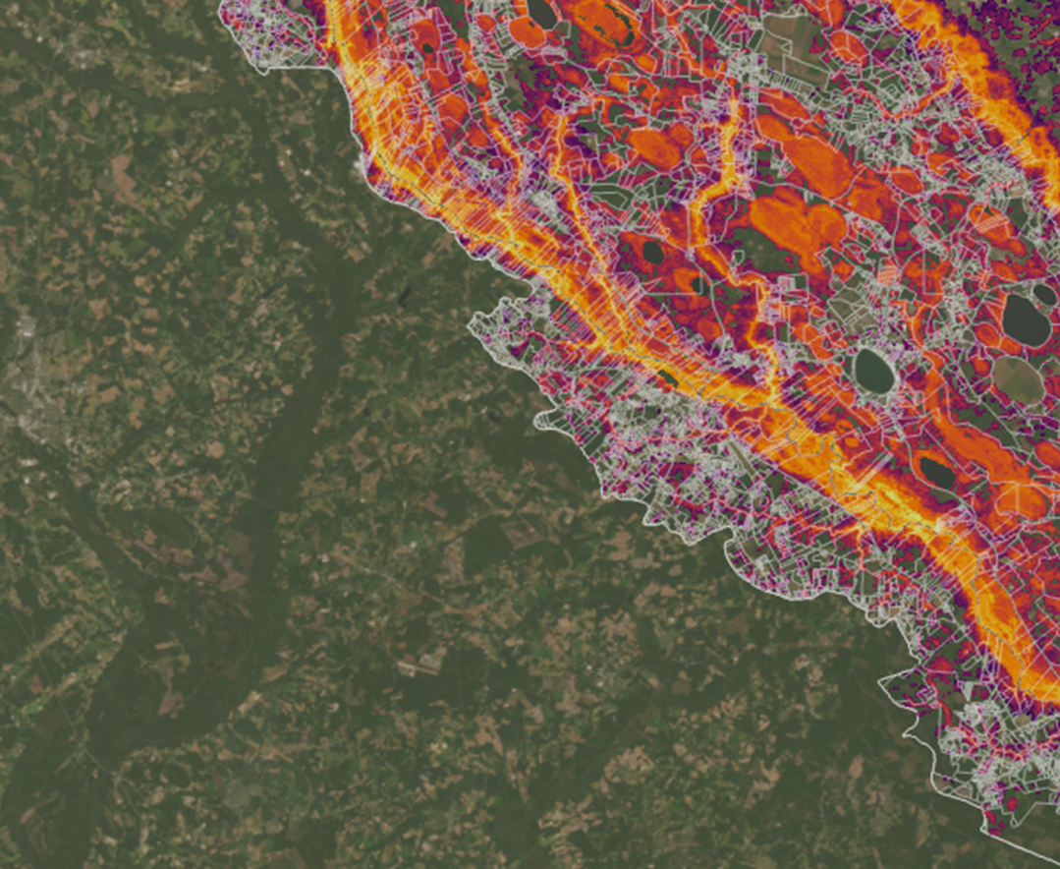

Parcel Prioritization Tool
Cape Fear River Basin
TNC Water Strategy
Image Credit: Andrea Bruns
Notes:
In partnership with Duke and advised by Ryan Emanuel
Done by Andrea Bruns and Clair Elias
When conducted at the parcel scale, prioritizations identify individual plots of land that have or could potentially have a relatively powerful positive impact on the broader surrounding environment.

Slide 4
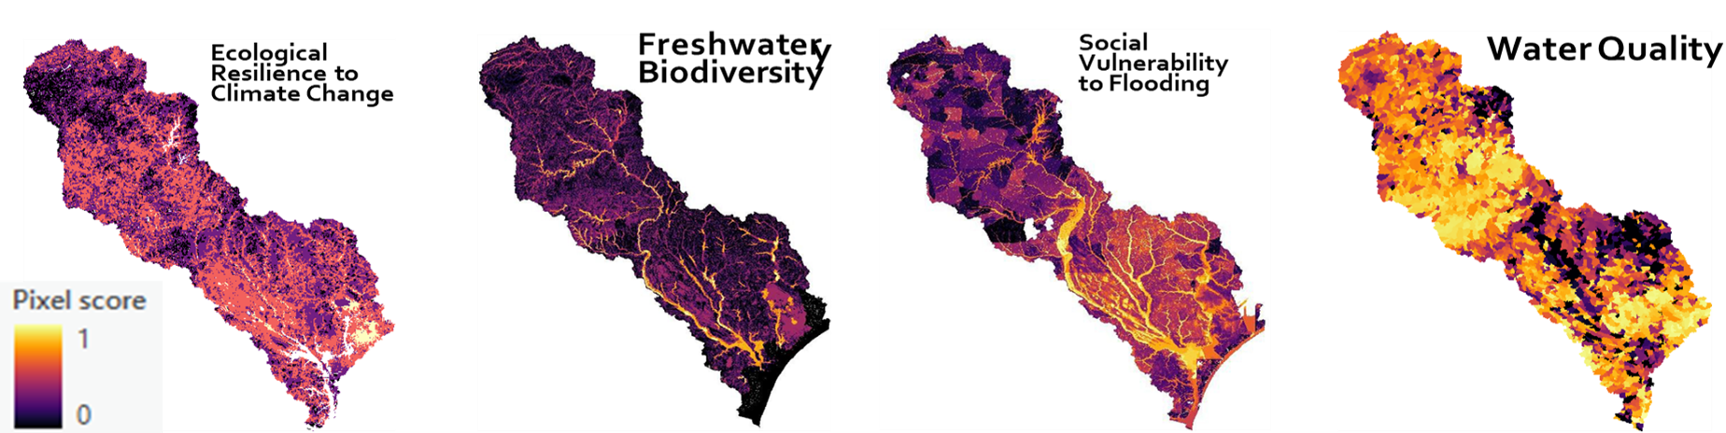
Objective Outcomes
Eight sub-objectives
Four basin wide objective scores
Notes:
Objective & Sub-Objectives
Protect Freshwater Biodiversity (FBD)
Protect and restore populations of rare, important, and anadromous fish, including sturgeon, shad, striped bass, eel, and herring; as well as populations of rare resident fish, such as Cape Fear Shiner
Protect and restore populations of freshwater bivalves.
Conserve contiguous target functional vegetation communities, including wetland and floodplain forests, by prioritizing target community density.
Conserve target functional vegetation community biodiversity by protecting areas with multiple community types.
Increase Ecological Resilience to Climate Change (ERCC)
Protect and enhance terrestrial diversity and connectivity to support species movement induced by localized impacts of climate change.
Protect and enhance stream and riparian habitat to support aquatic species connectivity amid climate-induced changes in instream flow, salinity, and temperature.
Mediate Social Vulnerability to Flooding (SVF)
Enhance resilience of socially vulnerable communities subject to hurricane and storm flooding.
Improve and Maintain Water Quality (WQ)
Highlight areas with medium-high Water Quality Risk Index (WQRI) for potential restoration opportunities that help improve water quality.
Highlight areas with low WQRI for potential conservation opportunities that preserve presently good water quality.

Slide 5
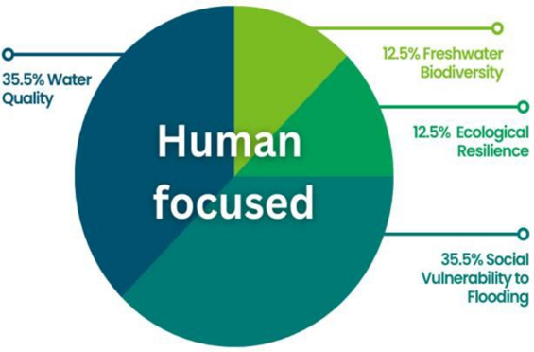
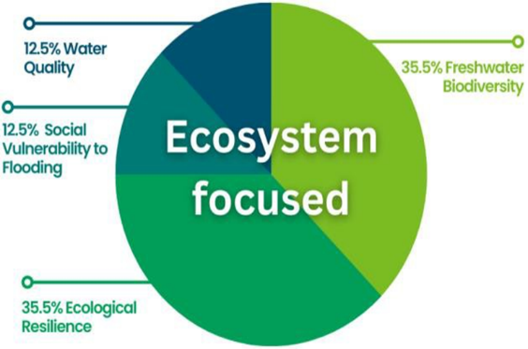
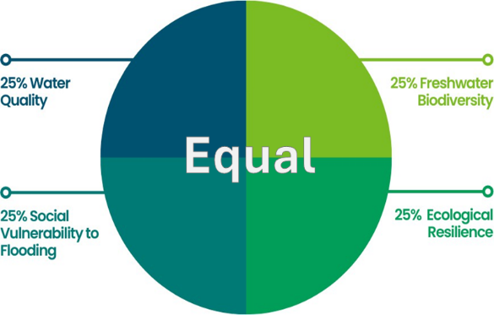
Combining Objectives: Parcel Level

Slide 6
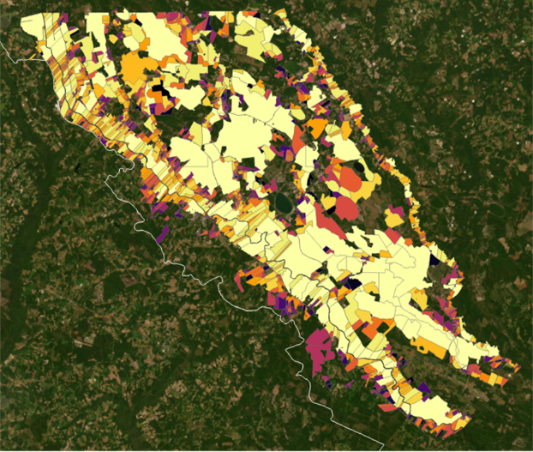
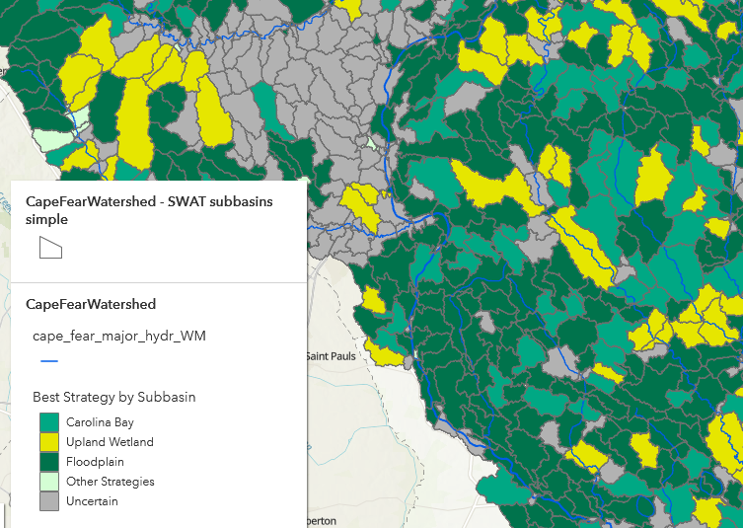
Connecting Tools
Image Credit: Andrea Bruns
Where are the conservation & restoration opportunities?
How much good do we get out of restoration implementation?
Parcel Prioritization Spatial Layer
Soil & Water Assessment Tool

Slide 7
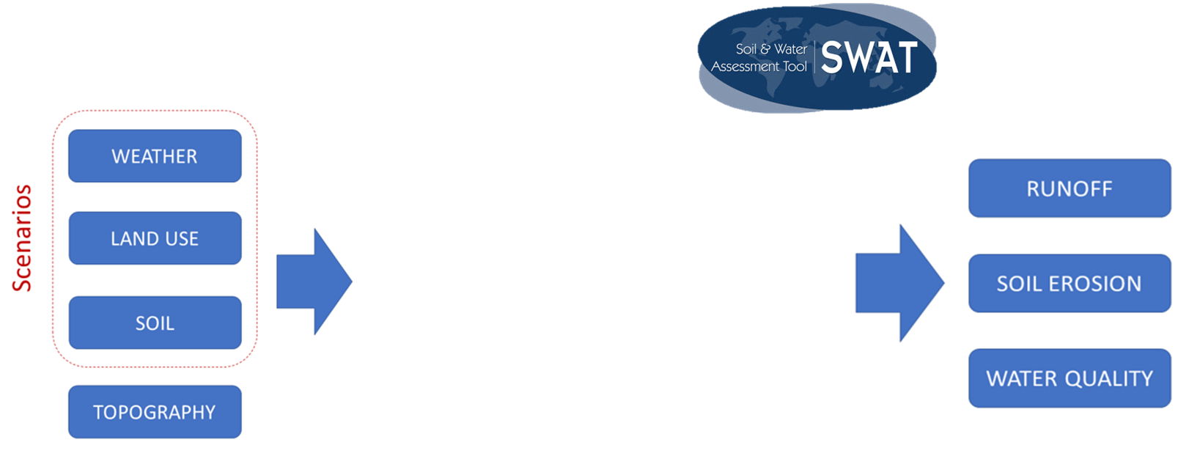
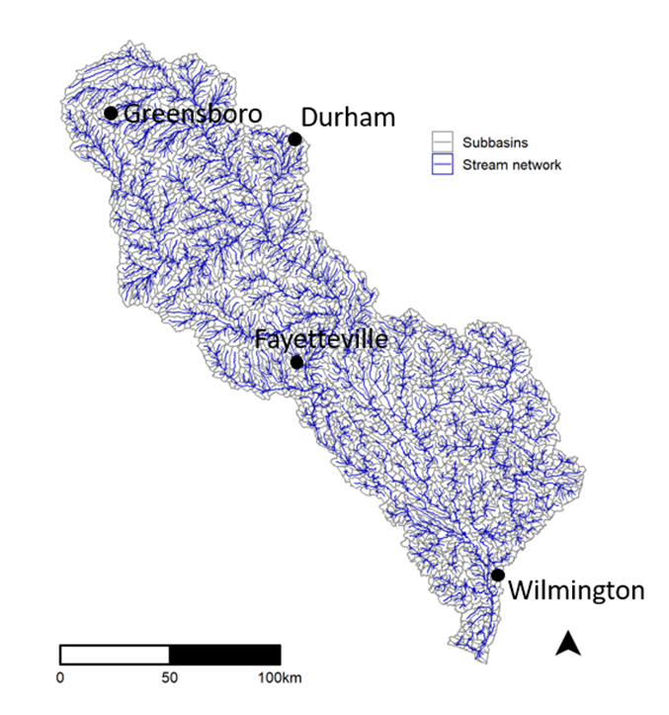

TNC's Watershed Modeling Tool
Driving Conservation and Resilience

Slide 8
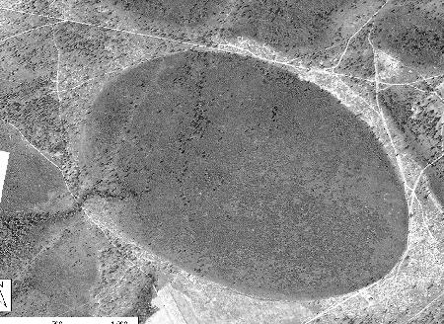
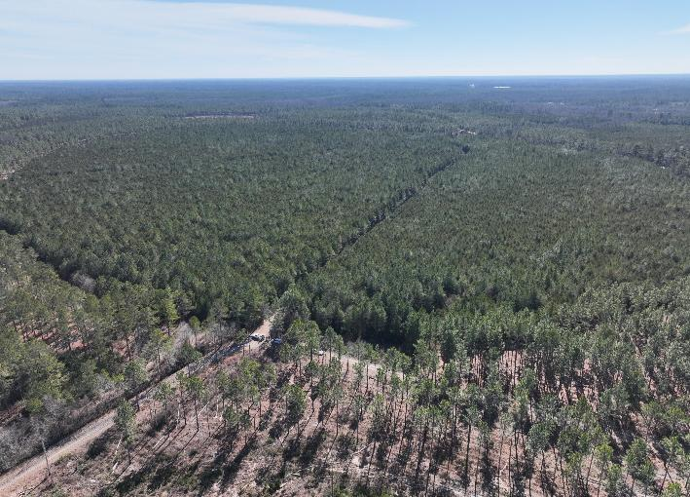
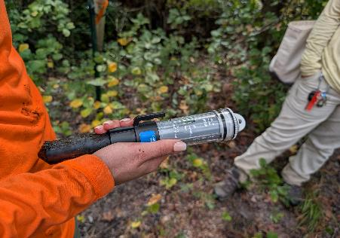
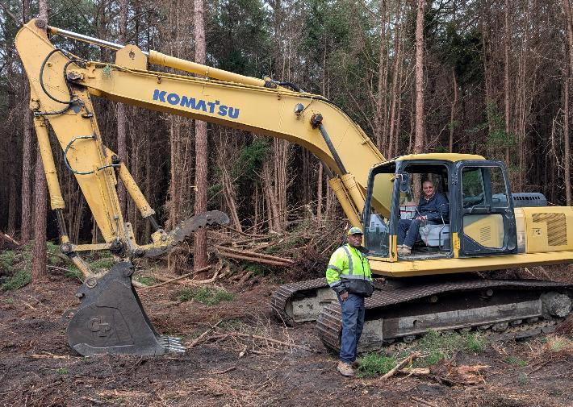
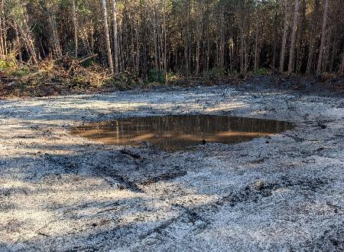
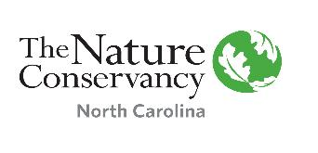
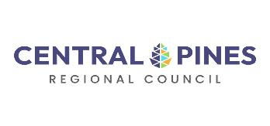
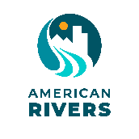

Learning Laboratories: The Essence of it
Upland Wetland – Bushy Bay
Bladen County, NC
1930s Imagery
2024 Drone Imagery
2026 construction
SW & GW data collection
Vernal pool excavation
Image credits: Margaret Fields, Dohn & Richard Broadwell
Notes:
TNC, TLC, and AR will also demonstrate 25,000 acres of active habitat restoration projects on the NE Cape Fear, the Black, mainstem Cape Fear and the Deep that have benefits for both fish and people. The efforts include restoration of floodplains, wetlands, peatlands, Carolina bays, urban constructed wetlands, and in-stream connectivity. These projects will be learning classrooms for the COGs.

Slide 9
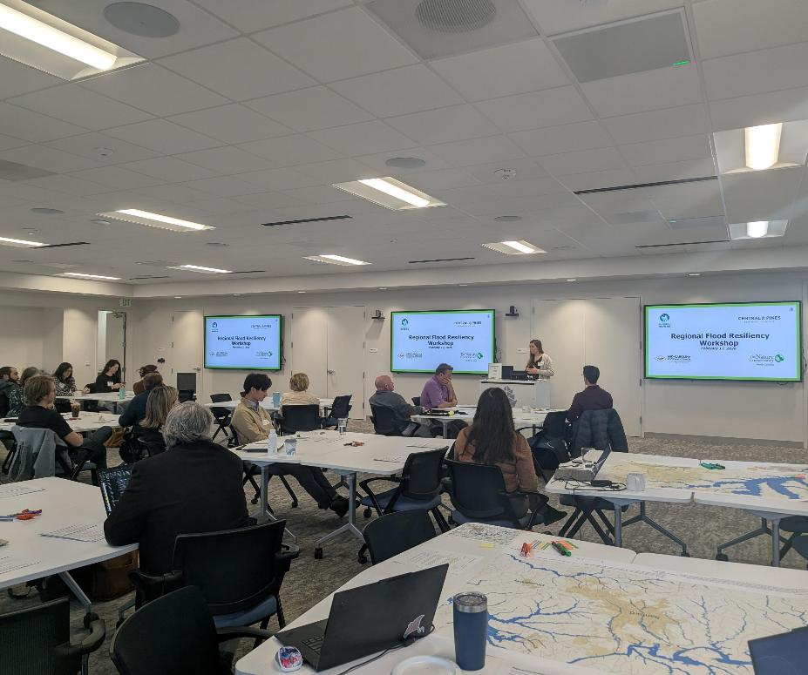
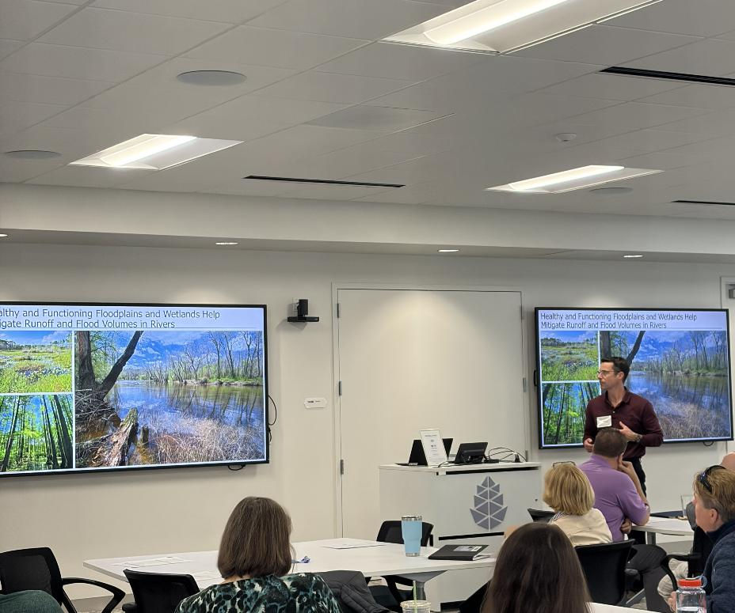
COG Led Community Workshops

Slide 10
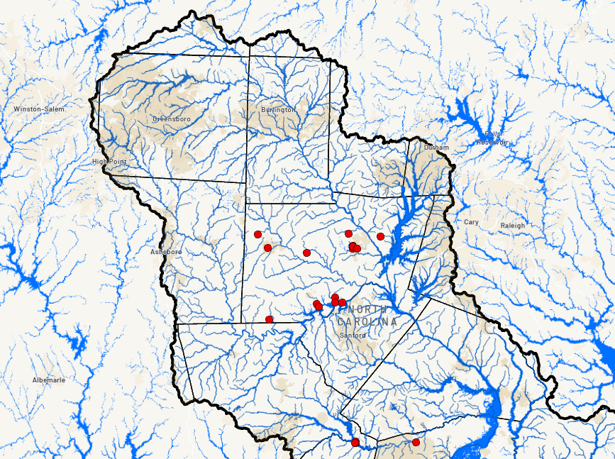
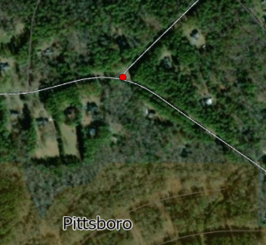
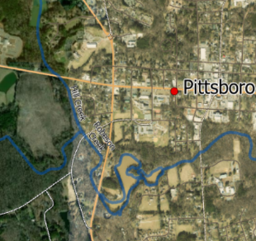
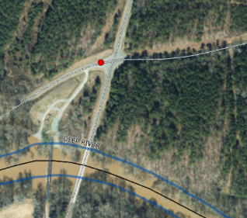
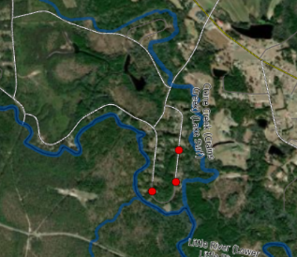
Jurisdictional Flooding Mapping Feedback
> 80 points identified
High risk locations
Large contributing watershed – cumulative effect
Urban suburban/rural interface
Undetermined – more information required
Notes:
Prior to this meeting, we asked you to complete a preassessment to help the project team better understand your concerns, issues and solutions around flooding in your neighborhoods. We appreciate you all taking the time to do this and we want to look closer at this with you all now in order to understand themes that emerged as well as tie your knowledge of the flooded areas and the impacts on your community, as well as solutions that would work best for you communities.
Prior to this meeting, we asked you to complete a preassessment to help the project team better understand your concerns, issues and solutions around flooding in your neighborhoods. We appreciate you all taking the time to do this and we want to look closer at this with you all now in order to understand themes that emerged as well as tie your knowledge of the flooded areas and the impacts on your community, as well as solutions that would work best for you communities.
Take a look at this. What jumps out to you?
Pause.
Let participants name 2–3 themes.
Guide the Room
“The dominant themes we’re hearing are flooded roads and access points, flooded homes and buildings, and repeated flooding. That tells us this isn’t isolated — it’s recurring and affecting daily life and mobility.”
Then layer in:
“We’re also seeing standing water and stream erosion, which signals longer-term watershed and drainage issues — not just one-off storm events.”
Then shift tone slightly:
“Health concerns and disproportionate impacts are part of this story. That tells us flooding is not just infrastructure — it’s equity, safety, and quality of life.”
Then close the loop:
“And reduced water quality shows that what starts as a flooding issue quickly becomes a broader watershed issue.”
Take a look at this. What jumps out to you?
Pause.
Let participants name 2–3 themes.
Guide the Room
“The dominant themes we’re hearing are flooded roads and access points, flooded homes and buildings, and repeated flooding. That tells us this isn’t isolated — it’s recurring and affecting daily life and mobility.”
Then layer in:
“We’re also seeing standing water and stream erosion, which signals longer-term watershed and drainage issues — not just one-off storm events.”
Then shift tone slightly:
“Health concerns and disproportionate impacts are part of this story. That tells us flooding is not just infrastructure — it’s equity, safety, and quality of life.”
Then close the loop:
“And reduced water quality shows that what starts as a flooding issue quickly becomes a broader watershed issue.”
Before this workshop, we asked you all to fill out a pre-assessment related to your communities' concerns regarding flooding.
In that pre-assessment, there was the option to use an online mapping tool to add points where flooding may be occurring.
So for the purposes of this workshop, we captured about 20 points (more are coming in everyday) in the Central Pines Region of the basin and we went through and looked at all of them so we could get a preliminary idea of where and why some of this flooding may be occurring.
While looking, we were generally able to breakdown these points into 4 categories.
Ones we think are high risk locations
Ones that may have a large contributing watershed leading up to said point. Which means there is a large cumulative effect that has to be addressed
Areas where there is an urban or suburban/rural interface where flooding could be caused by a watershed, could be a stormwater infrastructure issues, or BOTH (highly likely)
Spots that we need more information on, they don’ automatically jump out as areas that should be flooding in the first place (i.e. they are relatively rural, at a high point or on a hillslope, or at the top of their watershed.
All of these require us to ask more questions to better understand their situational dependencies. We will get to that later.

Slide 11
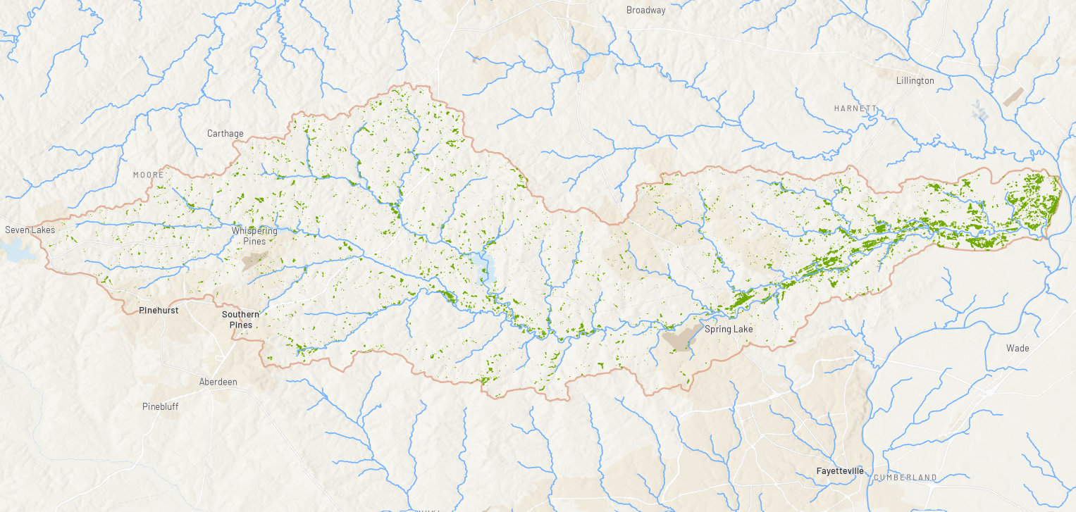
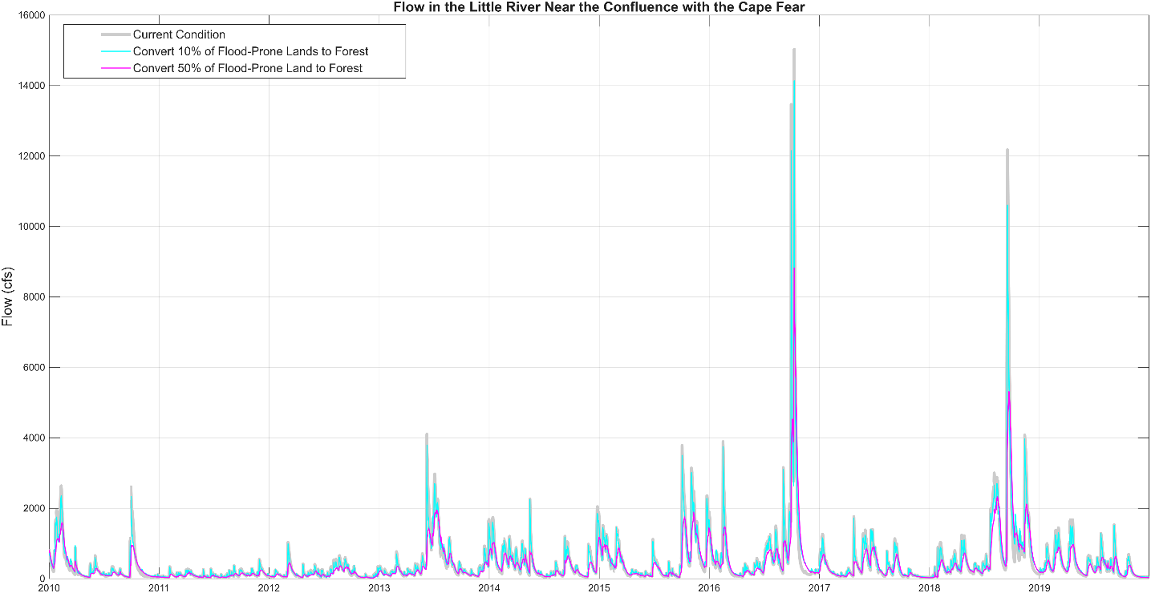
5,209 acres of land that is:
Not currently forested
Low elevation and flat
More than 330 feet from any structure
Within the FEMA 500-year floodplain OR within the mapped area of inundation from Hurricane Mathew and/or Florence
13% reduction in peak flow
56% reduction in peak flow

Slide 12
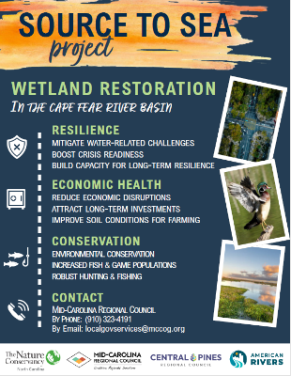

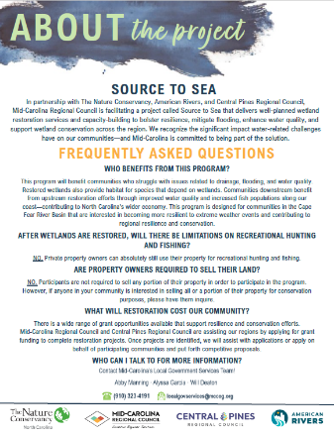
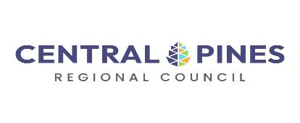


Why Partner with Regional Councils?
Connect Member Governments to TNC Staff
Familiarity with Member Governments
Help identify potential projects
Connections with other COGs & local agencies
Create capacity for Member Governments
Image Credit: Andrea Bruns
Notes:
In partnership with Duke and advised by Ryan Emanuel
Done by Andrea Bruns and Clair Elias
When conducted at the parcel scale, prioritizations identify individual plots of land that have or could potentially have a relatively powerful positive impact on the broader surrounding environment.

Slide 13
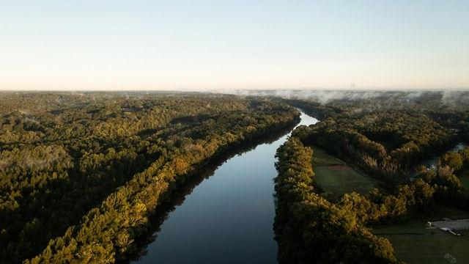
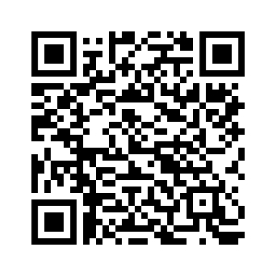
What’s Next?
Analyzed areas of concern identified by municipal governments during workshops.
  Identifying potential projects.
Fall workshop meeting to be scheduled.
  Explore opportunity areas and projects
  Local Govs. & Land Trusts/Restoration Orgs.
Begin compiling relevant natural infrastructure projects into a regional action plan through the FRB tool.
INSERT QR CODE HERE
Contact Us:
Jaimie Walters (MCRC):
jwalters@mccog.org
Chris Lawson (CPRC):
clawson@centralpines.gov
Notes:
There are two main themes we are aiming to focus on regarding synthesis, first we want to reflect on our understanding of what capacity building looks like the regional communities of government. This includes below 3 bullet points on slide
Second, we want to reflect on the areas of opportunity that may have been highlighted in the pre-assessment or at this workshop. This will include synthesis of the three bullet points on slide.
What we need from local governments (from you all) moving forward:
Consider what role that natural infrastructure can play for your local community and your neighbors up and down stream
Think outside the box regarding resiliency. Can you accomplish similar risk reduction using natural infrastructure instead of large-scale gray infrastructure? Where does it fit in?
Keep the dialogue open between all of us moving forward
Additionally, we want you all to anticipate multiple other touchdown points this year into 2027 to really start getting at the increased understanding of natural infrastructure, capacity and connection building, and project identification. This may include field visits to demonstration sites, partnerships and meetings with local NGOs and groups that do on the ground natural infrastructure work, and eventual project identification and on the ground work.

