Slide 1

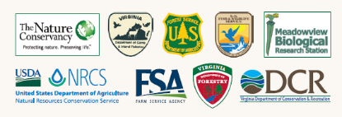
Restoring Northern Range Longleaf Pine Communities
Longleaf
Cooperators
Of Virginia
BRIAN VAN EERDEN
DIRECTOR, VIRGINIA PINELANDS PROGRAM

Slide 2
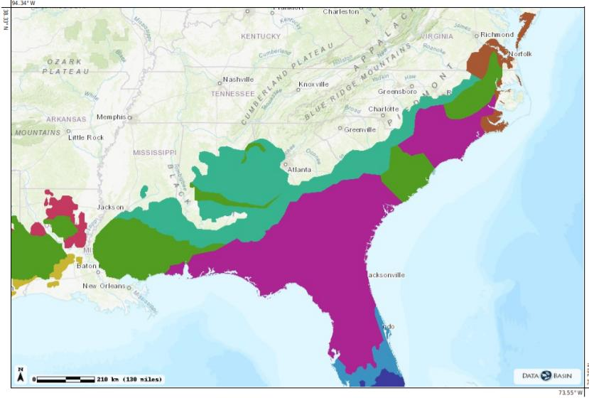
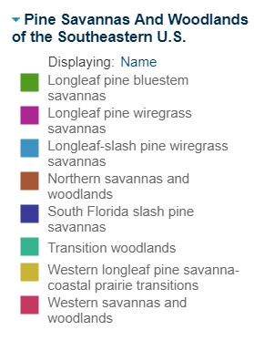
Pine Savannas and Woodlands of the Southeastern U.S. (Peet, Platt, Costanza 2018); SALCC

Slide 3
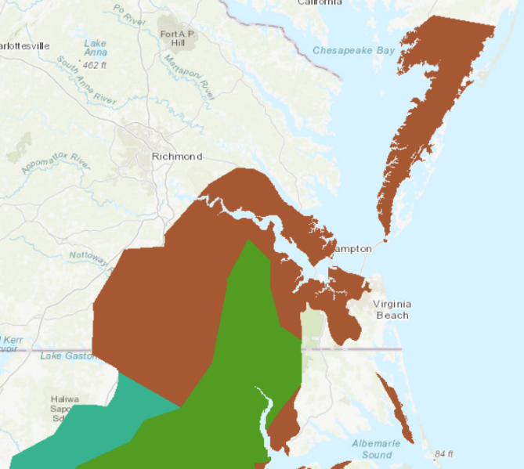
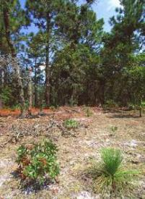
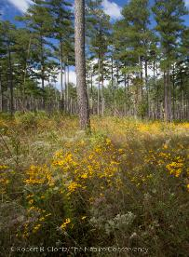
xeric sandhill
(South Quay Sandhills NAP)
Northern savannas and woodlands
mesic/dry savanna
(Piney Grove Preserve)
Longleaf pine/ bluestem savannas
Pine Savannas and Woodlands of the Southeastern U.S. (Peet, Platt, Costanza 2018); SALCC

Slide 4
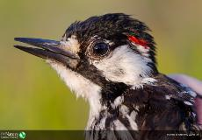
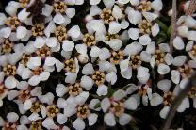
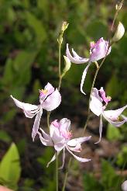
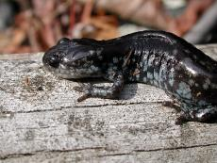
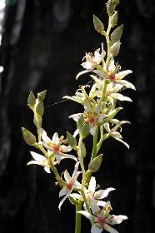
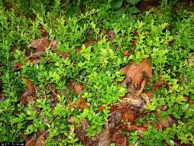
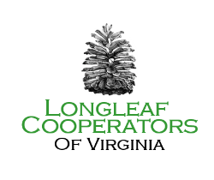
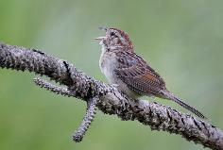
Open pine woodland and savanna specialists
RCW
Pyxidanthera barbulata
Calopogon pallidus
Mabee’s salamander
. Small
Zigadenus glaberrimus
Bachman’s sparrow
M. Drummond
Vaccinium crassifolium

Slide 5
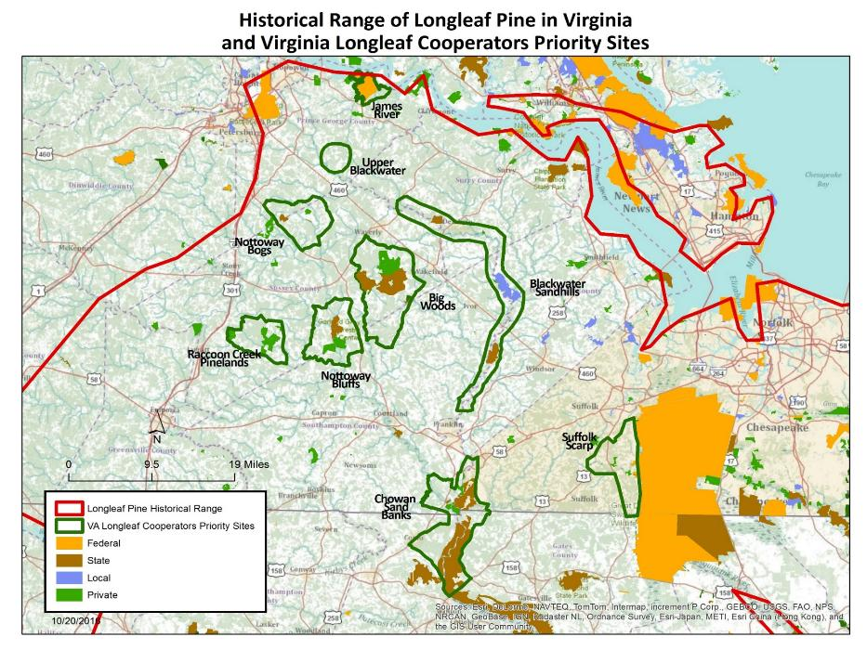

Slide 6
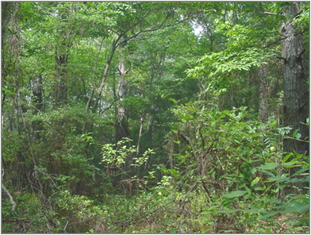
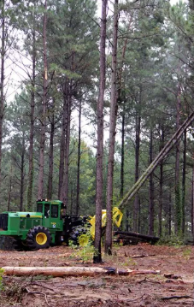
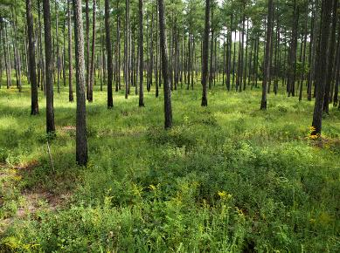
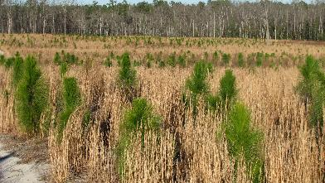
Restoring Northern Range Longleaf Pine Communities
B. Clontz
Timber Management

Slide 7
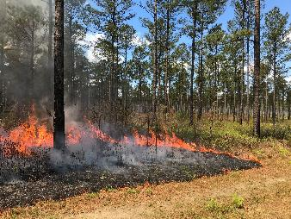
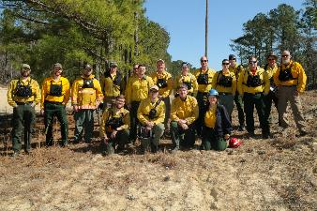
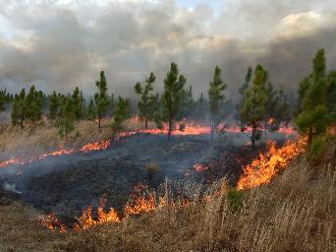
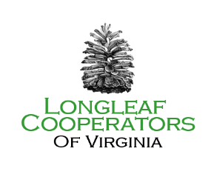
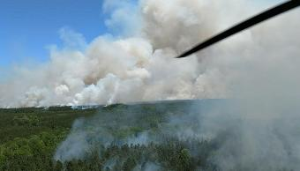
Fire management
5K-8K/acres Rx burns/yr
Goal – 10K-12K acres/yr

Slide 8
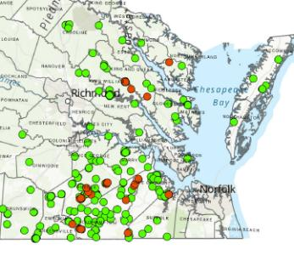
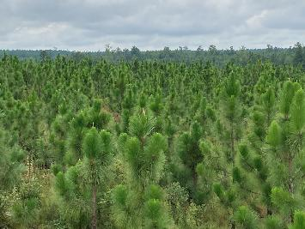
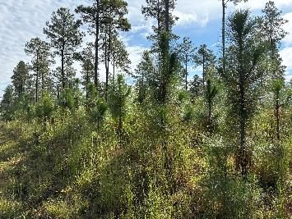
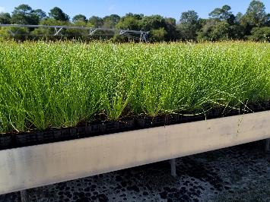
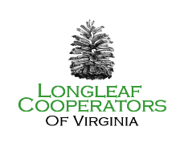
Longleaf pine establishment
Longleaf planting project sites (VA DOF)
understory planting
Raccoon Creek Pinelands preserve
VA Dept of Forestry longleaf nursery

Slide 9
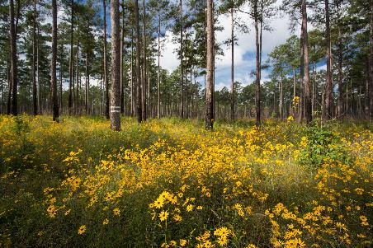
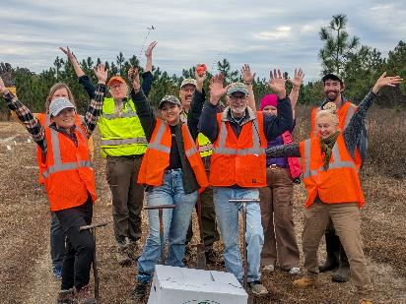
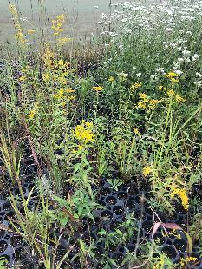
Groundcover Restoration
Native plant seed orchard planting
Containerized seedlings

Slide 10
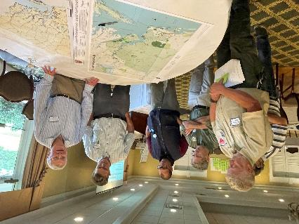
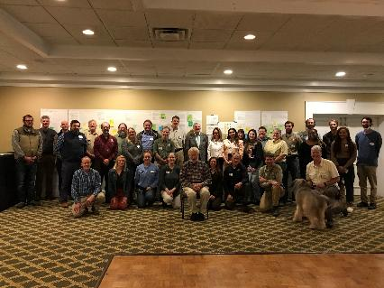
2025-2030 Strategic Planning
Strategy teams:
Outreach
Fire management
Restoration
Protection
Science

Slide 11

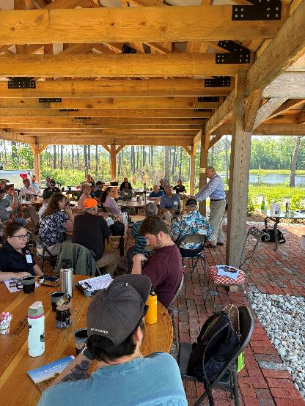
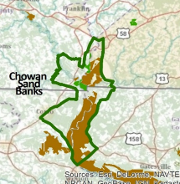
Outreach
NC/VA partnership opportunities: Chowan Sand Banks
Raccoon Creek Pinelands Pavilion
VA Pinelands Office, Waverly

Slide 12

Questions

