Slide 1
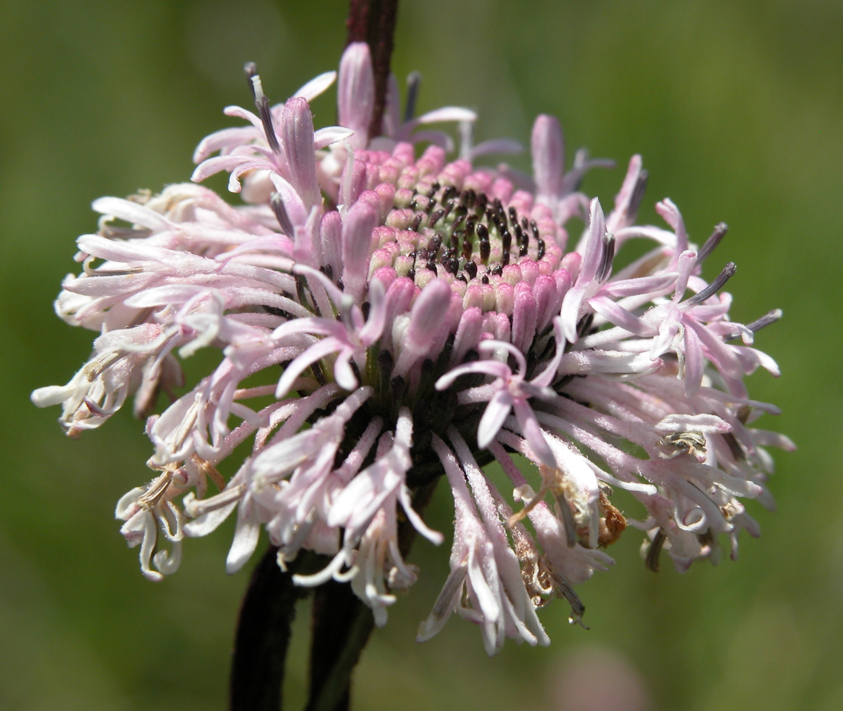
Plants in North Carolina
~5,000 native species
- 969 rare species
- ~1/5 plant species is rare
- 31 endemic to NC
- 48 known from <5 populations globally (G1)
Butner Barbara’s Buttons by Misty Buchanan

Slide 2
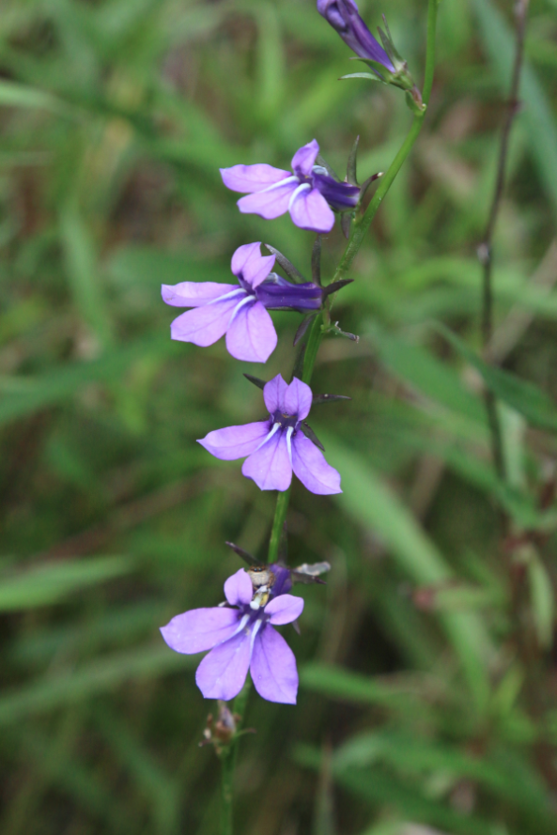
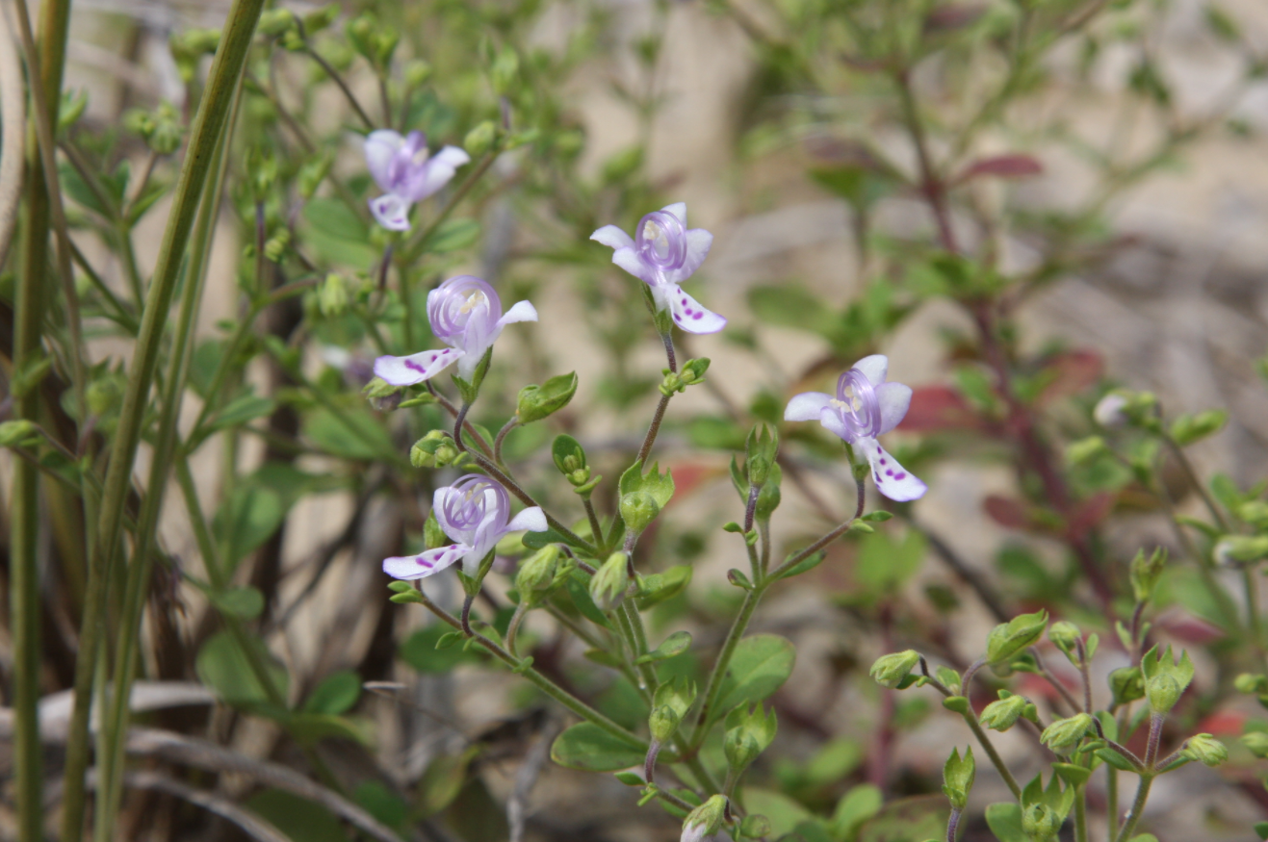
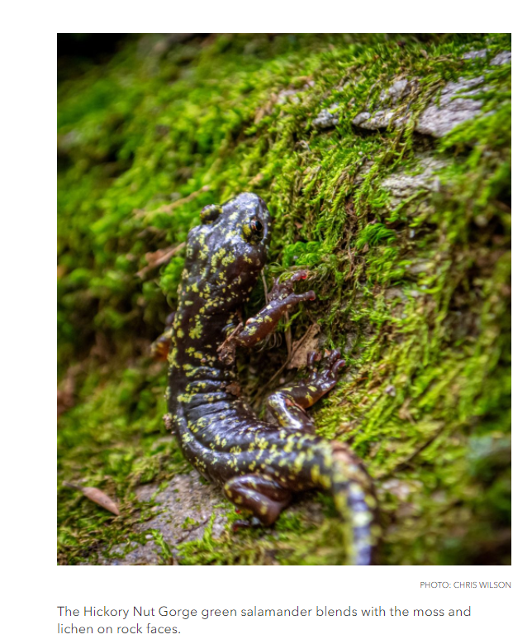
Still discovering new species!
Dune Bluecurls (2018)
Plant Photos by Bruce Sorrie
Hickorynut Gorge
Green Salamander (2019)
Streamhead Lobelia (2020)
Notes:
Bruce Sorrie and Bert Pittman: Streamhead lobelia
Weakley et al: Dune Bluecurls

Slide 3
NHP Data
BRENDA l. Wichmann, State Botanist
June 2022

Slide 4
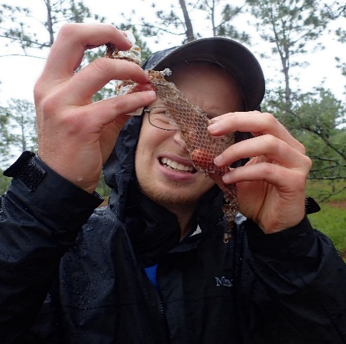
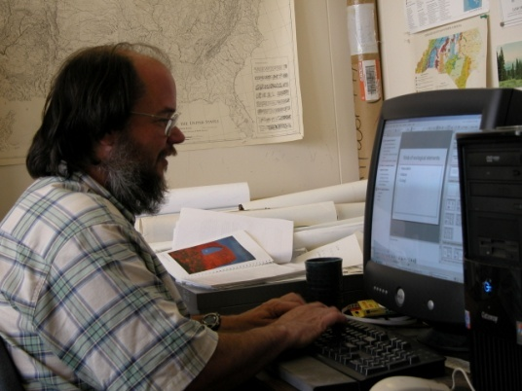
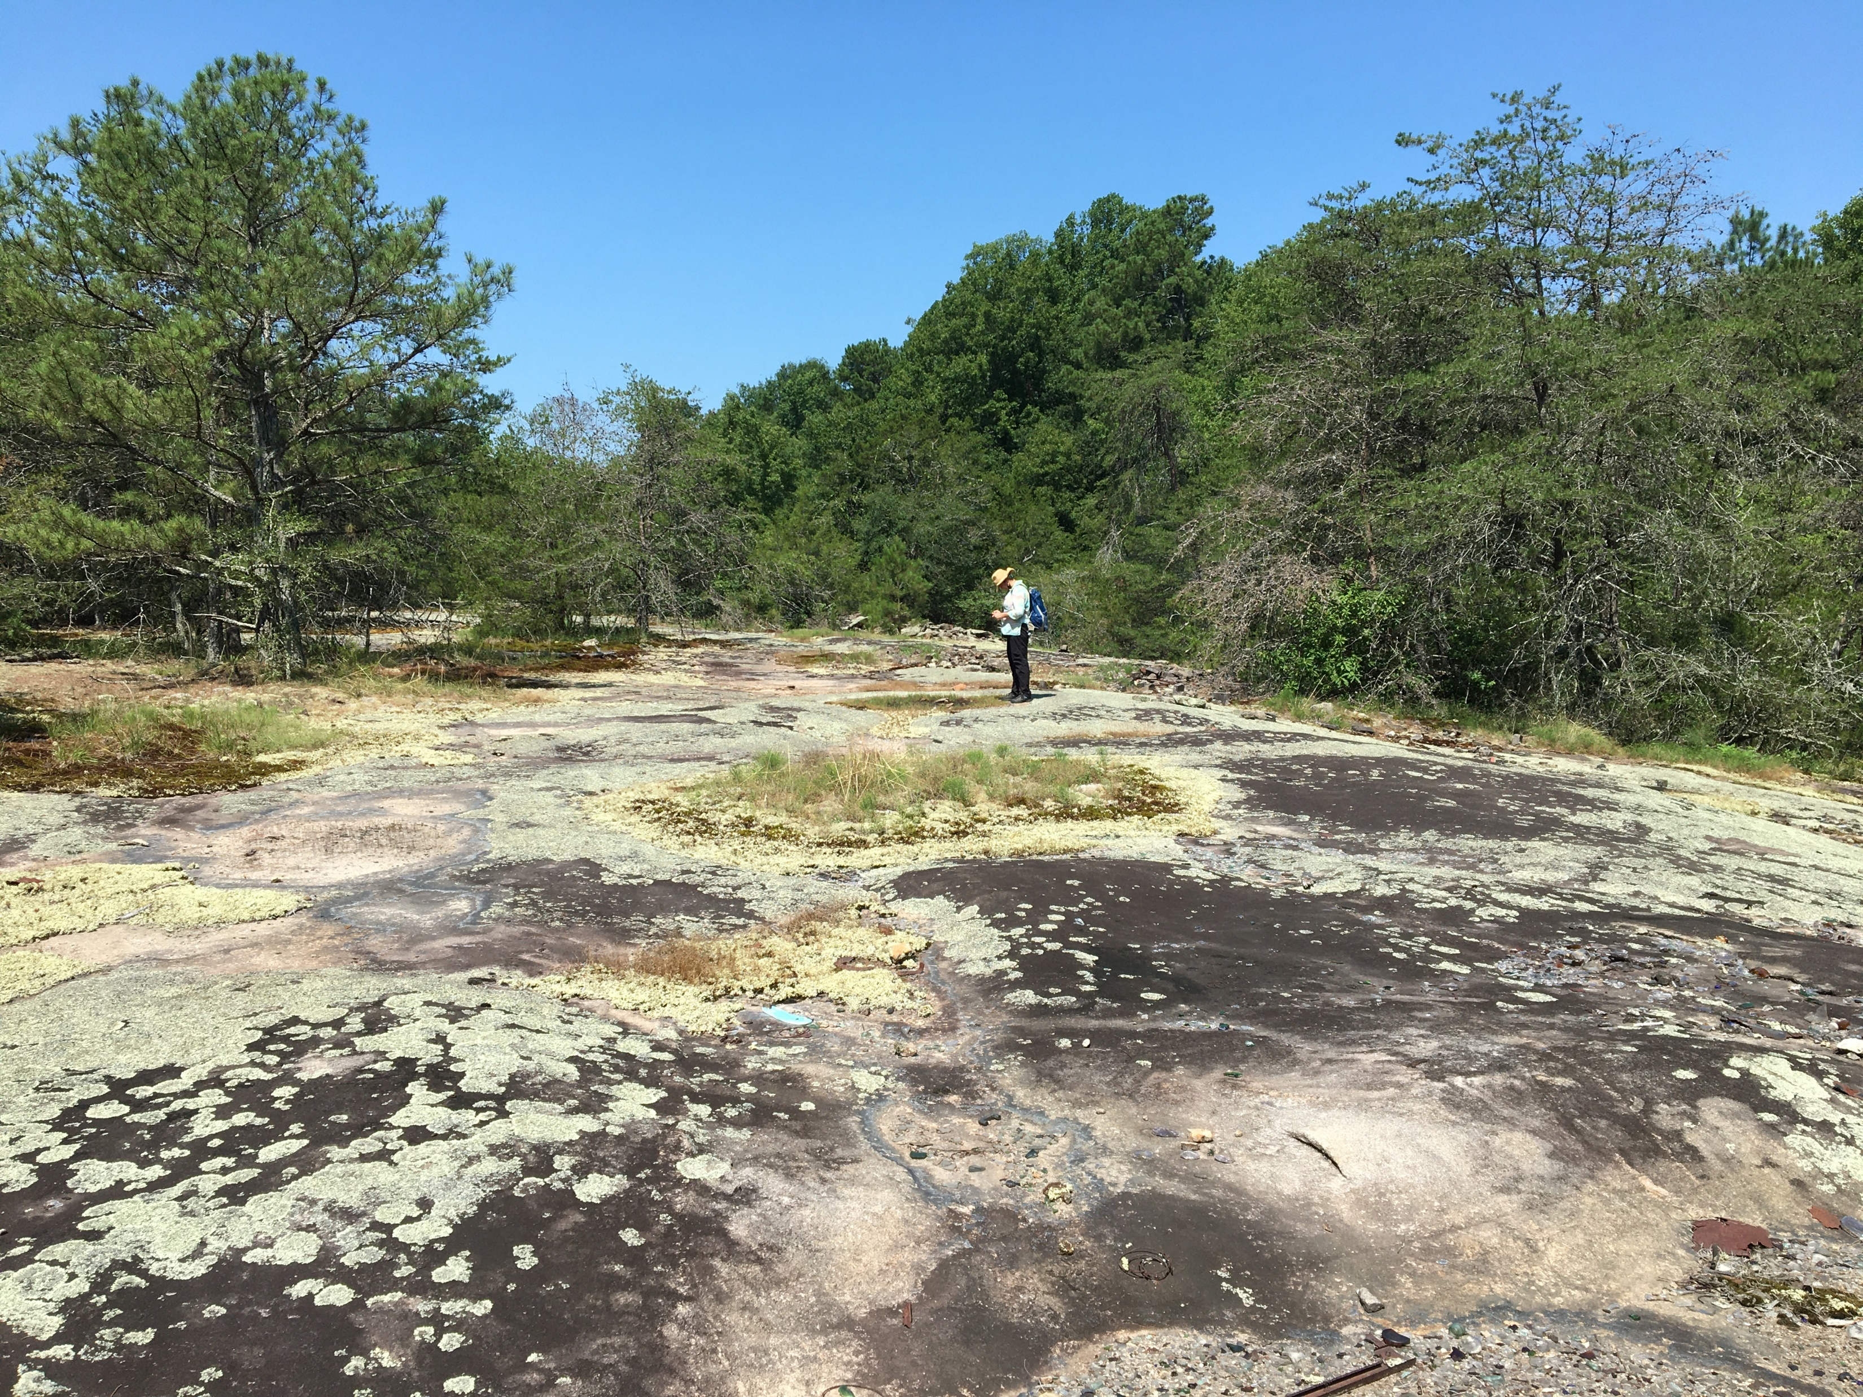
The Natural Heritage Program’s primary purpose is to assist in establishing state nature preserves.
Survey natural areas
Maintain inventory of species, natural communities, and natural areas
Share information for protection of rare species and their habitats
Prioritize lands for conservation
Establish Dedicated Nature Preserves and Registered Heritage Areas
Notes:
If you are not familiar with the Natural Heritage Program, we are within the Department of Natural and Cultural Resources in the Division of Land and Water Stewardship. The primary purpose of the NC Natural Heritage Program, or the NCNHP, is to provide assistance in establishing nature preserves, and we do this in a few different ways. NCNHP staff conduct systematic biological surveys with the goal of finding and documenting locations of rare species and high quality natural communities; we identify natural areas and prioritize them for conservation; we maintain a database of the locations and statuses of natural heritage elements (DEFINE ELEMENT); we establish Dedicated Nature Preserves (DNPs) and Registered Heritage Areas (RHAs); and we share the information that we have through our online data products and publications in order to help protect NC’s rarest species and their habitats.

Slide 5
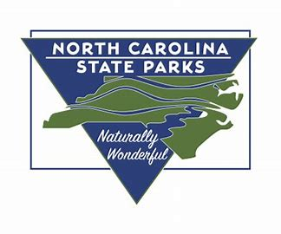
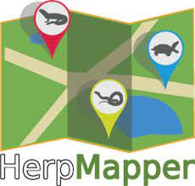
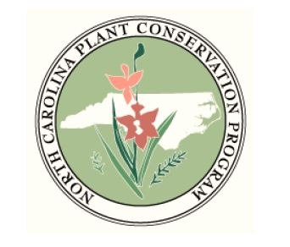
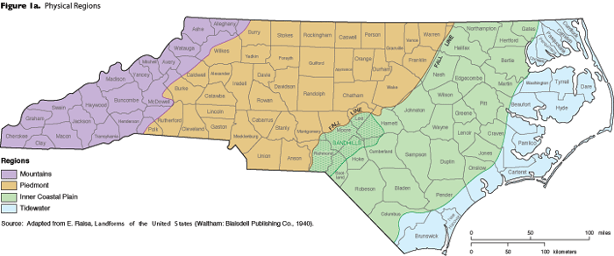
NHP Data – Comprehensive Statewide
Detailed site surveys & county inventories conducted by NHP staff biologists
Equally important are contributions from partners, academic researchers, environmental consultants, and private citizens
Gathered from trusted natural history and citizen science databases
Notes:
NHP biologists cannot be everywhere. In addition to site surveys conducted by our biologists and our archive of county inventories, we work with a statewide network of partners and others who contribute information. We also source information from social and collection databases such as HerpMapper, iNaturalist, & SERNEC (Southeast Regional Network of Expertise and Collections [database of herbarium records]).

Slide 6
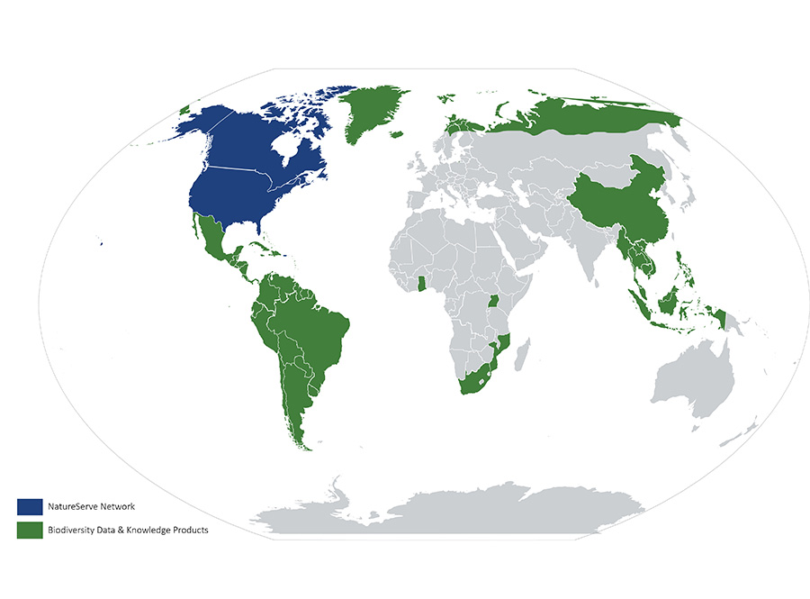
NHP Data – Scientific Data Standards
NatureServe Core Methodology
Specific standard procedures for gathering, managing, & representing data for species and ecological systems
Unites efforts, crosses jurisdictional boundaries to promote knowledge for effective biodiversity conservation
>40 yrs of authoritative data that is comparable over the full range of a species or ecological system
Biotics Data Management System
Element Occurrences (EOs)
Natural Areas (or Conservation Sites)
Notes:
NCNHP is part of the NatureServe network using data standard to collect and manage biodiversity data for conservation that spans jurisdictional lines or involve large landscapes.
NHP uses the Biotics DMS to track or record data on EOs and Natural Areas.
[Element Occurrence Data Standard - https://www.natureserve.org/products/biodiversity-observation-data-standard]

Slide 7
NHP Data – EO Ranking & Tracking
Element Occurrence (EO)
Area of land/water in which a species [or natural community] is, or was, present
“population” or “sub-population”
Location mapped & available data is tracked over time in Biotics
EO Rank
Measure of viability and/or ecological integrity based on EO size, condition, & landscape context (NatureServe Standard)
A, B, C, D, & F (failed-to-find), H (historical), X (extirpated)
Updated as additional data becomes available!
Notes:
EO Data is COMPILED from staff and external sourced and then EVALUATED for accuracy (identification, etc.) and ASSESSED (i.e., ranked) to determine the viability and/or ecological integrity. , and Recorded in Biotics database
Element Occurrence (EO) Ranks are based on size, condition, and landscape
context, and are considered a measure of viability
https://www.natureserve.org/products/biodiversity-observation-data-standard

Slide 8
NHP Data – Natural Areas
Natural Area (or Conservation Site)
Area of land/water with boundaries determined & mapped according to biological and ecological considerations
Area identified & characterized for protection
Contains EOs
Identified & characterized by NHP Biologists based on evaluation of available data
Natural Area Rating
Aggregated value based on evaluation of state-wide EO data including number and status of EOs as well as EO Rank
Notes:
Natural area could be contrasted with Managed Area, which are delineated on property boundaries. Sometimes coincide with natural area boundaries.

Slide 9
NHP Data – Data Contributions & Updates
Contributed data is invaluable and fundamental to conservation of North Carolina’s natural resources
EO Updates (plants)
Allow for “population” monitoring
Evaluation of viability over time and across regional scales
e.g., increase/decrease due to active management (e.g., controlled burning) or catastrophic events (e.g., hurricanes)
Natural Area Rating
Aggregated value based on evaluation of state-wide EO data including number and status of EOs as well as EO Rank
Based on available data (EO updates are very helpful!)
New EOs provide new opportunity for evaluating land for conservation
Notes:
Things do change

Slide 10
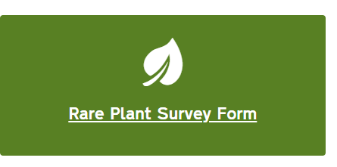
Contribute to the NHP Database
We welcome your data contributions!
We are pleased to receive data in a format that best suits you.
www.ncnhp.org

Slide 11
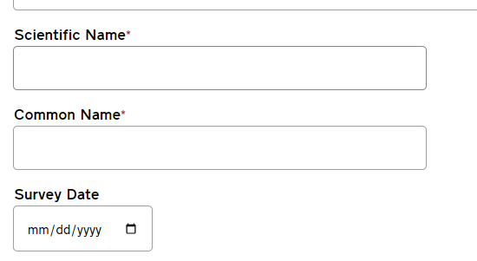
Online Webform @ ncnhp.org
Rare Plant Survey Form
complete & submit online
www.ncnhp.org → Share Data → Contribute Your Data → Rare Plant Survey Form

Slide 12
Download Form @ncnhp.org
Rare Plant Survey Form
Download MS Word doc
Complete & mail in via email or USPS
Instructions & Address posted online
www.ncnhp.org → Share Data → Contribute Your Data → Rare Plant Survey Form (same location as webform)

Slide 13
Contribute via iNaturalist
Join and Trust our Projects on iNaturalist

Slide 14
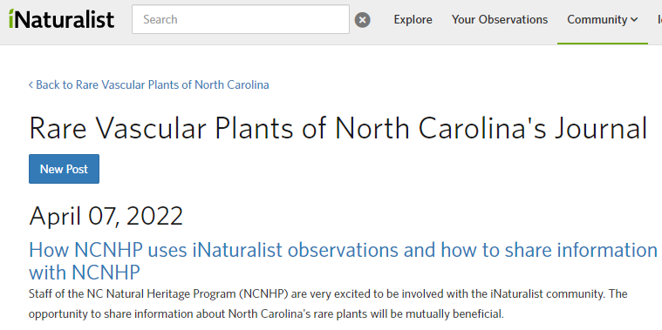
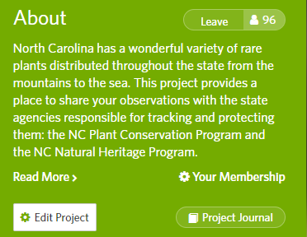
Read our Journal Post for Details
www.inaturalist.org/projects/rare-vascular-plants-of-north-carolina/journal
Notes:
Rare Vascular Plants of North Carolina's Journal · iNaturalist

Slide 15
Bulk Data & Other Contributions
Contact our Botanist for more options
MS Excel template & data guide
Geodatabase
www.ncnhp.org/contact
brenda.wichmann@ncdcr.gov
State Botanist
Brenda L. Wichmann

Slide 16
We Value Your Data!
Contributed data is invaluable & fundamental to the conservation of North Carolina’s natural Resources
EO updates are imperative to routine evaluation of species’ viability at state and regional scales
NHP data is routinely updated and evaluated to prioritize land for conservation
Notes:
Frequent EO updates are imperative to our process and the NatureServe data standard

Slide 17
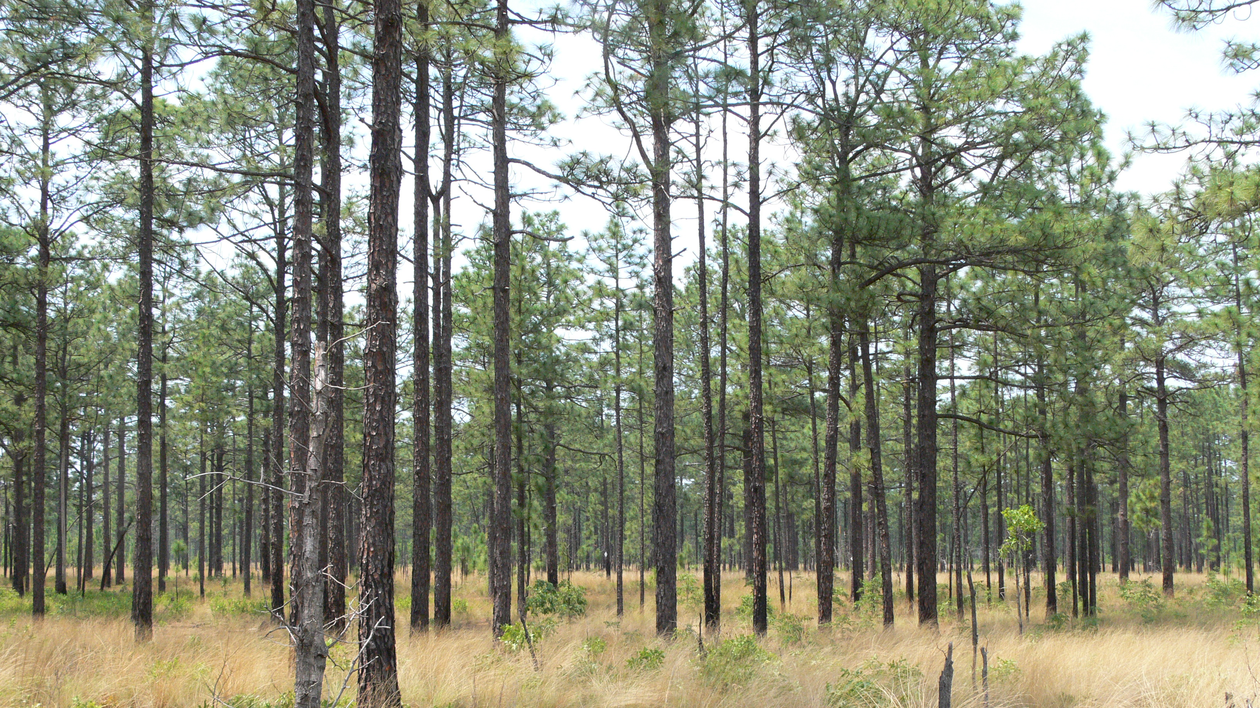
North Carolina Sandhills Conservation Partnership
Conservation Reserve Design Working Group
Summit Review
June 7, 2006
Notes:
What I am going to show is basically how we came up with a set of maps to help guide conservation – a “vision” so to speak. How to get the most bang for conservation buck

Slide 18
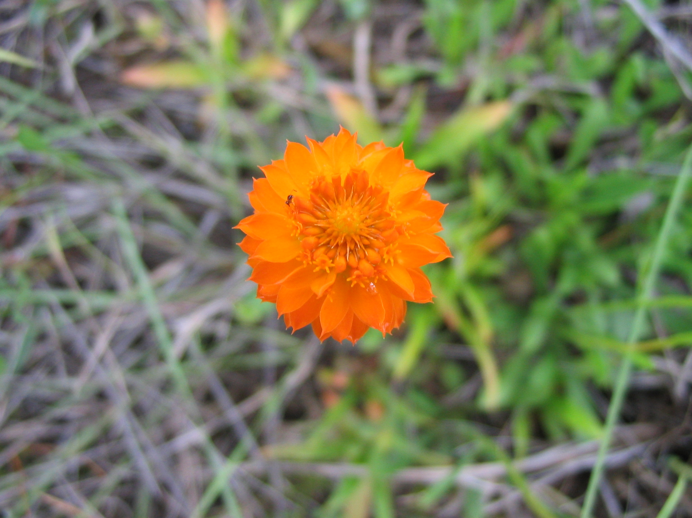
Reserve Design Overview Outline
Goal
Objectives
Strategies
Methods
Results/Conclusion
Yellow milkwort (Polygala lutea)
Photo: Scott Hartley

Slide 19
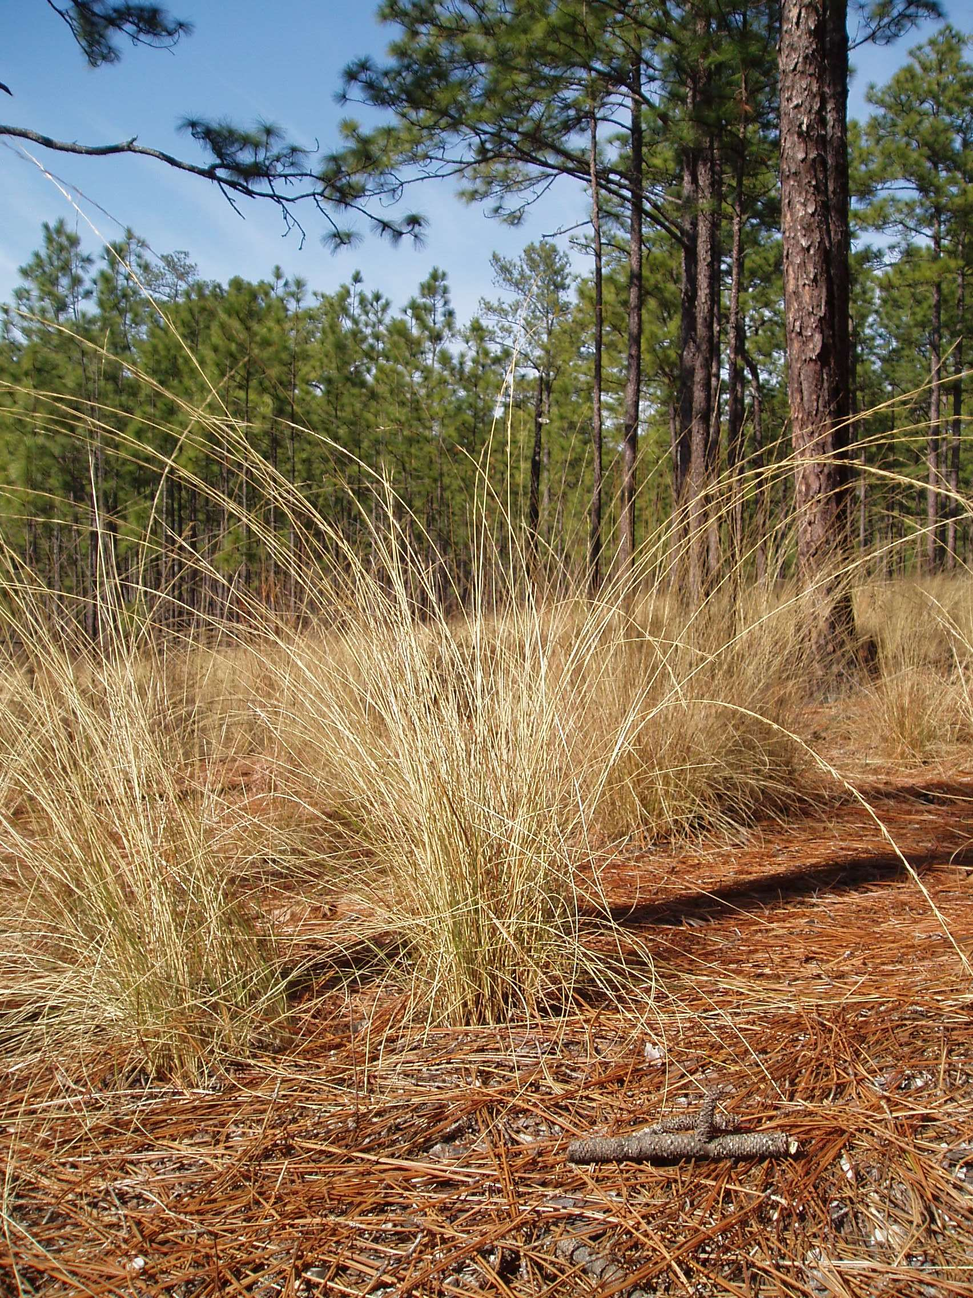
Synthesize biological information and create a vision to guide long-term conservation of native Sandhills ecosystems.
Goal:
Notes:
I intentionally added a photo where wiregrass is more prominent. While we are celebrating the RCW, and perhaps think of the longleaf as the symbol of the Sandhills, we can’t overlook “Keystone” species. In the Sandhills Longleaf ecosystem, the understory is so important to carry fire, and burn hot, but not too hot, to maintain the ecosystem.

Slide 20
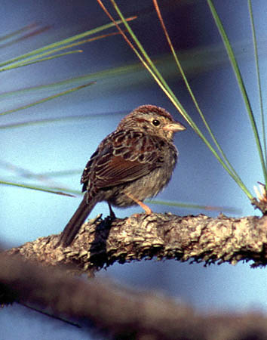
Objectives
Identify the most important areas to conserve from a biological perspective
Identify buffers to adequately conserve the resources and ecological processes of protected areas
Identify connections between important areas that promote gene flow and wildlife movement
Provide this information to other working groups for implementation
Bachmans sparrow (Aimophila aestivalis)
Photo: Greg Lasley
Notes:
Bachmans sparrows (Aimophila aestivalis) require grass cover for nesting and also feed on the seeds of wiregrass and other sandhills grasses and forbs.

Slide 21
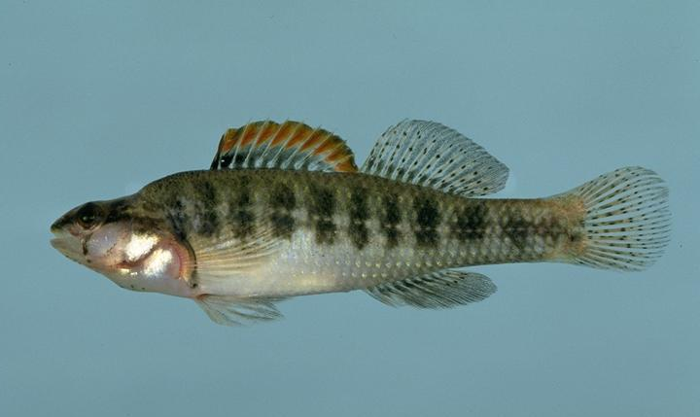
Strategies
Identify biological targets for conservation, including species, natural communities, and animal habitats unique to the Sandhills
Map areas of known ecological significance
Identify areas of potential ecological significance
Identify functions of individual connectors and buffers; fill information gaps; map functional connectors and buffers
Periodically review new information and update reserve design
Pinewoods darter (Etheostoma mariae)
Notes:
Pinewoods darter found primarily in streams of Lumber drainage, mainly in the Sandhills.

Slide 22
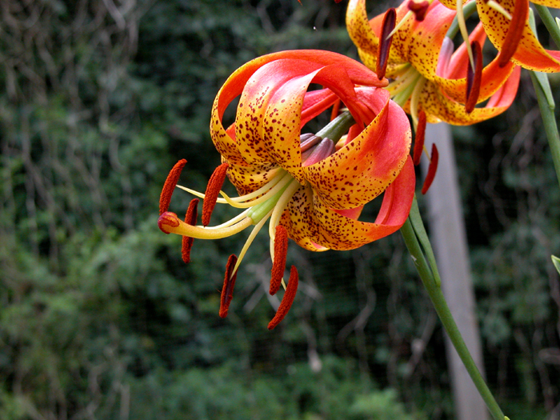
Methods
Define focus area
Sandhills lily Lilium pyrophilum
Notes:
Based on Sandhills soils

Slide 23
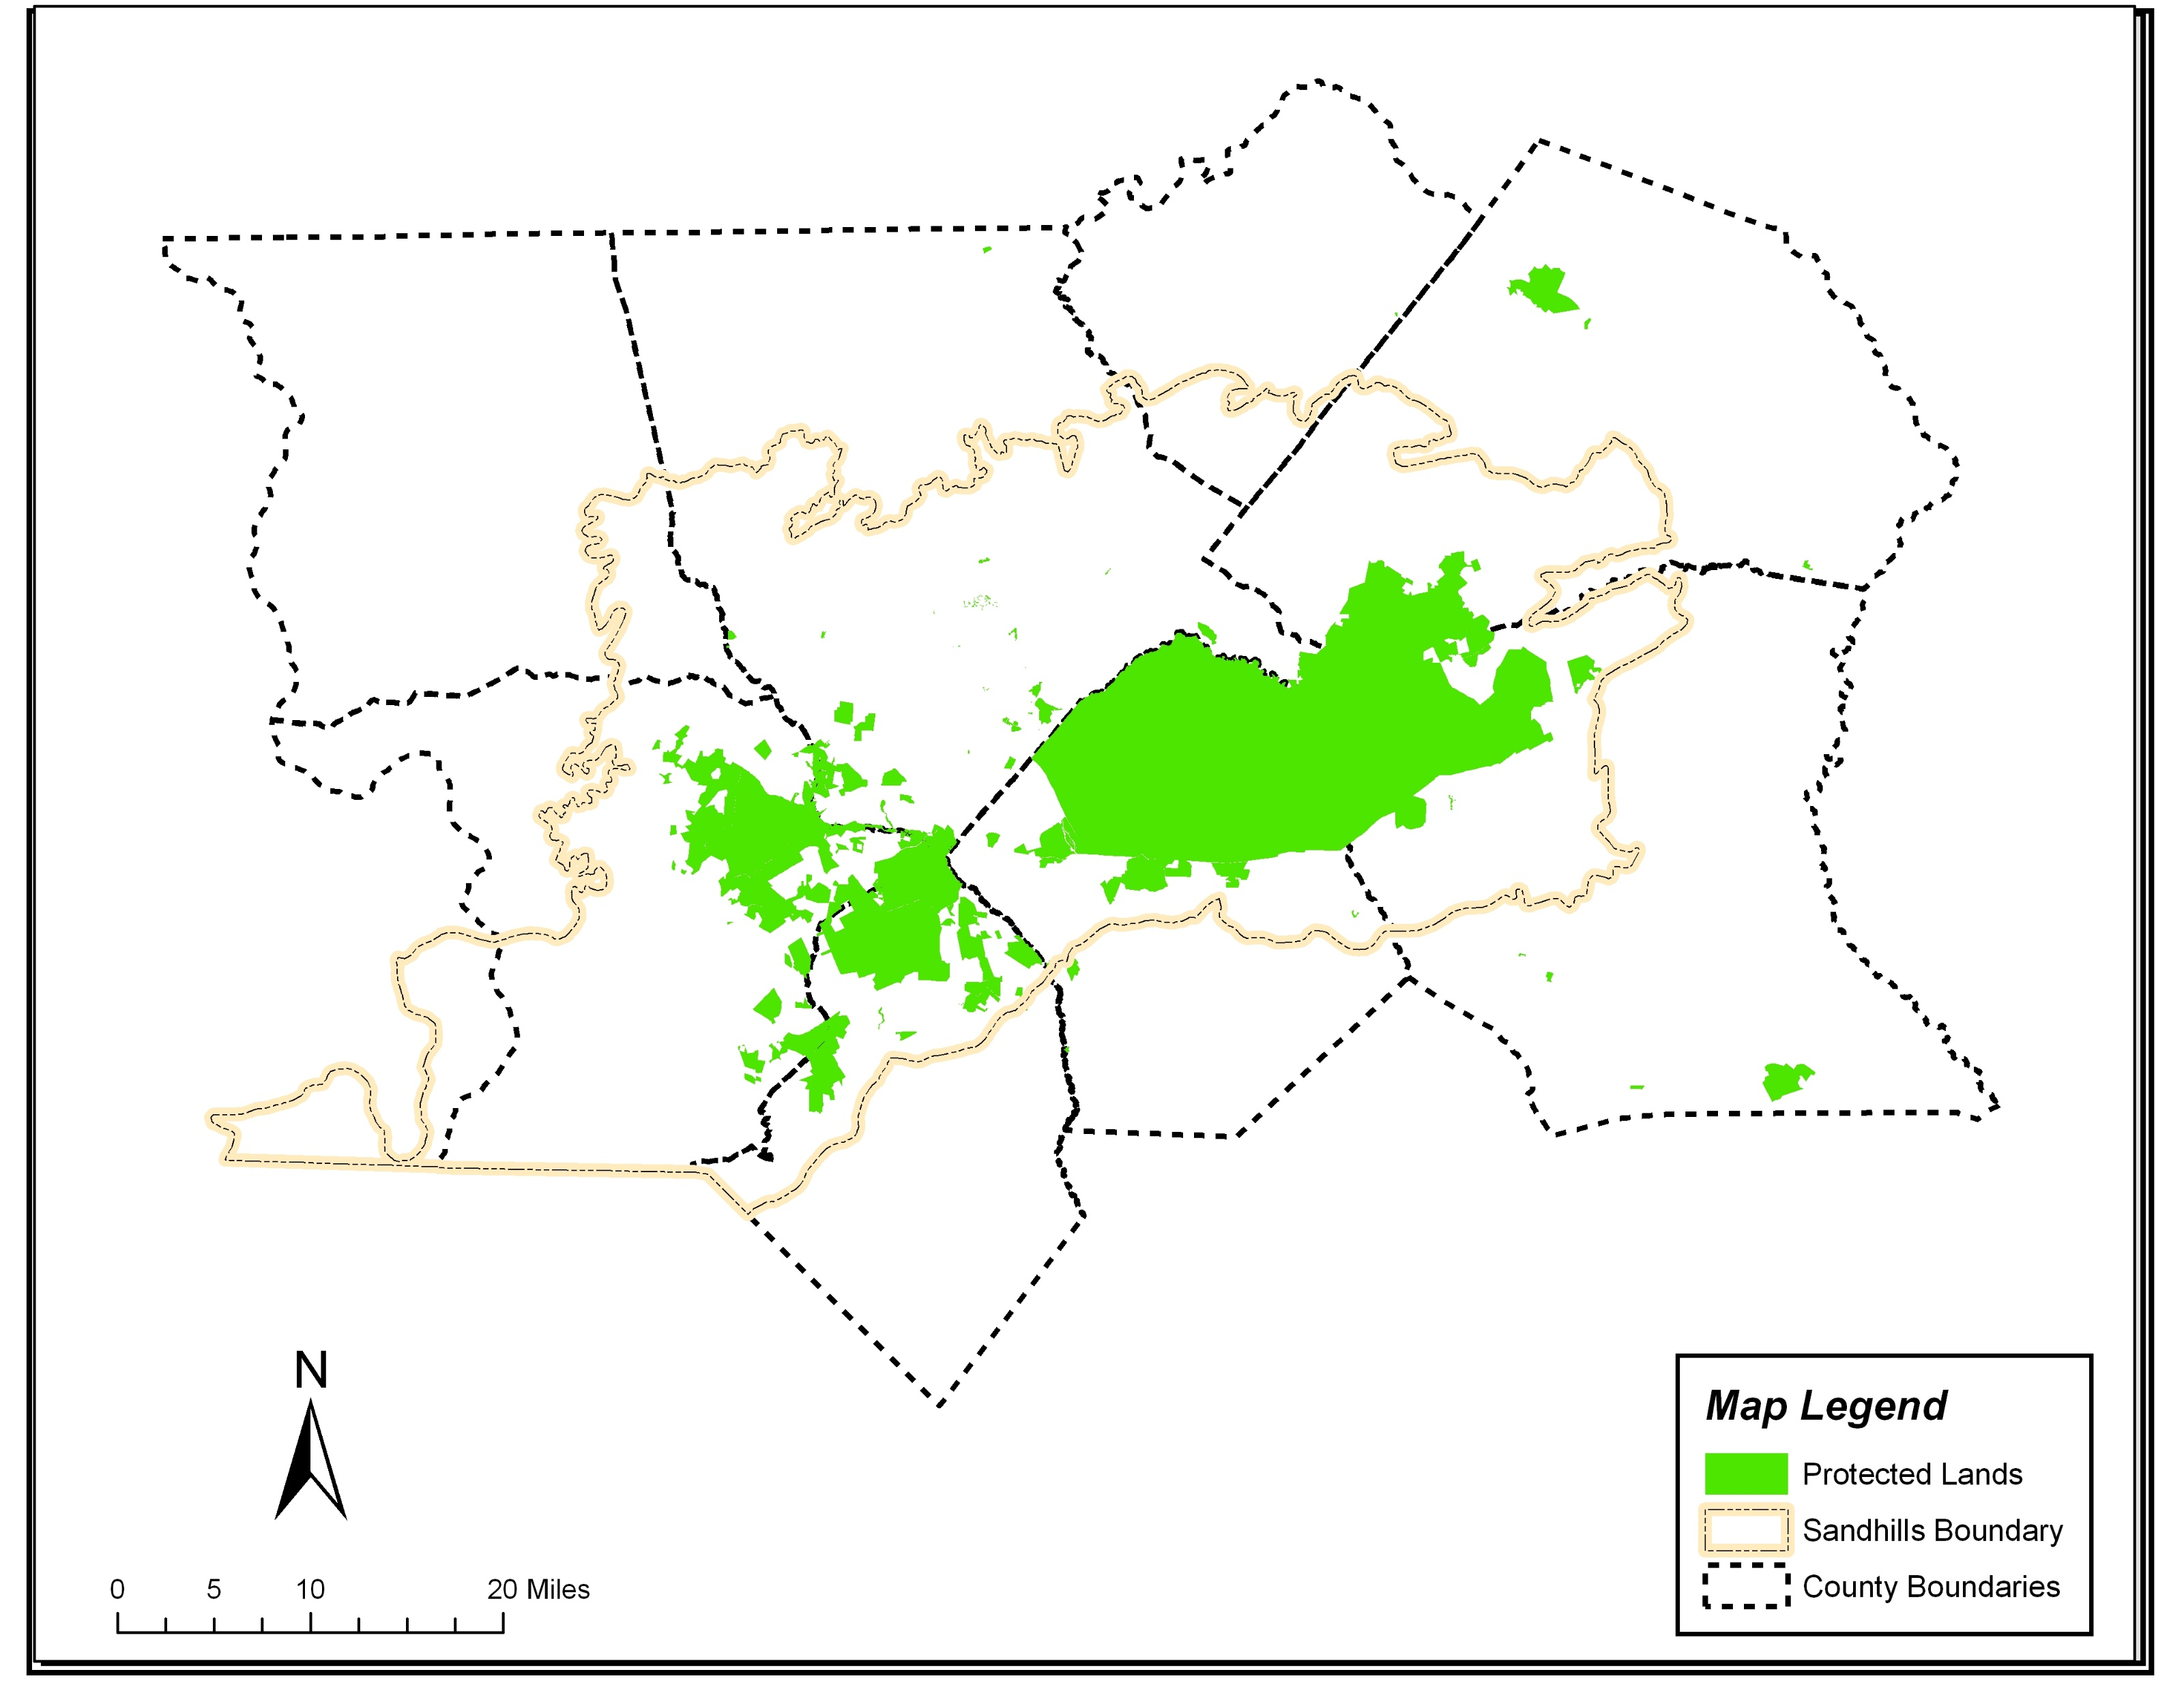
Notes:
Hoke, Harnett, Cumberland, Scotland, Richmond, and a smaller proportion of Lee and Montgomery.

Slide 24
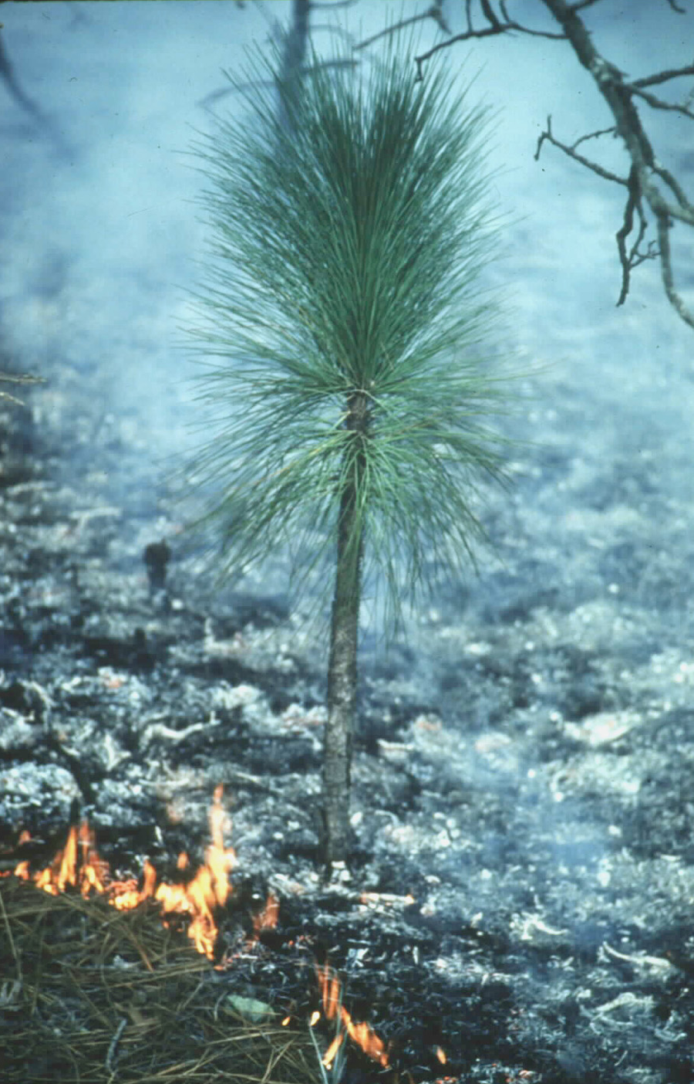
Methods
Define focus area
Identify target elements for conservation
Sensitive species
Natural communities
Special animal assemblages
Aquatic communities
Notes:
Ecosystems can also be targets - processes such as fire

Slide 25
Targets
Target
Target Selection Justification
Nested Targets
Red-cockaded Woodpecker
Federally endangered species
Old-growth longleaf pine-wiregrass
Longleaf Pine Mosaic
Longleaf community types encompass the primary source of biodiversity in the Sandhills and have experienced great losses in original habitat extent
Small patch communities, rare plants, rare animals, matrix community types
Streamhead Pocosins/Seeps
Habitat for rare plants and animals, sensitive to diverse sets of environmental factors
Canebrakes, Sandhills seeps, Streamhead Atlantic white cedar, Streamhead pocosins, rare plants, rare animals, lepidoptera
Blackwater Streams
Healthy aquatic systems that are newly threatened by increasing development
Beaver pond communities, floodplain forests and rare species, aquatic communities and associated rare species
Upland Depressional Wetlands
Habitat for rare plants and animals, sensitive to diverse sets of environmental factors
Small depressional ponds, vernal pools, rare herps, rare plants, small depressional pocosins and swamps
Notes:
Note that we have one species target, which a separate group tackled. Jay Carter will brief on that group. We took on, well, everything else. Grouped into categories, with one big target, and many of the others, of limited spatial extent, or “patches”. embedded within this longleaf-wiregrass mosaic.

Slide 26
Methods (cont.)
Identify known areas of ecological significance for targets (primary areas)
Guiding principle: Most effective to conserve habitats where they are
Notes:
Guiding principle: Have to conserve the things where you have them
Natural Heritage Areas
Other viable element occurrences
Polygons drawn around centroids based on topo and aerial photos
Other public lands known to have substantially intact natural communities (i.e. SGL, which doesn’t have all communities mapped)

Slide 27
Examples of Nested Targets
Scientific Name | Common Name | Broad Habitat | Importance of Sandhills | State Status | Federal Status | State Rank | Global Rank
Rhynchospora crinipes | Alabama Beaksedge | blackwater stream | occurs nowhere else in NC | T |  | S1 | G3
Eupatorium paludicola | Bay Boneset | Upland depressional wetlands |  | E |  | S1S2 | G2
Lilium pyrophilum | Sandhills Lily | streamhead pocosin | endemic | E |  | S2 | G2
Lindera subcoriacea | Bog Spicebush | streamhead pocosin | North Carolina populations predominantly in Sandhills | SC-V |  | S2 | G3
Rhus michauxii | Michaux's Sumac | Longleaf pine forest | North Carolina populations predominantly in Sandhills | E | E | S2 | G2G3
Sagittaria macrocarpa | Streamhead Sagittaria | beaver pond, impoundment | endemic | T |  | S2 | G2
Schwalbea americana | Chaffseed | Longleaf pine forest | occurs nowhere else in NC | E | E | S1 | G2
Orthochilus ecristatus | Spiked Medusa | Longleaf pine forest |  | E |  | S1 | G2G3
Carex austrodeflixa (former sp 4) | Canebrake Sedge | streamhead pocosin | North Carolina populations predominantly in Sandhills | SR-L |  | S3 | G3G34
Dichanthelium cryptanthum (former sp 9) | Hidden-flowered Witchgrass | streamhead pocosin openings |  | SR-T |  | S2 | G3G4Q
Lobelia boykinii | Boykin's Lobelia | upland depressional wetland |  | E |  | S1S2 | G2G3
Tridens chapmanii | Chapman's Redtop | Longleaf pine forest |  | SC-V |  | S1S2 | G3
Carex decomposita | Cypress Knee Sedge | beaver pond, impoundment |  | SR-O |  | S2 | G3G4
Muhlenbergia torreyana | Pinebarren Smokegrass | Upland depressional wetlands |  | SC-V |  | S2 | G3
Myriophyllum laxum | Loose Water-milfoil | impoundment |  | E |  | S2 | G3
Rhynchospora macra | Southern White Beaksedge | seepage bog, beaver pond | occurs nowhere else in NC | T |  | S2 | G3G4
Xyris scabrifolia | Harper's Yellow-eyed-grass | streamhead pocosin, bog | North Carolina populations predominantly in Sandhills | SC-V |  | S2 | G3
Astragalus michauxii | Sandhills Milk-vetch | longleaf pine forest | North Carolina populations predominantly in Sandhills | SC-V |  | S3 | G3
Pyxidanthera brevifolia | Sandhills Pyxie-moss |  | Currently only known in NC from Sandhills | T |  | S2 | G3
Notes:
Not complete list

Slide 28
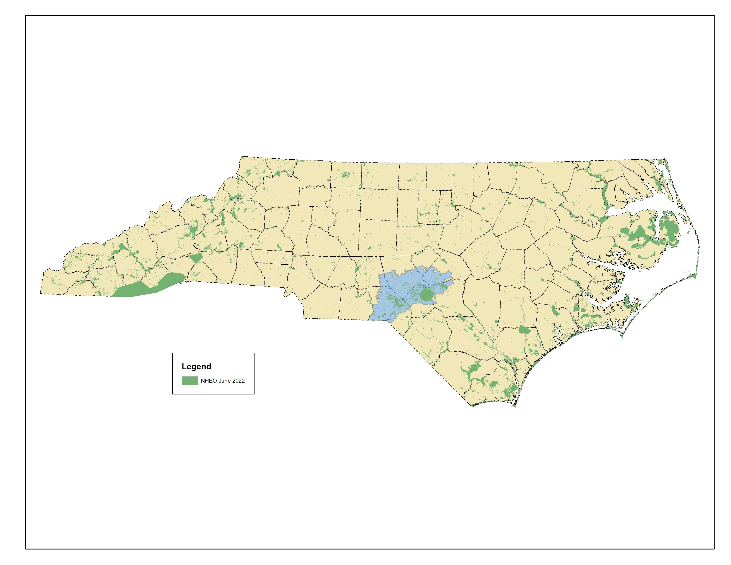
All element occurrence polygons (plant, animal, natural community and animal assemblages), including historic and failed to find
Low and Very Low accuracy records filtered out
Please use these data for making conservation decisions
Notes:
I used points in later slides, because many of the records we have do not show up at this scale. But we would want people to use the polygons

Slide 29
All element occurrence polygons (plant, animal, natural community and animal assemblages), including historic and failed to find
Low and Very Low accuracy records filtered out
Please use these data for making conservation decisions
…but their precision means that most records don’t show at this scale
Notes:
I used points in later slides, because many of the records we have do not show up at this scale. But we would want people to use the polygons

Slide 30
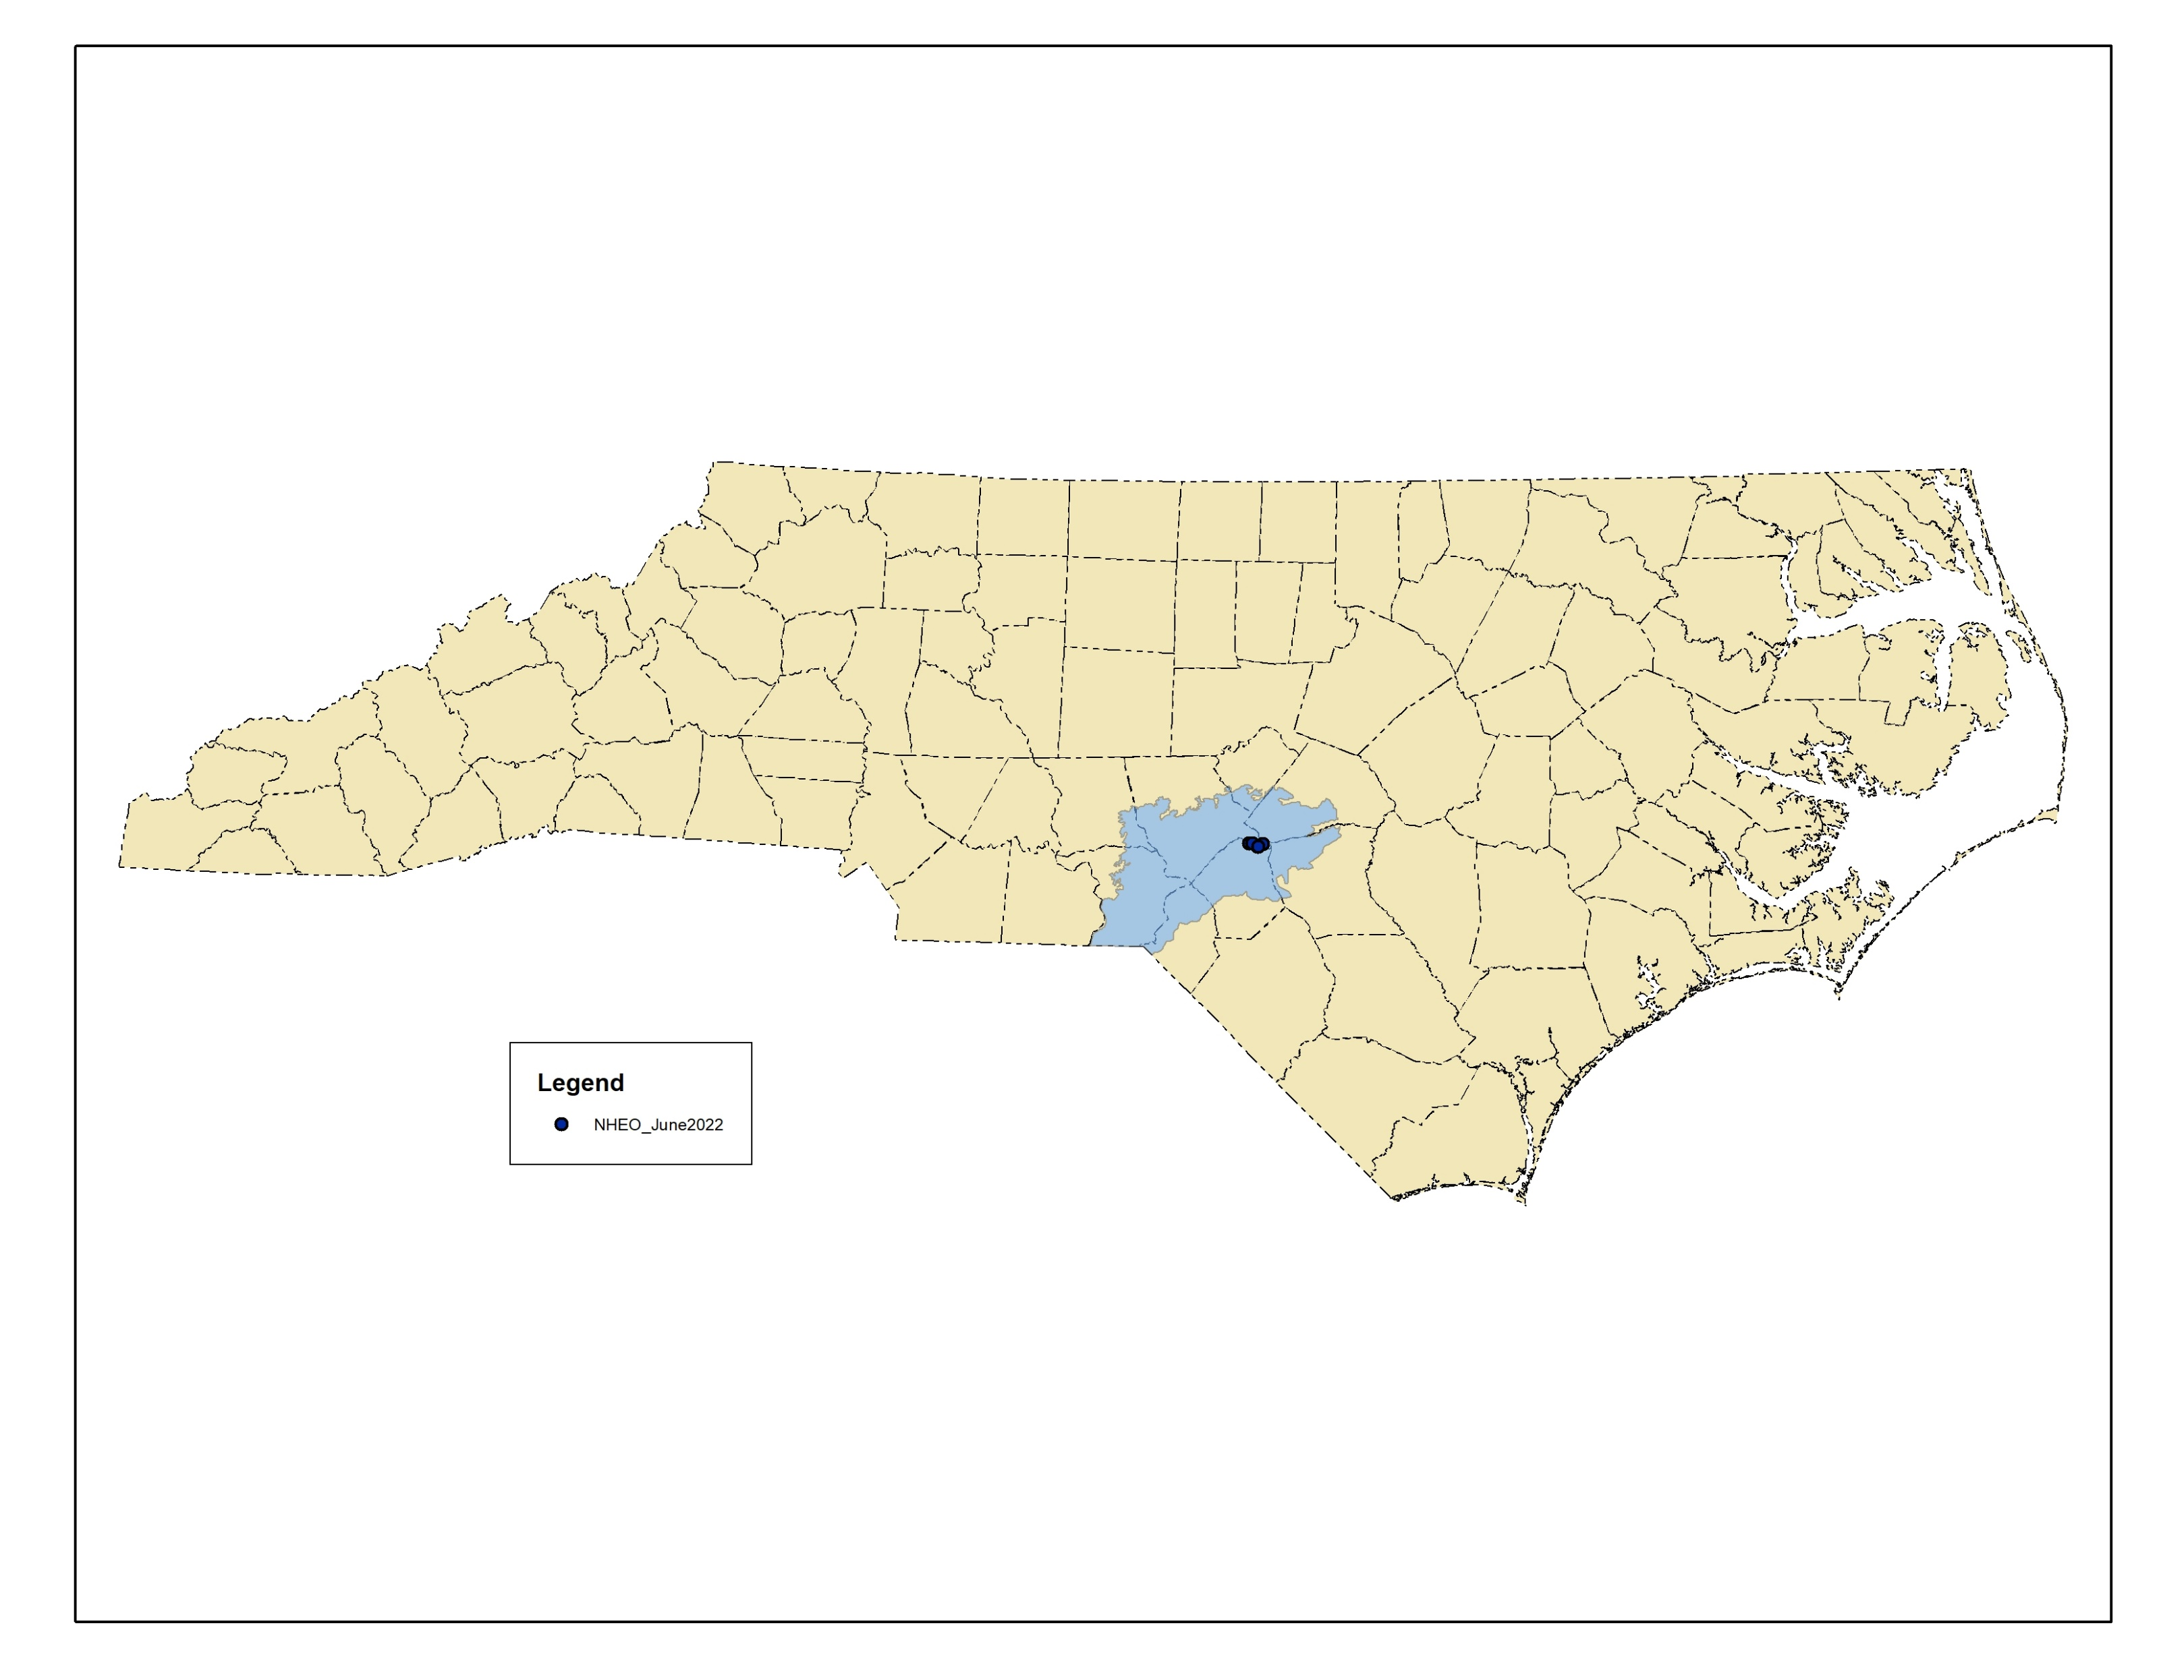
Alabama Beaksedge (Rhynchospora crinipes)
Two known populations in NC, both at Fort Bragg
Seepy banks of blackwater rivers
S1G3
NC Threatened

Slide 31
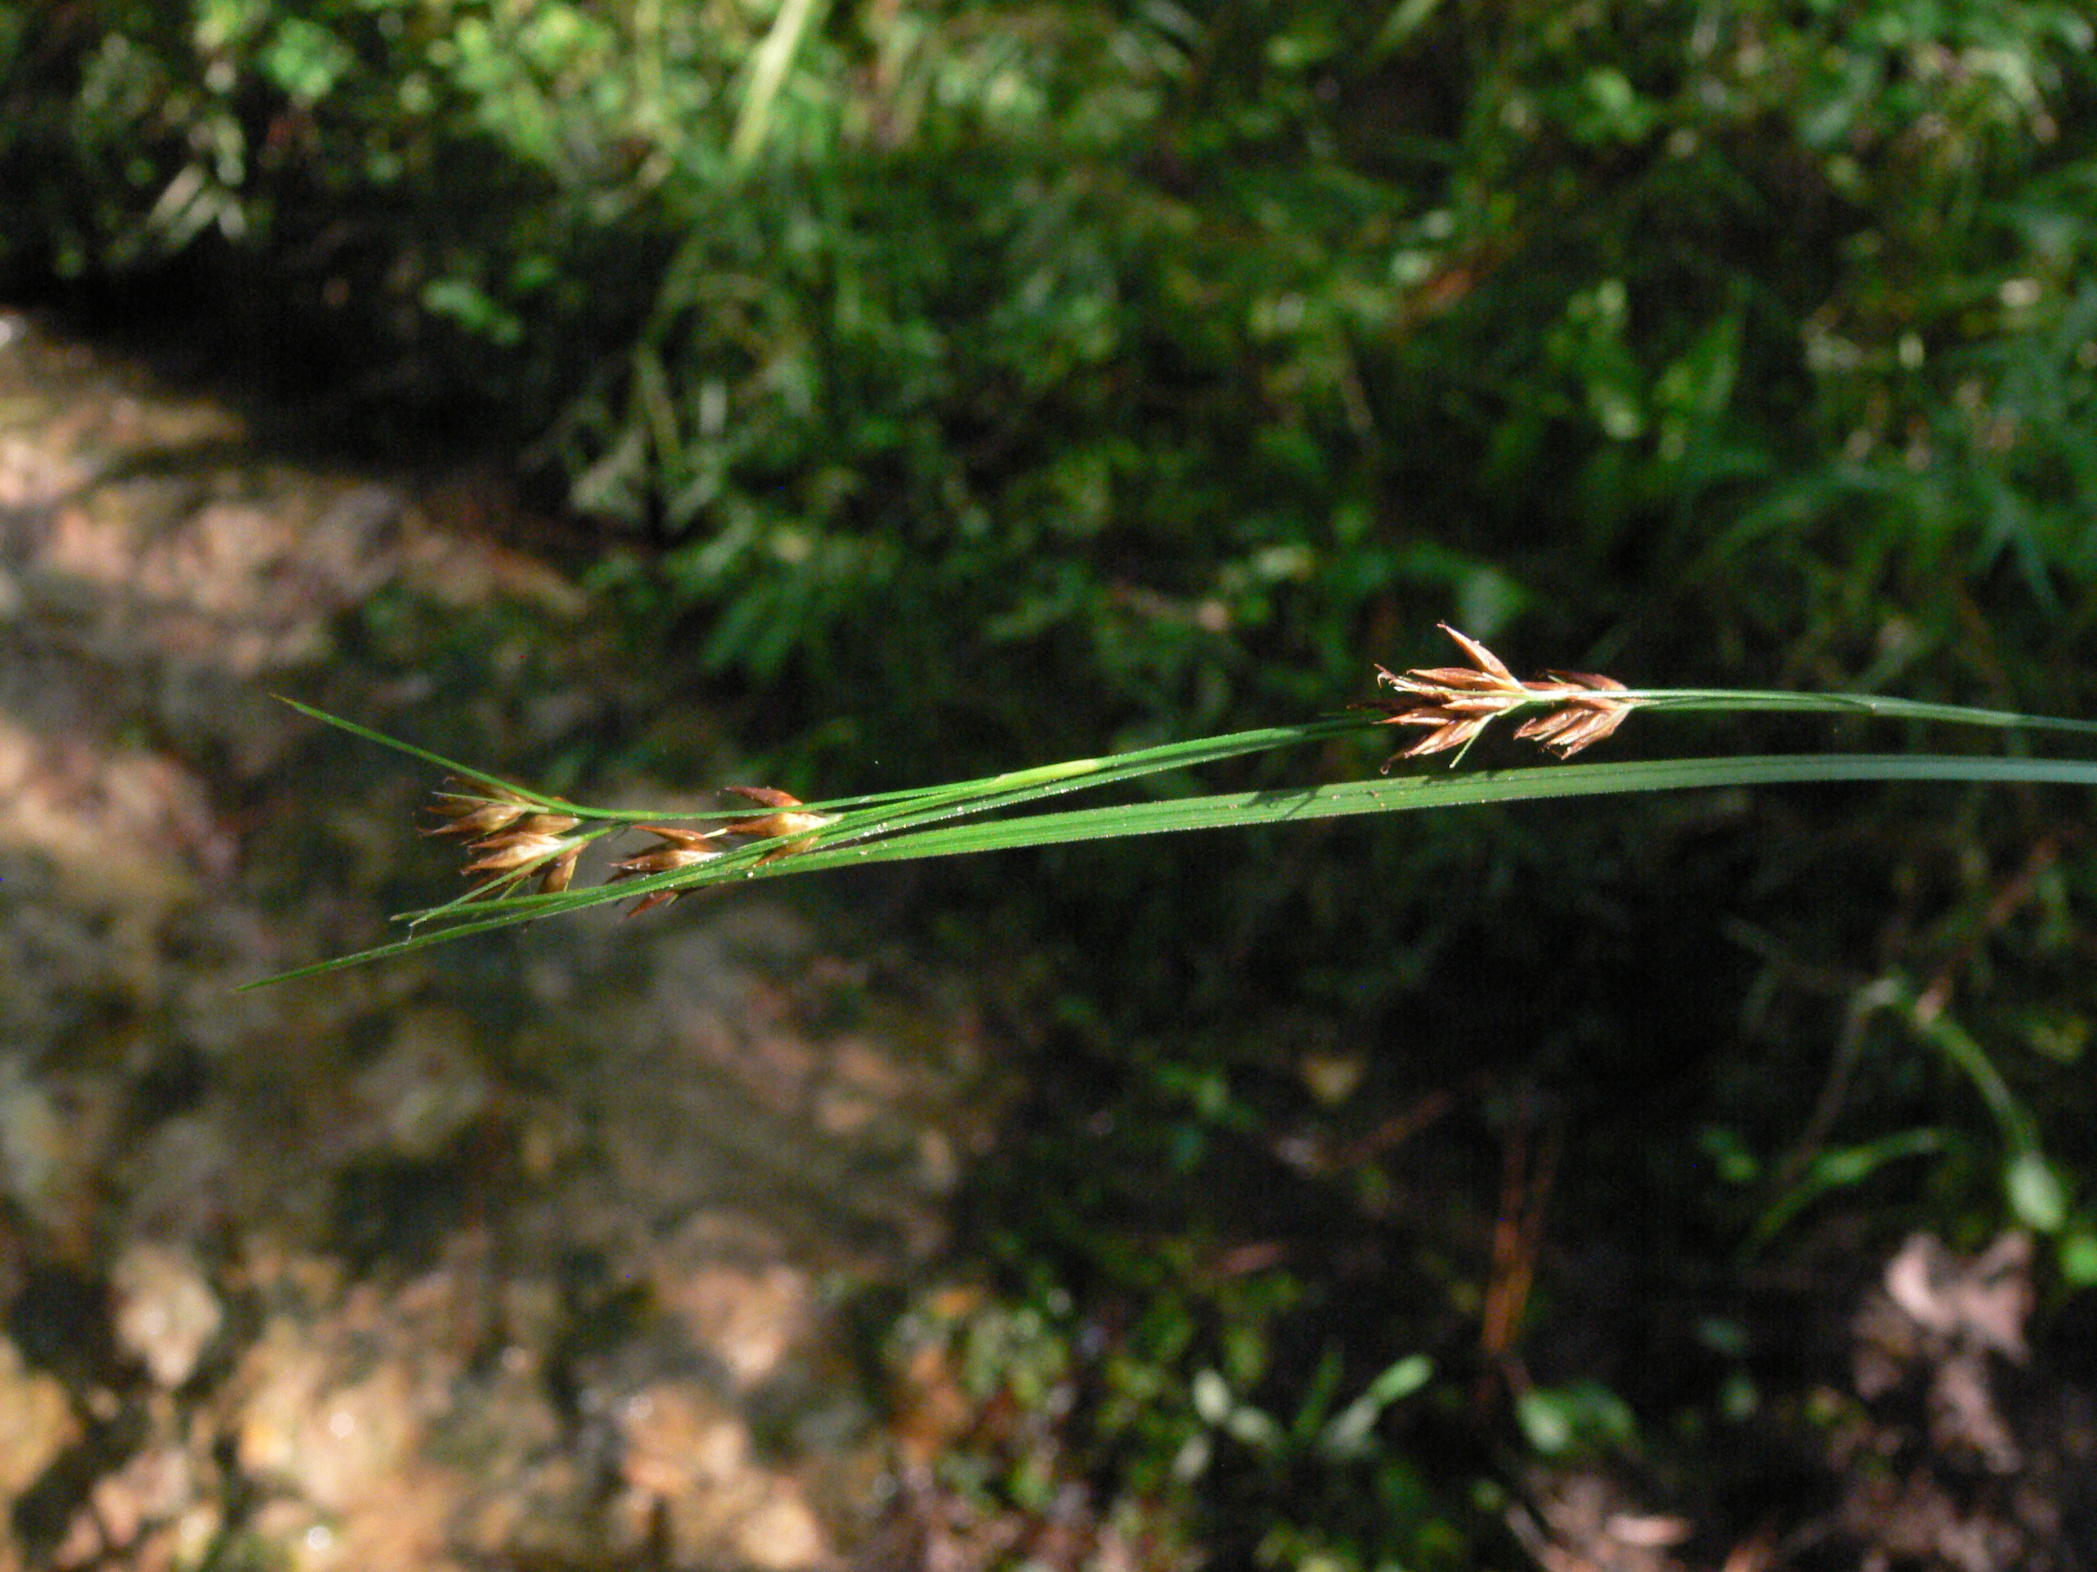
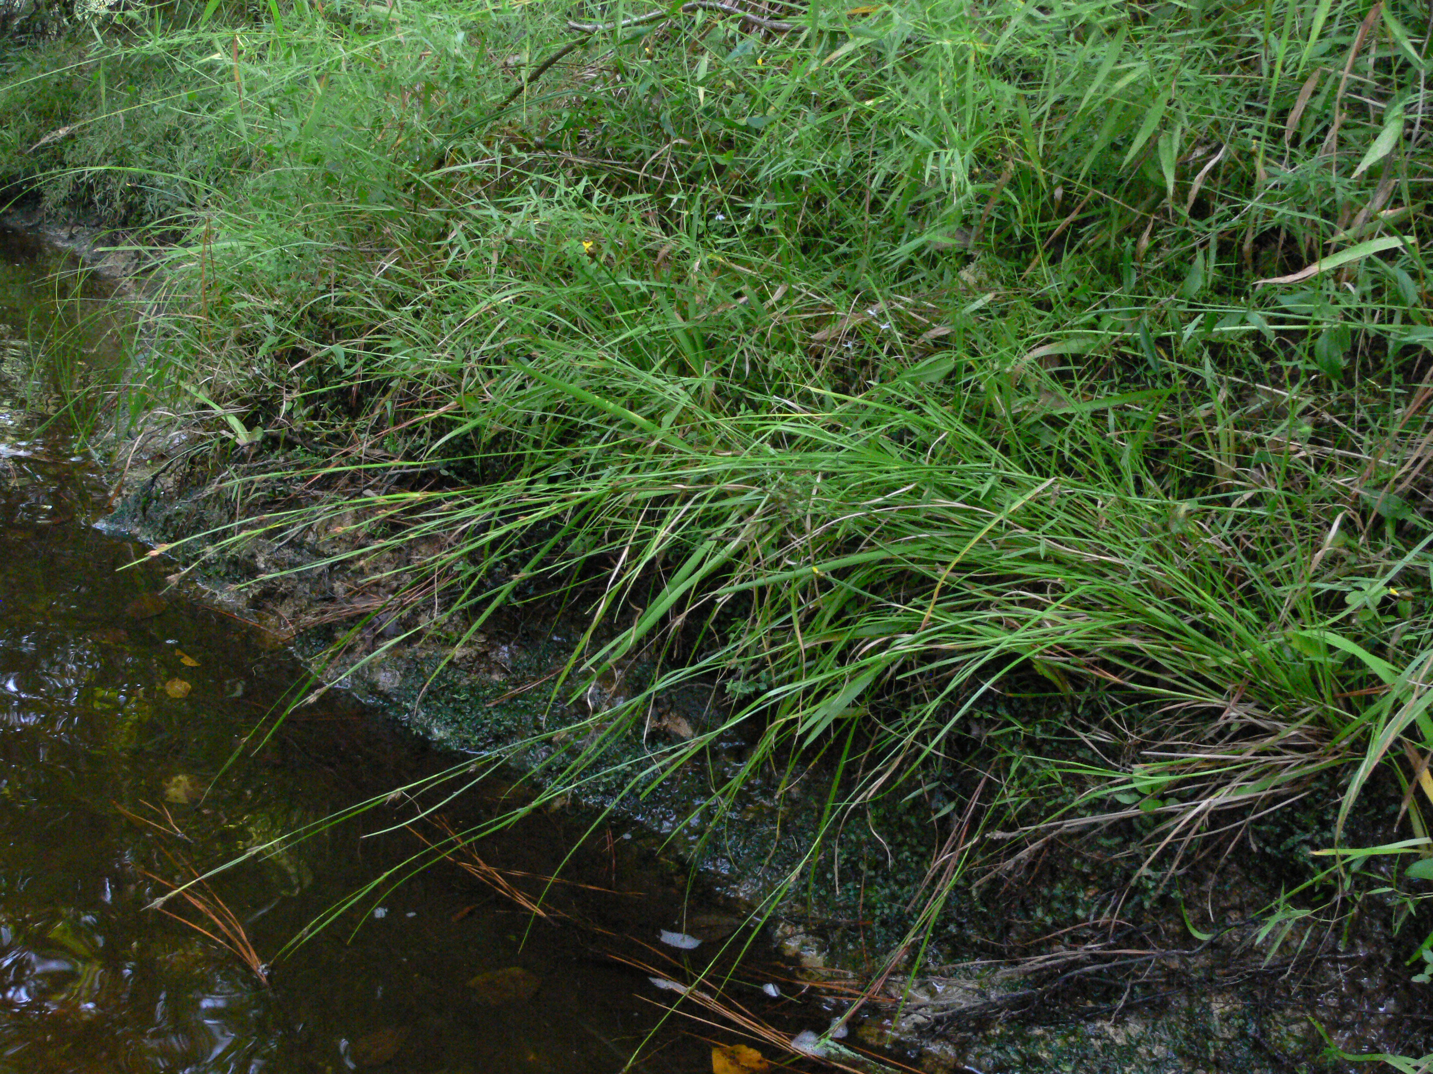
Alabama Beaksedge by Bruce Sorrie

Slide 32
Twisted-leaf Goldenrod (Solidago tortifolia)
Current extant NC populations predominantly in Sandhills, where it is associated with longleaf pine forest
S1G4G5
NC Endangered

Slide 33
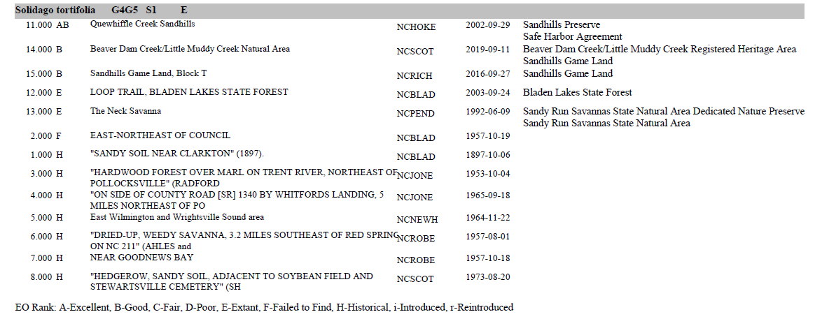
Element Occurrence (EO) Ranks are based on size, condition, and landscape
context, and are considered a measure of viability

Slide 34
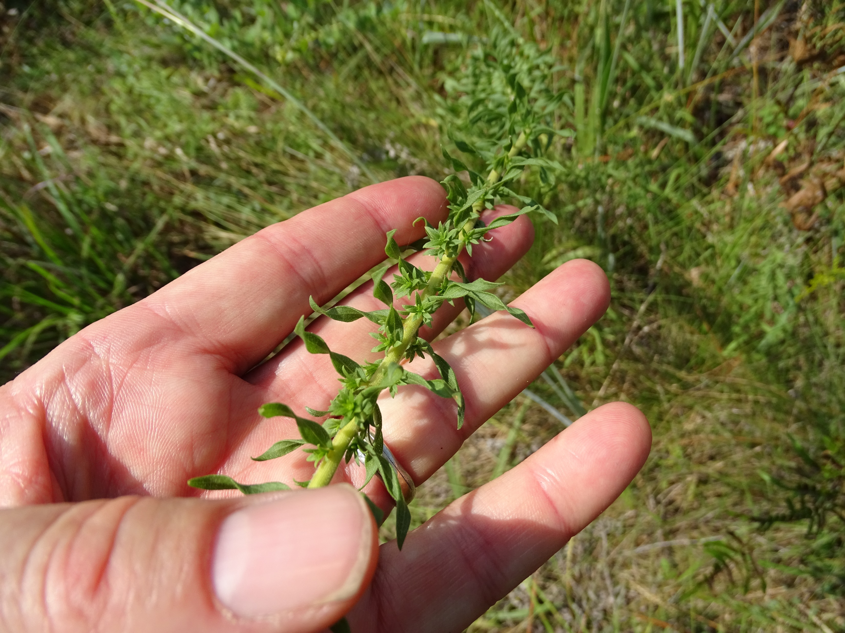
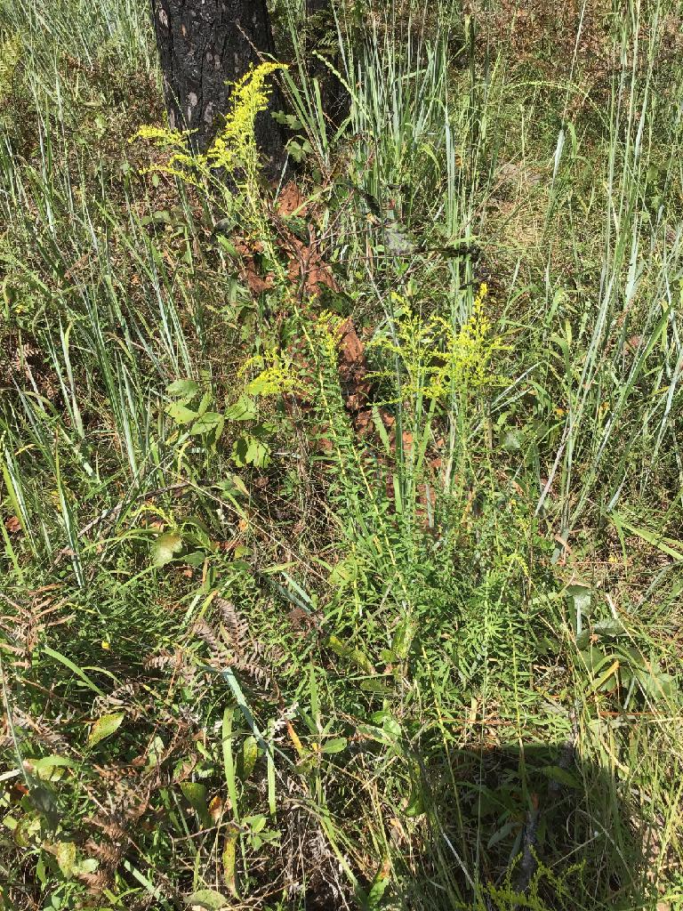
Twisted-leaf goldenrod, Beaver Dam Creek/Little Muddy Creek Natural Area, Sandhills Game Land
Notes:
Is also a registered heritage area!

Slide 35
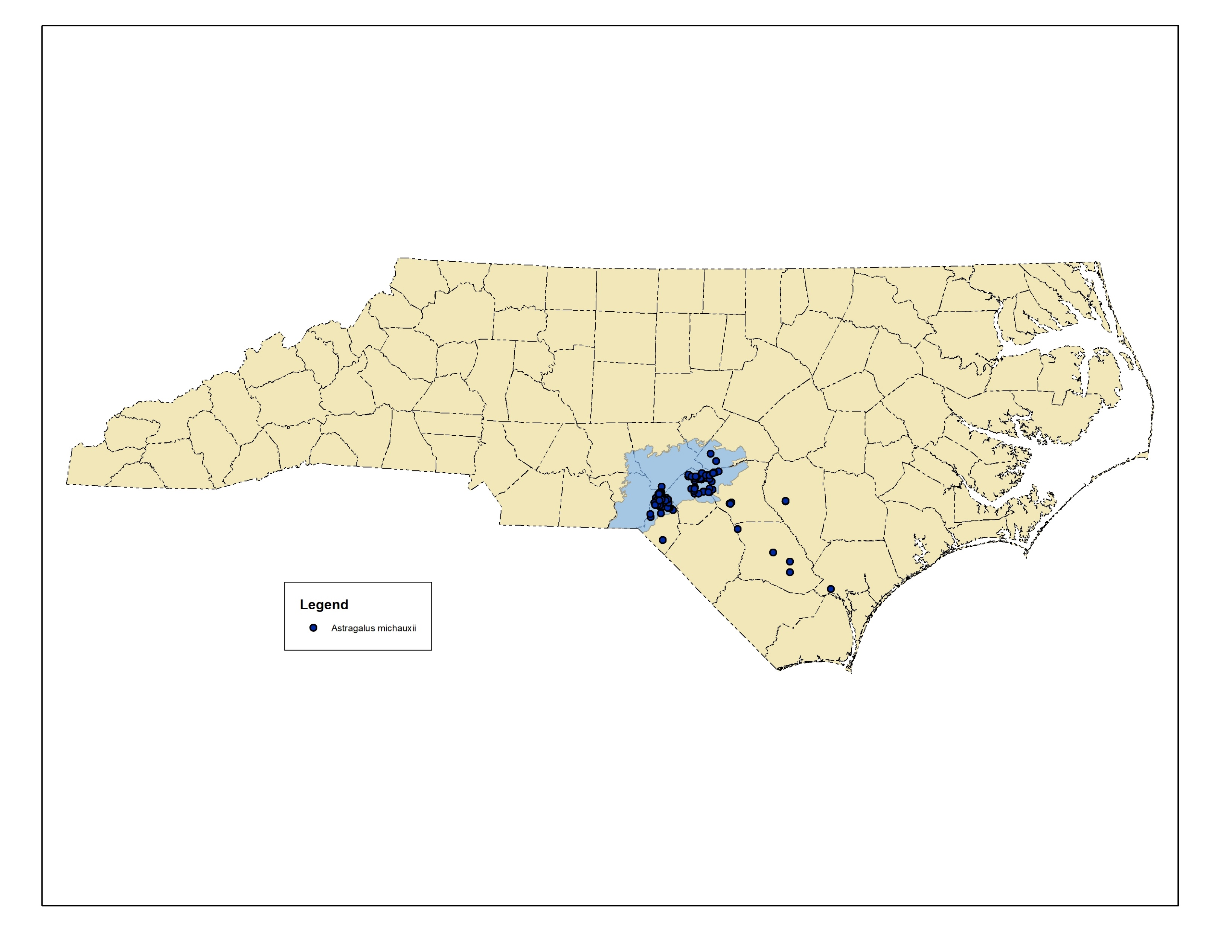
Sandhills Milk-vetch (Astragalus michauxii)
NC populations predominantly in Sandhills
Associated with longleaf pine forest
S3G3
NC Special Concern-Vulnerable
Notes:
Currently 81 NC populations, mostly associated with longleaf pine

Slide 36
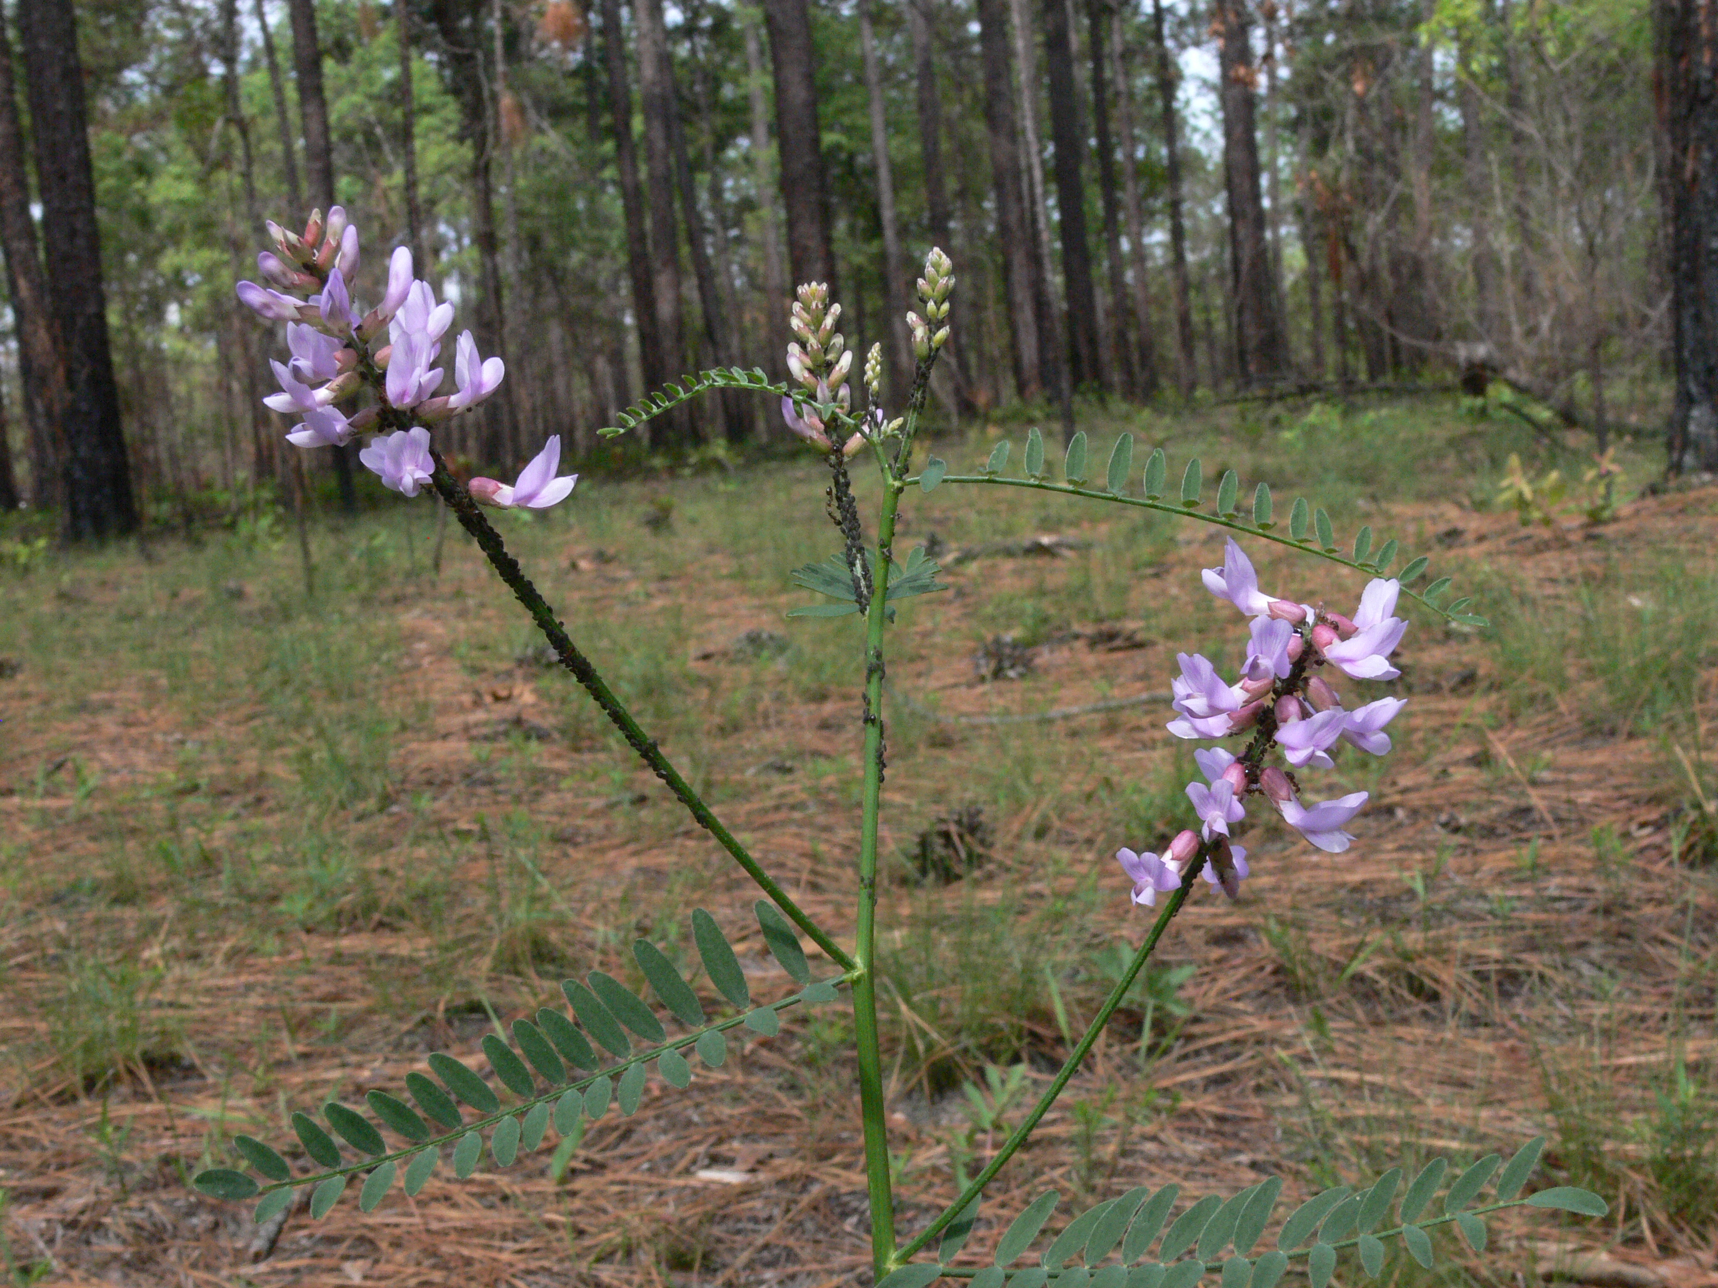
Sandhills Milk-vetch by Bruce Sorrie

Slide 37
Bog Spicebush (Lindera subcoriacea)
NC populations predominantly in Sandhills
Streamhead pocosins and along blackwater streams with Atlantic white cedar or pond pine
S2G3
NC Special Concern-Vulnerable
Notes:
71 current populations. It is known from only a few dozen counties within its small range (VA to FL/AL), centered mainly in the Sandhills of the Carolinas and southern MS to southern AL

Slide 38
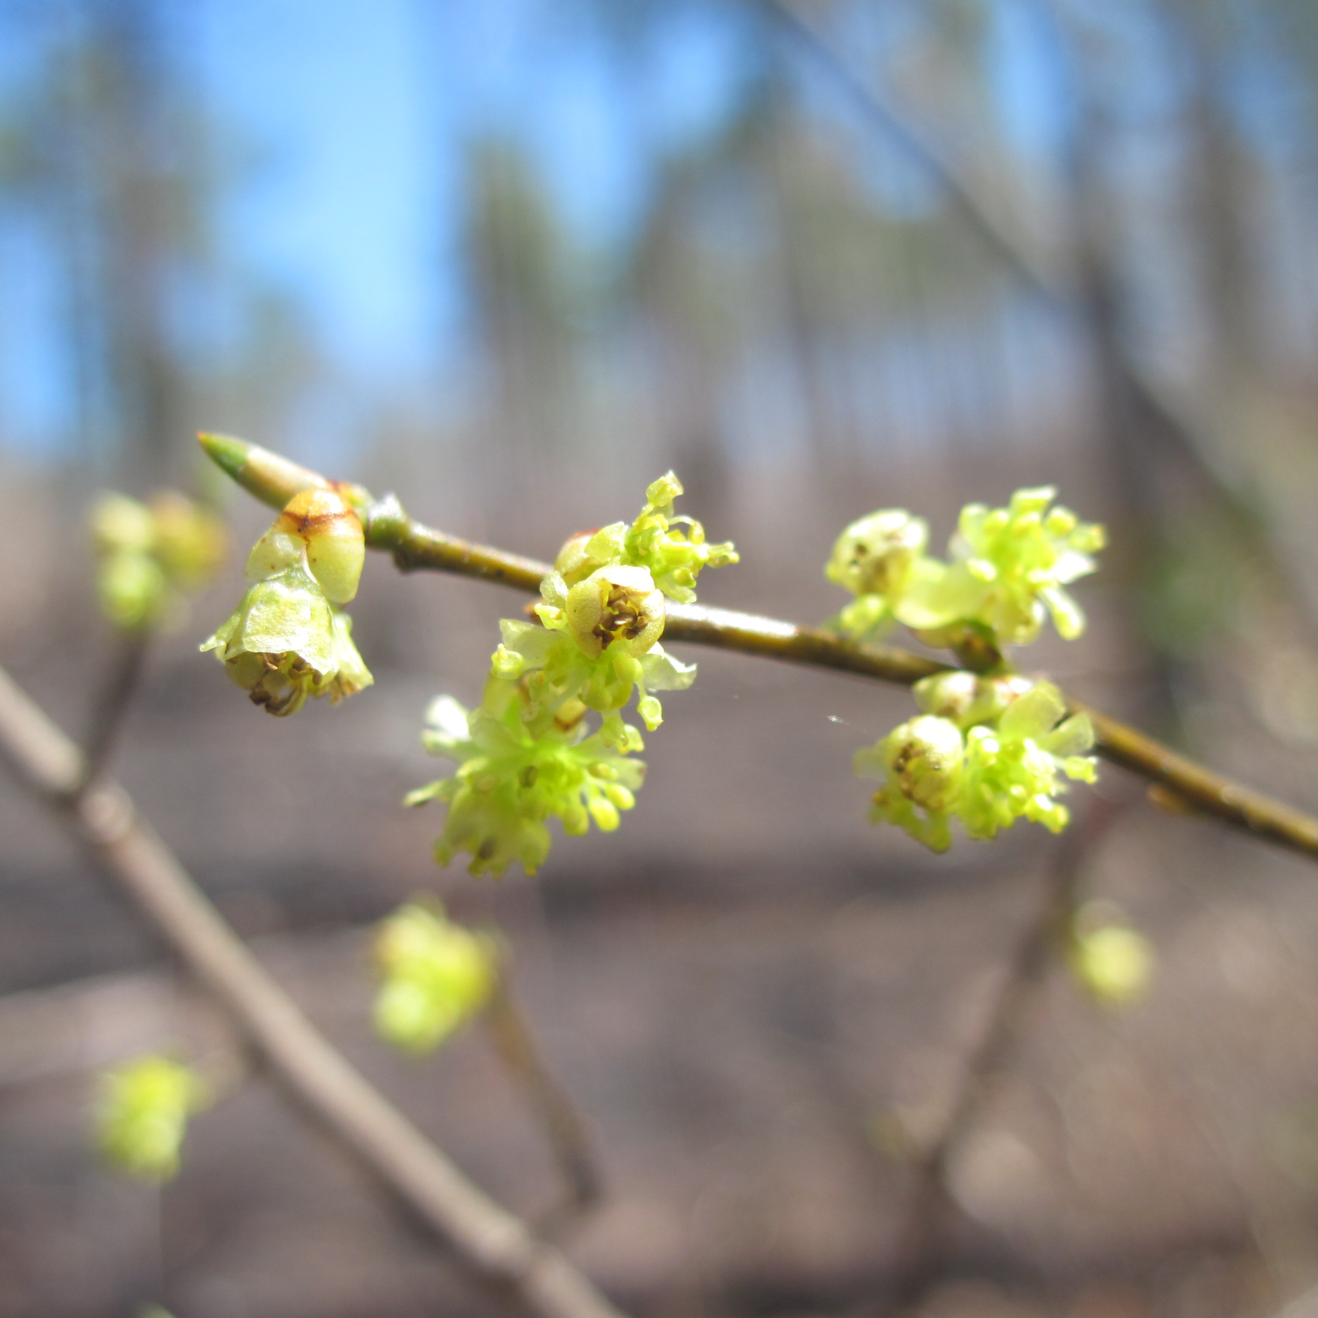
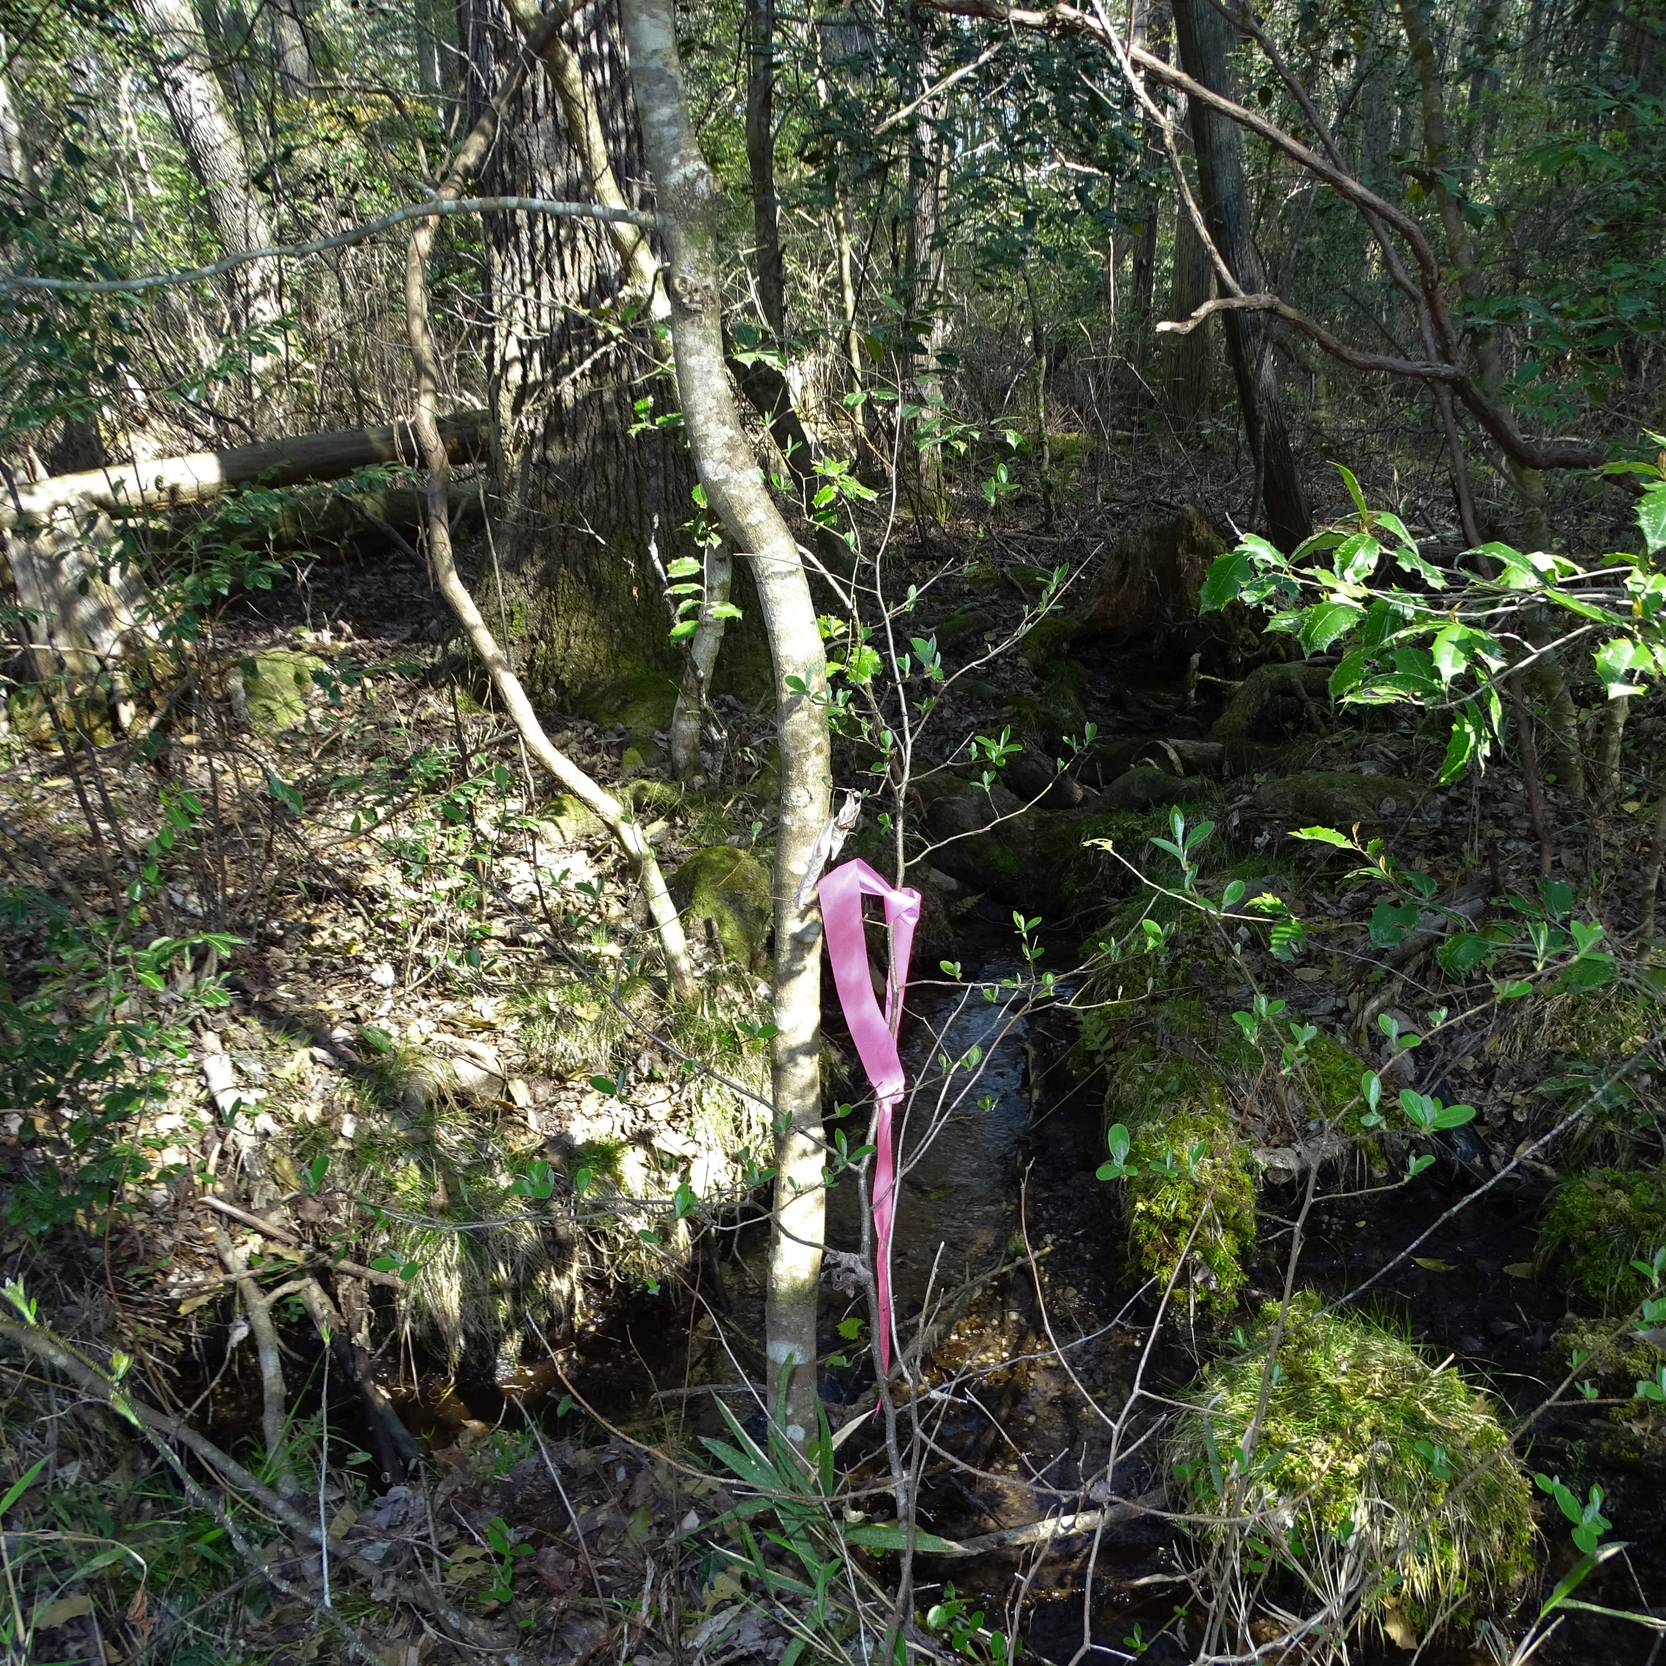
Bog Spicebush by Crystal Cockman
Notes:
Blooms in March and early April, essentially before the leaves emerge

Slide 39
Southern White Beaksedge (Rhynchospora macra)
13 currently known populations in NC
Sandhill seeps, streamhead pocosins
S2G3G4
NC Threatened
Most populations on Ft Bragg, but also Bonnie Doone, SGL, and Gibson Pond (DOT)
Notes:
Disjunct to Croatan NF; extends to Florida and East Texas

Slide 40
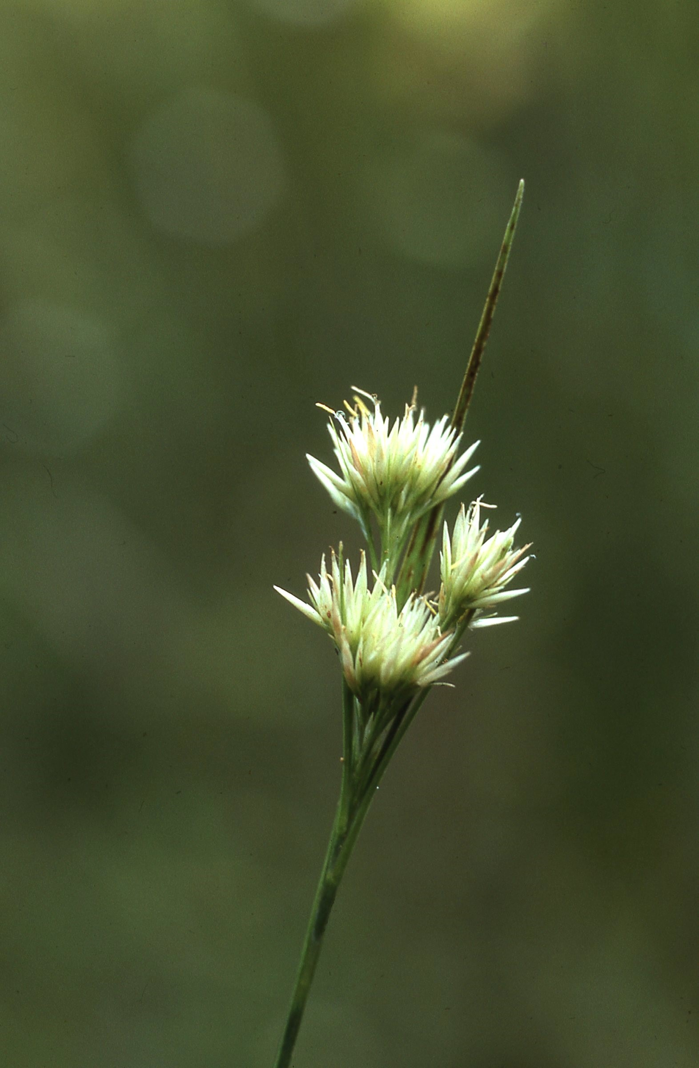
Southern White Beaksedge by Bruce Sorrie

Slide 41
Streamhead Sagittaria (Sagittaria macrocarpa)
6 records from NC, all in Sandhills
Blackwater stream impoundments
S2G2
NC Threatened
Notes:
Based on S-rank and G-rank, it looks like the Sandhills is of primary importance for conservation. Known only from the Sandhills of NC and SC; Weakley (2018) says "potentially to be expected in e GA".

Slide 42
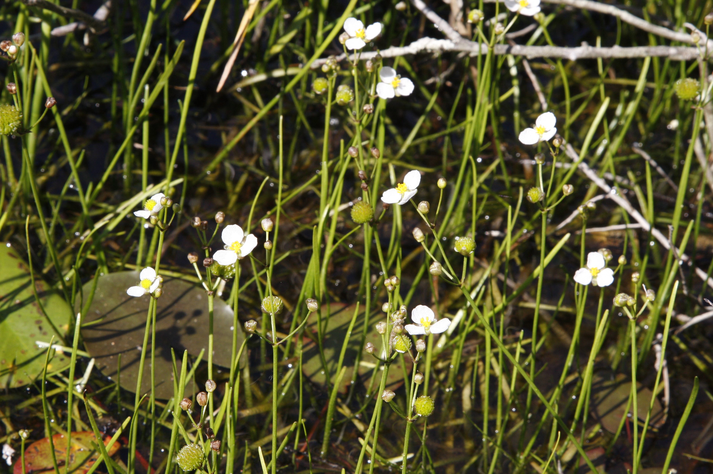
Streamhead Sagittaria by Bruce Sorrie

Slide 43
Harper’s Yellow-eyed-grass (Xyris scabrifolia)
37 current populations in NC, with most in Sandhills
Sandhill seeps and bogs
S2G3
NC Special Concern-Vulnerable
Notes:
NC populations predominantly in Sandhills.

Slide 44
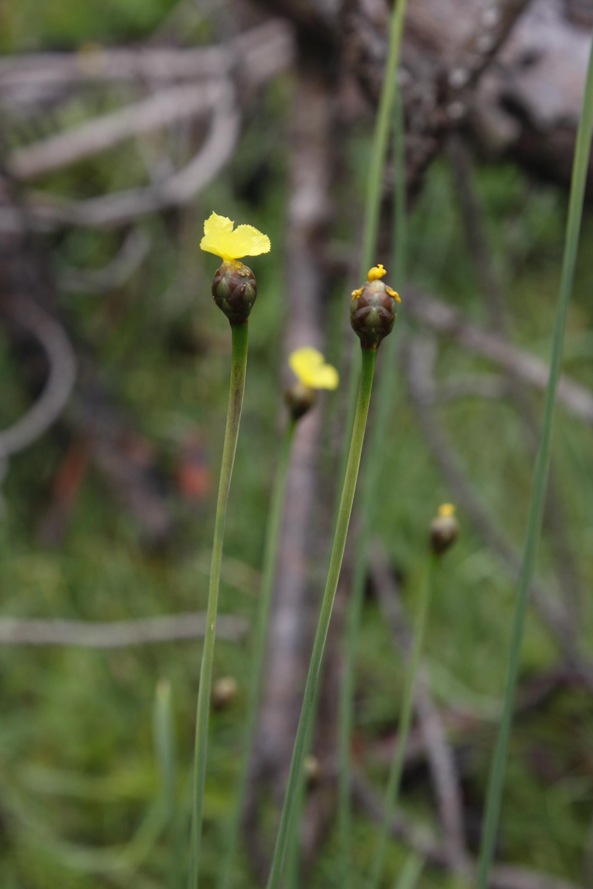
Harper’s Yellow-eyed-grass by Bruce Sorrie

Slide 45
www.ncnhp.org

Slide 46
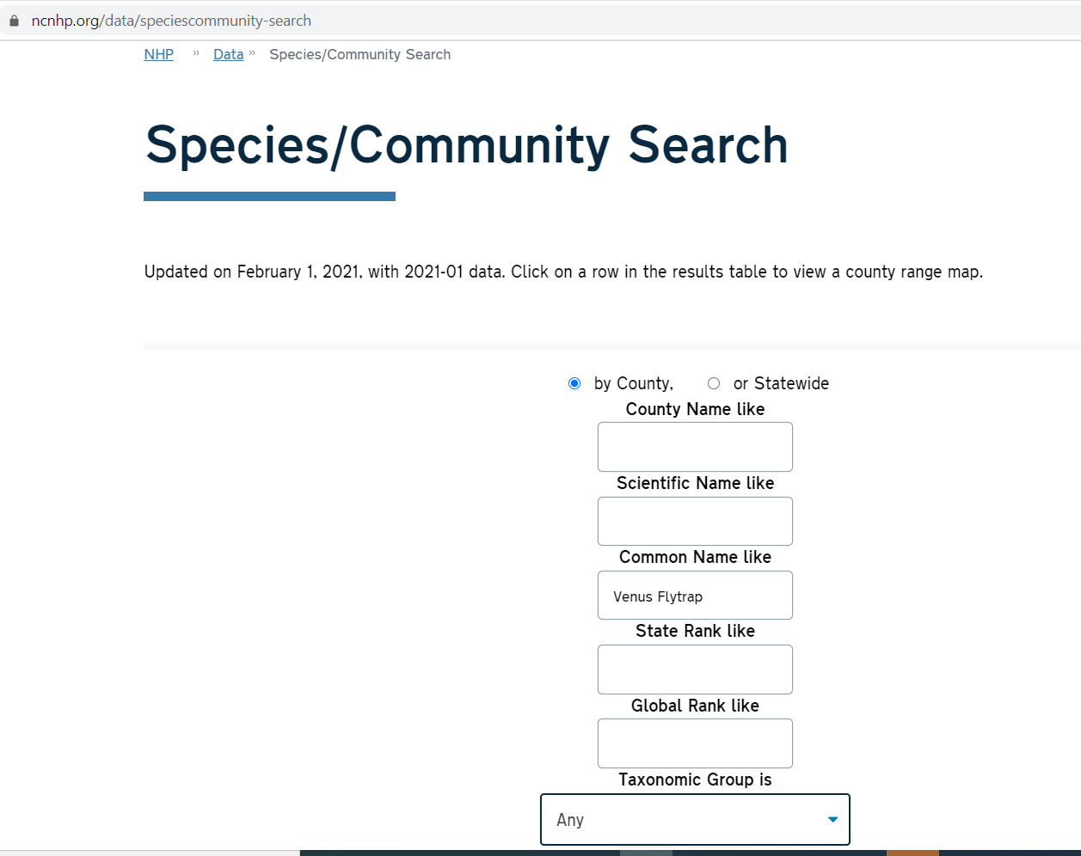

Slide 47
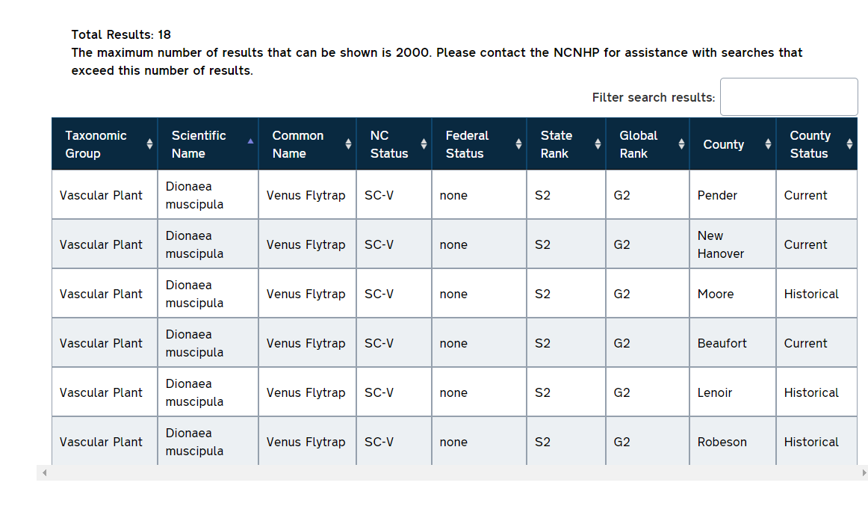
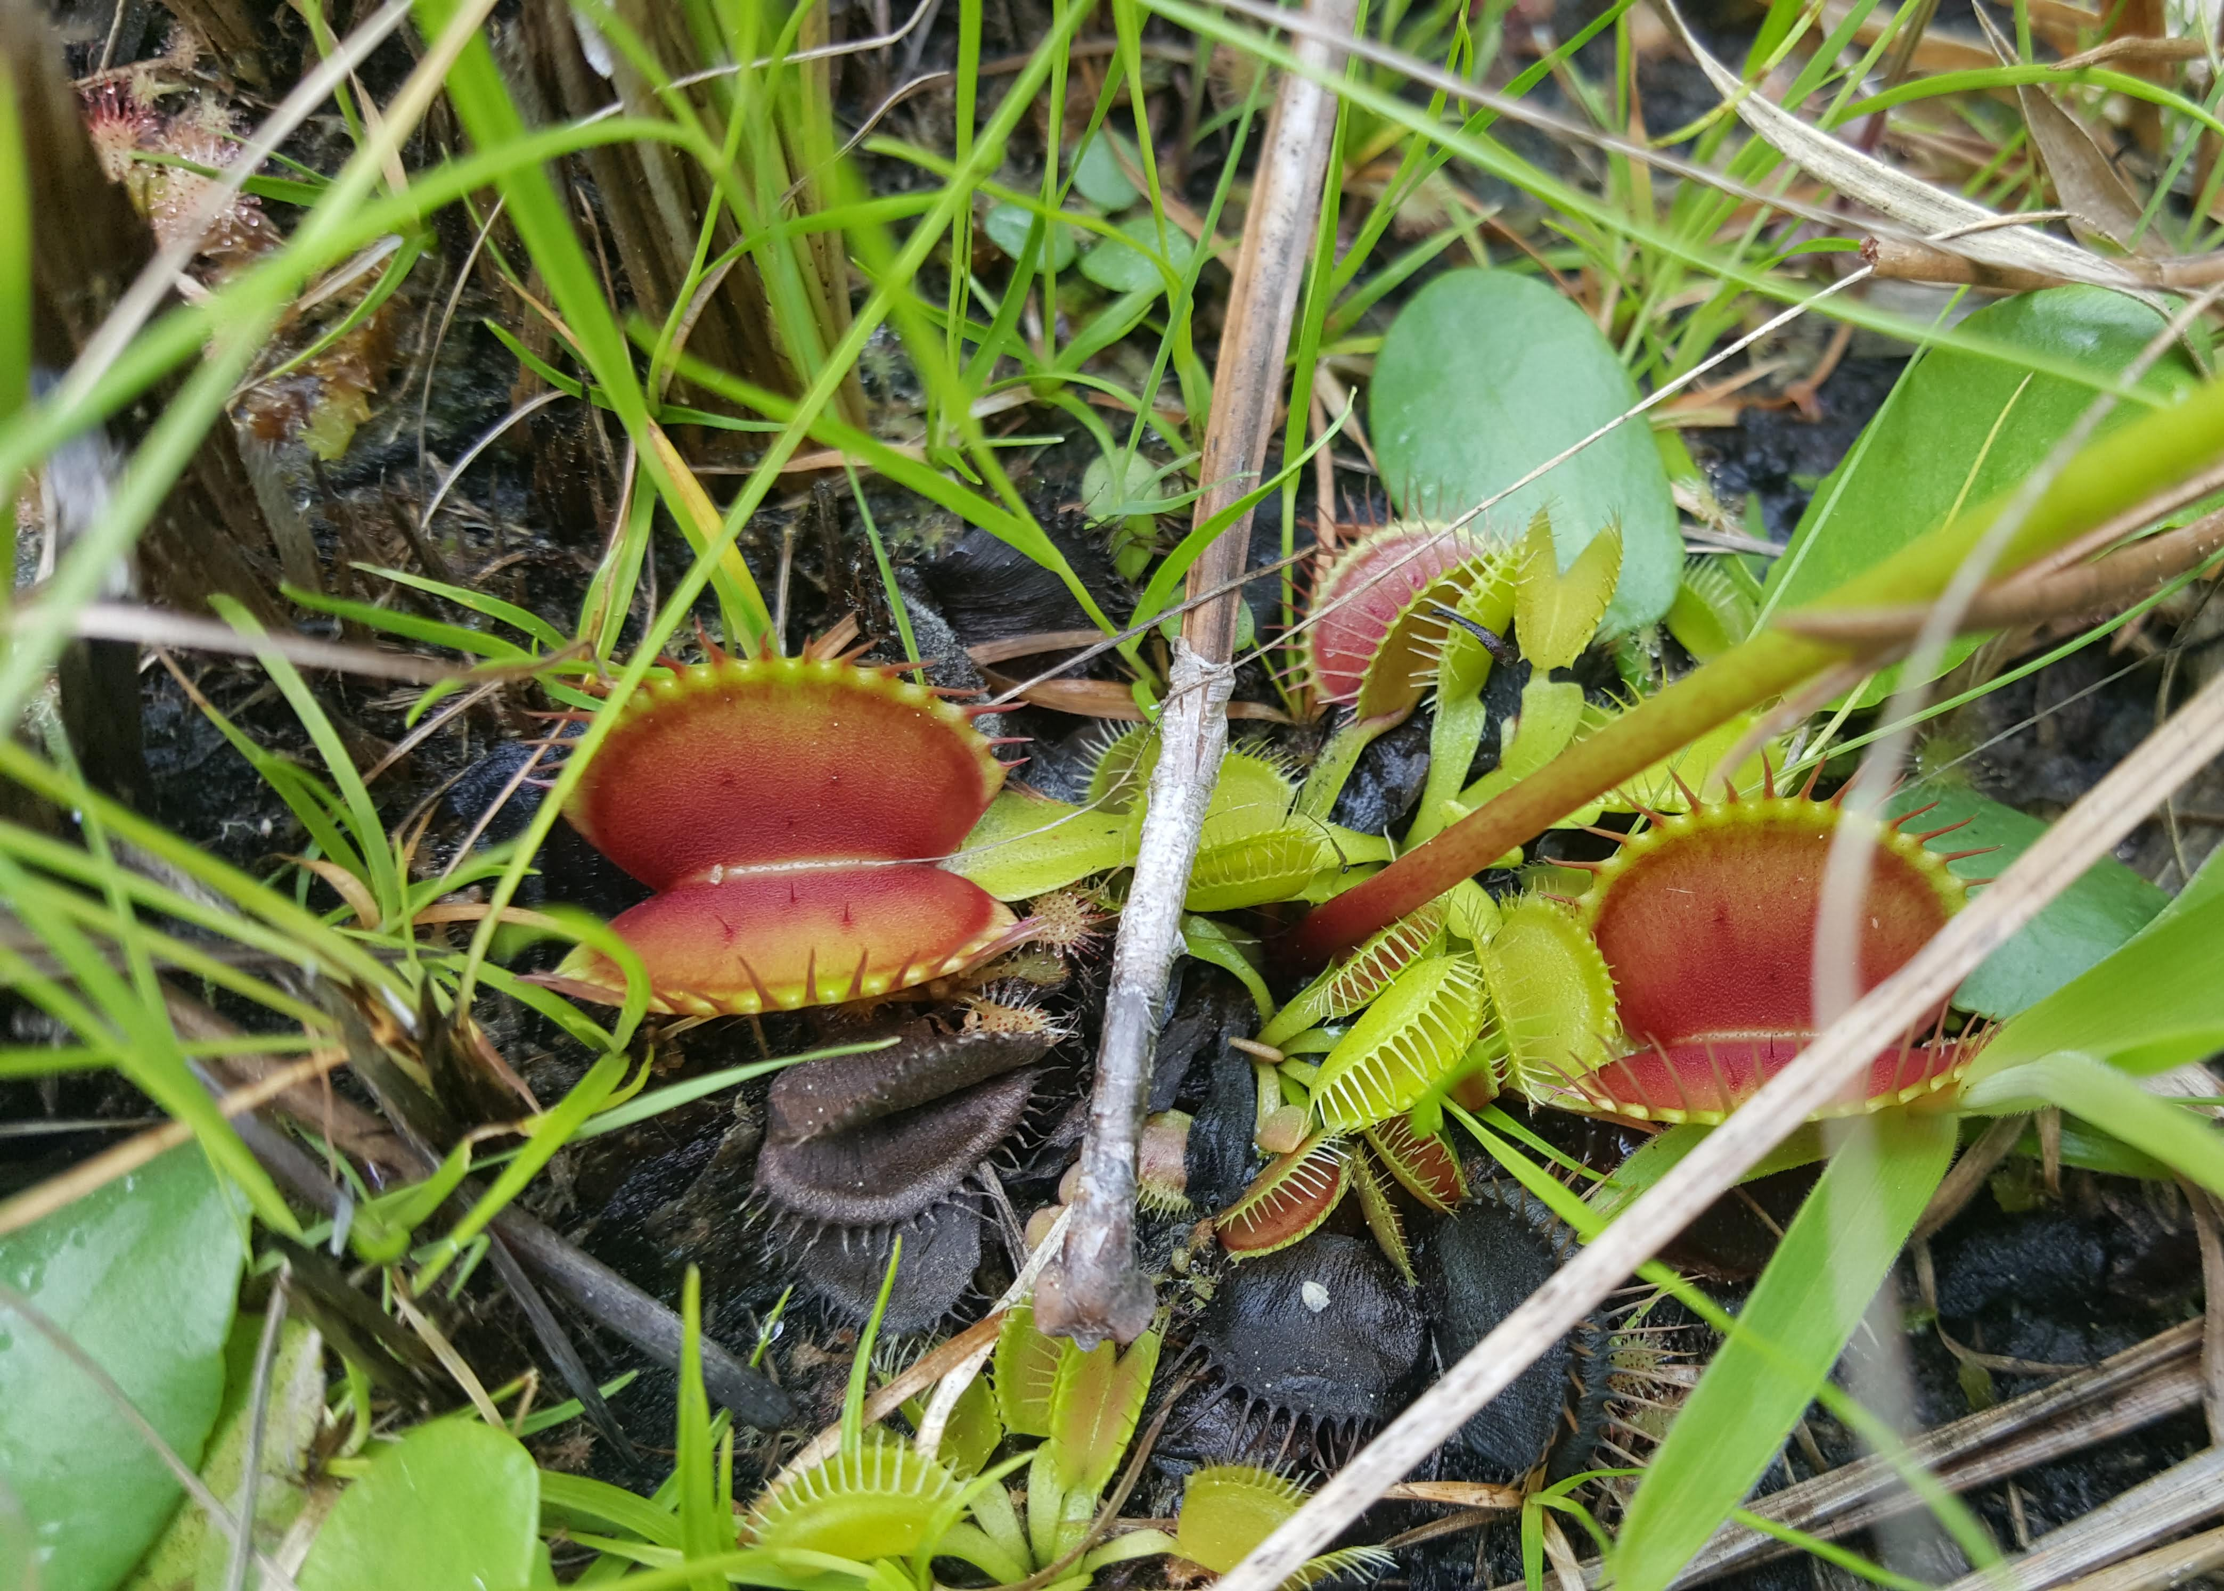

Slide 48
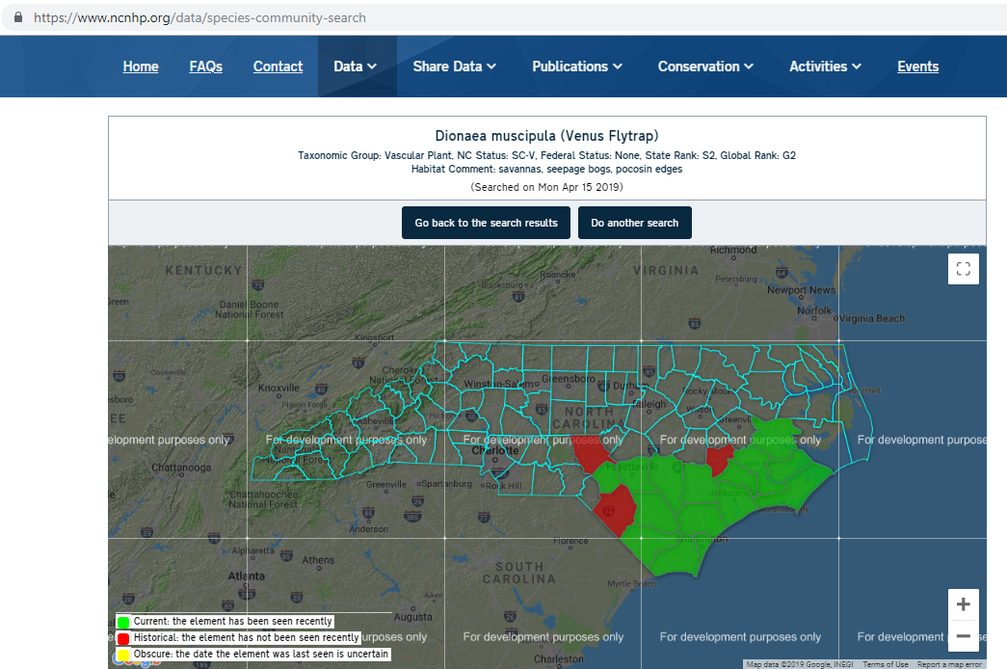

Slide 49
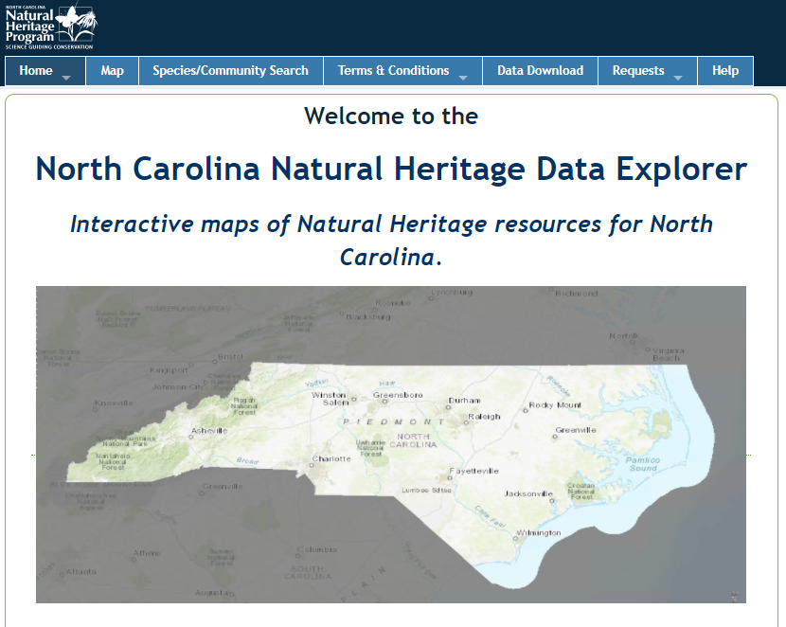
Natural Heritage Data Explorer
https://ncnhde.natureserve.org/
Notes:
Before I conclude this presentation, I would like to point you towards our Natural Heritage Data Explorer website.

Slide 50
www.ncnhp.org

Slide 51
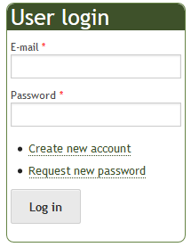
Natural Heritage Data Explorer

Slide 52
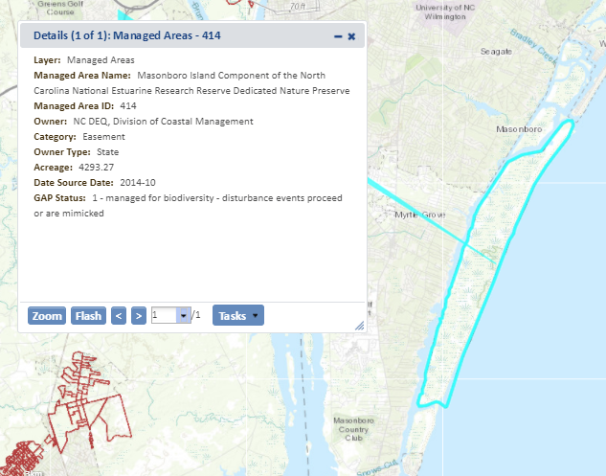
Natural Heritage Data Explorer

Slide 53
Natural Heritage Data Explorer

Slide 54
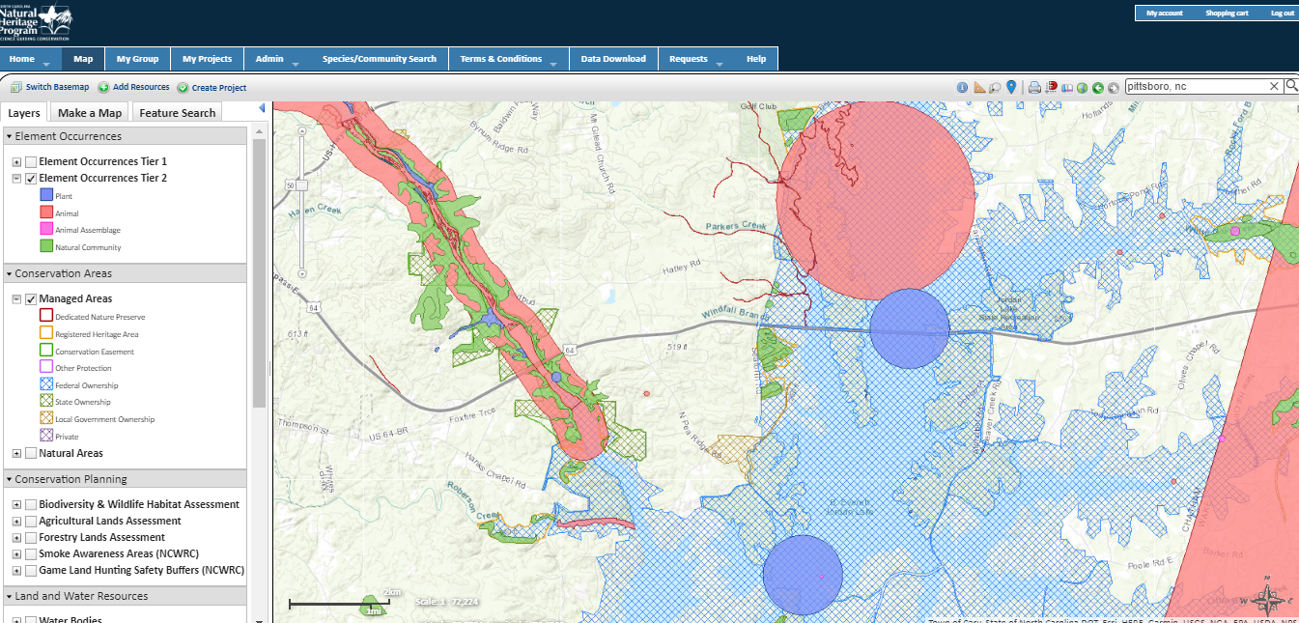

Slide 55
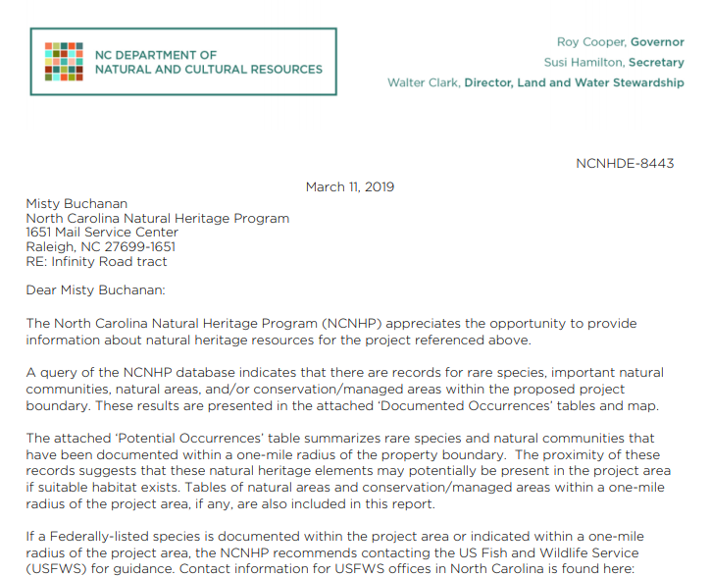
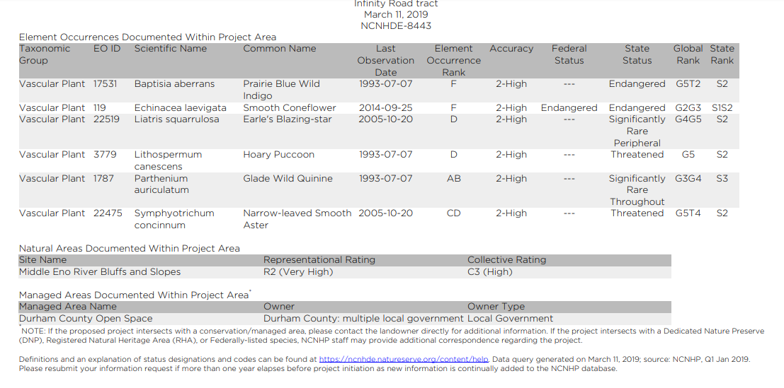
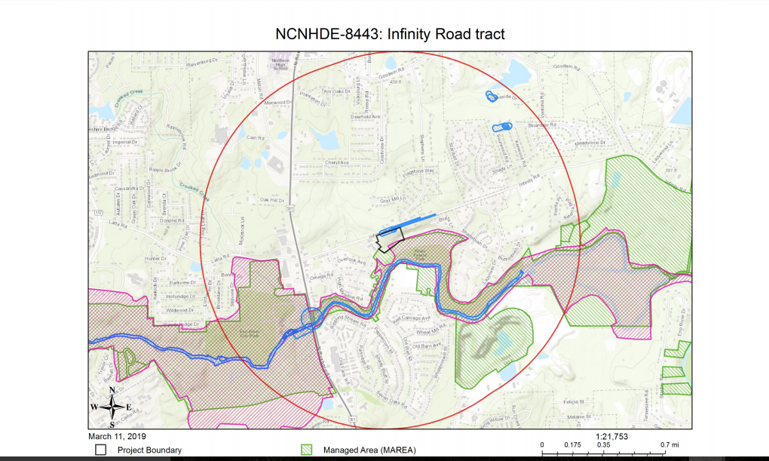

Slide 56
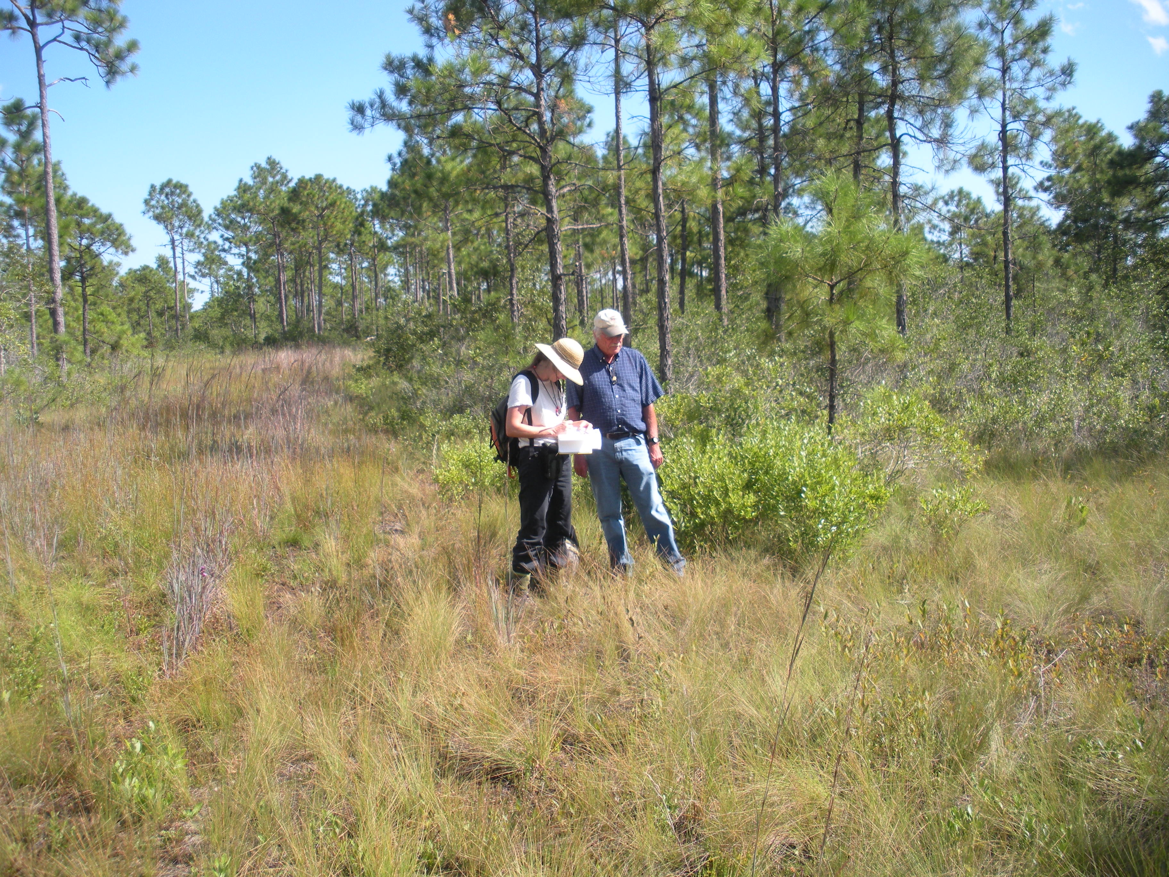
Questions?

Slide 57
Questions:
Brenda Wichmann
Division of Land and Water Stewardship
Natural Heritage Program
Brenda.Wichmann@ncdcr.gov

Slide 58
Michaux’s Sumac (Rhus michauxii)
NC populations predominantly in Sandhills, where it is associated with longleaf pine forest
S2G2G3
NC and US Endangered

Slide 59
Michaux’s Sumac
by Bruce Sorrie

Slide 60
Natural Heritage Natural Area :
An area of land or water important for preservation of North Carolina’s biodiversity.
Conservation is the primary objective.
Natural area records are used to:
Evaluate qualification for state nature preserves.
Focus conservation action.

Slide 61
Gathering and storing information
We collect information from many sources:
NHP biologists
Partner agencies
Consultants
Researchers
Students
Naturalists
A major source of information comes from county inventory program

Slide 62
Animals in North Carolina
- 706 rare species
- 120 native mammals
- 475 native birds
- 115 species endemic to NC
- 25 species extirpated from NC
Southern Hognose by Ryan Elting

Slide 63
Sandhills Salamander
Endemic to North Carolina
small streams in the Sandhills
Notes:
Fascinating creatures are endemic to our state.

