Slide 1
Joint Chiefs Update
NC Longleaf Summit

Slide 2
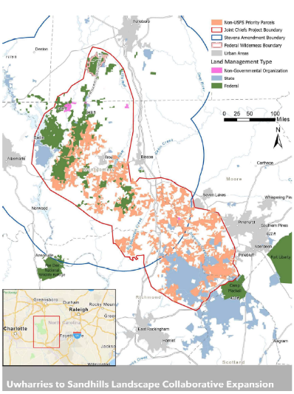
What is Joint Chiefs
Reallocation of funds from USDA
  Chief of:
    US Forest Service
    NRCS

Slide 3
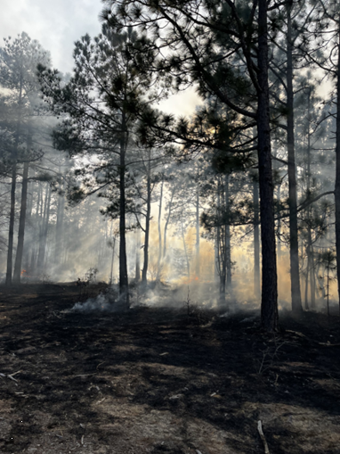
Landscape-Scale Priorities and Objectives – 2022-2024
  Reduce and mitigate wildfire threats to communities and landowners
    Reduce wildfire fuel loads by at least 166.5 thousand tons
  Protect water quality and supply for communities and industry
    Restoration of open canopy pine forest
  Improve habitat conditions for at-risk species
    Restore populations of fire-dependent species

Slide 4
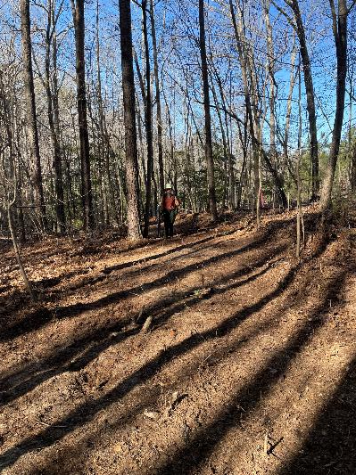
Joint Chiefs 2022 - 2024 Accomplishments
Ember Alliance Crew
  115 ac mechanical treatment
  12,513 acres of prescribed burning
  413 acres of silvicultural treatments
  72 ac longleaf planting
NRCS Cost-Share/QF TA ($893,926.48):
  90 landowners reached
  232 landowner contacts
  74 site visits
  48 management plans/cost share contracts
  >10,000 acres of private land prescribed burning
NCFS
  EA crew allowed NCFS extra capacity on 5,099 ac
  SA burns reduced from 8,000 ac to 6,000

Slide 5
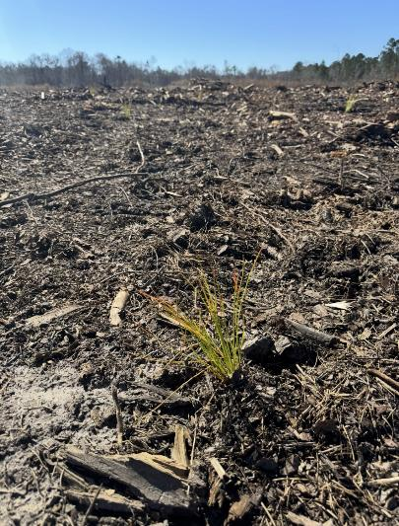
Successful Joint Chiefs Proposal 2025-2028
Objectives
  Reduce and mitigate wildfire threats to communities and landowners
  Protect water quality and supply for communities and industry
  Improve habitat conditions for at-risk species

Slide 6
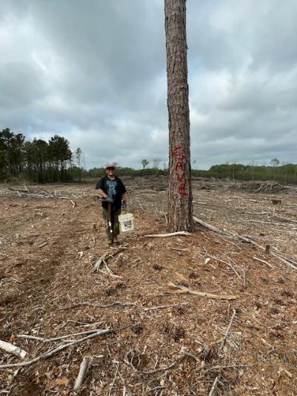
Successful Joint Chiefs Proposal 2025-2028
Strategy
    Dedicated pot of EQIP funding for private landowner habitat improvements
    Increase RxB through continued partnership w/EA
    Host critically needed fire and land management training sessions and mentorship opportunities for Catawba Nation

Slide 7
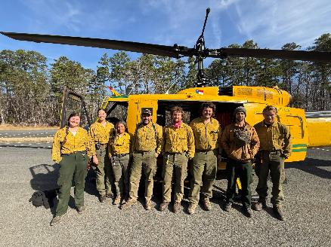
Successful Joint Chiefs Proposal 2025-2028
Planned Deliverables
    Private Land
      Dedicated pot of EQIP funding
      Restore or improve 3,000 ac
      2,500 ac of NCFS RxB
    Uwharrie National Forest
      Improve or restore 24K ac
      600 ac of non-native treatments
      225 ac TSI
      90 ac LL planting
      3 miles of eroded trail maintenance
    Outreach
      Catawba Nation workforce development
      1 learn and burn annually
      1 education and outreach event annually

