Slide 1

The Eastern NC Sentinel Landscape Partnership:
Update
NC Longleaf Pine Summit
DECEMBER 3, 2025
Chris Baillie
ENCSL Partnership Coordinator/Resilience Specialist
Legacyworks Group

Slide 2
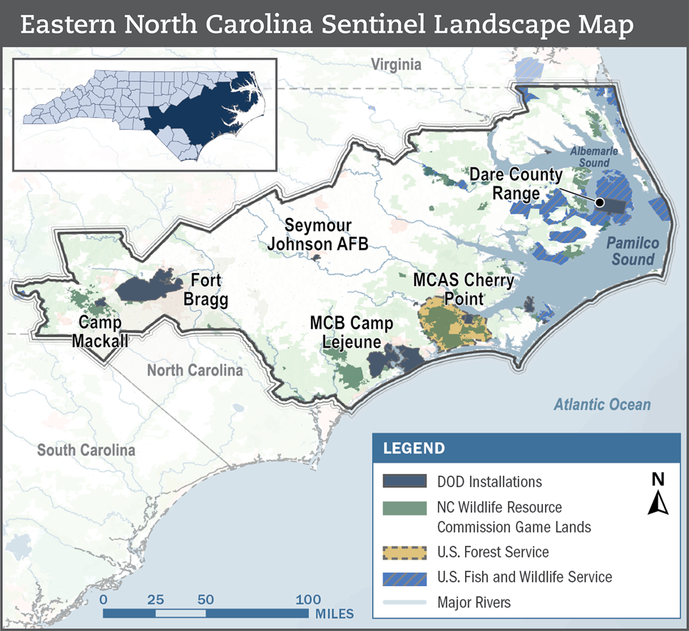

ENCSL (est. 2017)
Spanning 11 million acres across a 33-county region in North Carolina’s Coastal Plain and Sandhills, the Landscape is anchored by seven military installations and ranges - Fort Bragg Army Base/Camp Mackall, Seymour Johnson Air Force Base, the Dare County Range, Marine Corps Base Camp Lejeune/Marine Corps Air Station New River, and Marine Corps Air Station Cherry Point.
Image Credit: REPI

Slide 3
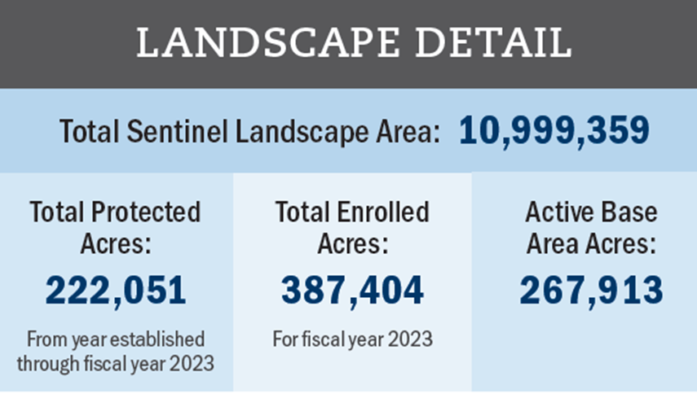
ENCSL Partnership
  12 Federal Partners
  9 State Partners
  11 Local Partners and Collaborating Regional Partnership
  25 Private Partners
https://sentinellandscapes.org/landscapes/eastern-north-carolina/

Slide 4
Landscape Goals
Sustain and enhance testing and training mission capabilities for North Carolina’s military installations and ranges through compatible land use, as well as working land productivity and resilience
1
Enhance fish and wildlife habitat on public and private lands, increasing their resilience to human and natural disturbances
2
Enhance the resiliency of military installations, defense supporting communities, and infrastructure of shared military and civilian importance to natural hazards
3
Increase awareness of the Eastern North Carolina Sentinel Landscape’s mission, its value to partners’ stakeholders, and opportunities for expanded stakeholder participation
4

Slide 5
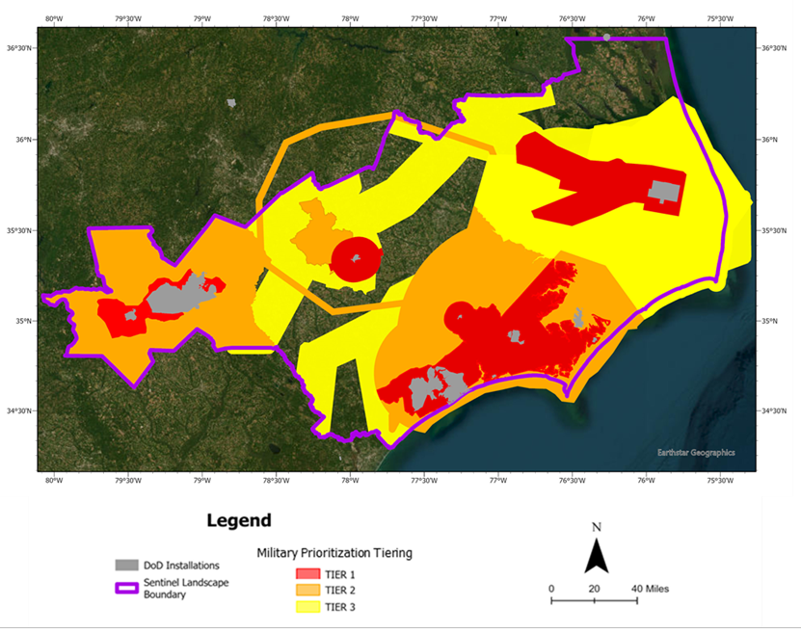
ENCSL Partnership-Military Priority Geography Tiering
  Tier 1: Highest likelihood of direct military mission sustainment benefits.
  Tier 2: Direct/indirect military mission sustainment benefits.
  Tier 3: Primary indirect military mission benefits.

Slide 6
ENCSL Partnership: Key Acquisitions
  Natural and Working Land Conservation
  Habitat Restoration
  Landowner Technical Support and Resource Delivery
  Vulnerability Assessments, Resilience Planning, and Hazard Mitigation Project Implementation

Slide 7
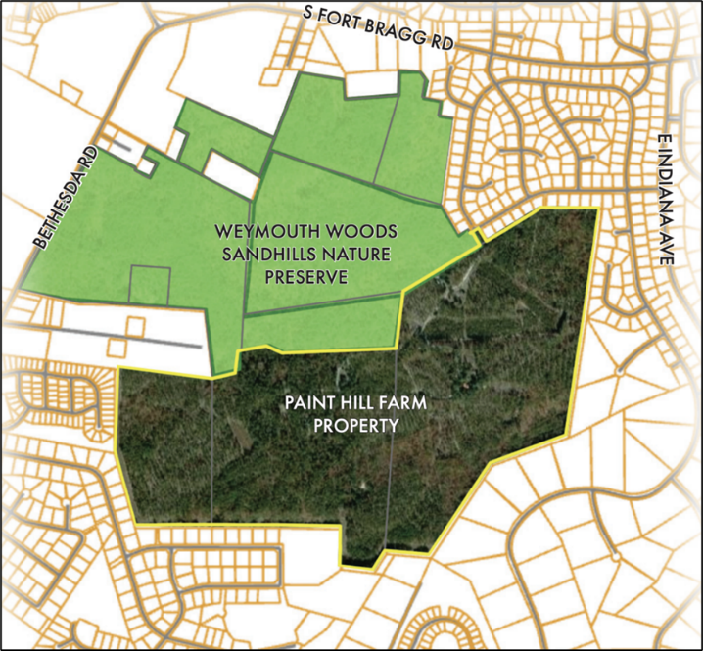






ENCSL Partnership: Partners’ Key Acquisitions
Title: Paint Hill Farm
Partners: The Nature Conservancy, NC Division of Parks and Recreation, NCLWF, US Army-Fort Bragg, DOD REPI, DOI LWCF
Summary: Protecting a unique property of ecological and military significance
Image Credit: TNC

Slide 8
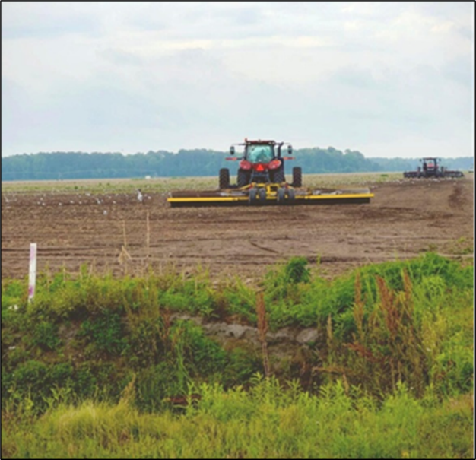



ENCSL Partnership: Partners’ Key Easements
Title: McCotter Promised Land Opportunity Zone
Partners: Working Lands Trust, Marine Corps Installations-EAST, NC Department of Agriculture, DoD REPI
Summary: Largest conglomerate ag land easement funded with state and federal funding in NC history. Preserving operational capabilities for America’s Air Station (MCAS Cherry Point)
Image Credit: WLT

Slide 9
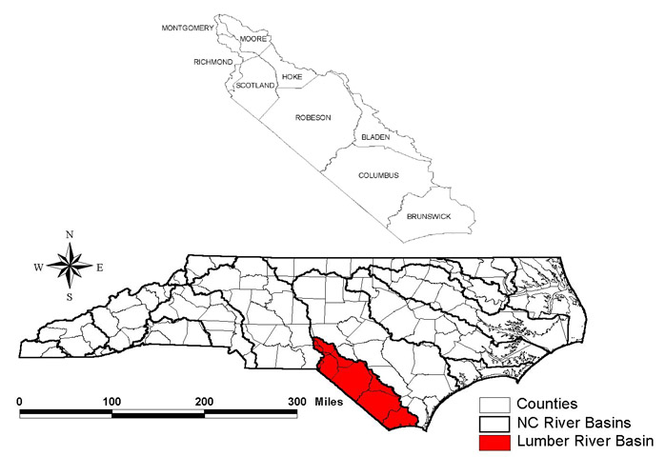

ENCSL Partnership: Partners’ Key Easement Opportunities
Title: Land of the Pines: Protecting Critical Conservation Areas and Working Lands in the Lumber River Watershed
Partners: NCDA, USDA NRCS
Summary: $5M in NCDA funds leveraging $10M in USDA NRCS RCPP funds to implement easements in critical conservation areas in the Lumber River Watershed.

Slide 10
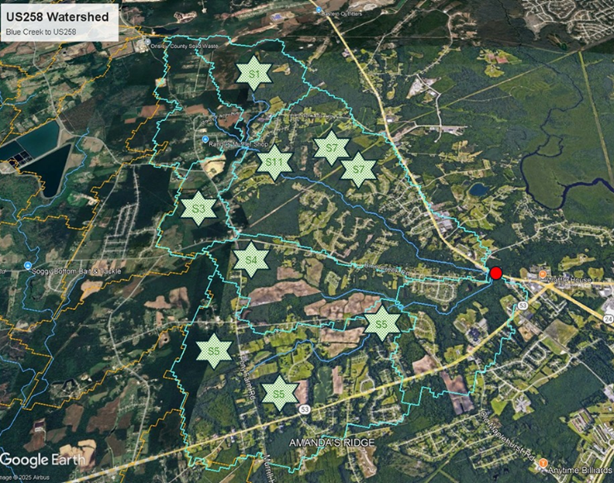





ENCSL Partnership: Partners’ Landowner Outreach, Technical Support and BMP Resource Delivery
Title: Advancing Community-Led Resilience Initiatives and Co-Designed Conservation Practices in a Sentinel Landscape
Partners: NCFSWC, NFWF, WLT, EDF, Lumbee Tribe, multiple SWCDs
Summary:
Augment underserved landowner access to conservation and resilience programming.
Community-led resilience planning.
BMP identification & implementation.
Image Credit: Dan Line

Slide 11




ENCSL Partnership: Partners’ Comprehensive Resilience Planning
Title: Marine Corps Base Camp Lejeune/Marine Corps Air Station New River Military Installation Readiness Review
Partners: Onslow County, City of Jacksonville, City of Swansboro, DoD OLDCC, MCB Camp Lejeune, MCAS New River
Summary:
Identify defense supporting community vulnerabilities.
Develop green and gray infrastructure solution sets.
Create project implementation pathways.
Image Credit: MCB Camp Lejeune

Slide 12



ENCSL Partnership: Near Term Priorities
Building Capacity
Innovative Finance and Increasing Investment
Enhanced Advocacy

Slide 13
Questions?
Chris Baillie
Chris@legacyworksgroup.com

