Slide 1
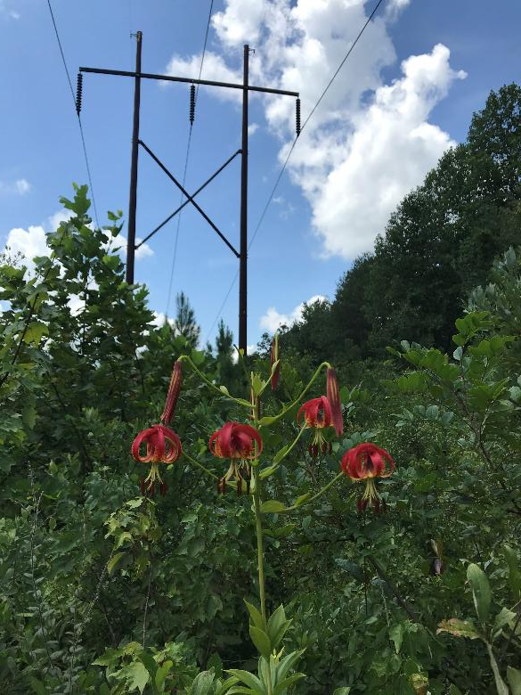
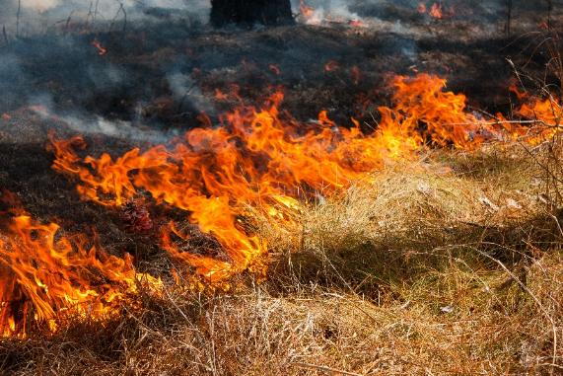
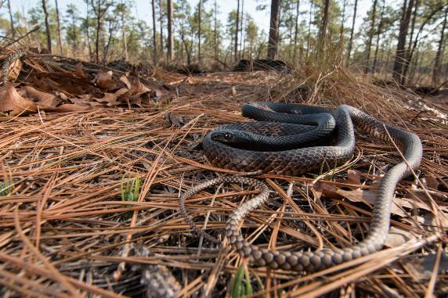

Powering Biodiversity
Nathan Shepard, Eastern Region Field Biologist www.ncnhp.org
Notes:
But the state of North Carolina is really a magical place.

Slide 2
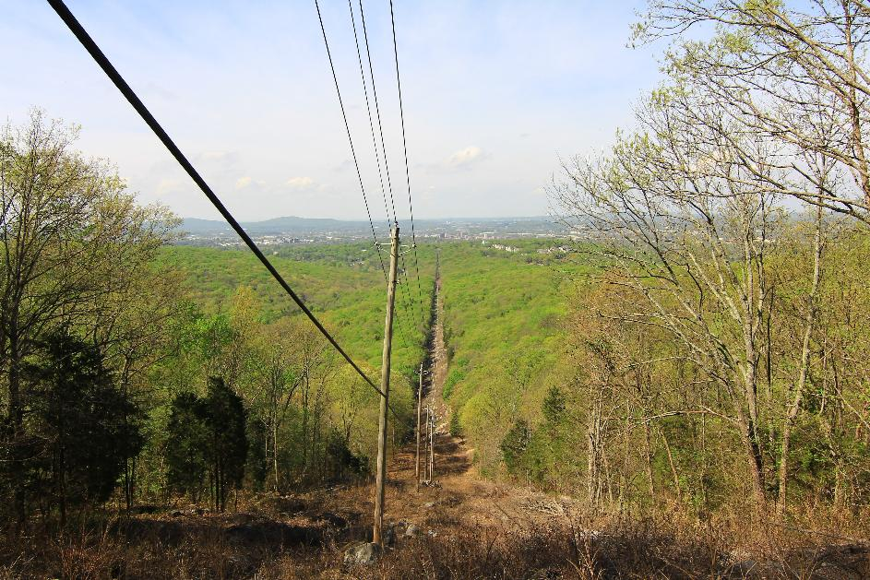
Linear Fragmentation (Edge Effects)
Basic Types:
  Rights-of-way (Powerlines, pipelines)
  Roads
  Trails
  Ski slopes
  Railways
Alterations
  Exposure
  Wind
  Alter plant communities
  Soil moisture

Slide 3
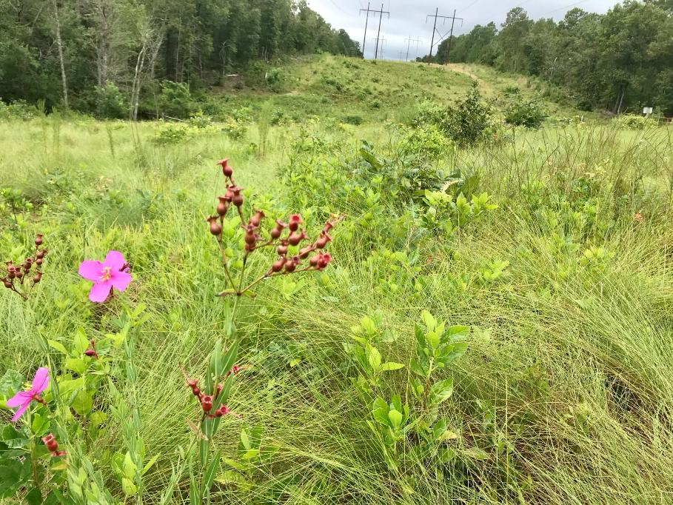
Regional and Global Wildlife Success
Global Impact
Early Successional Habitats
Corridor connecting populations
Pollinator richness
Climate Change Adaption
Creating suitable habitat

Slide 4
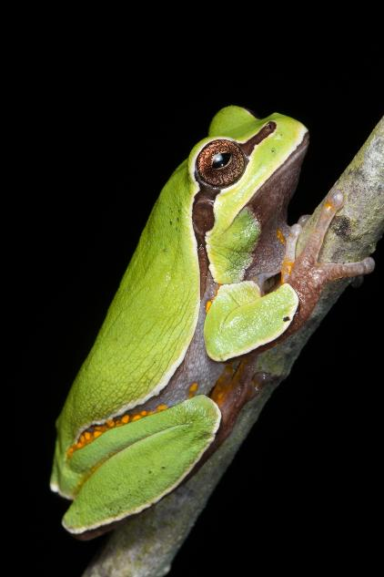
Regional Benefits
Keeping fire maintained ecosystems open
  Providing habitat, intact natural communities
  Corridor for movement and dispersion
  Specific habitat for breeding, nesting, foraging space
  Source populations of rare plants
  Population stronghold
Support impacted habitat
Management can partially replicate natural processes
Prolong population survival

Slide 5
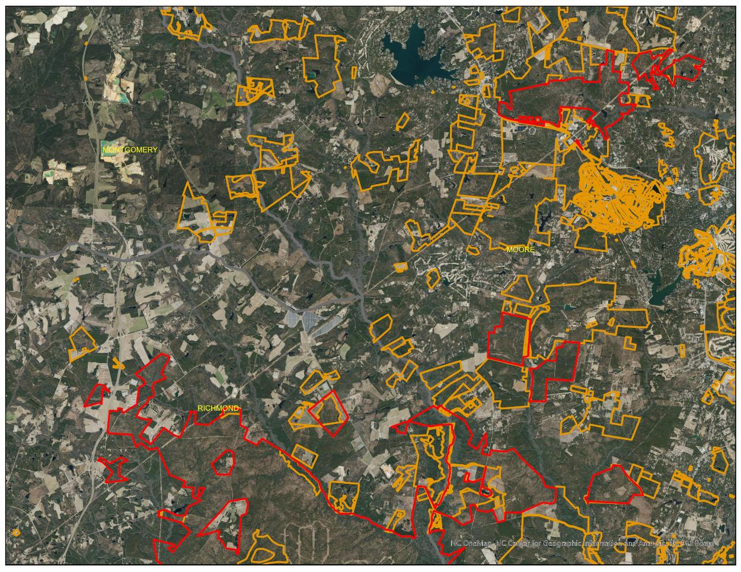

Slide 6
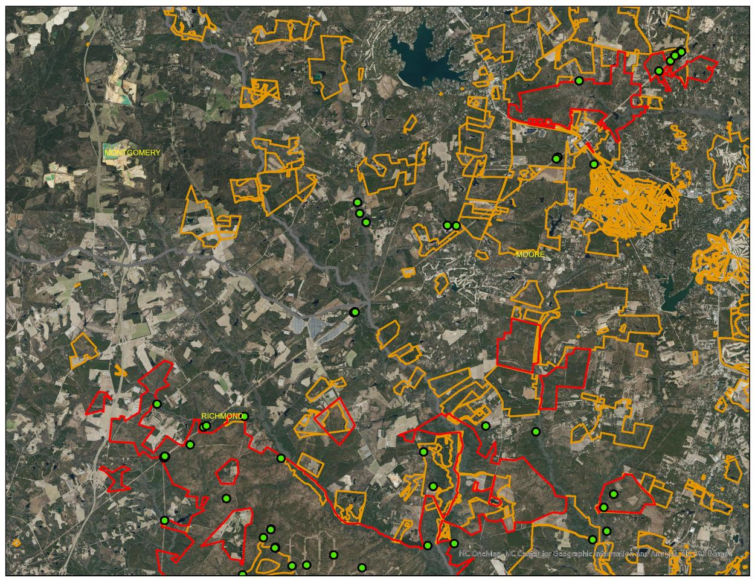

Slide 7
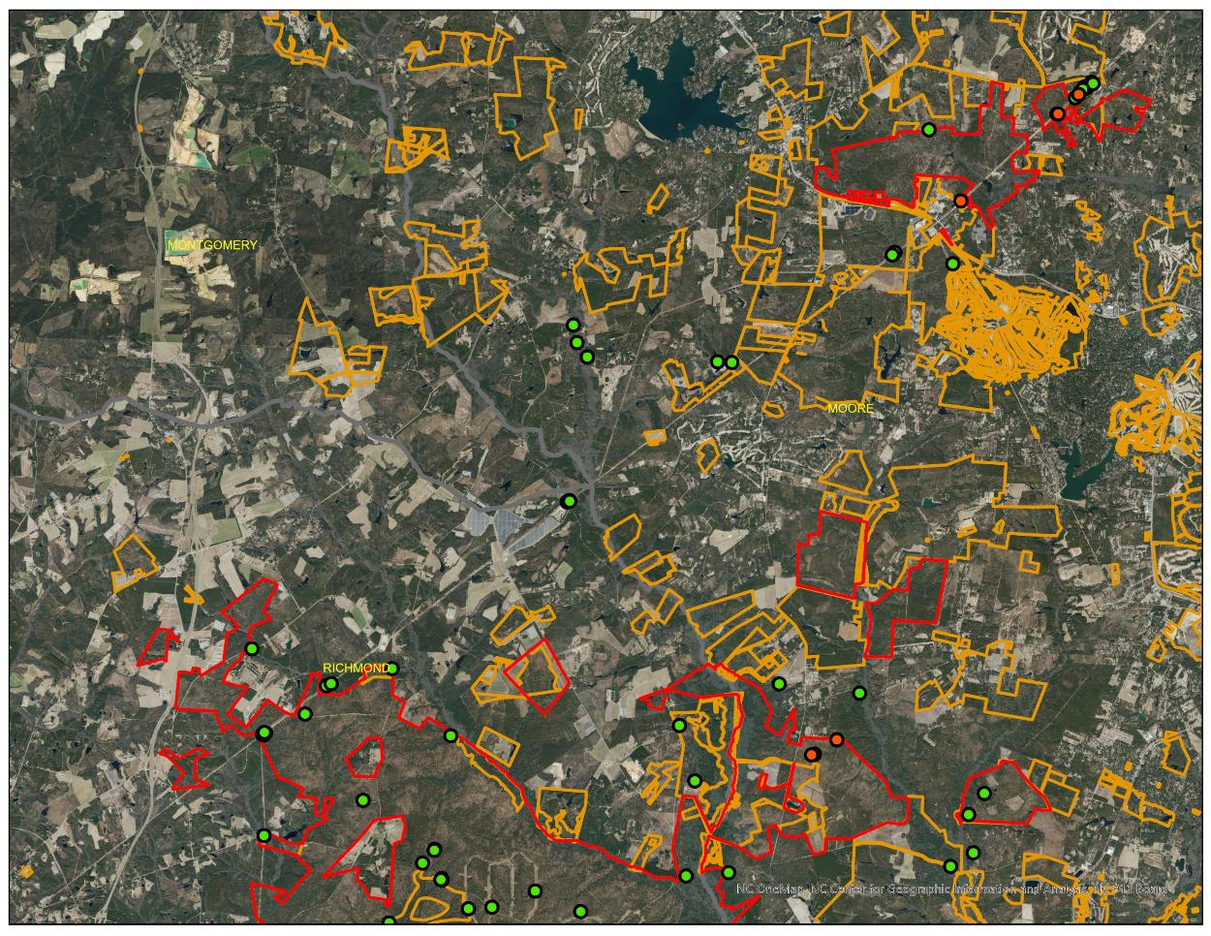

Slide 8
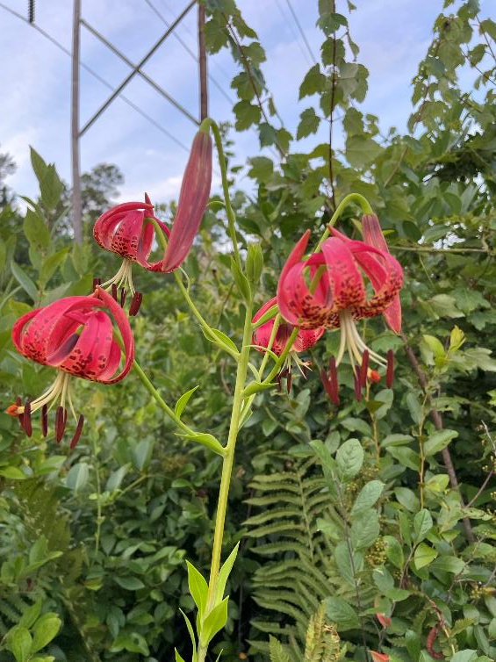
Fire Lily (Lilium pyrophilum)
Seepage, streamhead habitat
Flowers mid-summer
Long, narrow leaves in whorls
Requires open canopy habitat
May not flower each year
Regional endemic
REQUIRES FIRE

Slide 9
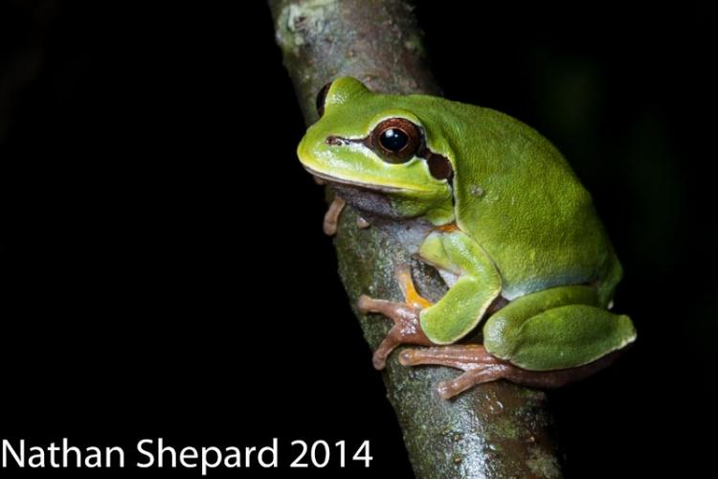
Pine Barrens Treefrog (Hyla andersonii)
Riparian habitat
  Streamhead Pocosin
  Sandhill Streamhead Swamps
  Seepage slopes
Breeding Season
  Late Spring, Early Summer
Females lay 2-3 clutches of ca. 200 eggs
Require canopy opening for breeding
3 disjunct populations
REQUIRES FIRE

Slide 10
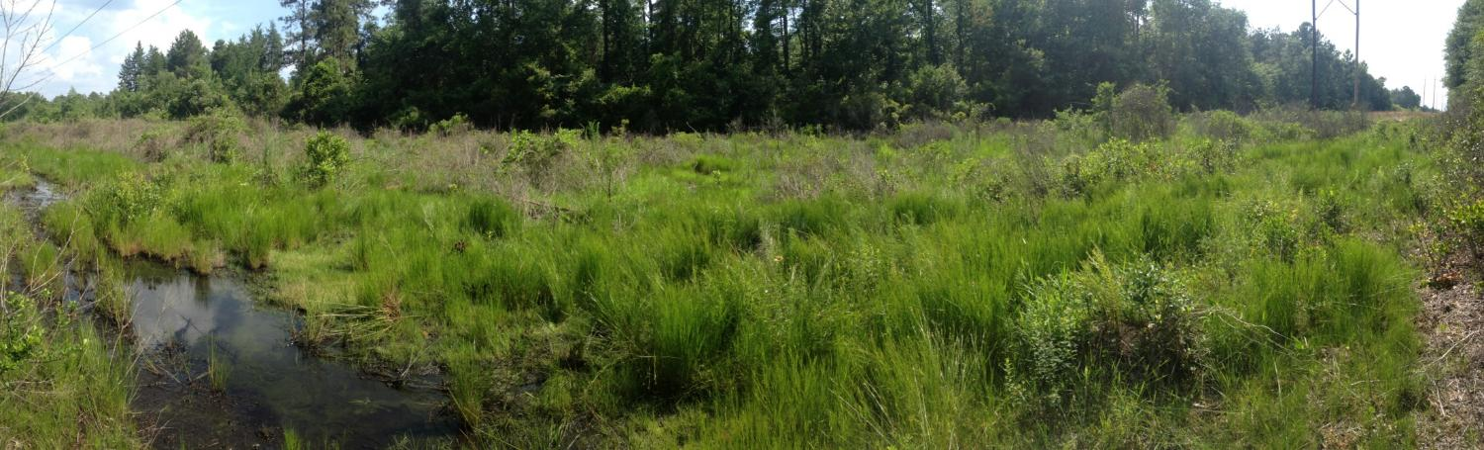

Slide 11
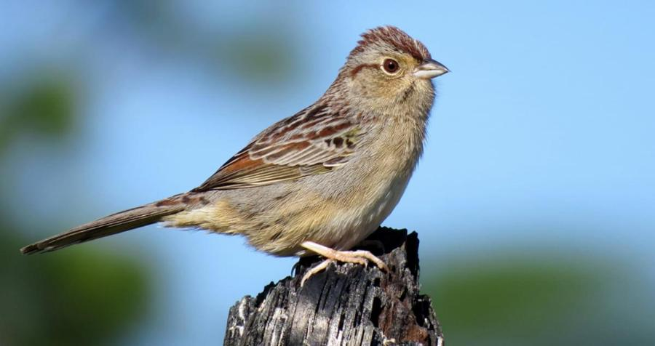
Bachman’s Sparrow (Peucaea aestivalis)
Key habitat
  Dry Longleaf Pine/Oak Scrub
Breeding season starts late spring
1-2 clutches, 3-5 eggs
Ground nesting
REQUIRES FIRE

Slide 12
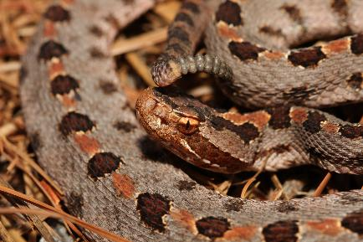
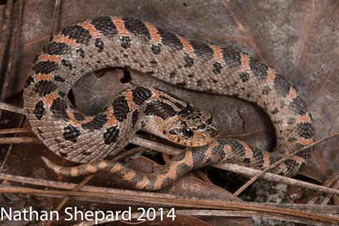
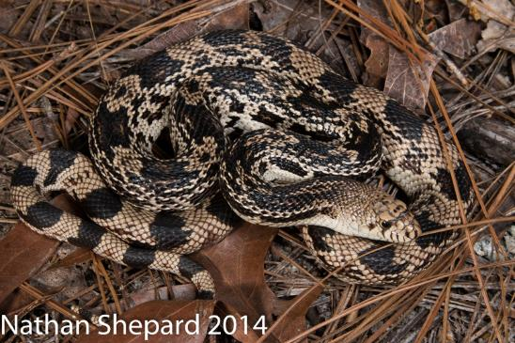
Upland Snakes
Key habitat
  Dry Longleaf Pine/Scrub
Breeding Season
  Late Spring, Early Summer
Uses powerlines for movement and FOOD
Corridor between populations
Nest sites
REQUIRES FIRE

Slide 13
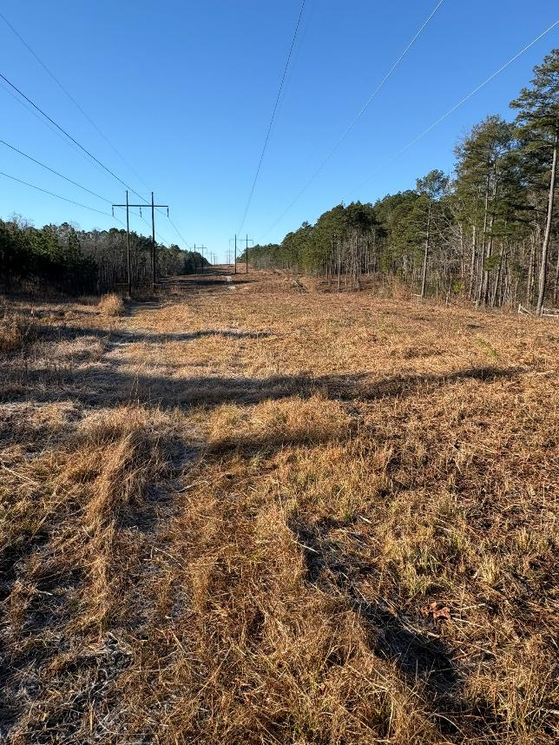
Management
Management Options
  Mow, Chemical, fire
Management Considerations
  Time, labor, ground sensitivity
Goals – extend plant populations into adjacent forests
Signage
MOU agreements
Priority Sites
RISKS – invasive species highways

Slide 14
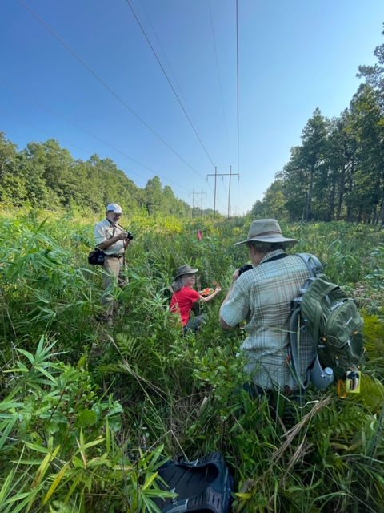
Questions?

