Slide 1
RCW Conservation Strategy
for North Carolina
September 2026 – NCSCP
Nicole Sikula
USFWS, Acting Deputy Field Supervisor
Raleigh Ecological Services Field Office

Slide 2
Outline
Purpose and Need
Timeline
Overall Structure of the Strategy
Standard RCW AMMs (Avoidance & Minimization Measures)
Conservation-focused Consultation Options
Strategy’s Conservation Measures
Strategy’s Mitigation Measures
Effectiveness Monitoring
An RCW Fund

Slide 3
Purpose and Need
Prioritize our greatest needs for expanding NC RCW populations.
Provide streamlined RCW consultation options for small projects that may “take” RCWs.
Develop a means to implement prioritized RCW conservation actions using offsets from the streamlined consultation process.

Slide 4
Timeline
August 27, 2025 – Internal Mtg with USFWS Region & RCW Recovery Coordinator
January 27, 2026 – Virtual Mtg with NC RCW experts
January 27, 2026 – Rough draft provided to RCW experts for review
May 6, 2026 – Version 2 provided to internal USFWS Region 4 RCW experts
August 4, 2026 – Version 3 provided to RCW stakeholders for final review
Hope to finalize Strategy and its Programmatic BO by end of calendar year.

Slide 5
Overall Structure of the Strategy
Introductory Sections 1-4
NC Conservation Priorities, Section 5
RCW Standard AMMs, Section 6
Conservation-focused Consultation Options (CFCOs), Section 7
  Strategy’s Conservation Measures (for the Service’s PBO)
Effectiveness Monitoring, Section 8

Slide 6
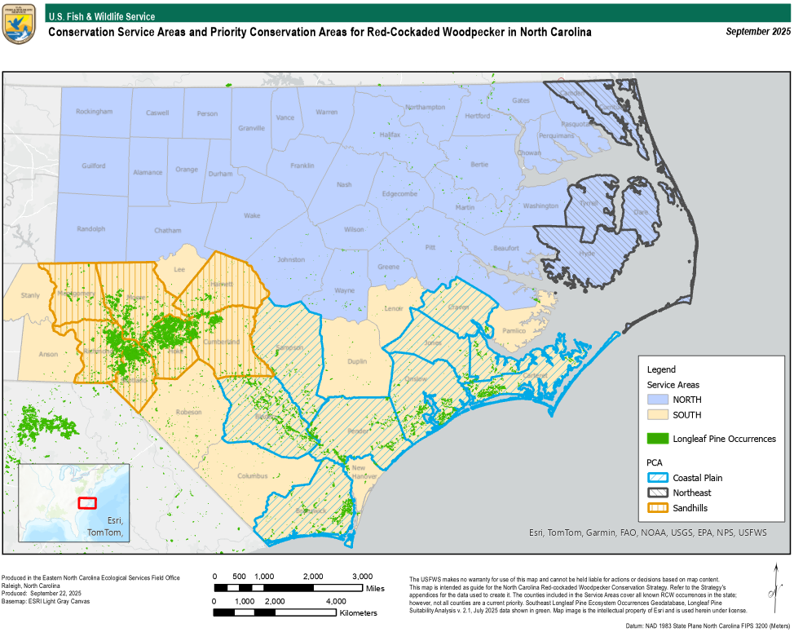
Priority Conservation Areas

Slide 7
Conservation Priorities
Northeast PCA: Assess the current baseline and future viability of Northeast North Carolina (NENC) populations and identify viable recruitment habitats. Enhance and augment viable habitats.
Coastal Plain PCA: Assess protected lands’ capacity for sustaining RCW populations. Increase and expand current populations using strategic recruitment and habitat enhancement. Strengthen protections for vulnerable populations and maintain habitats with routine prescribed fire.
Sandhills PCA: Maintain the combined East and West Sandhills population by strengthening connectivity and seek opportunities to further expand protected and occupied habitats.

Slide 8
Draft Conservation Priorities
PCA | Assess | Enhance | Expand | Augment | Maintain
Northeast | *Partner with grant opportunities to fund a full assessment of the current status and habitat viability of NENC recovery populations. Determine if Dare County Bombing Range pilots could assist with helicopter surveys on: Alligator River & Pocosin Lakes NWRs, Dare County Bombing Range, Gull Rock & North River Game Lands, P3, and Buckridge Coastal Reserve. *Identify high ground habitats within recruitment distance of active clusters. | *Enhance identified recruitment habitats as needed on USFWS NWRs, NCWRC Game Lands, Dare County Bombing Range, NCDEQ Buckridge Coastal Reserve, and other protected areas. *Enhance Dare County Bombing Range habitats to prepare for translocation. | *Incentivize RCW conservation on high-ground habitats in Currituck, Dare and Tyrrell Counties. | * Evaluate genetic diversity and develop and implement a PCA translocation plan. *Translocate RCW to Dare County Bombing Range as appropriate in partnership with the Virginia USFWS | *Establish a drone helicopter monitoring program in partnership with UNC Chapel Hill and Dare County Bombing Range. *Promote land management practices that preserve large live pine trees.
Coastal Plain | *Survey number of active cavities and amount of nesting and foraging habitats on: Croatan NF, Holly Shelter & Angola Bay Game Lands, Boiling Spring Lakes (BSL), Plant Conservation Reserve, 421 Sand Ridge, and Bladen Lakes. *Identify areas where pine trees can be planted in protection for 100 years. | *Partner with Croatan NF to increase RCW populations by enhancing habitat. *Partner with NCWRC to enhance habitats as needed on Game Lands. *Partner with NCDNCR to enhance/maintain habitats on Land & Water Fund Project lands and State Parks as appropriate. *Partner with NCDA and the City of Boiling Spring Lakes to enhance habitats as needed. *Partner with NCFS & NCWRC to enhance habitat on Bladen Lakes State Forest. | *Utilize translocation or artificial cavities for strategic recruitment into enhanced habitats and dispersal corridors. *Incentivize RCW dispersal corridors among Croatan NF, Camp Lejeune, and Holly Shelter Game Lands in County and City/Town open spaces within Onslow and Pender Counties. * Encourage Camp Lejeune’s RASP to reach recovery goal off-base, incentivizing RCW dispersal on Stone’s Creek and Bear Garden. *Incentivize RCW a dispersal corridor from MOTSU/BSL to Green Swamp and through existing managed areas in Brunswick, Bladen, Pender and Sampson Counties, including 421 Sand Ridge, to Bladen Lakes State Forest. | *Evaluate genetic diversity among populations and develop and implement a PCA translocation plan. *Evaluate potential to translocate birds to Suggs Mill Pond Game Land, Green Swamp Preserve, Jones Lake State Park, Singletary Lake State Park, and Bladen Lakes State Forest. | *Evaluate and strengthen land use protections for vulnerable populations. *Establish a prescribed fire strike team for the Coastal Plain with highly skilled burn boss able to manage urban interfaces. *Establish routine monitoring and maintenance at any new corridor clusters. *Develop an effective RCW public outreach campaign so that property owners understand how to conserve RCW in developing areas.
PCA | Assess | Enhance | Expand | Augment | Maintain
Sandhills | *Assess amount of suitable habitat on Uwharrie NF and viability of RCW translocations. *Partner SEI, TNC, and private landowners to survey RCW nesting and foraging habitats on SHA lands. *Identify historic clusters that may be restored. *Identify areas where pine trees can be planted in protection for 100 years. | *Partner with NCWRC, the US Army, USFS, NCDA at McCain Forest and Eastwood, TNC, Three Rivers Land Trust, and State Parks to maintain/enhance habitats. *Incentivize RCW habitat enhancements on private lands. *Restore identified historic clusters. *Plant pines in identified areas for 100-year growth. | *Continue to capitalize on opportunities to fill gaps between East and West Sandhills. *Support western expansion in collaboration with the Uwharrie Corridor project. *Support NCWRC in restoring habitat connecting Sandhills GL blocks B to C. *Incentivize RCW conservation easements in ENCSL priority areas in Harnett, Hoke, Moore, Richmond, and Scotland Counties. | *Evaluate need and opportunity to translocate RCWs to the Uwharrie NF where suitable habitat is present. | * Establish routine monitoring and maintenance at any new corridor clusters. *Maintain capacity for controlled burning and resource sharing among partners. *Reduce use of and dependence on artificial cavities in viable populations. *Develop an effective RCW public outreach campaign so that property owners understand how to conserve RCW in developing areas.

Slide 9
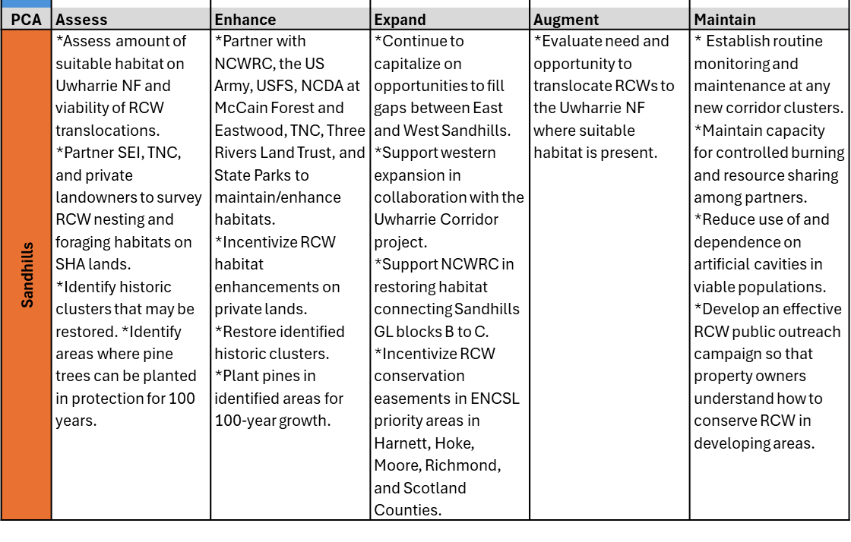
Draft Conservation Priorities

Slide 10
Standard RCW AMMs
From the 2003 Recovery Plan
Distance to Active Cavity Tree | Avoidance & Minimization Measures
0 ft | Avoid
50 ft | Avoid disruption (e.g., heavy machinery, vehicles) during Apr 1-Jul 31 breeding season. Keep clear of structures/equipment. Remove all hardwoods, shrubs, and ornamentals.
200 ft | Avoid removal of pine trees that meet or exceed the minimum size for the habitat type.
0.25 mi | Recommend: Maintain at least 75 ac of mature, pine forest with stands not separated by ≥ 200 ft. Conserve 30-40 sq ft per acre of large live pine basal area.
0.5 mi | Where the above is already lost, minimize further loss by maintaining the standard within its foraging partition. Ideally, maintain ≥ 120 unfragmented acres and minimize habitat loss to < 50% of existing pine forest.
6 km | Avoidance is accomplished by performing a species survey to verify absence of the RCW within a 0.5 mi radius of the project perimeter.

Slide 11
Standard RCW AMMs
Additional Conservation Measures
Distance to Active Cavity Tree | Minimization Measures
0 ft – 0.5 mi | Ensure remaining pine trees are not damaged by construction or soil compaction. Ideally, set a protective barrier at least 1 foot away from the trunk for every 1 inch of the tree’s diameter.
0 ft – 0.5 mi | Maintain the property, post construction, to ensure the habitat remains suitable for the RCW and does not contribute to further habitat loss through degradation or unsuitable modifications.

Slide 12
Conservation-focused Consultation Options (CFCOs)
The Service is developing a Programmatic Biological Opinion (PBO) that will cover all take associated with implementation of the Strategy.
  < 8000 acres of RCW occupied habitat permanently lost over 10 years.
    13 PBGs (1% of 2025 Baseline)
    52 active cavities
    Tracked by “Habitat Zone” (distance to nearest active cavity/cluster)
  Capable of serving 1,000 – 2,000 small projects over 10 years.
  Take authorized under the Strategy must be in exchange for benefits to the RCW via in-kind or in-lieu fee offsets.
  Take authorized for translocation (for conservation, not recovery purposes) of up to 13 PBGs.
  Take associated with RCW habitat enhancement up to 32,000 acres.

Slide 13
Strategy’s Conservation Measures
How will the Service limit CFCO’s to avoid, minimize, and mitigate for take of RCWs?
  Prevent cumulative loss of >20% of the local RCW population over 10 yrs.
    Example: A city has 10 PBGs. Take under the Strategy is authorized for up to 2 PBGs; thereafter no more take may be issued using the Strategy’s CFCO’s.
  Minimize the amount of acres lost per project and per year based on impacts to RCW. Proposed Action caps, with some exceptions depending on resiliency of the local RCW population, are:
    Within 200 ft: ≤ 1 ac/project and cumulative annual loss ≤ 20 ac/yr
    Within 0.25 mi: ≤ 5 ac/project and cumulative annual loss ≤ 125 ac/yr
    Within 0.5 mi: ≤ 7 ac/project and cumulative annual loss ≤ 148 ac/yr
  Require take authorized under the Strategy to be mitigated at ratio’s appropriate for the relative level of harm and harassment expected.

Slide 14
Strategy’s RCW Mitigation Measures
Distance to Active Cavity Tree | Mitigation Measures
0 ft | Translocate birds if needed, replace cavities at a 2:1 ratio with artificial cavities, and contribute ~$500 to RCW.
50 ft | Translocate birds if needed, add 1-2 artificial cavities to the local population, and contribute to the RCW Fund at a 4:1 ratio.
200 ft | Contribute to the RCW Fund at a 2.5 – 3.5 :1 ratio.
0.25 mi | Contribute to the RCW Fund at a 1.75 – 2.5 :1 ratio.
0.5 mi | Contribute to the RCW Fund at a 1 – 1.5 :1 ratio.
6 km | Survey for NLAA or contribute to the RCW Fund at a 0.25 – 0.5 :1 ratio.

Slide 15
Effectiveness Monitoring
How will the Service monitor for effectiveness of the Strategy in contributing to the conservation and recovery of RCW?
Targets:
    The current NC RCW population will be compared to the 2030 & 2035 NC RCW population to determine if its growth rate exceeds 1-2%.
    The amount of PBG’s authorized for take over 10 yrs should be half the amount gained through strategic recruitment and protection of dispersal habitats (i.e., replacement at a 2:1 ratio).
    The quantity of good-quality, protected habitat established under the Strategy through In-Kind, In-lieu Fee, and Conservation Banking should be twice the amount of habitat impacted under the CFCOs.
Reported at the 5 and 10-yr marks.

Slide 16
An NC-RCW Fund
We are currently seeking a third-party partner willing to establish a Service-approved in-lieu fee fund.
  Ability to accept funds from mostly private landowners and other donors.
  Funds must be accounted for: 1) tracked by Priority Conservation Area or Service Area if outside, and 2) used solely to benefit the RCW and administer the program.
  Funds deposited into the NC-RCW Fund can be allocated to any project or conservation effort that aligns with the conservation priorities established in Section 5 of the Strategy.
  Projects using the RCW funds should follow the Service’s ESA Compensatory Mitigation Policy unless otherwise agreed upon by the Service.
  Projects within the same Service Area that implement PCA-Specific Objectives should be prioritized above any projects that do not meet these criteria.

Slide 17
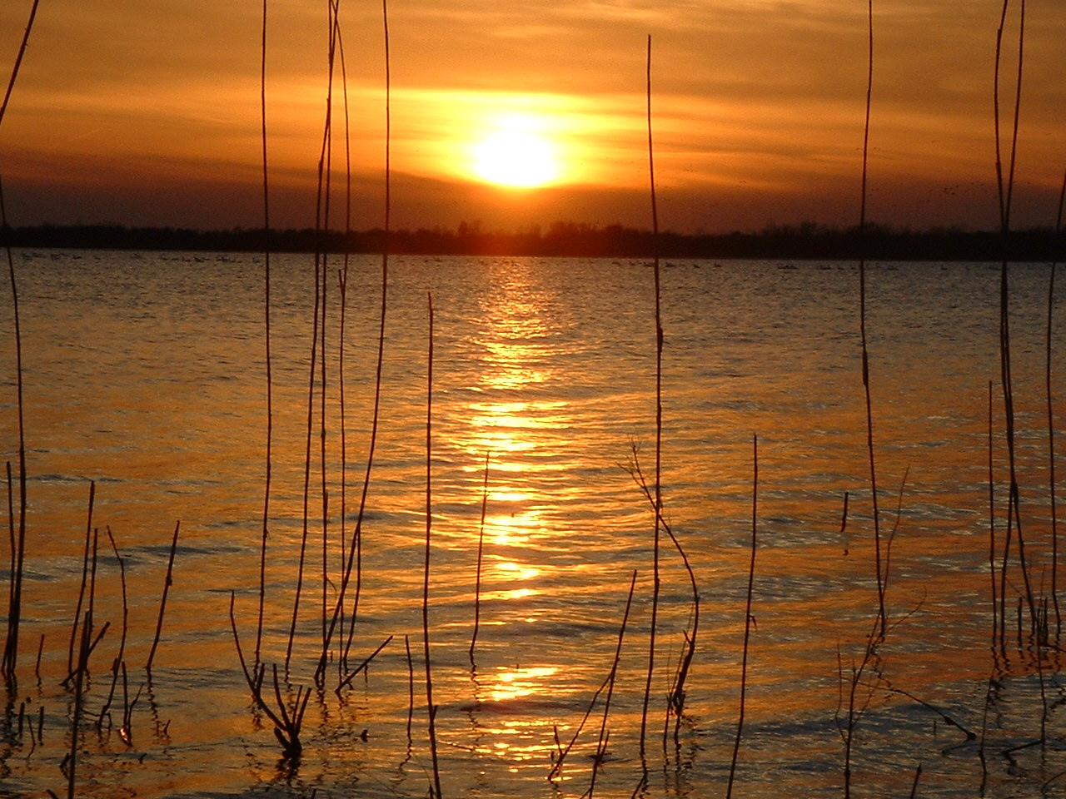
Questions

