Slide 1
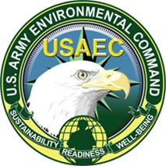
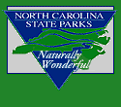
NC Sandhills Conservation Partnership
Ten years of collaborative conservation
Notes:
We are all here today to celebrate 10 years of collaborative conservation in the Sandhills. It’s a fantastic accomplishment, and I’ve been very excited to be a part of the effort over the last two years.
Today, I am going to share with you some results from the Partnership review I’ve been facilitating over the last few months. But first, I’d like to start with some background and briefly describe why we thought an internal review of the Partnership would be a worthwhile endeavor.
We all know the basic facts about the Partnership – how it was ultimately conceived in response to the RCW conflict but that it took on the larger mission of working to conserve other native species and their homes in Sandhills.
Many stakeholders that were already involved in the RCW situation elected to participate in the Partnership as an obvious and logical step toward sustaining their work on RCW recovery.
Other stakeholders chose to participate for a variety of reasons. Because they also wanted to play a role in RCW recovery, and/or they wanted to learn more about managing longleaf pine, and/or their geographic focus area overlapped with that of the Partnership.
Whatever the initial motivation, most partners recognized that the Sandhills Conservation Partnership was a great opportunity to proactively and cooperatively plan and implement conservation strategies for Sandhills species and their habitats – they recognized that by promoting this mutual interest, there was opportunity for each participant to realize mutual gain.
And over the years, partner contributions have included everything from meeting space, to funding for tracts, to equipment for burning, to capacity to lobby state and federal government and everything in between – the partners of the Sandhills Conservation Partnership wield a variety of capacity and expertise in contribution to the mission.

Slide 2
Ten years of collaborative conservation
Create a neutral forum for expressing and sharing ideas and perspectives about process and outcomes
Promote a common understanding of and an opportunity to build upon successes and lessons learned
Help ensure the efficiency, effectiveness, and sustainability of the NCSCP for years to come
Notes:
So this benchmark of 10 years of collaborative conservation provided an ideal occasion to ‘check in’ with partners to reflect on and learn from the past ten years in order to ensure the continuation of a collaborative path forward.
The purpose of the review:
1. Create opportunity for input, feedback
2. Promote mutual understanding, collective action
3. Sustain engagement/motivation, empower partners to shape the way forward, secure buy-in/commitments

Slide 3
Review Structure & Process
In-person interviews
Online surveys
Small workshops
Notes:
Interviews & Surveys – the opportunity to think and tell about your experiences with the Partnership
Small workshops – a chance for partners to collaboratively use results of the review to move the SCP forward
What I’ll focus on for the rest of this talk are some results from those interviews and surveys. In particular, I want to focus on some of the key benefits of the Partnership that were identified.

Slide 4
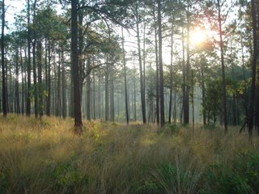
Partner Benefits
The Sandhills Conservation Partnership has been a
“REAL WIN.”
Money
Personnel Support
Access to expertise
Project Support
Relationships
Credibility
Information Sharing
Leverage Funding
Communication
Internal Recognition
Increased training
Increased Capacity
Realized Mandates
Demonstrated Success
Access to GIS DATA
A Seat at the Table
The ‘Big Picture’
Knowledge gained
Notes:
Let’s start with benefits that were identified for partners - as individuals and as organizations.
Understanding, acknowledging, and documenting the value of the Partnership for its partners can be critical for motivating continued involvement and for justifying the logistical and financial support of that involvement.
So I’ll share with you some of the key messages I received that many partners had in common. Most of what I heard can be summarized by this quote:
The ability to leverage funding for acquisition and resources for management, the establishment of stronger relationships that consistently help prevent major issues before they arise, and access to data and other information that make our jobs easier are just a few of what might be considered some of the more routine or obvious benefits.
Some of the less obvious ones I’ll highlight include factors like:
CREDIBILITY - Partners mentioned that their work within such a diverse Partnership for a significant period of time has lent credibility to their professional interactions outside of the Partnership as well as to funding applications to competitive sources.
INCREASED CAPACITY was mentioned in reference not just to money or management resources, but also for training and education such as with prescribed fire– the training is often offered here in the Sandhills by partners and supports training for TNC/DFR/Parks/Ft. Bragg.
Partners also talked about how the work with the Partnership helped enhance recognition within their own agencies - it helped highlight how their role in the Partnership directly contributed to the mission of the agency as a whole. This INTERNAL RECOGNITION has often resulted in awards and many times has resulted in a direct increase in resources to support the agency’s work in Sandhills.

Slide 5
Greater Benefits
The Sandhills Conservation Partnership is a
“model group for how to make collaborative conservation a success.”
The Sandhills Conservation Partnership has
“created conservation champions out of non-traditional partners.”
The Sandhills Conservation Partnership has been
“a test bed of innovation in new ways to do conservation.”
Notes:
I also want to highlight the contributions the Partnership has made to the greater conservation world that partners identified.
It’s important to acknowledge that the Partnership has been a leader in conservation and that many of the successes and lessons learned here in the Sandhills have been used to benefit conservation efforts across the state and even across the nation.
So here are three quotes that summarize these major contributions:
‘A model group for how to make collaborative conservation a success’ - Proof of concept – SCP demonstrated the value and success of the multi-partner approach – this was mentioned at almost every interview and in almost every survey response
The SCP model has been used to foster and grow other conservation partnerships in the state like the Greater Uwharries Conservation Partnership and the Cape Fear Arch Conservation Collaboration.
Successes and lessons learned have also influenced the approach taken by partners in their work in other landscapes, or regions, or states.
‘Created conservation champions’ - Energized a non-traditional base of support - the more diverse the voices are that are out in support of conservation the better our chances of success.
‘A test bed of innovation’ - NCSCP provides built in support and flexibility that allows us to experiment with new ways of doing business.
New funding paradigm where military, state, and private funds can be leveraged.
This Partnership has demonstrated a new strategy that conservation stakeholders, especially land trusts, can apply in other locations nears military installations.
Results of the effort have impacted policies nationwide
Opportunity to continue to experiment to address future challenges, to stay at the forefront to stay competitive for funding, to stay relevant

Slide 6
Future Priorities
“Our work is not done.”
Sustain RCW recovery and conserve other species
Acquire remaining large tracts, especially intact longleaf sites
Steward and manage existing areas
Connect and restore corridors between core areas
Scale up to make connections across a larger landscape
Increase work with local governments
Strategize to conserve working farms and forests
Incorporate aquatics, surface and groundwater concerns
Notes:
Now looking forward, here’s what I heard from partners about our future priorities.
“Our work is NOT done” – This message is important in an environment where funding is becoming increasingly tight and competition is getting tougher.
We need to continue to focus on sustaining RCW recovery while at the same time using the success of its recovery as a launching pad for successful conservation of other Sandhills species like the tiger salamander, gopher frog, St. Francis satyr, etc.
Focus on acquiring those last big tracts that are left, which are either vital connectors or intact, natural longleaf sites. At the same time, we need to start to thinking about when it’s enough. When focus might shift more heavily toward stewardship and management and how to enable and sustain that effort over the long-term.
Focus on connecting and restoring corridors between those large core areas – shoring up connections in the network so we have an ecosystem that is sustainable and functional for a variety of species.
Beyond more of the same – many partners mentioned working toward connectivity across the landscape, e.g. to the Uwharries and the Piedmont, to the Coastal Plain of NC, and down through the Sandhills of SC
Increased work with local governments, which we’ve already started on with the GGT
Conservation of working farms and forests – their role in buffering and connecting
Incorporating more aquatics – surface and groundwater concerns might become increasingly relevant

Slide 7
Challenges
“Challenges will always arise but none that cannot be overcome together.”
Securing/sustaining money to buy lands
Securing/sustaining money and capacity to manage lands
Identifying opportunities to increase public support
Finding new opportunities to educate landowners
Sustaining turnover in land and leadership
Defining success to justify and secure resources
Notes:
Our discussion of future priorities also included references to challenges we continue to face and will face in the future.
Some remain the same, but may become more difficult; some are relevant now that we’ve been working together for ten years (highlight the last two).
Especially in the face of increasing development pressure and rising land prices, more competition for the same funding pool
Especially as more land is acquired, as increased populations present more difficulties for burning, as carbon becomes regulated
Not only because it can help us weather storm in bad financial years but also because long-term sustainability of the ecosystems depends on everyone understanding and appreciating the big picture, not just the conservation stakeholders
There are lots of forests on private lands and they are an important piece of the overall picture.
Turnover in land and associated rise in forest fragmentation is definitely a concern but also leadership within the partnership, within partner organizations is important to consider – there is information and commitments that need to be passed along in order to sustain the effort. There is also turnover at the local government level, especially with planning boards etc. that can present challenges.
Defining what success looks like in the next 5 or 10 years will also be important for guiding us forward, for continuing to demonstrate the value of our efforts, to justify and secure resources.

Slide 8
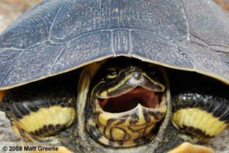
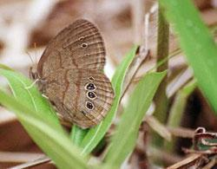
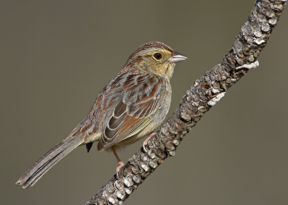
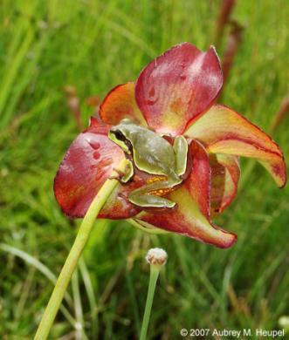
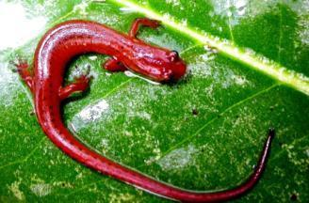
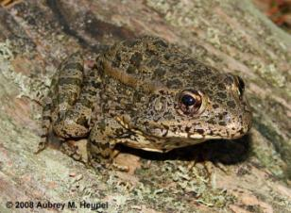
Thank You
Notes:
But I can’t emphasize enough, how excited partners are about what’s been accomplished and what the Partnership offers, how thoughtful and insightful they are about the Partnership and where it needs to focus in the future, and how engaged they still are with the mission to conserve and protect the species and habitats in the Sandhills.
Finally, I would like to take this opportunity to personally thank all the partners that sat with me for an interview and that participated in the survey. It has been a tremendous learning experience for me and I hope that ultimately the Partnership reaps benefits from this effort as well.
Thanks for your time and if anyone has any questions, please let me know.

Slide 9
Photo Credits
Red-cockaded woodpecker - Lower Cape Fear Bird Club
http://lcfbclub.googlepages.com/Woodpecker_red-cockadedDsc_0089A.jpg/Woodpecker_red-cockadedDsc_0089A-large.jpg
Eastern tiger salamander - David Scott and Mike Dorcas
http://www.bio.davidson.edu/projects/herpcons/herps_of_NC/salamanders/ambtig.html
Eastern fox squirrel – Jeff Pippen Photography
http://t3.gstatic.com/images?q=tbn:YnrnfEPplx1Q8M:http://www.duke.edu/~jspippen/mammals/foxsquirrel040515-093brunswickcoz.jpg
Chicken turtle - Eric Spadgenske
http://www.outdooralabama.com/watchable-wildlife/images/chicken%20turtle1.JPG
Rafinesque’s big-eared bat - Georgia Museum of Natural History
http://naturalhistory.uga.edu/~GMNH/gawildlife/images/Mammalia/prafinesquii.jpg
Bachman’s sparrow – Lower Cape Fear Bird Club
http://lcfbclub.googlepages.com/Sparrow_Bachmans1330C.jpg/Sparrow_Bachmans1330C-large.jpg
On Thank You Page – Bachman’s from roysephotos.com

