Slide 1
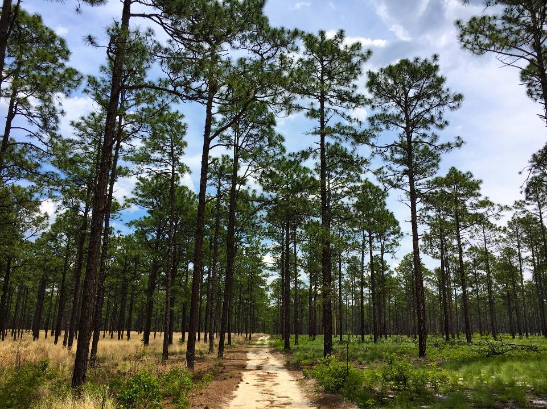
NC Sandhills Conservation Partnership
2025 Year in Review
Calloway Forest – photo Gretchen Coll

Slide 2
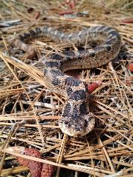
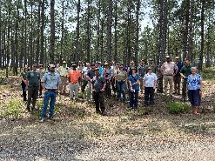
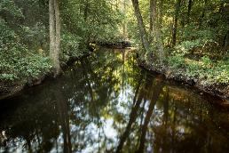
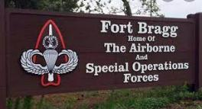
Partnership meetings
Focus on Fort Bragg (Dec 2024)
New/Potential Federal Endangered Species listing (Mar 2025)
Joint meeting with SC Sandhills Conservation Partnership (June 2025)
Sandhills Stream Flow Study (Sep 2025)
SC-NC Sandhills joint field trip
photo Godbold
Drowning Creek-
photo Jeff Marcus
Southern hognose snake-
photo Kerry Brust

Slide 3
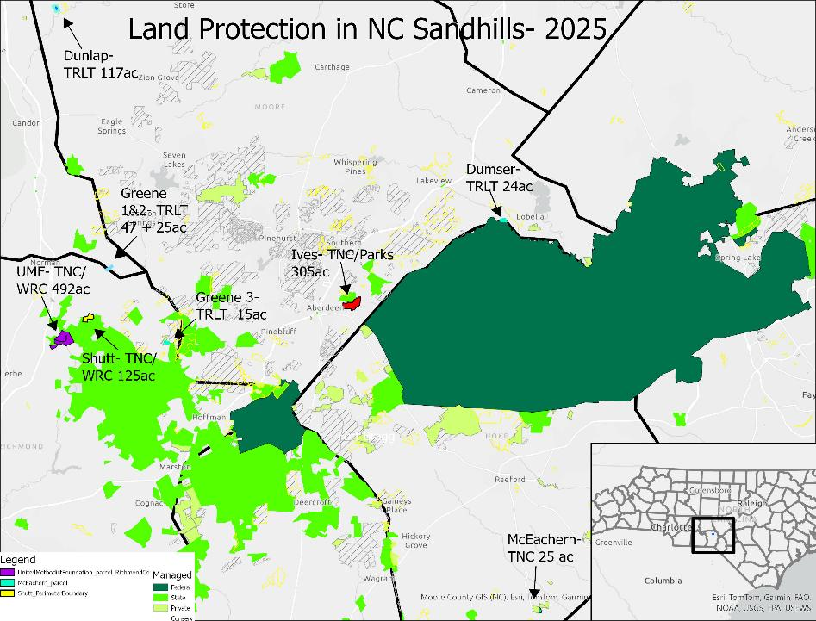

Slide 4
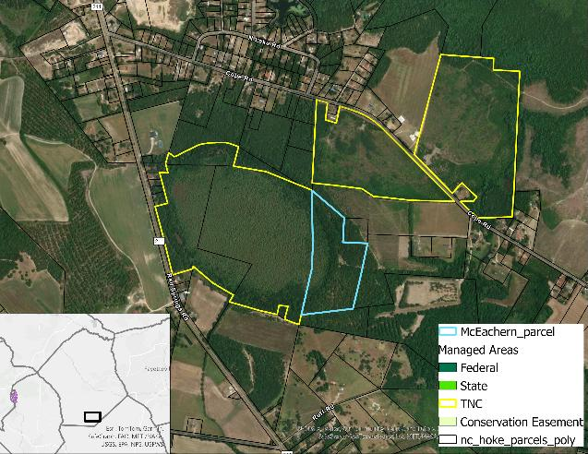
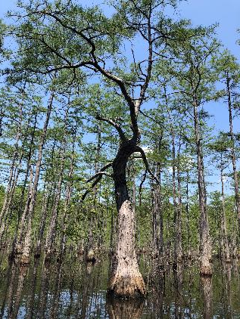
McEachern Tract at Antioch Bay

Slide 5
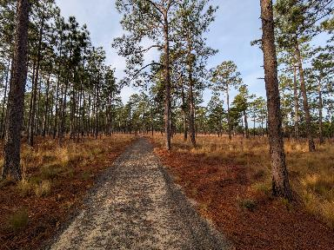
Ives- 305 acres to State Parks
Paint Hill Farm-
photo Matt Greene

Slide 6
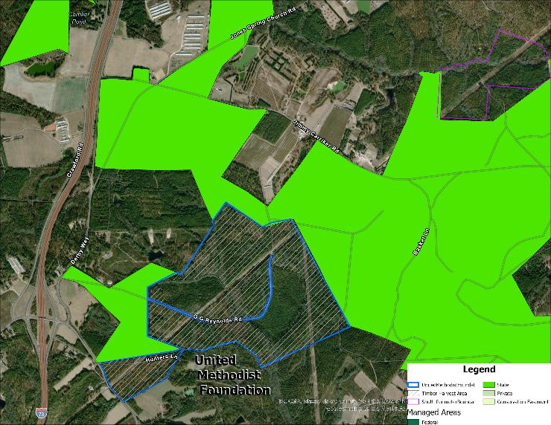
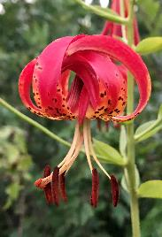
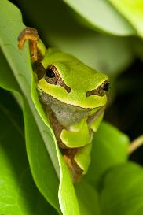
Shutt and United Methodist Foundation
Shutt 125ac
Sandhills Lily
Photo Jeff Marcus
UMF 492ac
Pine Barrens Tree Frog-
Photo Brady Beck

Slide 7
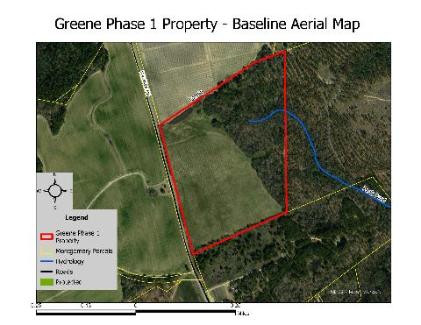
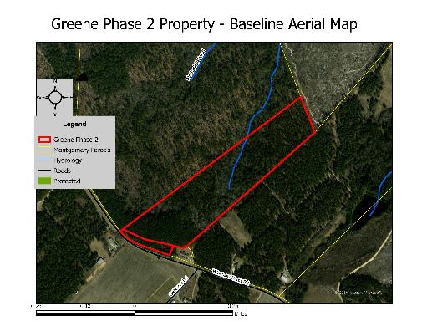
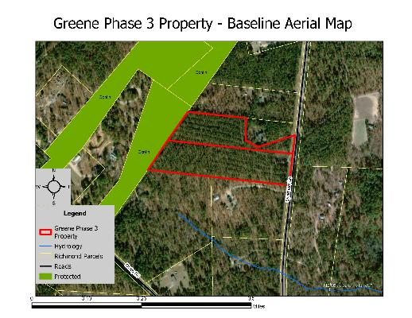
Greene CE phase 1-3

Slide 8
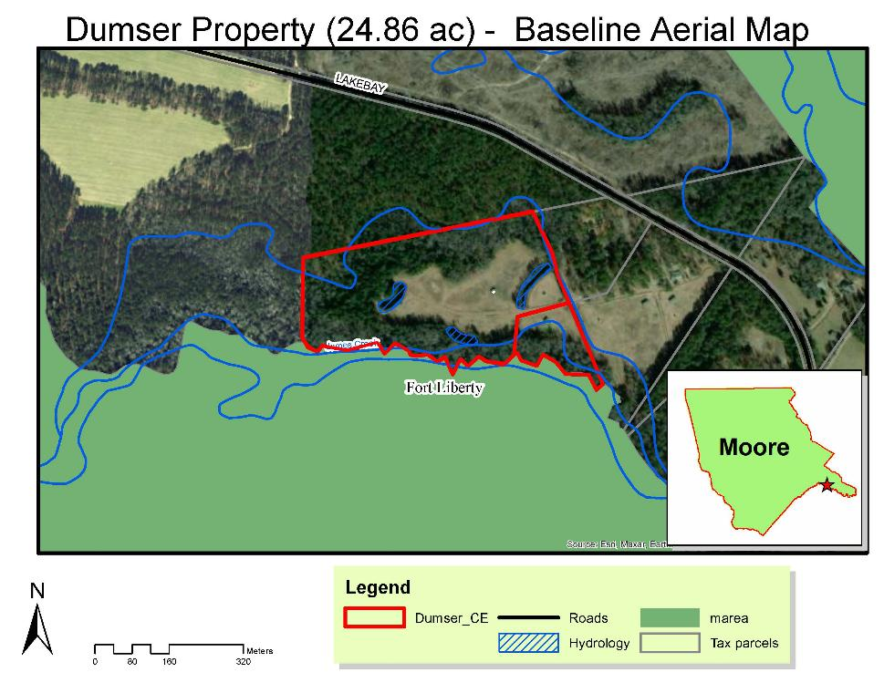

Slide 9
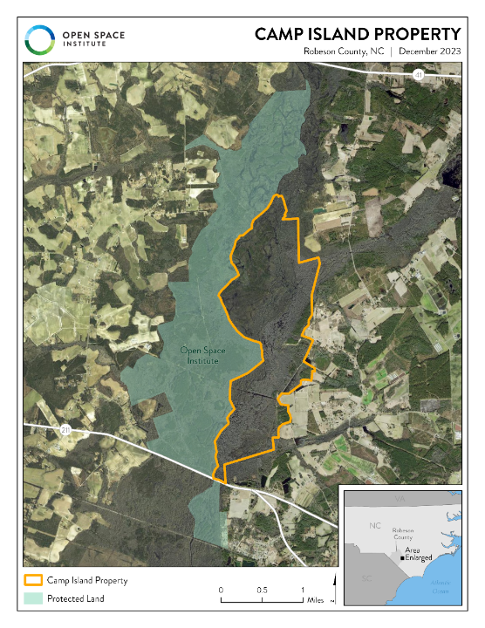
Camp Island
1400 acres purchased by Open Space Institute and transferred to Lumbee Tribe

Slide 10
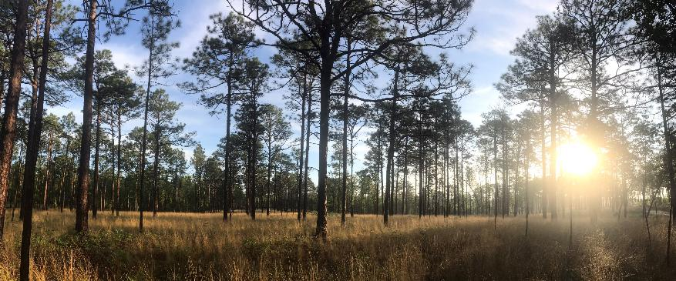
Staff Turnover
Welcoming key new staff/roles at Fort Bragg, State Parks, NC Wildlife Resources Commission, Three Rivers
Induced early retirements at US Fish and Wildlife Service
Layoffs at Sandhills Ecological Institute
Sandhills Game Land- photo Jeff Marcus

Slide 11
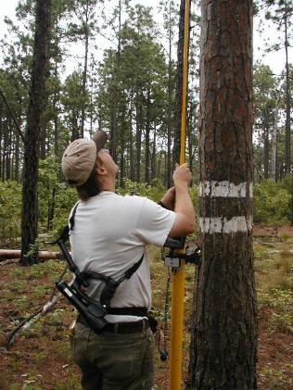
Red cockaded Woodpecker monitoring- where do we go from here?
~46 year dataset on RCW activity status and reproductive success
Many research projects
Funding halted in 2025 for monitoring much of Fort Bragg, Camp Mackall, Sandhills Game Land
Regulatory requirements for downlisting

Slide 12
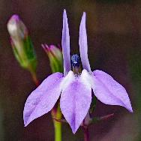
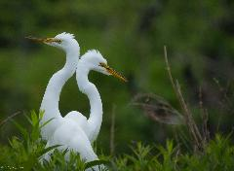
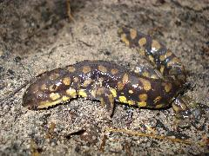
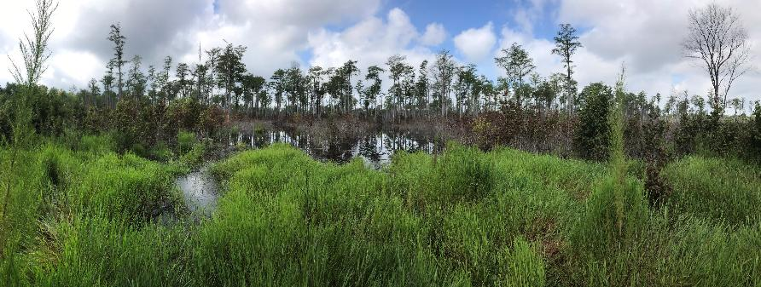
Carolina Bays Conservation Plan
Boykin’s lobelia-
iNaturalist
Great egrets at Dunahoe bay
photo Laura Gingrich
Tiger salamander-
photo Jeff Marcus
Big Cypress Meadow bay in McIntosh complex- photo Jeff Marcus

