Slide 1
Sandhills Conservation Partnership Land Protection Work Group
September 14, 2022
Jeff Marcus, Crystal Cockman, Emily Callicut, Brady Beck

Slide 2
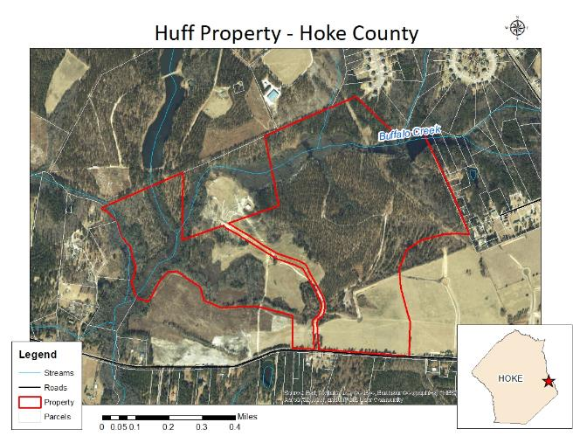
Huff conservation easement

Slide 3
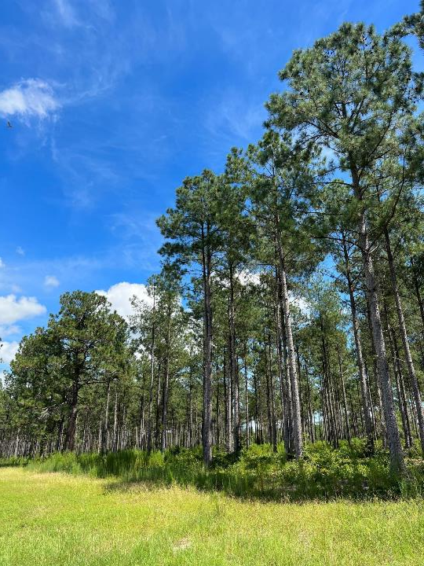
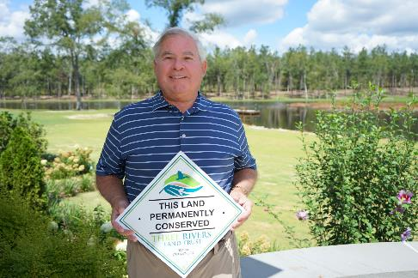
Ralph Huff

Slide 4
TNC projects
3 projects set to close soon: Creed CE, Caddell, BLATCO
5 year extension granted for Cooperative Agreement with Fort Bragg

