Slide 1
Sandhills Blackwater Stream Flow Comparison
Matt Moskwik (2017)
Lydie Costes (Sept. 2025)

Slide 2
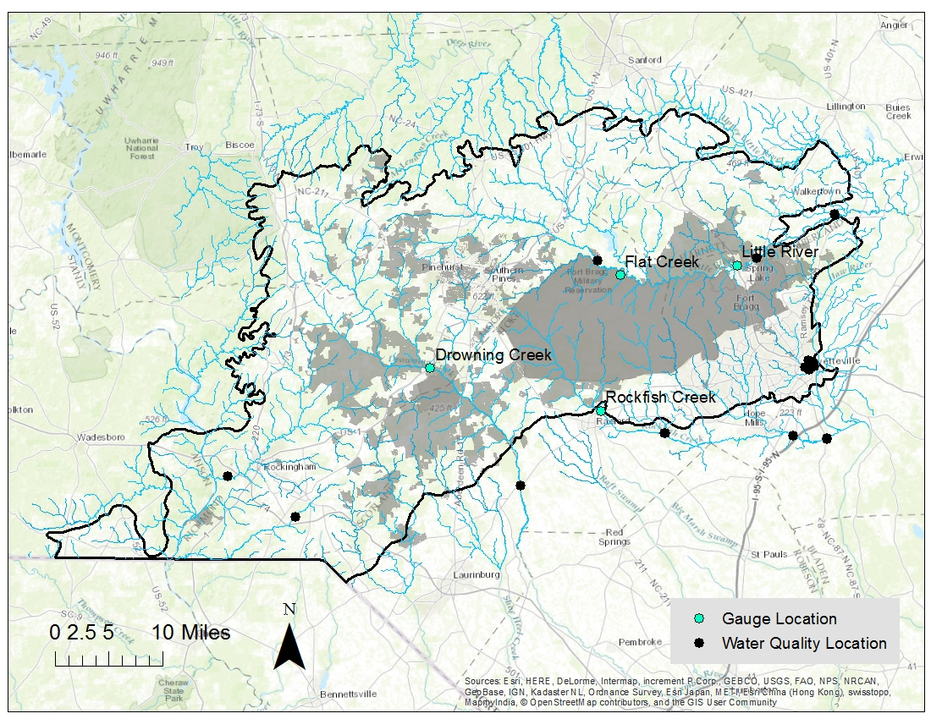
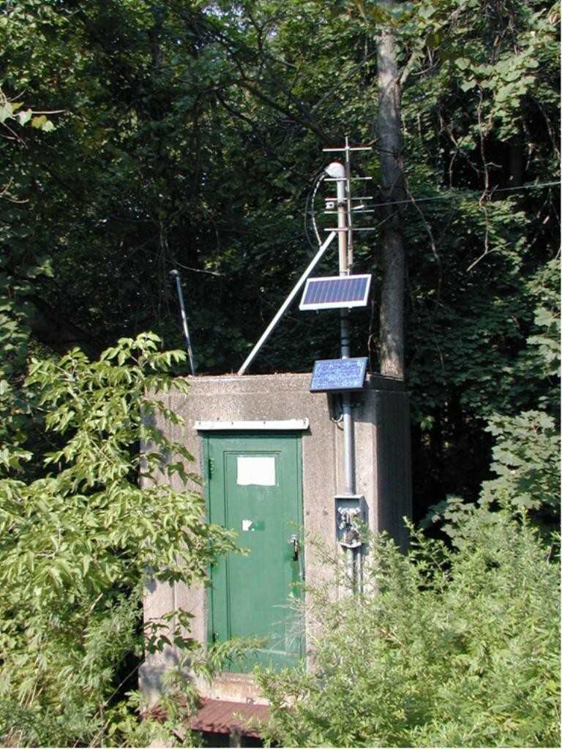
Monitoring Locations

Slide 3
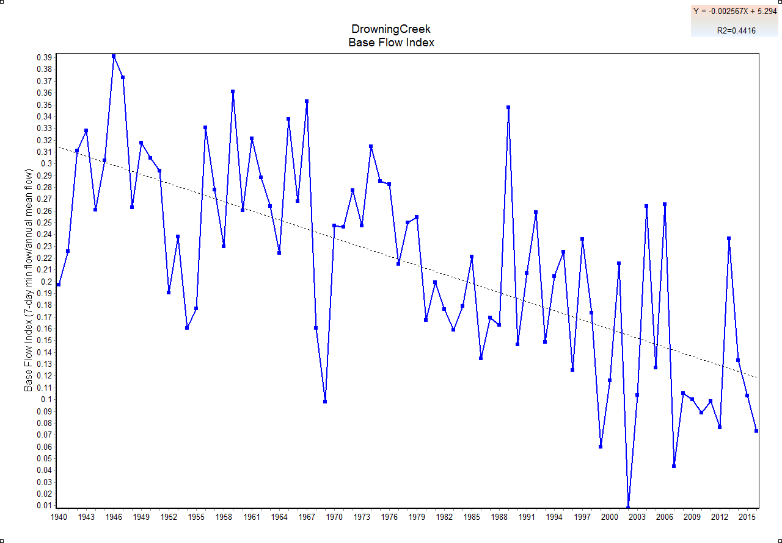
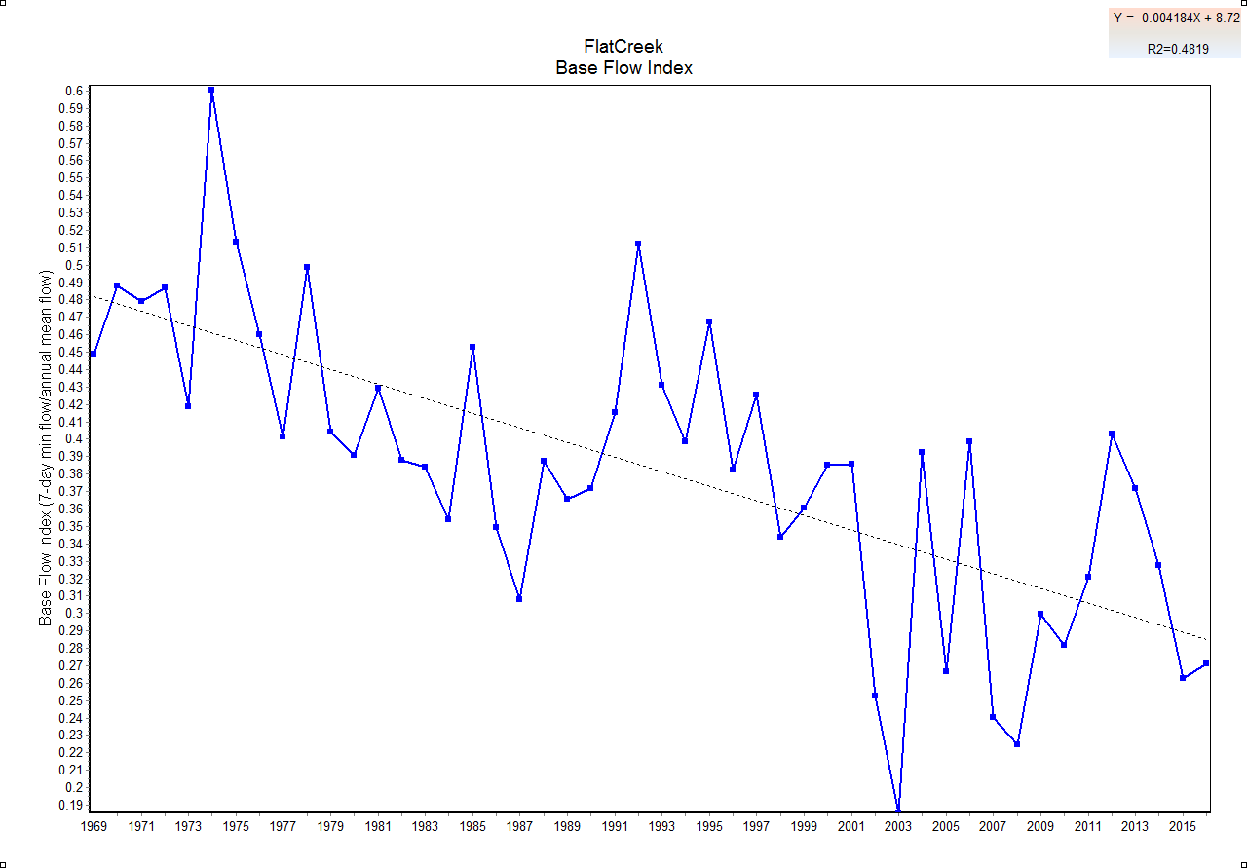
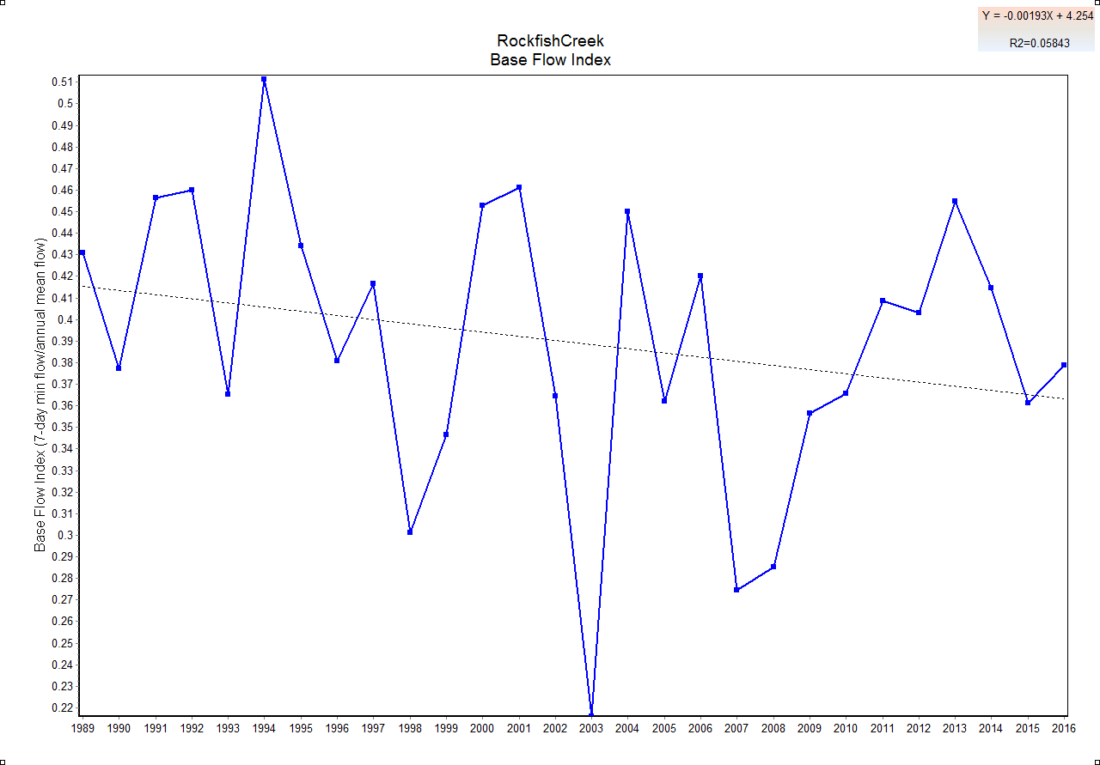
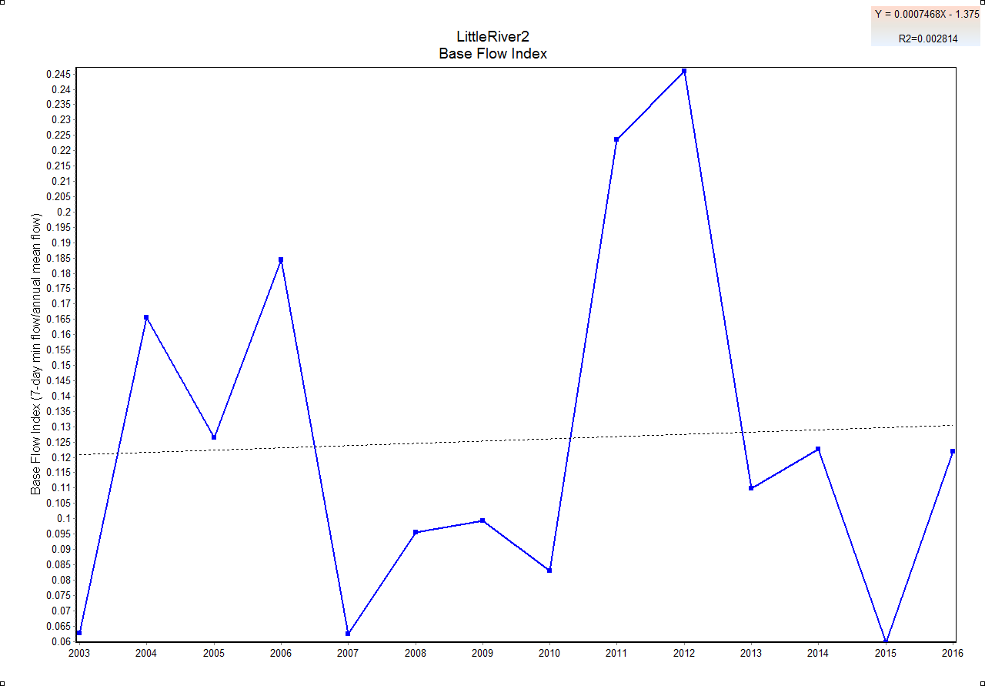
Baseflow Index Comparisons of Four Streams by M. Moskwik in 2017
Drowning Creek
Flat Creek
1940
190 cfs
2016
156 cfs
1969
11 cfs
2016
8 cfs
Rockfish Creek
Little River
2003
389 cfs
2006
323 cfs
1989
105 cfs
2016
86 cfs

Slide 4
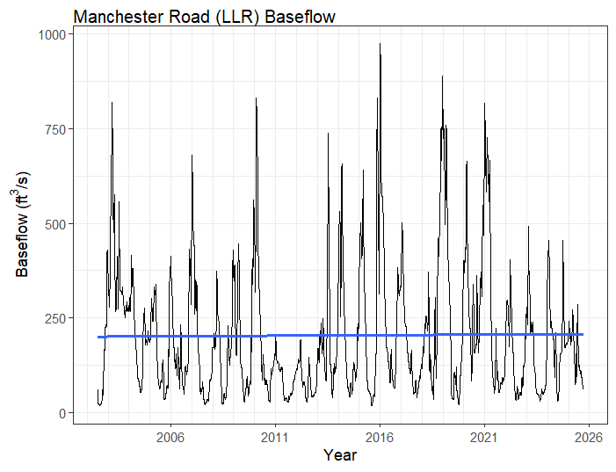
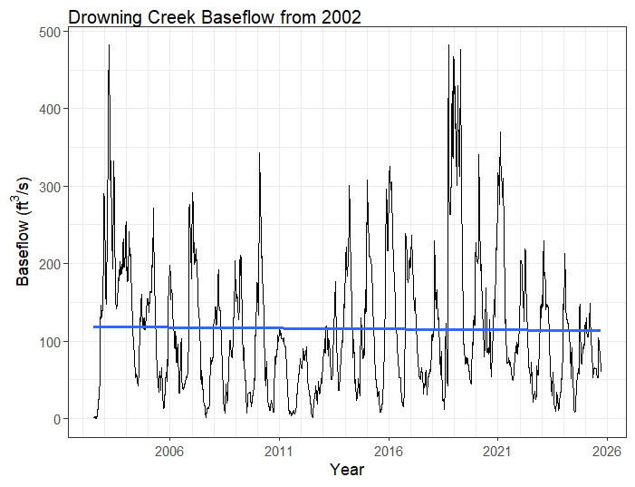
Baseflow of Lower Little River and Drowning Creek, 2002-2025
Both baseflows look fairly stable over this time period.
Because the Manchester Road gage only has 23 years of data, let’s check one of LLR’s tributaries, Flat Creek.

Slide 5
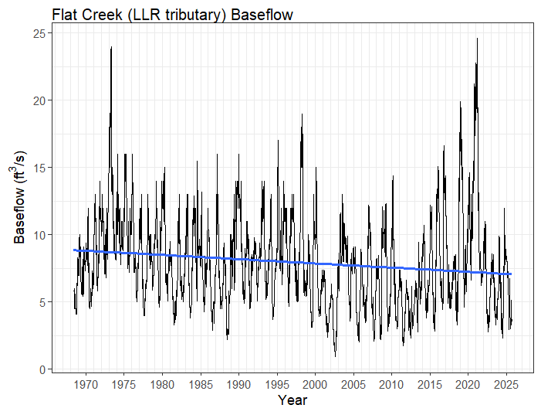
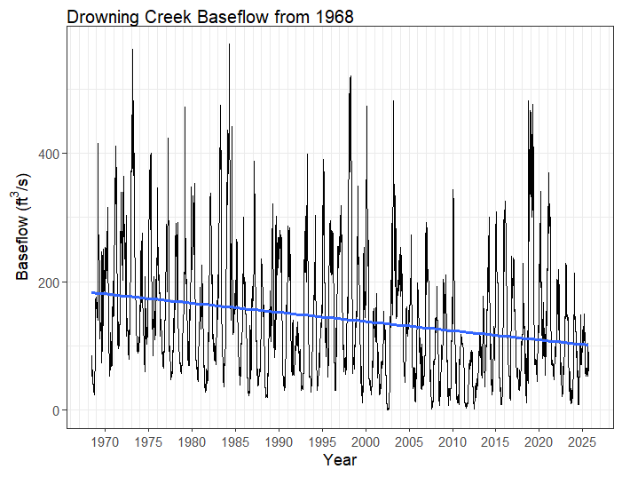
Baseflow of Flat Creek and Drowning Creek, 1968-present
Both streams have experienced a decline in baseflows since 1968, but the decline is steeper for DC.
Next, let’s look at flow trends.

Slide 6
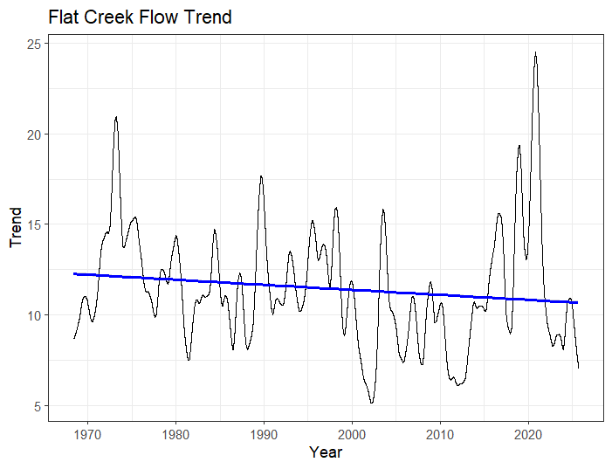
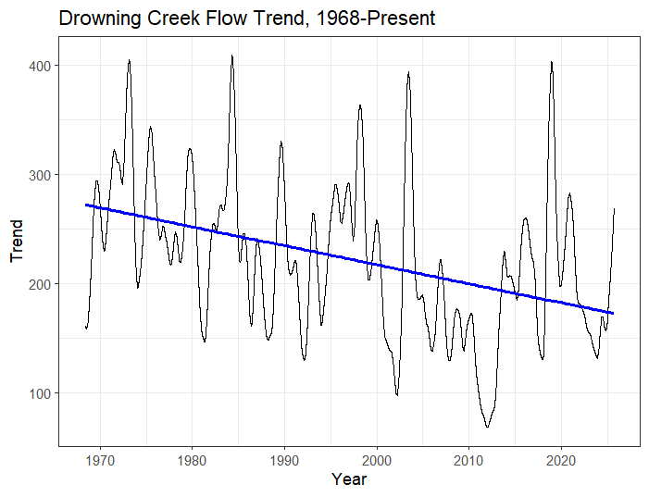
Flow Trend of Flat Creek and Drowning Creek, 1968-present
Both streams have experienced a decline in flow trend since 1968, but the decline is steeper for DC.
Next, let’s look at minimum flows.

Slide 7
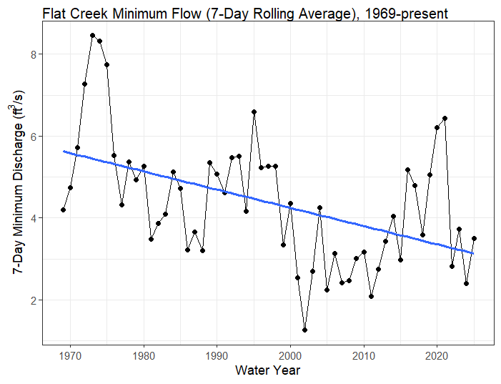
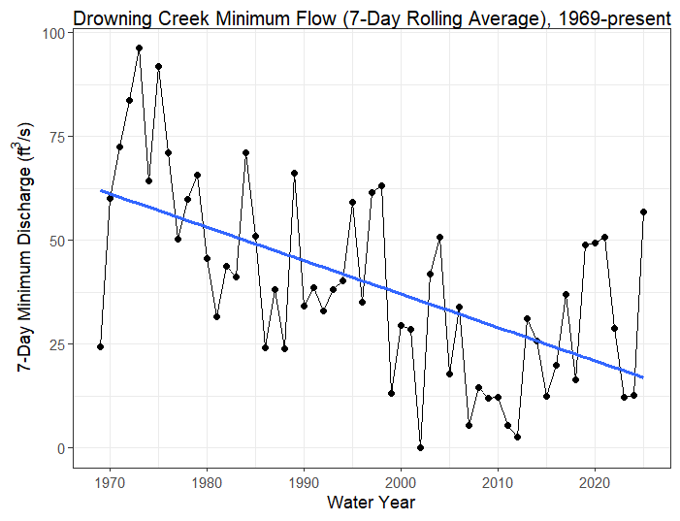
7-Day Minimum: Flat Creek and Drowning Creek, 1969-2025
Both streams have had a decline in minimum (7-day average) flows, though DC is a bit steeper.
Note that the 2025 data are incomplete (graphs made in September, flows currently declining).

Slide 8
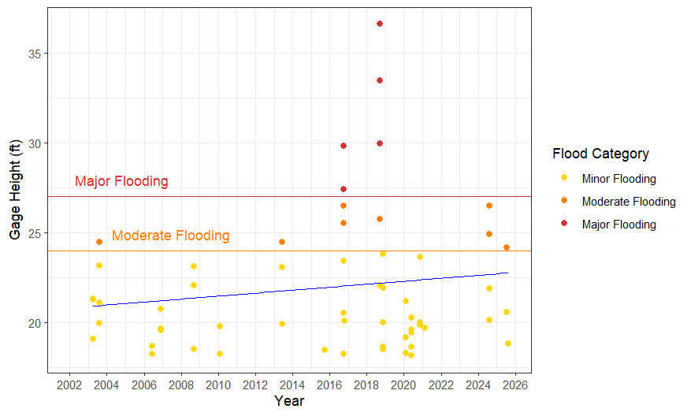
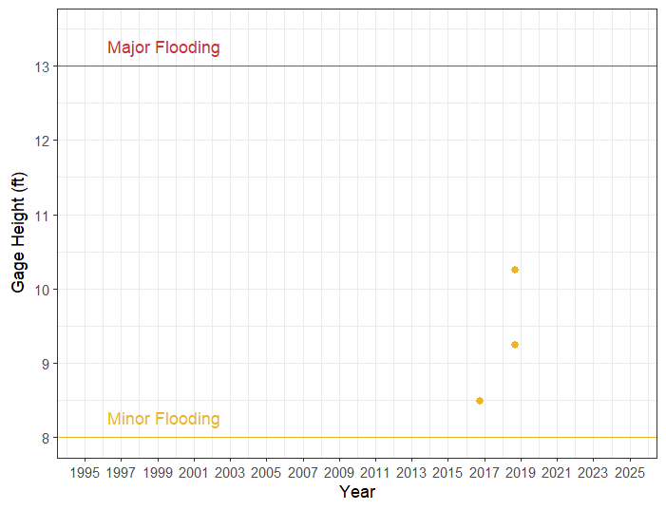
How about flooding: how does flooding compare in the two watersheds?
Lower Little River (Manchester) Flood Days
Drowning Creek (Hwy 1) Flood Days
DC has had 3 days of minor flooding since 1996. DC is a smaller basin delineated from the US 1 gage (see table). Also, the wide floodplains of DC mean that it is better equipped to retain floodwaters and less prone to extreme flooding, at least at this point in the watershed. The downstream Lumber River does have a history of problematic flood events, but those issues are not addressed by the scope of this study.
Stream | Basin Size* | Mean Flow*
DC (US 1) | 183 sq mi | 237 CFS
LLR (Man) | 348 sq mi | 386 CFS
*Source: StreamStats

