Slide 1
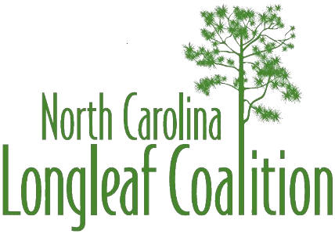
North Carolina Longleaf Coalition
www.nclongleaf.org

Slide 2
The mission of the North Carolina Longleaf Coalition is to promote the maintenance and restoration of North Carolina’s longleaf pine ecosystem, including its cultural and economic values, by forming a collaborative network of diverse stakeholders to provide strategic leadership across the historic range while also supporting local restoration activities.

Slide 3
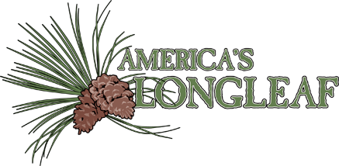
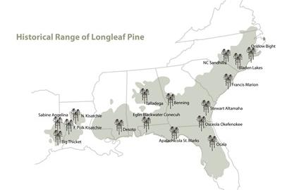

Slide 4
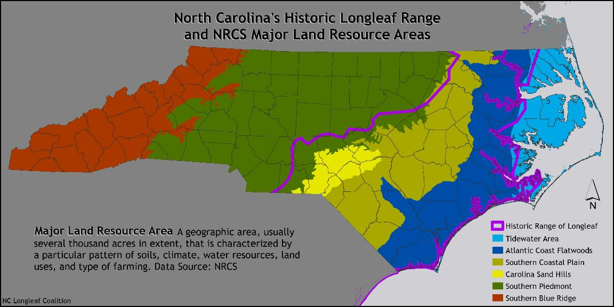
North Carolina Longleaf Coalition

Slide 5
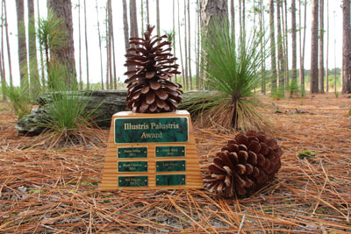
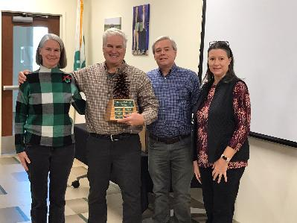

Illustris Palustris Award
Since 2013, the North Carolina Longleaf Coalition has recognized significant accomplishments to longleaf conservation efforts in North Carolina through the Illustris Palustris Award. This annual award is presented to an individual in recognition of outstanding contributions to promote the maintenance and restoration of North Carolina’s Longleaf Pine ecosystem. Qualified nominees have gone “above-and-beyond” in their longleaf efforts through leadership, advocacy, and outreach.
Honorees are recognized at an award ceremony with a certificate and inclusion on the Illustris Palustris Pine Cone Award. To date, we have honored 12 recipients.

Slide 6
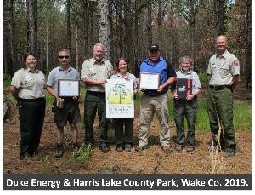
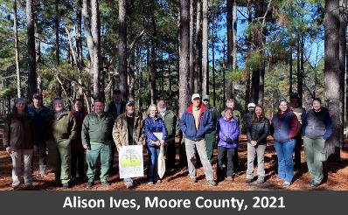
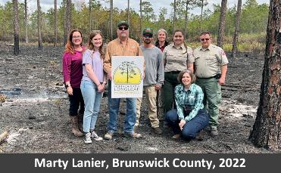
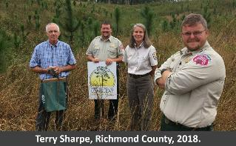
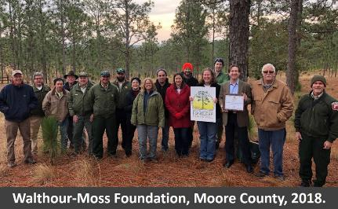
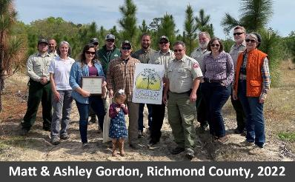
Longleaf Honor Roll
Longleaf Honor Roll: NC Longleaf Honor Roll Program recognizes landowners who are working to improve stands and balance all the values of a longleaf forest – wood products, wildlife habitat, recreation and aesthetics.
To date there have been 26 landowner recognitions in 13 counties.

Slide 7
Longleaf for All works to increase minority participation in forestry-related programs, practices, and activities, and help landowners reap the economic, ecological, and cultural benefits of owning forested land.
This group identified challenges facing minority landowners and professionals, as well as recommendations and networks that have led to potential on-the-ground results through the development of demonstration projects, including the Hoke Community Forest in North Carolina.

Slide 8
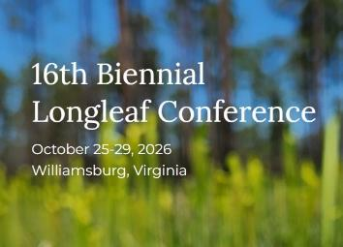
Fire in the Pines scheduled for Oct. 10, 2026 at Halyburton Park in Wilmington. Flytraps, Fire, Family and Fun!
Party for the Pine scheduled for April 18, 2026 at Weymouth Woods Sandhills Nature Preserve in Southern Pines.

Slide 9
2024 ALRI Range-wide Longleaf Accomplishment Report was recently released. Thanks to the work of so many amazing and motivated partners, 2024 was another record year for prescribed burning in longleaf!
In 2024, North Carolinians established 7,477 acres of longleaf forests, used prescribed fire to manage nearly 120,514 acres of longleaf, and protected over 6,367 acres of longleaf through acquisition and/or conservation easement.

Slide 10
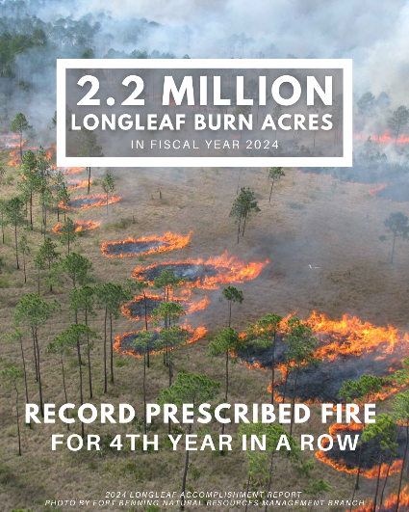
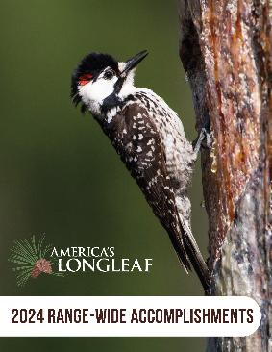
Planted 100,260 acres of new longleaf pine
Protected 49,337 acres through acquisitions and easements
Applied prescribed fire to over 2.2 million acres!
Applied silvicultural activities to 5,308 acres to convert existing forestland to longleaf-dominant forests

Slide 11
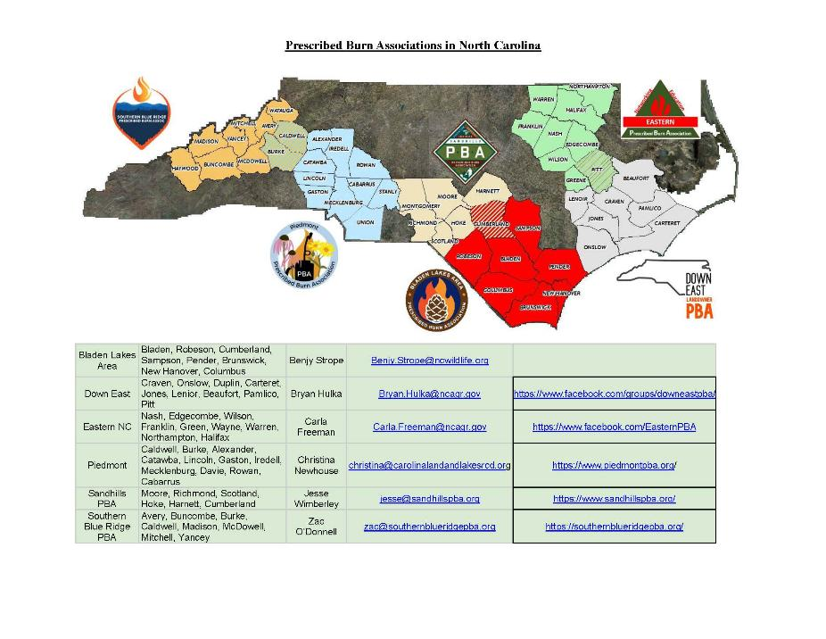

Slide 12
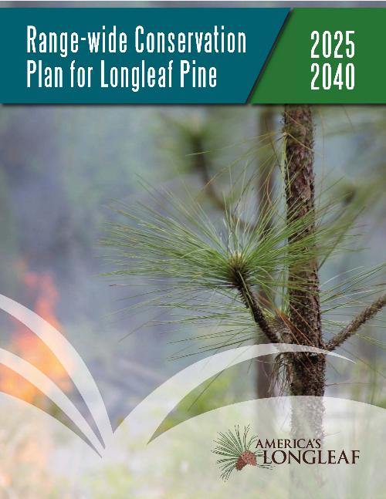
When America’s Longleaf Restoration Initiative was first formed, the extent of longleaf pine forests had been greatly reduced with an estimated 3.4 million acres remaining. Through the collaborative restoration and conservation efforts of partners involved in America’s Longleaf, that downward trend has been reversed and the current data indicate that the acreage of longleaf pine has increased to approximately 5.2 million acres. This progress is encouraging, but there is still much work to be done to achieve the restoration goals outlined in this Conservation Plan.

Slide 13
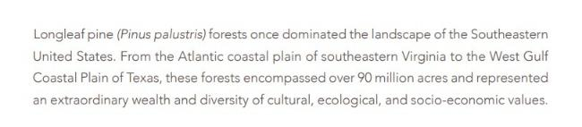
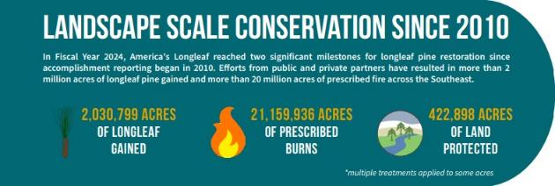
When America’s Longleaf Restoration Initiative was first formed, the extent of longleaf pine forests had been greatly reduced with an estimated 3.4 million acres remaining. Through the collaborative restoration and conservation efforts of partners involved in America’s Longleaf, that downward trend has been reversed and the current data indicate that the acreage of longleaf pine has increased to approximately 5.2 million acres. This progress is encouraging, but there is still much work to be done to achieve the restoration goals outlined in this Conservation Plan.

Slide 14
North Carolina Longleaf Coalition
www.nclongleaf.org

