Slide 1
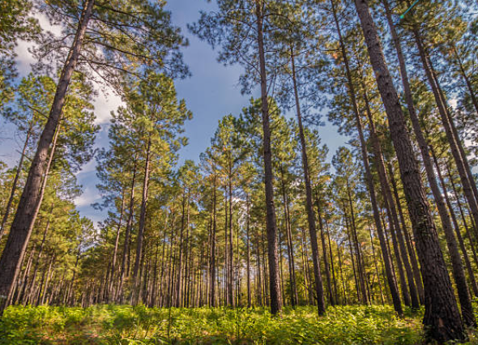
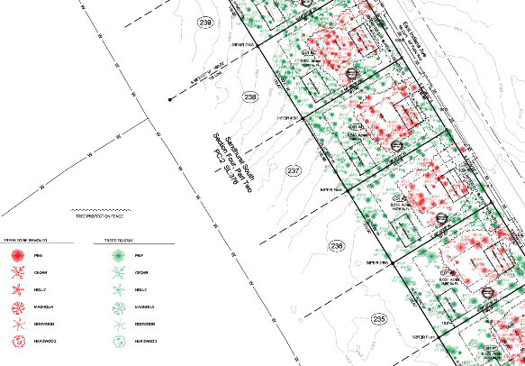
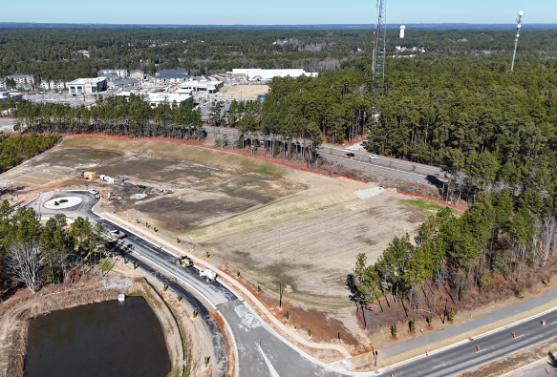

Southern Pines Update
Tree Protection and
Open Space
Ordinance Amendments
NCSCP Quarterly Meeting
6.10.2026

Slide 2
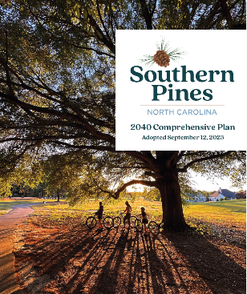
Project Timeline.
Sep ‘23
Town Comprehensive Plan Phase I key policies: “Define Open Space as a meaningful component of development, protect natural character, and minimize tree loss during development.”

Slide 3
Project Timeline.
Senate Bill 382 (Down-Zoning Provision) adopted
OA-03-24
Continued
Sep ‘23
Dec ‘24
Jan / Feb ‘26
OA-03-24:
Tree protection and Landscaping amendment project
Staff revisit the plan
Town Council adopts a small portion, instructs staff to start a new version

Slide 4
Down-Zoning Provision
(Senate Bill 382, now NC G.S. §160D-601(d))
(d) Down-Zoning. - No amendment to zoning regulations or a zoning map that down-zones property shall be initiated, enacted, or enforced without the written consent of all property owners whose property is the subject of the down-zoning amendment. For purposes of this section, "down-zoning" means a zoning ordinance that affects an area of land in one of the following ways:
(1) By decreasing the development density of the land to be less dense than was allowed under its previous usage.
(2) By reducing the permitted uses of the land that are specified in a zoning ordinance or land development regulation to fewer uses than were allowed under its previous usage.
(3) By creating any type of nonconformity on land not in a residential zoning district, including a nonconforming use, nonconforming lot, nonconforming structure, nonconforming improvement, or nonconforming site element.

Slide 5
Project Timeline.
OA-02-24:
Staff work with the Tree Protection focus group and legal consultants to draft a new version
Sep ‘23
Dec ‘24
Jan / Feb ‘26
May ‘26
June 9
TC Hearing

Slide 6
Main Components:
No change to the area requirement (usually 10% open space required).
5 Specified types of Open Space – in order of priority:
  Sensitive Natural Areas
  Tree Protection Areas
  Undisturbed Buffers
  “Usable” Open Space
  Planted Buffers
No conflict with G.S. §160D-601(d)

Slide 7
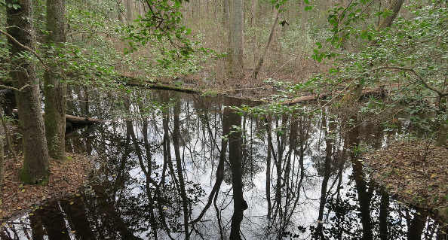
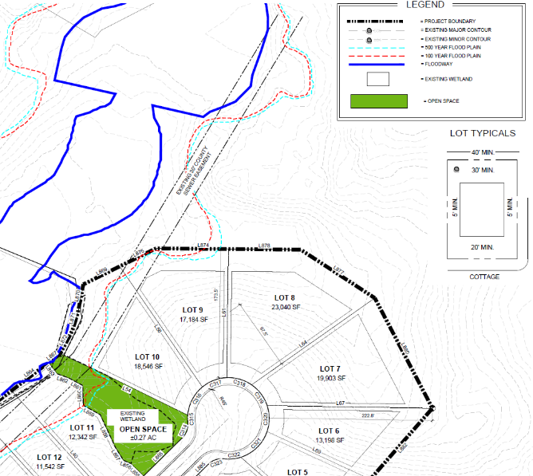
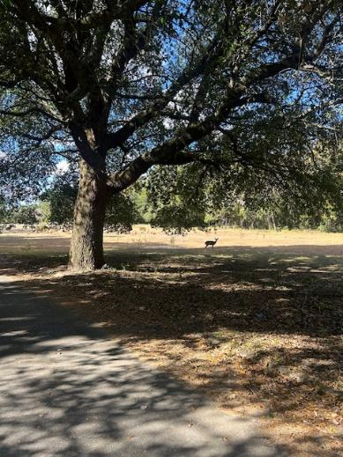
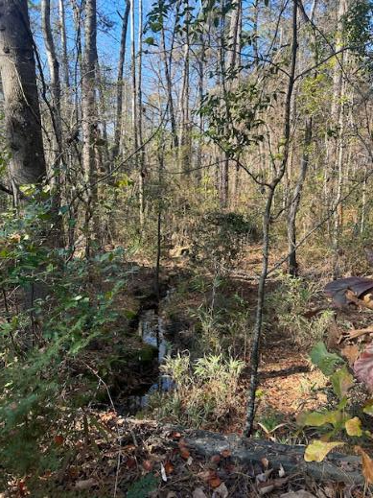
The 5 Open Space Types.
1. Sensitive Natural Areas:
- Wetlands
- Flood Hazard Areas
- Specimen Trees & Root Zones

Slide 8
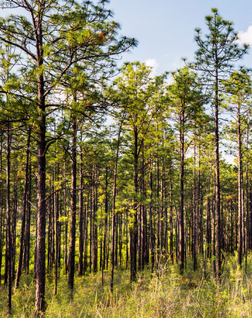
The 5 Open Space Types.
2. Tree Protection Areas*:
- Mature tree stands that comprise minimum density and dimensional requirements.
*Density: 1-inch diameter per 100 square feet of Open Space
*Minimum Width: 20-feet
*Maturity: minimum 6-inches diameter to count

Slide 9
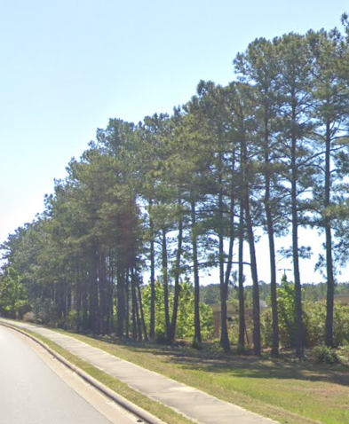

The 5 Open Space Types.
- Same TPA Requirements
- Serve the buffer function
- Mix with planted buffers when needed
3. Undisturbed Buffers

Slide 10
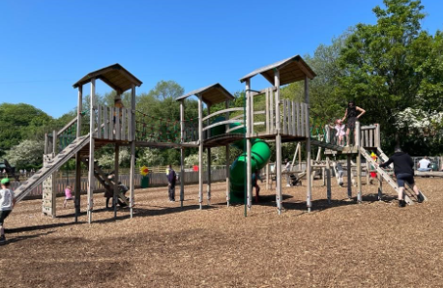
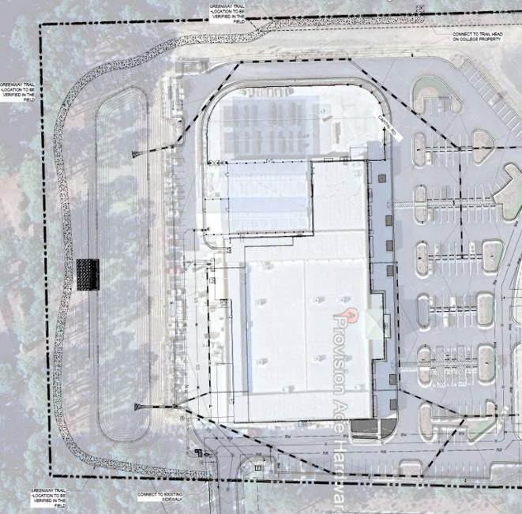
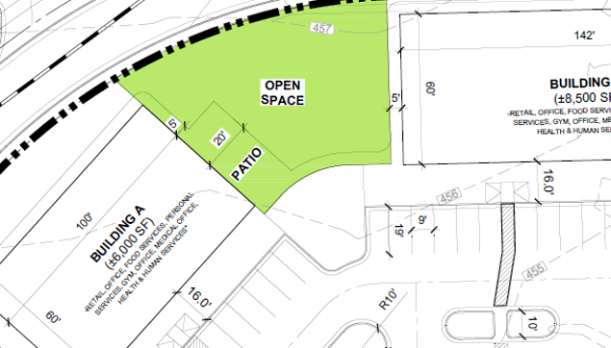
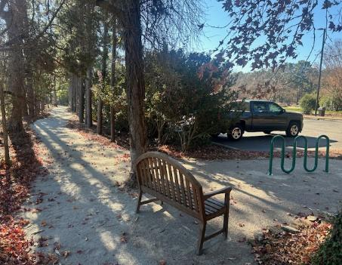
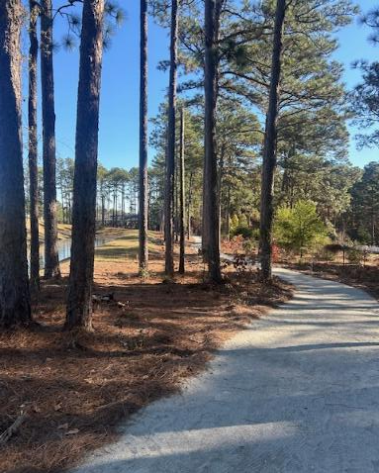
The 5 Open Space Types.
4. Usable Open Space
- Recreation type open space like playgrounds, trails, picnic areas, and ball fields.

Slide 11
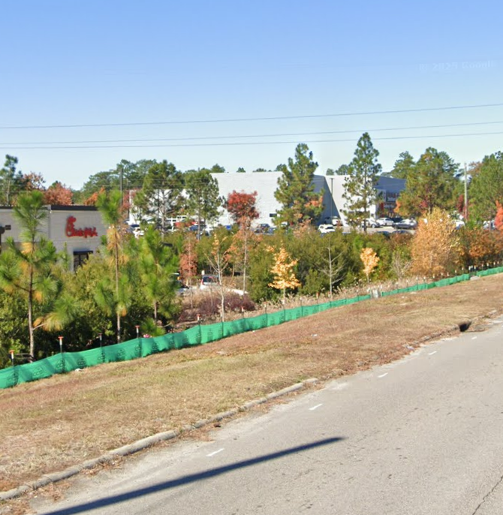
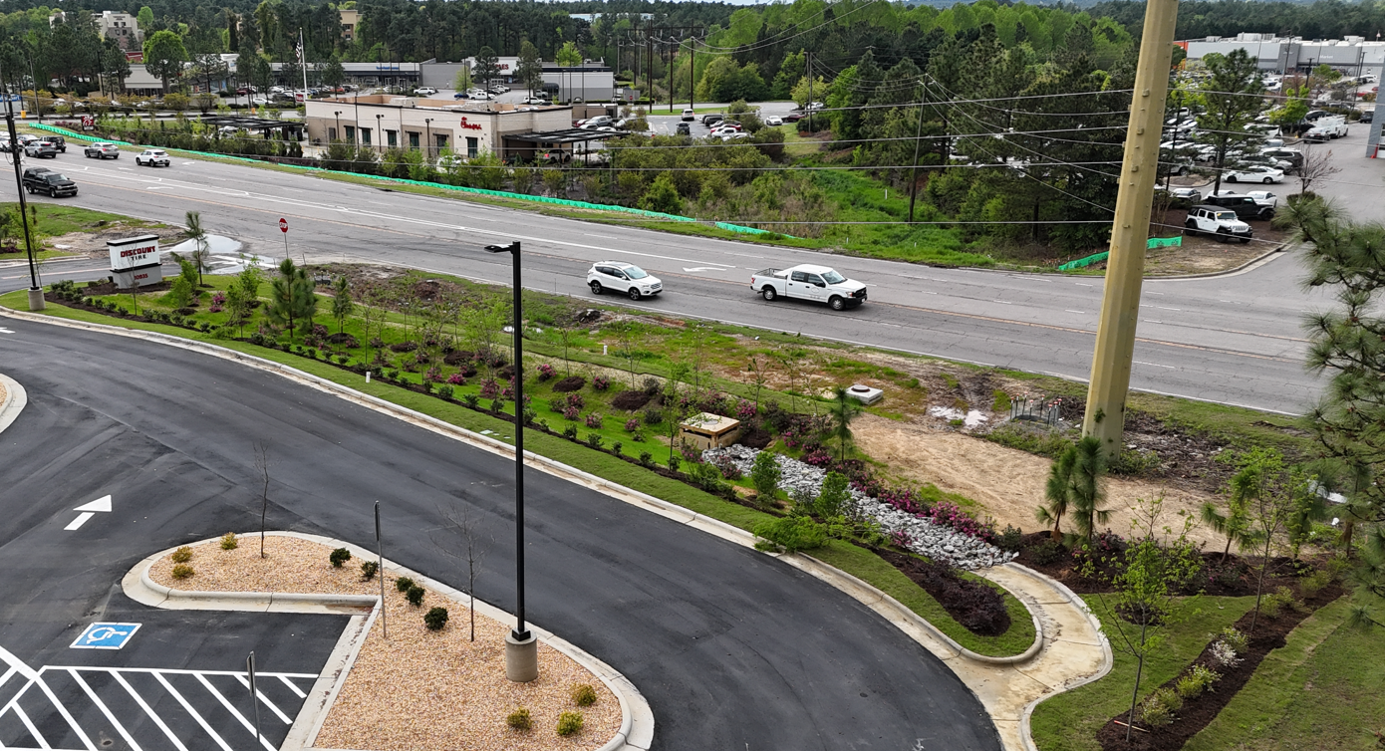
The 5 Open Space Types.
5. Planted Buffers

Slide 12
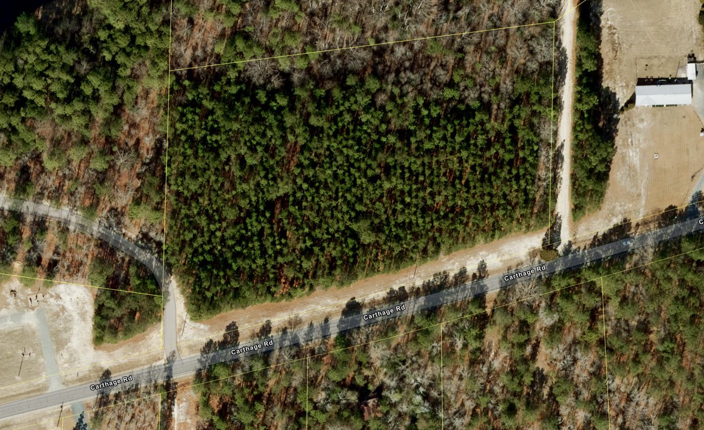





Example 1:
5-acres
10% = 21,780 sf
Zoning - GB
Undisturbed Buffer
(Type 3)
5-acres
10% = 21,780 sf
Zoning - GB
5-acres
10% = 21,780sf
Wetlands
(Type 1)
+
TPA
(Type 2)
~9,000 sf
(20’ x 300’)
Wetlands
~12,780 sf
40’ x 544.5’ = 21,780
Road 1

Slide 13
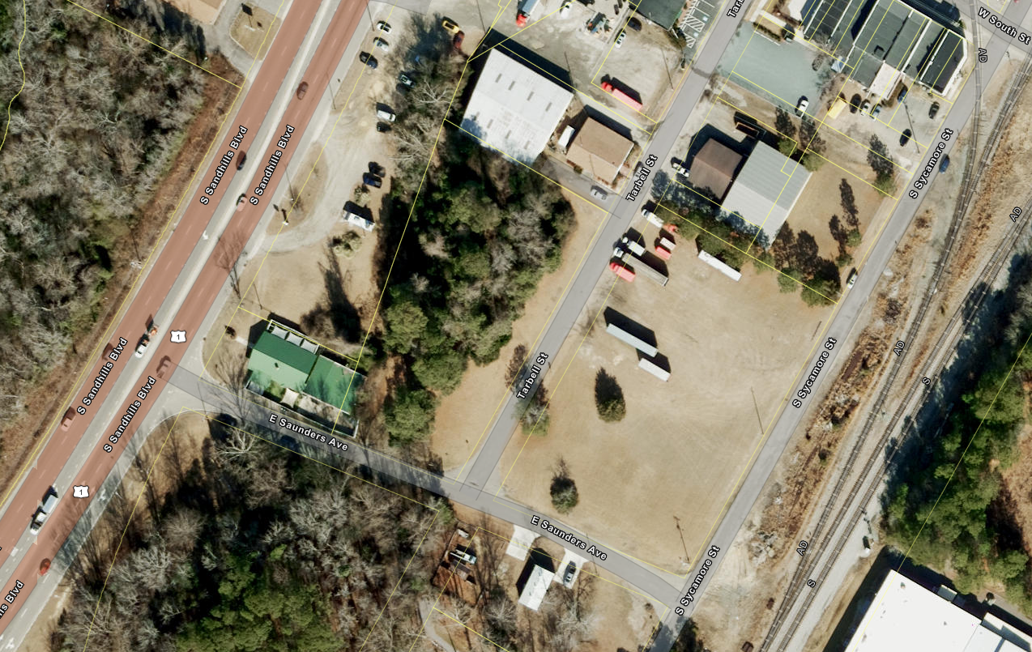
Example 2:
1.5-acres
10% = 6,534 sf
Zoning - Industrial
Road 2
(25’ x 200’)
Hwy 999
Hwy 999
Road 3
534 sf
Specimen Tree
(Type 1)
Road 1
5,000 sf
Planted Buffer (Type 5)
1,000 sf
Picnic Area (Type 4)

Slide 14
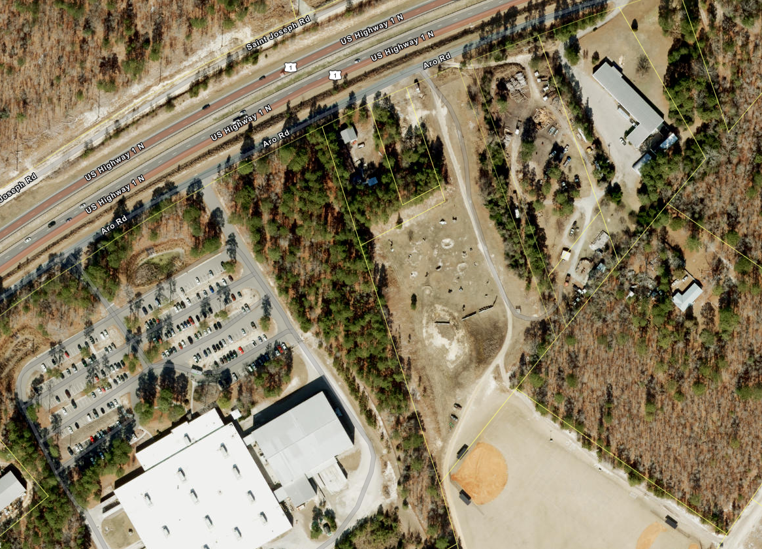
Example 3:
5.44-acres
10% = 23,700 sf
Zoning - Industrial
50’ Planted HCO Buffer
~6,000sf
Road 1
Hwy 00
Undisturbed Buffer
40’ x 300’
=12,000sf
20’ Planted Buffer
185’ x 20’
~3,700sf
~2,000 sf
Usable Open Space (picnic area)
Industrial abutting industrial required width = 10’

Slide 15
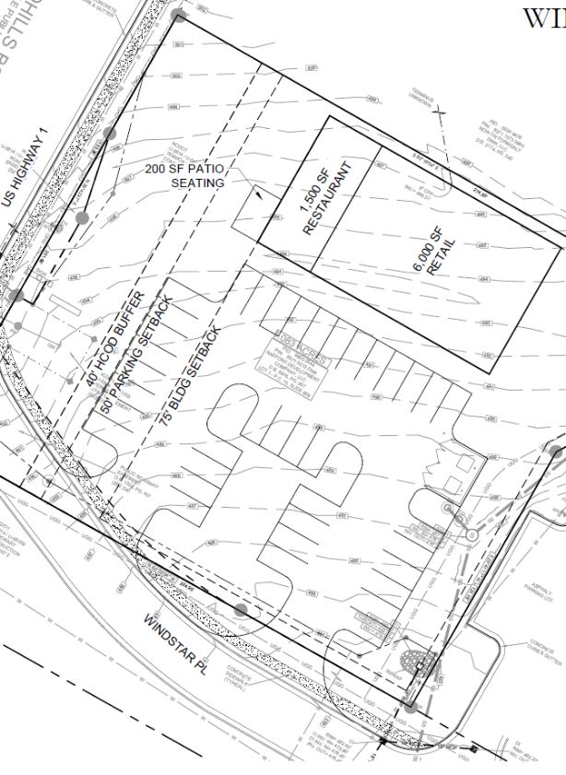
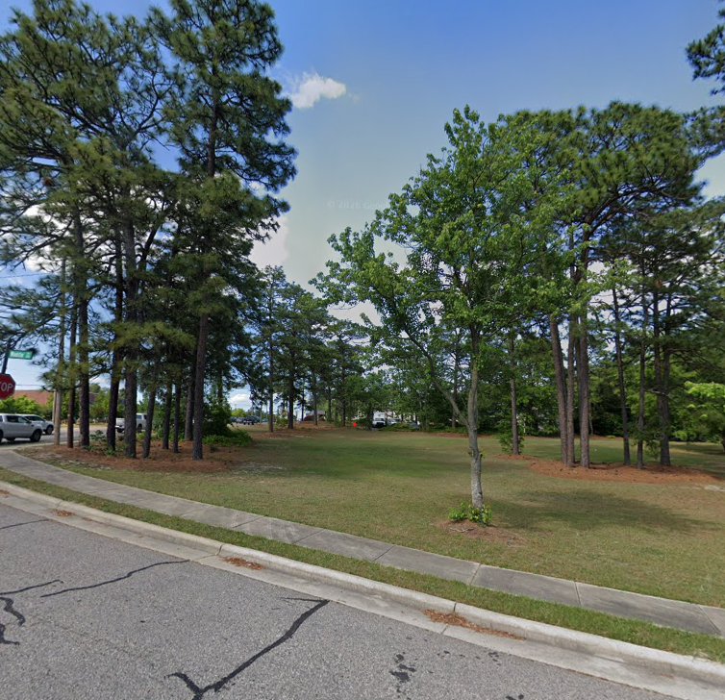
Administrative Minor Modifications
Example:
Type 3: Undisturbed & Planted Buffer
Type 1: Specimen Trees

Slide 16
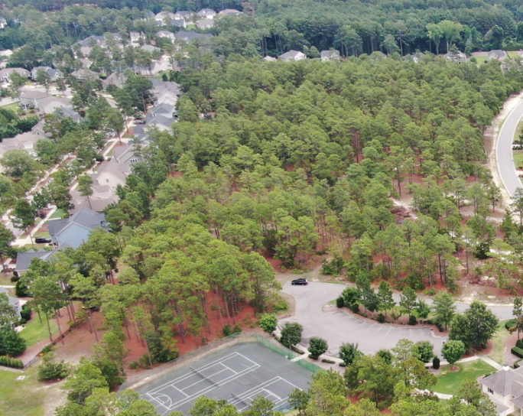
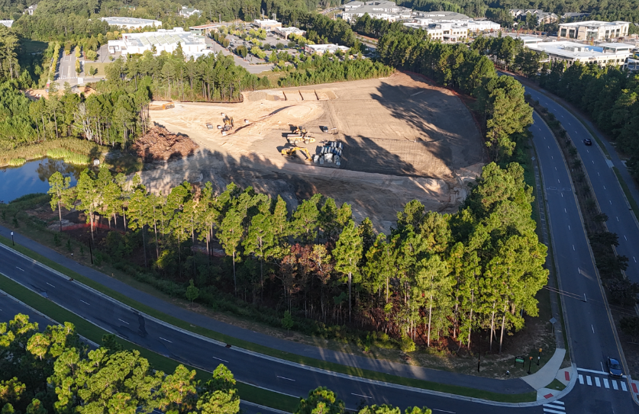

Questions for Southern Pines?

