Slide 1
Onslow Bight
Conservation Forum
3DEC25
Controlled By: G7, MCIEAST-MCB
CUI Category (ies): NA
Limited Dissemination Control: NA
POC: M Korenek, (910) 449-9791

Slide 2

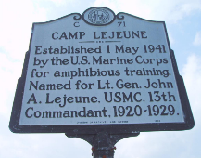
Accomplishments:
MCIEAST Encroachment Protection Easements
  Carteret 2 PH2 (Easement on 593.27 acres in Carteret County/NCCLT)
  McCotter 2.5 (1,568.43 acres of working lands located in Pamlico County, NC/NCADFP)
  Jenkins (199.14 acres of working lands located in Jones County, NC/NCADFP)
  Ramsey/Sharpe Tract (Ramsey tract 78.92 acres and adjacent Sharpe tract 3.52 acres in Onslow County, TNC)will add the combined 82.44 acres to the Horse Swamp Preserve)
Long-Term Restoration Success:
Camp Lejeune RCW Recovery
  Total clusters on the ground – 163
  Total number of active clusters – 157 (recovery goal of 173 – 16 away!)
  Number of potential breeding groups – 150
MCAS Cherry Point Living Shoreline
  12,036 linear foot rip rap sill parallel to the shoreline between the mouth of Slocum Creek and Hancock Creek in Havelock, Craven County, NC/REPI Challenge and military funds
Opportunities:
  Encroachment protection easements with multiple partners in progress.

Slide 3

Accomplishments:
Newport River Watershed Preserve: Partnered with the NC Coastal Land Trust to acquire or obtain commitments to acquire over 3,000 acres along Mill Creek Road, with financial assistance from the Navy. These properties contain valuable longleaf habitat.
North River Wetland Preserve Expansion: We are actively purchasing nearly 1,000 acres (fee-simple and easements) adjacent to the preserve in the North River headwaters. This project involves Weyerhaeuser and a private landowner, with support from the Navy, NC State Parks, and NCLWF. Some of this acreage may support longleaf restoration. The properties will support a segment of the NC Mountain-to-Sea Trail.
Turkey Creek Acquisition (Onslow County): Aquiring over 100 acres along 10,000 linear feet of Turkey Creek near Stump Sound through a donation, with transactional support from the NCLWF. This forested and riparian saltmarsh property has high natural heritage value and may contain minor stands of longleaf.
Long-Term Restoration Success:
Quaternary Property (Onslow County): We successfully transferred the 1,600-acre Quaternary Property along the White Oak River to the NCWRC about two decades ago. A key stipulation was that approximately half of the property, previously loblolly pine plantations, would be converted to permanent longleaf pine habitat. I am pleased to note that the WRC appears to have fulfilled this obligation, and there are now good stands of longleaf growing on the suitable acreage.
Opportunities:
We are currently working on new acquisition prospects in the same areas that have strong potential for longleaf pine restoration.

Slide 4

Accomplishments:
November 2024 - Closed on the second phase of Newport River Initiative with another 593 acres protected along the northern shoreline of the Newport River in Carteret County. As was the case with Phase I, the property was transferred to the N.C. Coastal Federation and plans are underway for a large-scale wetland restoration.
April 2025 - Closed on the purchase of the 96-acre South End of Topsail Beach. NCCLT currently holds ownership but plans to transfer the property to the State of N.C. to be managed by the Division of Coastal Management. The property will now remain open to the public in perpetuity.
Opportunities:
Several new land conservation opportunities have begun to materialize within the Onslow Bight Landscape - more good things to come.

Slide 5

Accomplishments:
Land Protection –In the process of conveying 3593 aces to NCWRC adjacent to Holly Shelter GL and several closings that got delayed but will protect 341 acres mostly surrounding Holly Shelter GL. Supporting partners include DoD/REPI, NCLWF, NCWRC.
Fire Management – in the OB, lead 16 burns on TNC preserve burning 980 acres and assisted partners in burning 2493 acres. Across the southeast (all three partnership areas) lead 67 burns on 4840 aces of TNC land and assisted partners in burning 14,869 acres.
Opportunities:
Currently working with NFWF to execute our joint CFA OB Longleaf Stewardship grant in the amount of $850,000 over two years to support shared fire crews, over 50,000 acres of prescribed burning, 1091 acres LLP planting, 3236 acres of midstory control and wiregrass planting, and outreach to over 7000 people, with funding going to NCSP, NCWRC, PCP, Waccamaw Siouan Tribe, Quail Forever and TNC.

Slide 6
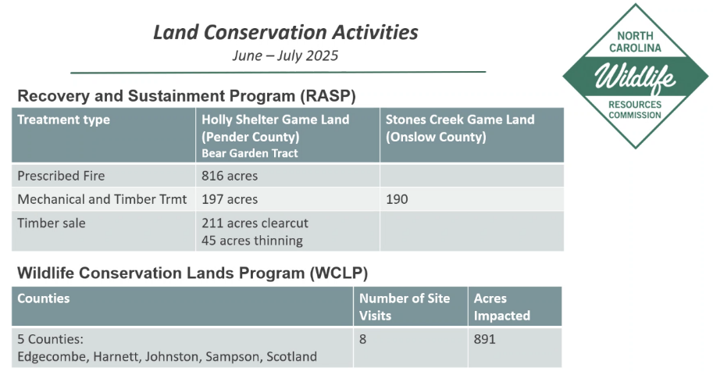

Slide 7
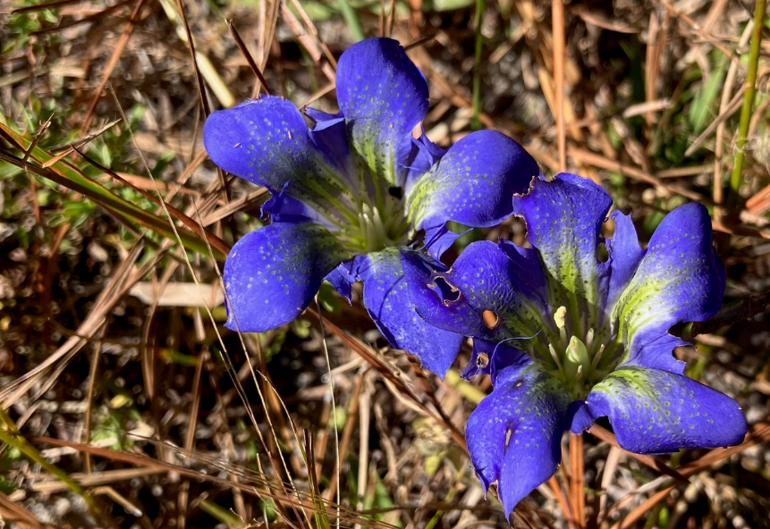
Pine Barren Gentian
(Gentiana autumnalis)
QUESTIONS?

