Slide 1
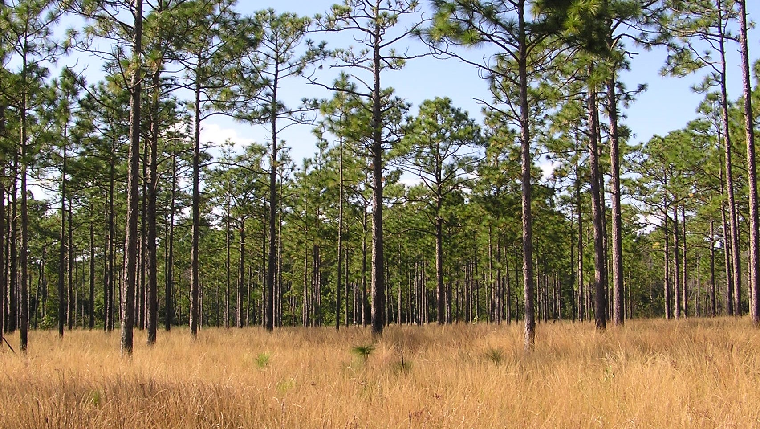
ONSLOW BIGHT CONSERVATION FORUM
- Partner Updates -
North Carolina Longleaf Pine Summit
March 9, 2022

Slide 2
North Carolina Coastal Land Trust
Onslow Bight and Cape Fear Arch landscapes this past year plus.
Prescribed burn on 105-acres of our 160-acre B.W. Wells Savannah in Pender County (CFA)
Prescribed burn on 33-acres our 298-acre Magnolia Preserve in Craven County (OB)
Planted 80-acres to longleaf pine on our 923-acre Bern Preserve in Craven County (OB).
Purchased 355+acres of land in Craven County from Weyerhaeuser Company which was added to our existing 568-acre Bern Preserve.
The 355-acre portion contains over 50-acres of mature longleaf pine!
The Bern Preserve lies adjacent to a portion of the Croatan National Forest.

Slide 3
The Nature Conservancy
Longleaf work on TNC properties in the Onslow Bight:
Burned 1103 acres
Completed TSI projects on 107 acres
TNC will also be submitting OB NFWF Grant application which has changed to a 3 year performance period. The grant will be similar to previous grants and will support:
Targeted outreach for private forest owners
Aerial ignition funds for multiple land managers in the Onslow Bight
4 month TNC crew for supporting prescribed fire and other restoration work among land managers in the Onslow Bight

Slide 4
The Nature Conservancy
Camp Lejeune-Holly Shelter Corridor:
Gray tract – ~40 acres beside NC 50 closed in to be included into TNC’s Flat Swamp Preserve
Corbett Brothers tract - ~264 acres most of which will go into HSGL. TNC will retain ~40 acres for Flat Swamp Preserve. To close later in 2022
Corbett Package tract - ~3,360 acres going into HSGL to close later in 2022.
Camp Lejeune-Croatan Corridor:
Matthews tract - ~200 acres closing in May going into TNC’s Horse Swamp Preserve.

Slide 5
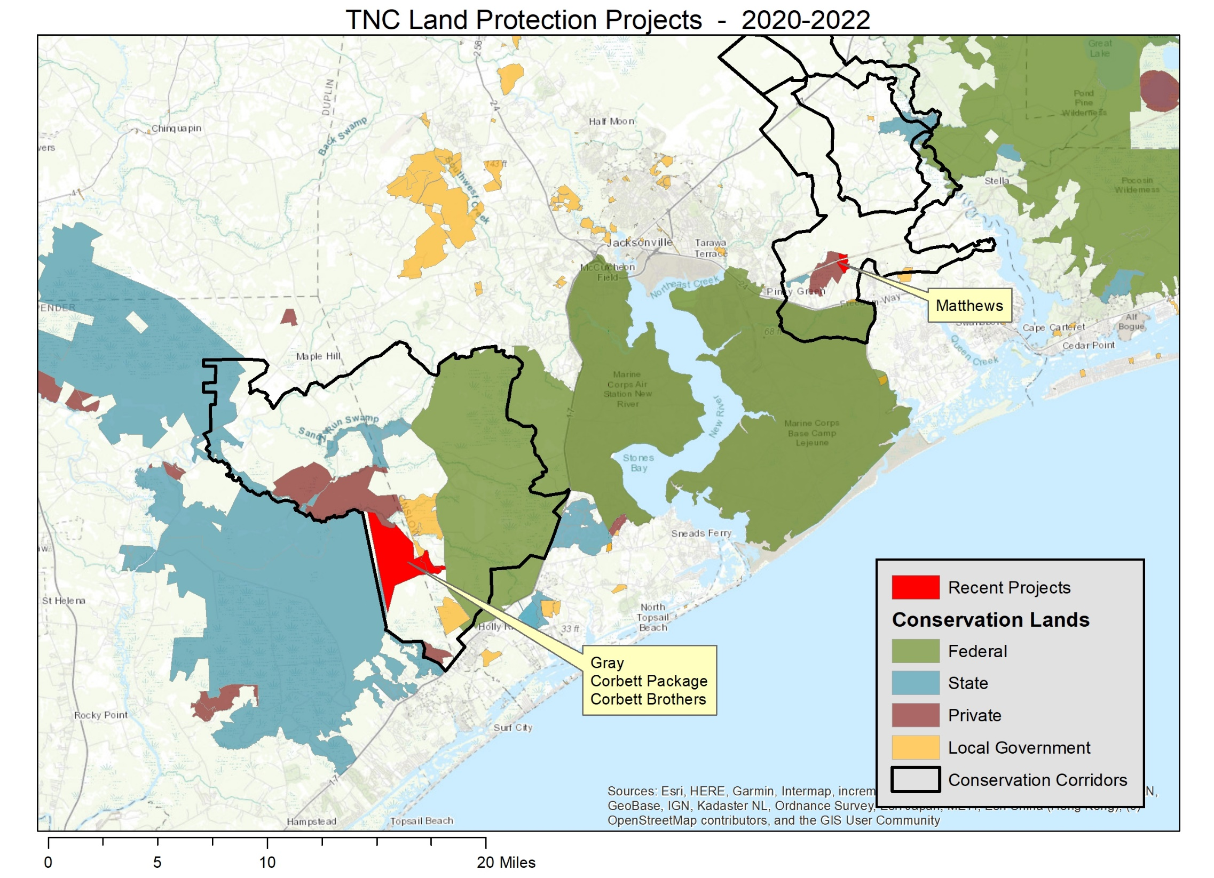

Slide 6
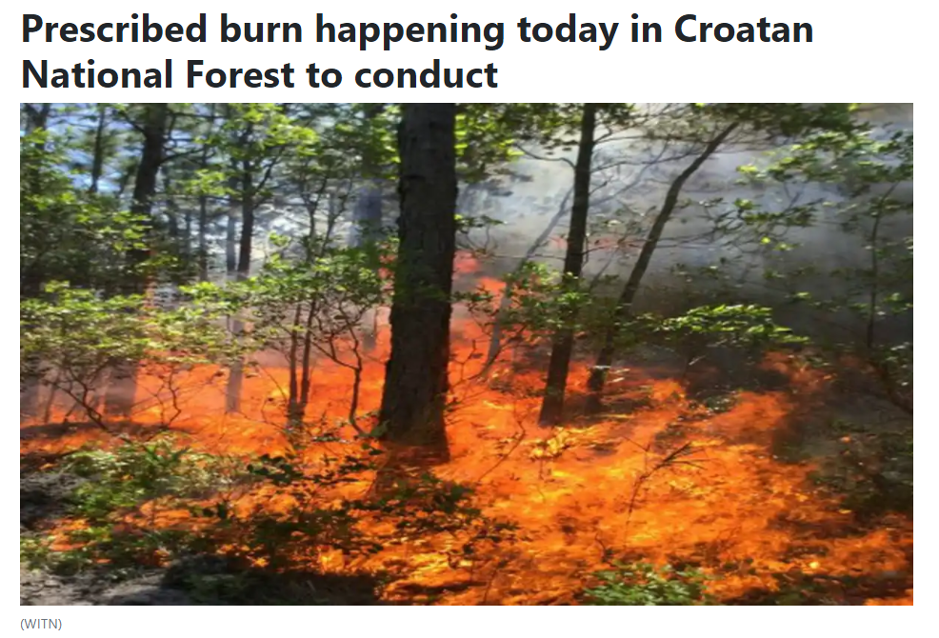
Croatan National Forest
14,654 acres burned in CY22, current to Feb 24.

Slide 7
NORTH CAROLINA WILDLIFE RESOURCES COMMISSION
REGION Acres LL Established Acres Burned Acres LL Maintenance Acres Acquired/Easements
Cape Fear-Bladen 384 4236 107 32
Northern Coast 52 472
Onslow Bight 1612 3565 315
Sandhills-Uwharrie 14408 675 125
--------------------------------------------------------------------------------------------------------------------------------------------------------
TOTALS 2048 22681 1097 157

Slide 8
Marine Corps Base Camp Lejeune
135 Acres Longleaf Planting
16,125 acres burned (55 wildfires – 7073 acres, 41 prescribed burns - 9052 acres)
43 Acres Mechanical TSI
156 acres mechanical midstory control (red-cockaded woodpecker)

