Slide 1
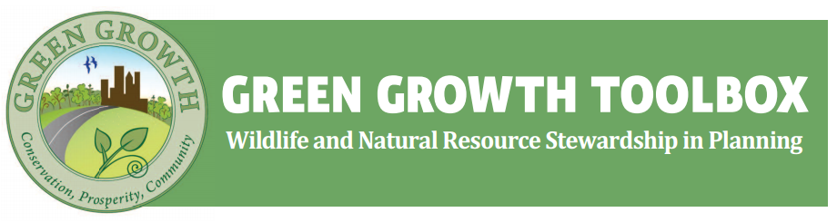
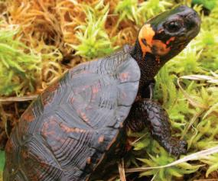
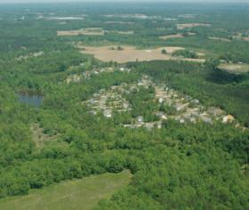
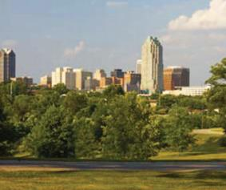
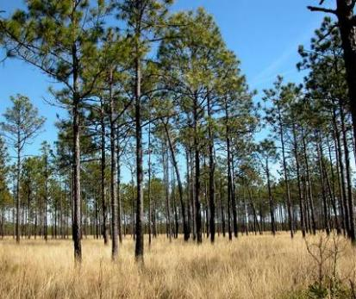


Alisa Davis
Wildlife & Fisheries Conservation Planner
NC Wildlife Resources Commission

Slide 2
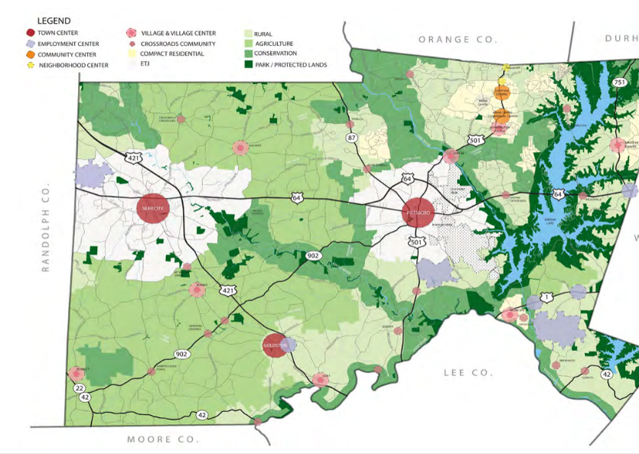
Land Use Planning…
“…the human use of land. It represents the economic and cultural activities (e.g., agricultural, residential, industrial, mining, and recreational uses) that are practiced at a given place.” –USEPA (www..epa.gov/report-environmental/land_use)
Hazard Mitigation & Safety
Community Service and Utility Accessibility
Transportation
Economic Growth
Conservation & Compatible Use Priorities

Slide 3
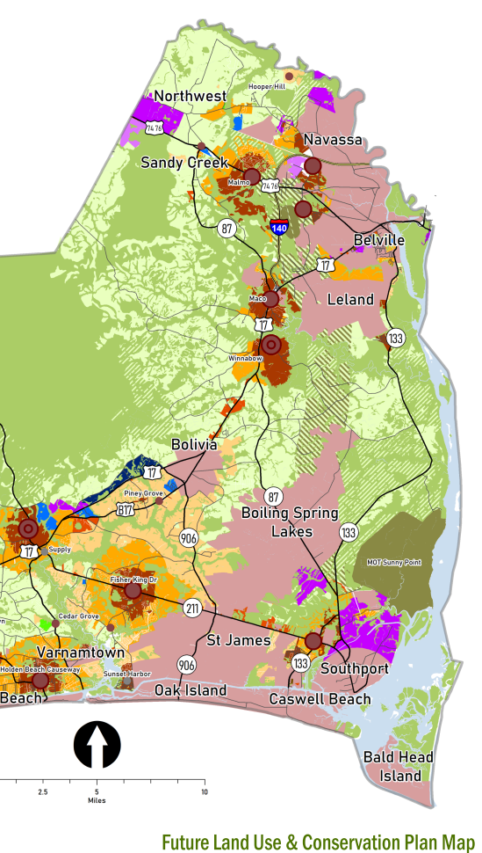
Land Use Plan
Develops policies to guide land use decisions
Informed by Community

Slide 4

Land Use Plan
Zoning & Ordinances
Develops policies to guide land use decisions
Informed by Community
Rules that dictate how properties can be developed
Zoning
Overlay Districts
Incentives
Design Requirements

Slide 5
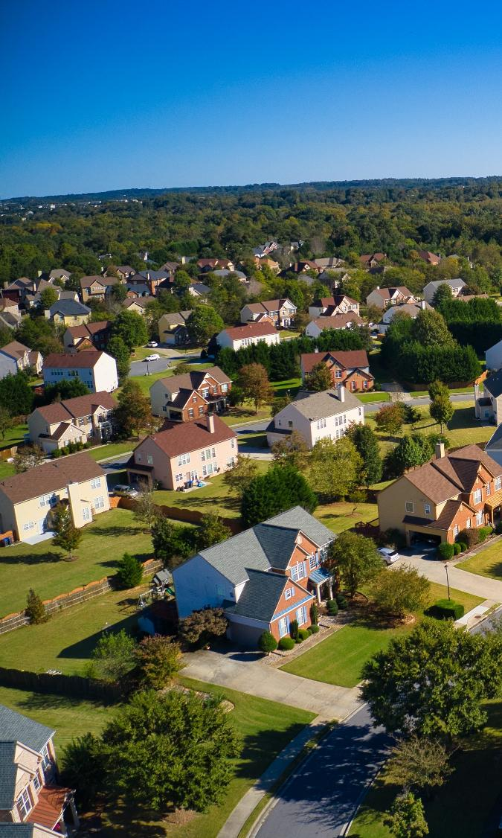
Land Use Plan
Zoning & Ordinances
Development Review
Develops policies to guide land use decisions
Informed by Community
Rules that dictate how properties can be developed
Zoning
Overlay Districts
Incentives
Design Requirements
Approvals sought by developer ensuring all ordinances have been followed

Slide 6
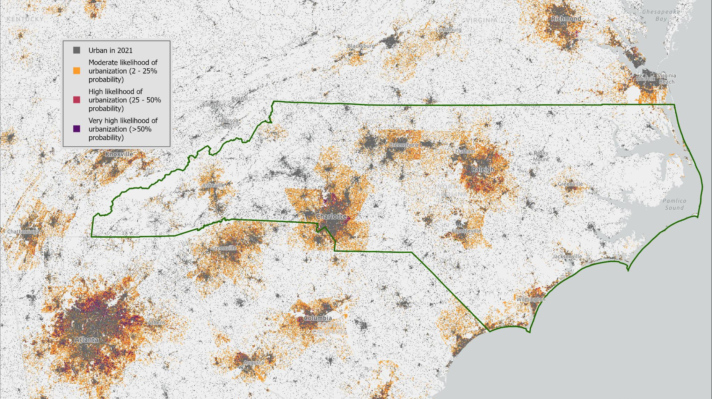
North Carolina State University FUTURESv2: Accessed through The Southeast Conservation Blueprint secassoutheast.org
Projected Urbanization 2060

Slide 7
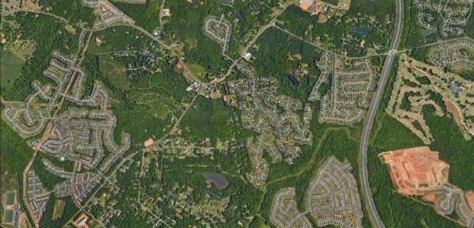
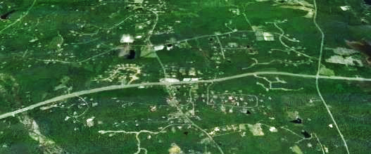
The #1 threat to wildlife in North Carolina
Habitat Degradation, Fragmentation, and Loss

Slide 8
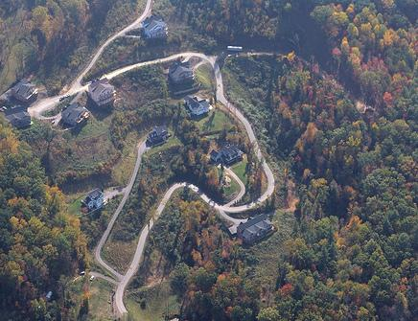
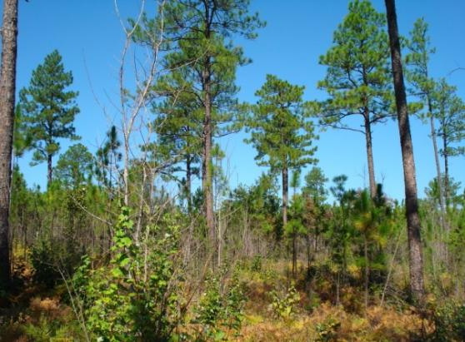
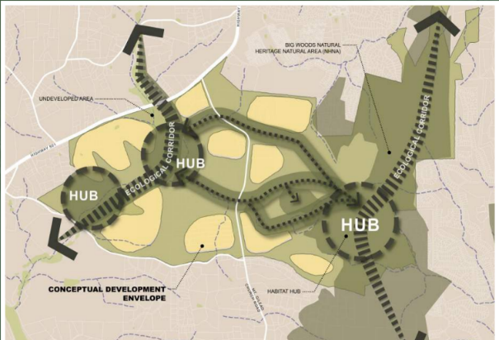
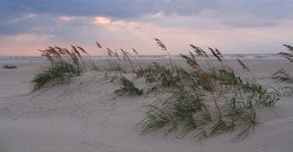
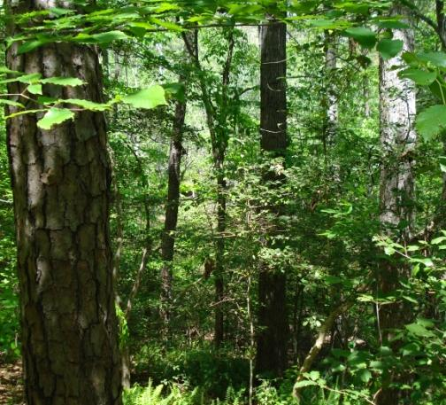
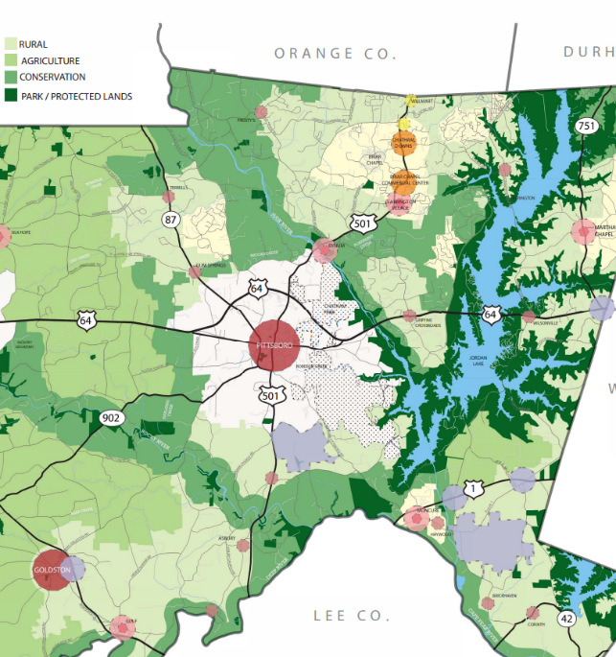
Green Growth
Conserving priority wildlife habitat while continuing to grow the economy

Slide 9
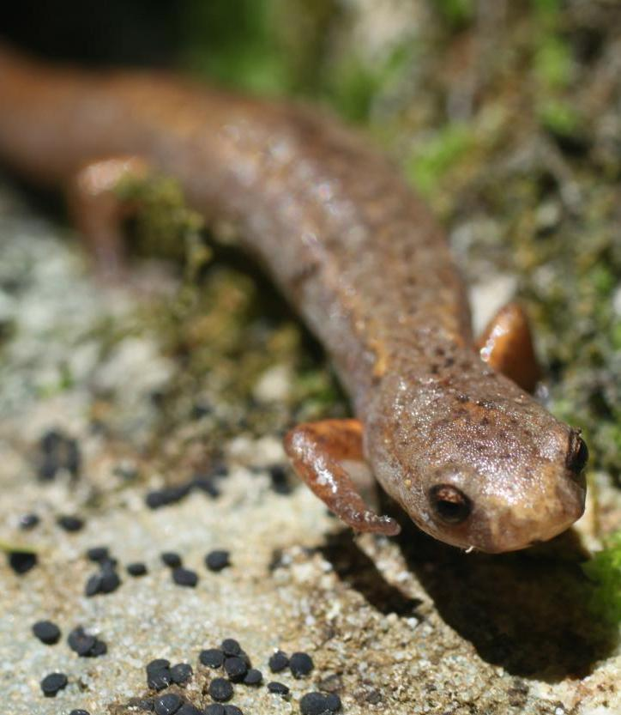
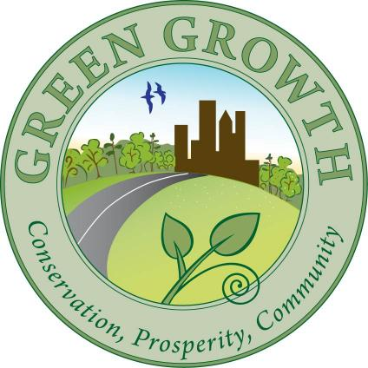
A non-regulatory
technical assistance program for integrating priority wildlife habitat
conservation in local government land use and
transportation planning
Notes:
So, the NC wildlife resources commission promotes a different planning paradigm, which is Green Growth. Green growth tries to get ahead of the development review by bringing conservation priorities into the planning and policy stages of community development. It is not about stopping development, rather it is about making land use decisions that avoid unnecessary habitat degradation, fragmentation, and loss. It is about understanding where priority habitats and natural resources occur in communities and supporting conservation of these areas, while promoting development in areas that are already degraded.
The Green Growth Toolbox program was created to be a resource to policy makers and community planners to support their economic growth while mitigating the negative impacts of growth on the environment.
Since 2010, we’ve trained over 760 professionals from local governments, regional councils of governments, consulting firms, and other conservation organizations. The Green Growth Toolbox is used in over 68 plans and ordinances in communities across the state.

Slide 10
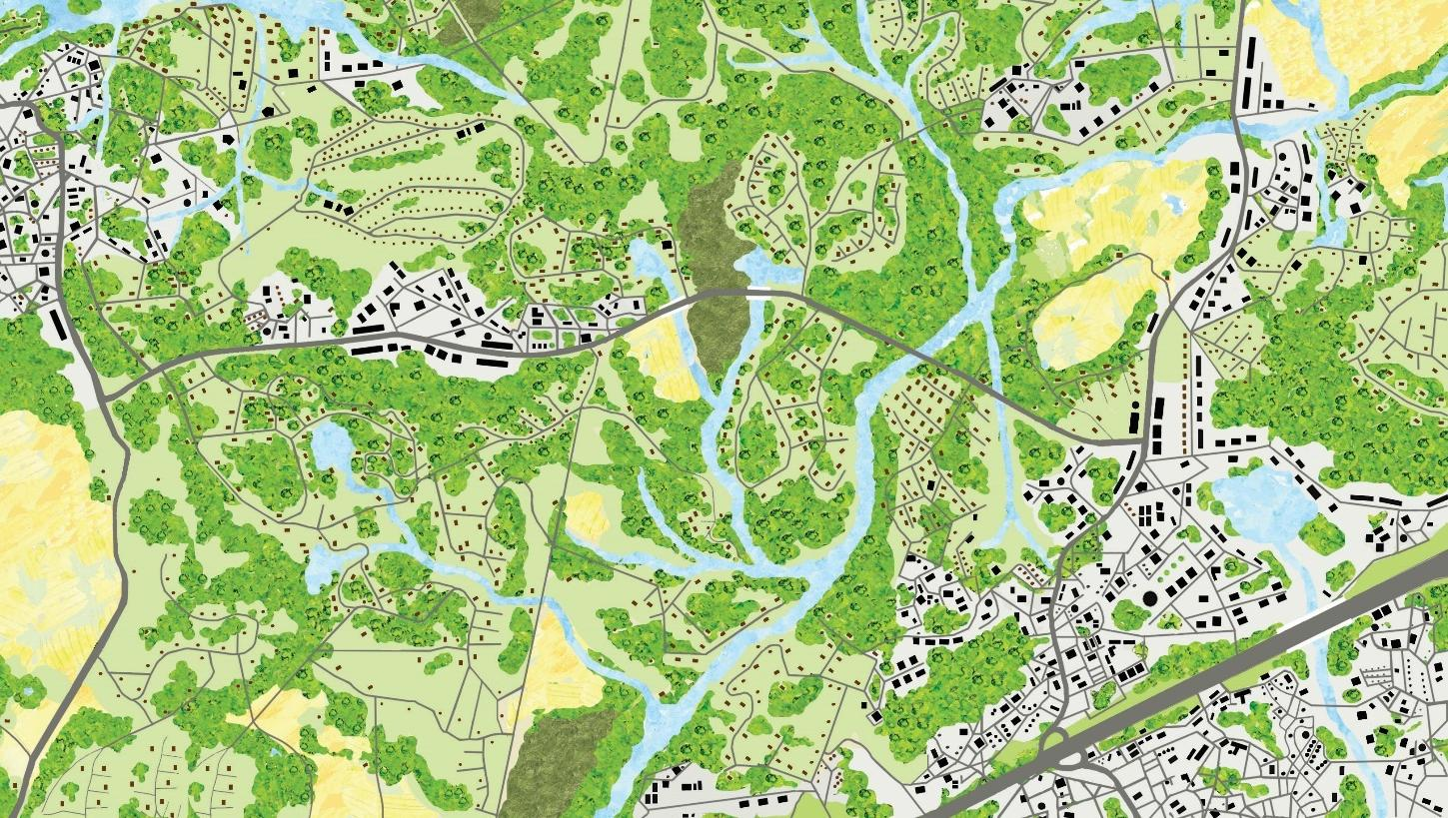
Habitat Fragmentation & Loss
Graphic design by Echo 3, Star, NC
Notes:
[Brooke] And, if you zoom into many of our communities what you will see on the ground is a development pattern like this; where there are homes and businesses spread through put the landscape and there are roads criss crossing every direction to connect everyone to everything.
The result of this pattern of development being that our natural areas are broken into smaller and smaller pieces that are not connected.
This is habitat fragmentation, and along with habitat loss, is the leading cause of wildlife population declines in the state, and we see it happening all over the state (and nation) as our communities grow.

Slide 11
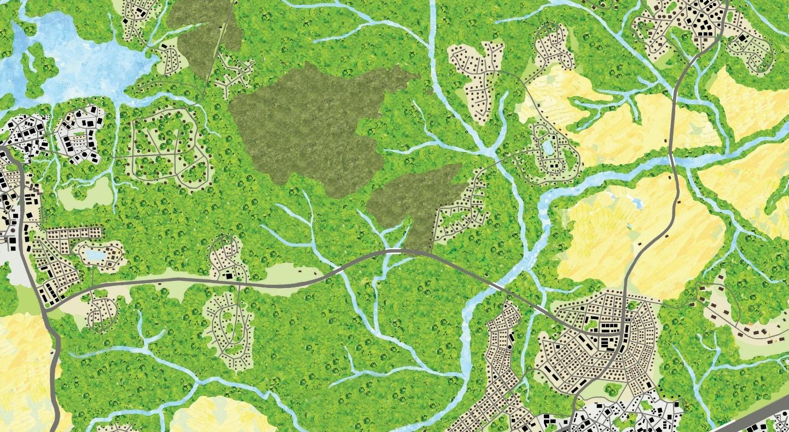
Plan for landscapes where development is not spread-out where wildlife & natural resources are secure.
Same amount of development
Conserve, Buffer, & Connect habitats
Minimize impacts
Improve habitat quality
Graphic design by Echo 3, Star, NC
Notes:
The result of a green growth development pattern would be more centralized development around existing infrastructure, it would be more inward and not outward growth so that our communities can support the same amount of development but like we see on this slide, our natural and working lands would be more intact, higher quality, buffered from development, and more connected.
Centralized development patterns promote infill development, and, in general, higher density development. We aim to help communities identify important natural areas and wildlife habitat corridors in their jurisdictions so that impacts on wildlife habitat can be avoided through future land use planning, incentives and ordinances and development design.

Slide 12
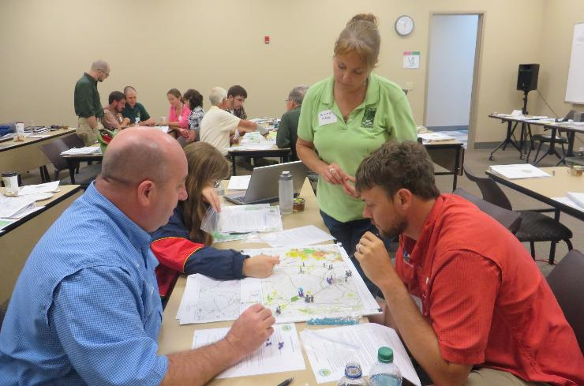
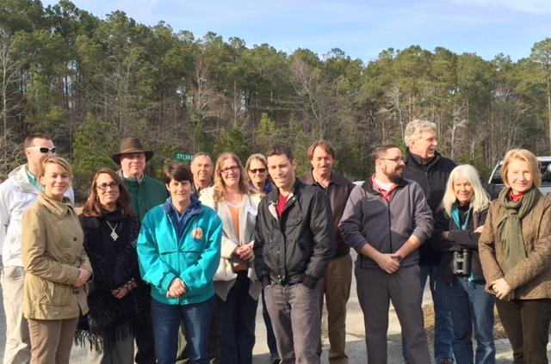
Green Growth Toolbox
Partners for Green Growth
Technical Assistance
Training Workshops
www.ncwildlife.gov/GGT
Recommended Conservation Data
Handbook and Regional Appendices

Slide 13
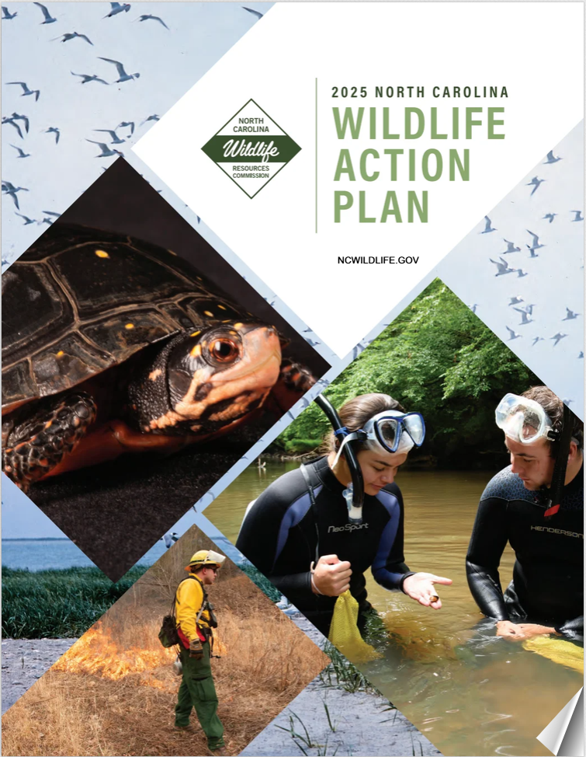
The Status of Wildlife in North Carolina
> 430 Species of Greatest Conservation Need
These species inhabit ‘Priority Habitats’
Spread-out development patterns are a top threat

Slide 14
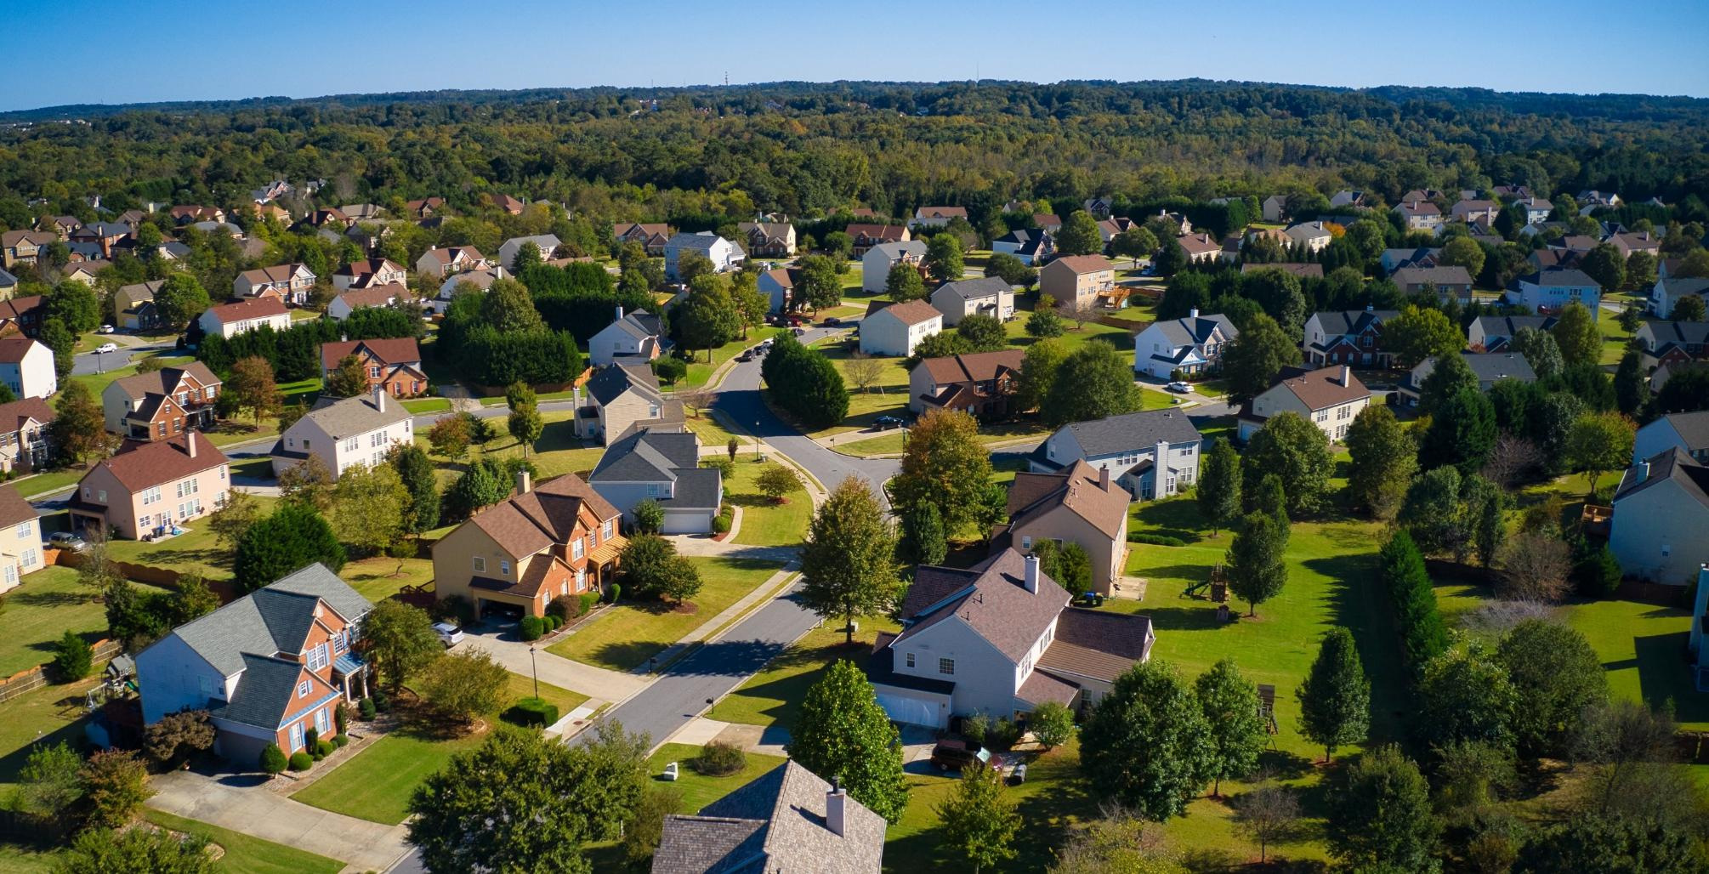
Spread-out development patterns cost developers & taxpayers more
38% higher upfront infrastructure cost, 10% higher maintenance
Taxes can be TWICE as high (Louisiana)
Notes:
Proof is in the Pudding!
At a larger scale, spread out development is costly to communities, where infrastructure costs are nearly 40% greater, with additional costs associated with its maintenance, for example, An analysis of budget deficits in Lafayette LA showed that taxes would need to be doubled to keep up with the costs of maintaining roads, and they would need to be quintupled from 1500 to 8000 a year to keep up with costs of maintaining all the other components of city services, on the flip side, more centralized development patterns would be less expensive to maintain and to build out
Section 1 of the GGT handbook
https://www.strongtowns.org/journal/2017/1/9/the-real-reason-your-city-has-no-money - taxes 2 times higher.

Slide 15
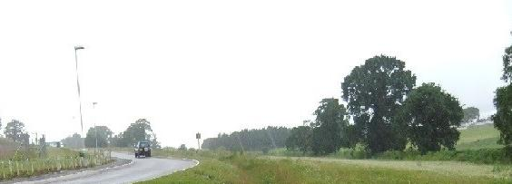
Cost of Stormwater Strategies
 | Construction cost/Gallon of water treated
Preserving Natural Areas | $0.03 - 0.05
Enhanced Infiltration | $0.05 - 0.10
Stormwater wetland ponds | $0.25 - 1.25
Sand/peat infiltration swales | $0.50 - 0.75
Rainwater harvesting | $0.50 - 2.50
Sand/peat filtration | $2.50 - 3.50
Renovation of urban streets | $5.00 - 12.50
Barrett L. Kays, Ph.D., FASLA, CPSS
Landis, PLLC, Raleigh, NC
Notes:
Barret Kays a professor at NC state shared this information at a green infrastructure conference a few years ago, he calculated the costs of different stormwater practices per gallon of water treated, and, as you can see the protection of natural areas is the cheapest option compared to the engineered practices. And, obviously, natural area provides multiple benefits that these other options won't provide.
We’re not suggesting that routing stormwater into natural areas is a method, rather that by having natural areas on the landscape they will naturally capture and filter stormwater.

Slide 16
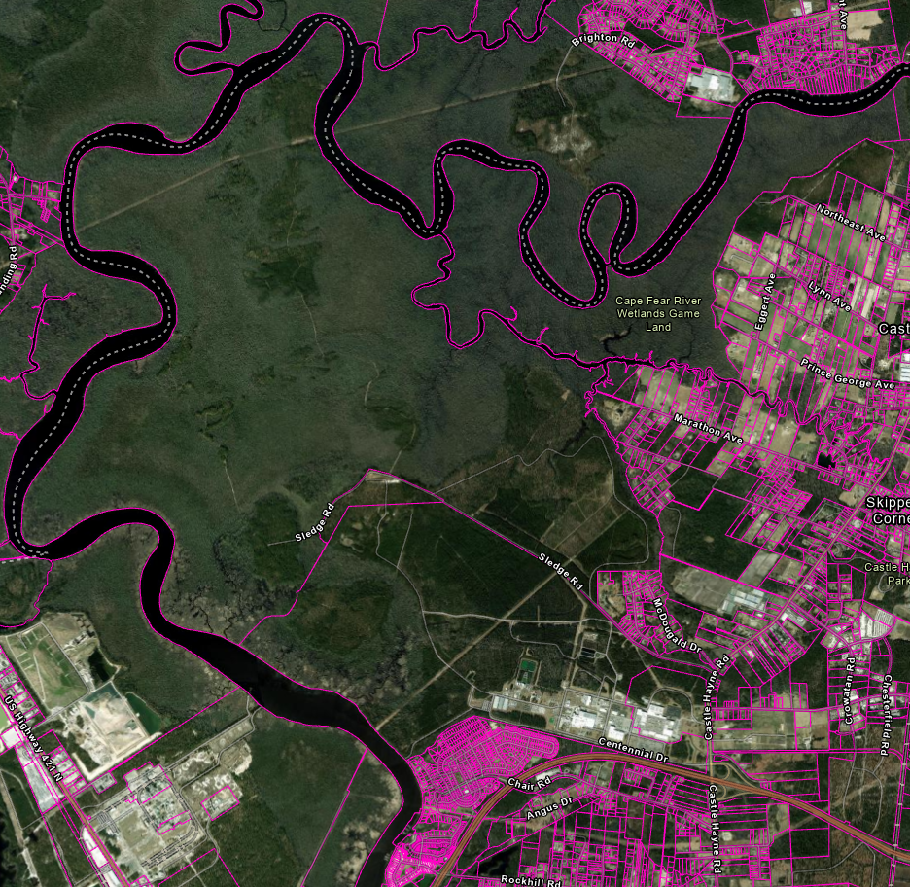
Barriers to Conservation in Land Use Planning
Private landowner rights

Slide 17
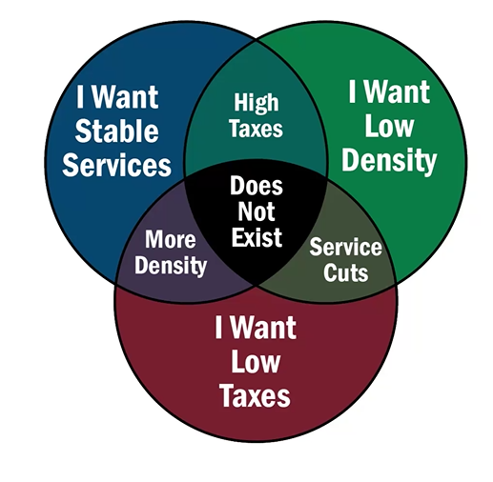
Barriers to Conservation in Land Use Planning
Private landowner rights
Balancing competing priorities

Slide 18
Barriers to Conservation in Land Use Planning
Private landowner rights
Balancing differing priorities
Political will

Slide 19
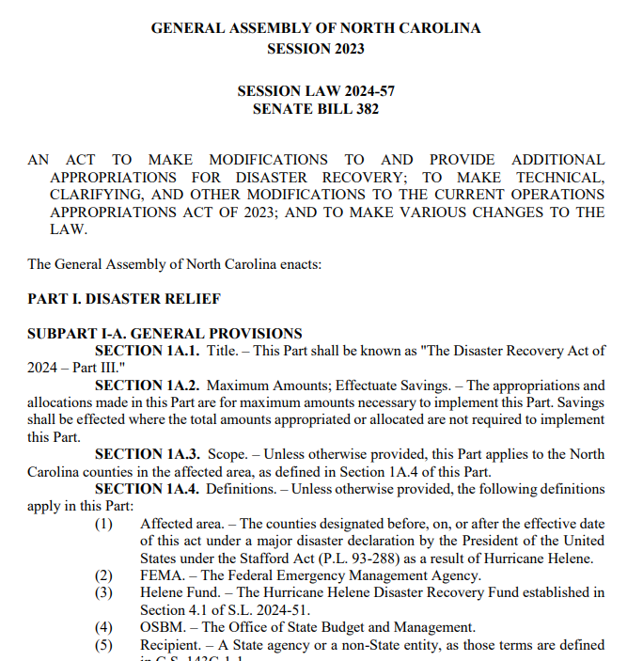
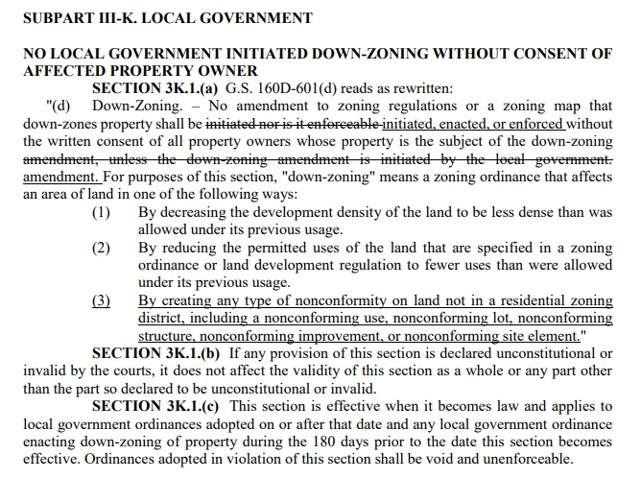
Barriers to Conservation in Land Use Planning
Private landowner rights
Balancing differing priorities
Political will
Legislative constraints
Notes:
Session Law 2024-57

Slide 20
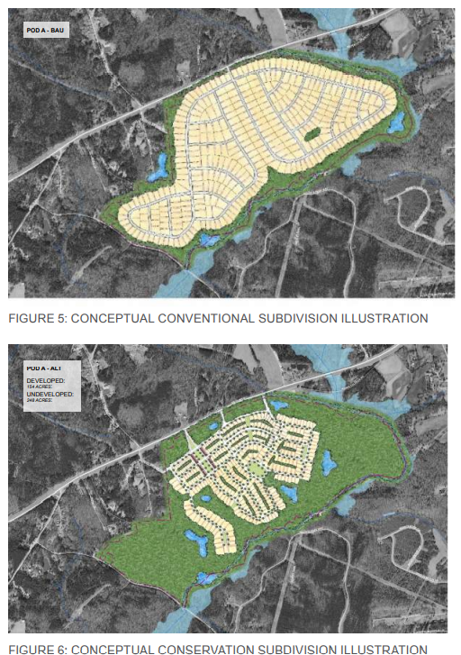
Barriers to Conservation in Land Use Planning
Private landowner rights
Balancing differing priorities
Political will
Legislative constraints
Roadblocks to implementation

Slide 21
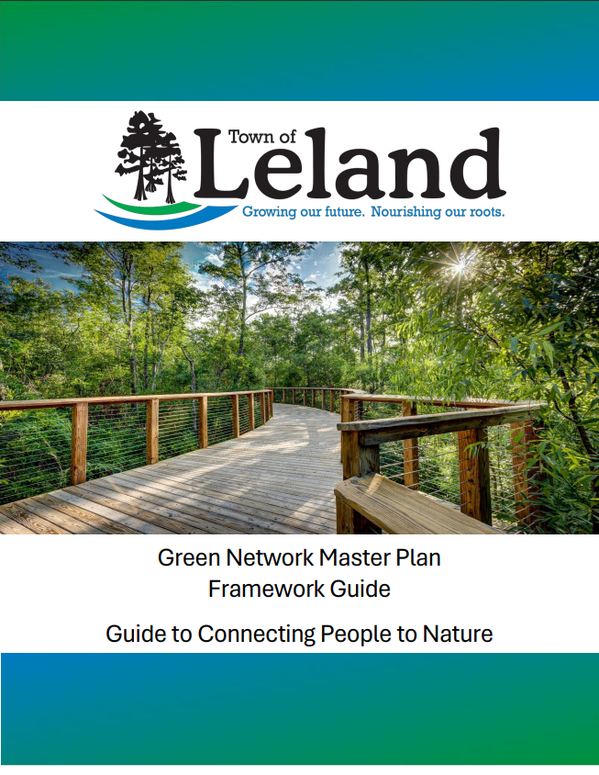
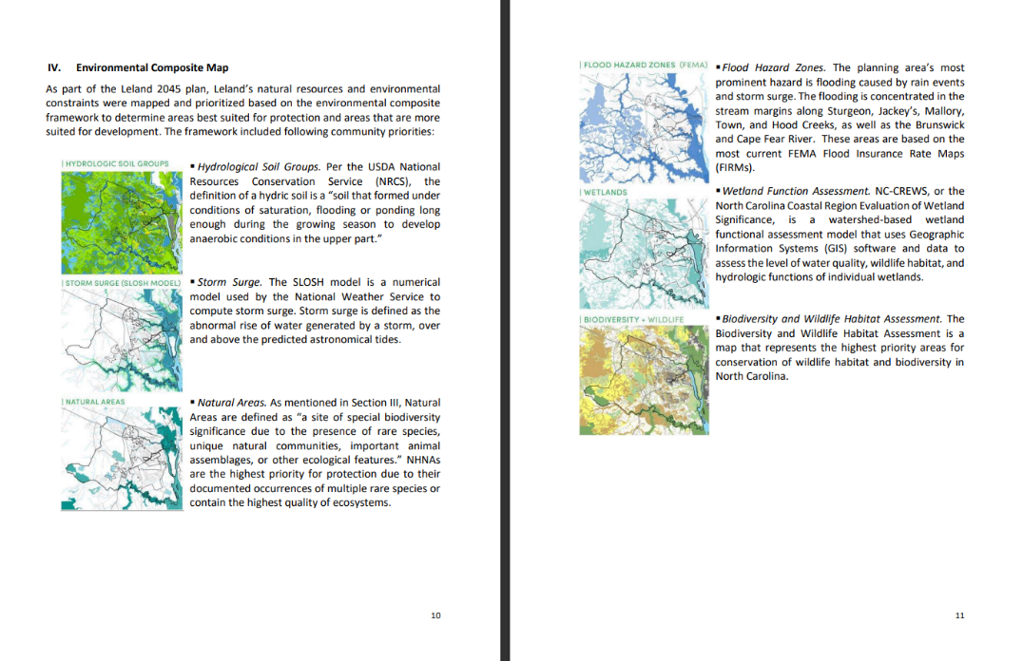
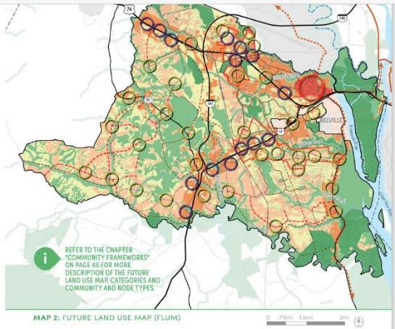
Leland Green Network Framework Guide
Notes:
Stormwater pump station moved due to flooding, being sited in location to have lowest impact, old location being turned into a park as art of this plan’s implementation
The town of Leland completed a preferred development guide that integrates recommended conservation data into an environmental composite map. This map was used to inform their policy on growth patterns for the town that would help conserve wildlife and reduce the impact of extreme weather events on it’s citizens.

Slide 22
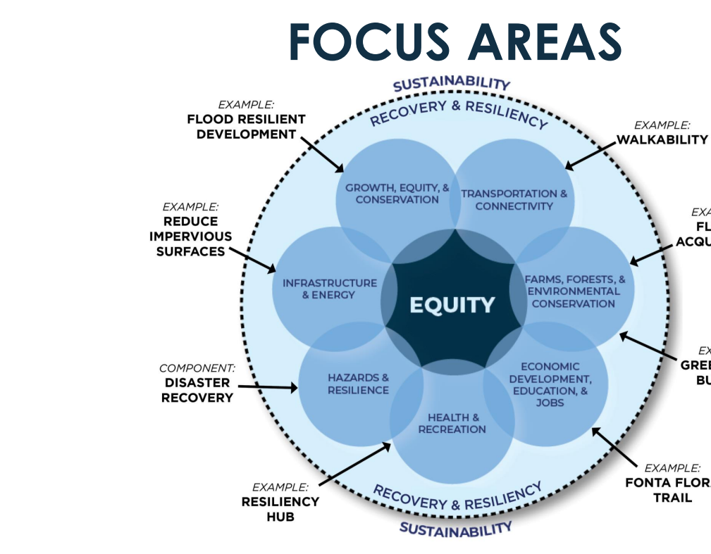
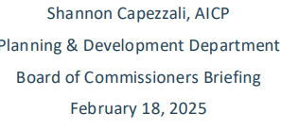
Small Area, Hazard Mitigation, and Resiliency Planning
Notes:
Small area plan and a hazard mitigation and resiliency plan

Slide 23
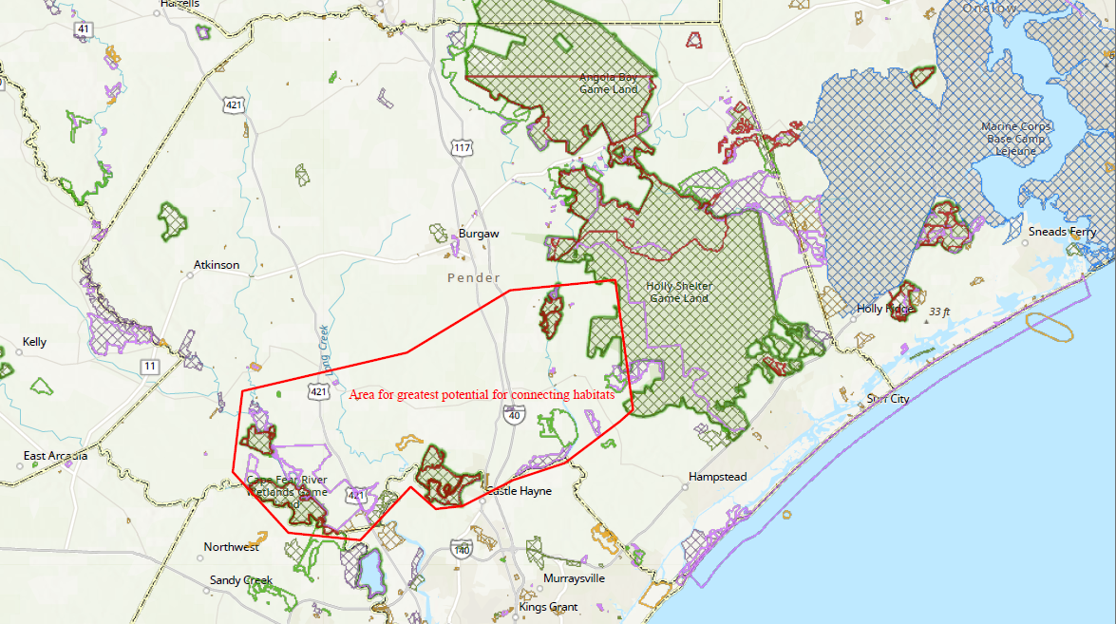
selecting visual aids
ENHANCING YOUR PRESENTATION
Notes:
Green Growth Toolbox Preferred Development Guide
Wildlife Corridors: Game Lands to the Rivers
Concepts and Policy Recommendations:
Riparian Buffers
Tree Preservation
Floodplain Development
Cluster Development with incentives
Big Question for Implementation: Which incentives will work?

Slide 24
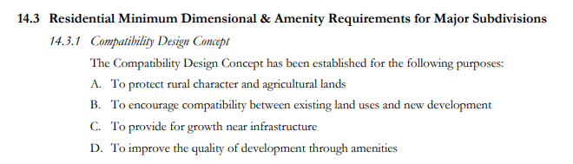
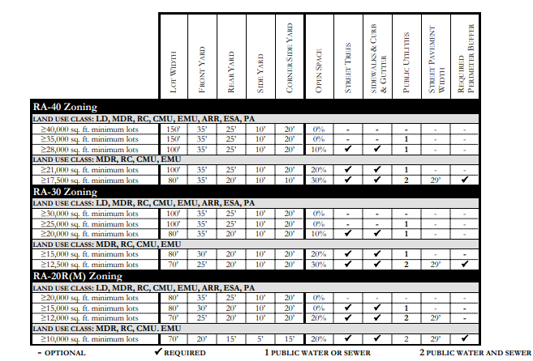
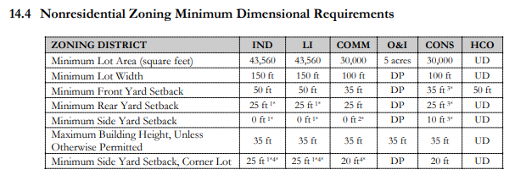
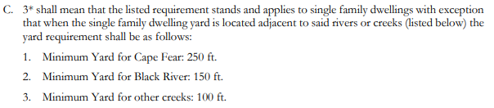
Incentives

Slide 25
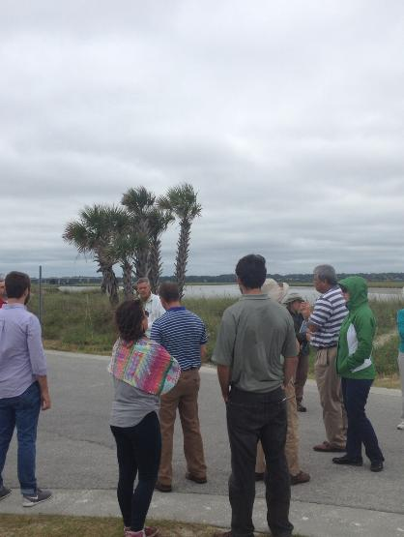
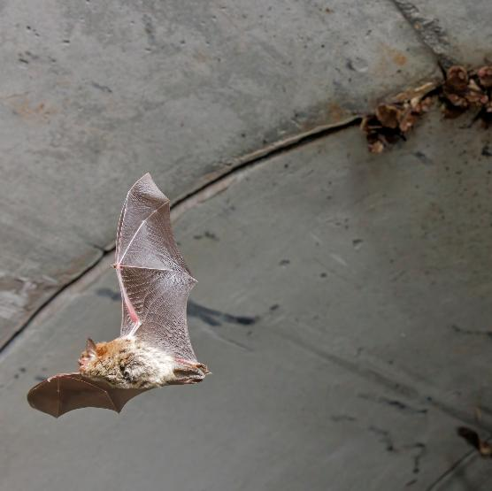
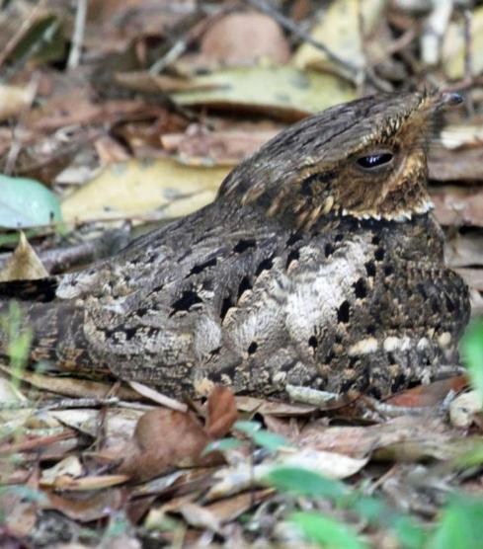
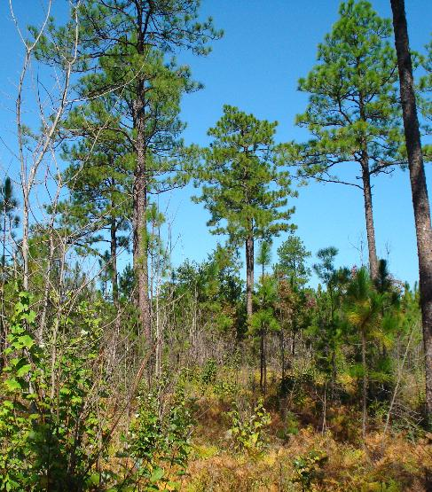
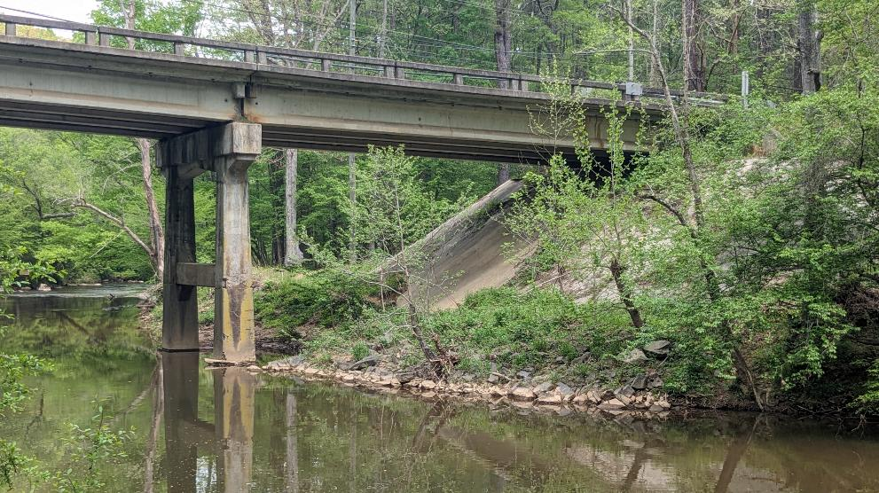

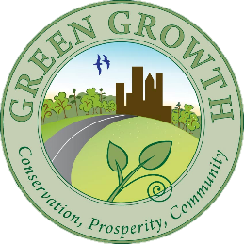

THANK YOU!
alisa.davis@ncwildlife.gov
brooke.massa@ncwildlife.gov
www.ncwildlife.gov/GGT

