Slide 1
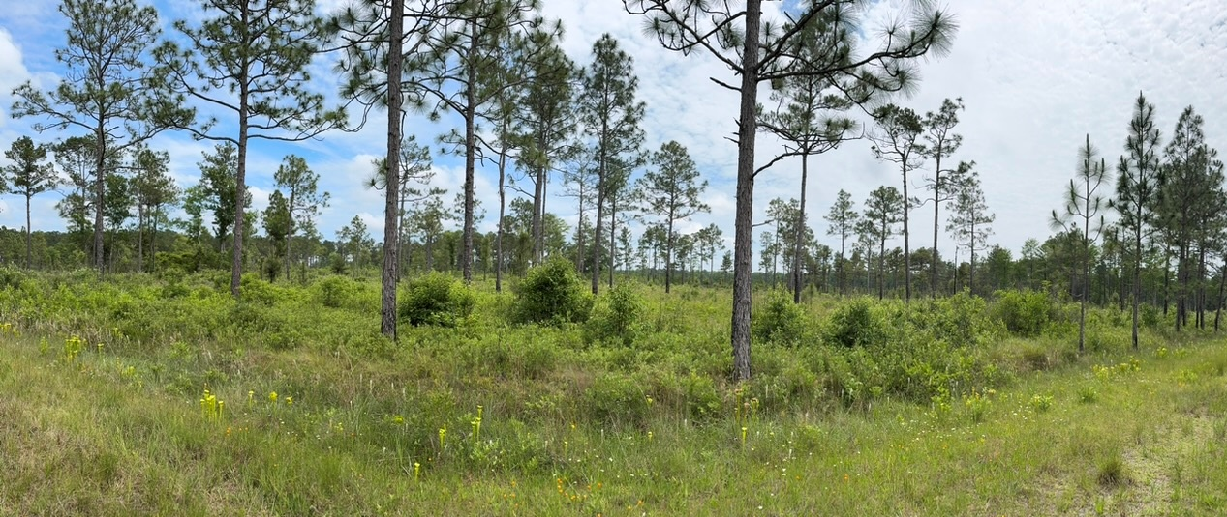
Invasive Ants in the Longleaf Pine Savannas
Kaitlin U. Campbell, Erika Rivera, Aaron Hartman, & Lisa Kelly
University of North Carolina- Pembroke

Slide 2
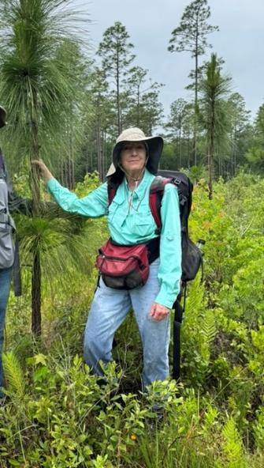
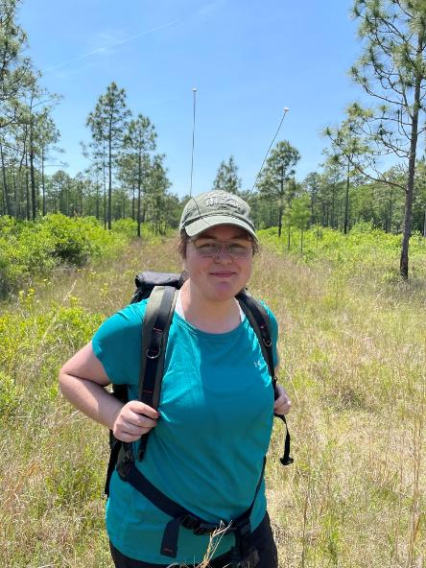
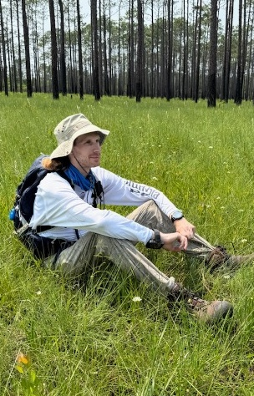
Acknowledgements of Co-authors

Slide 3
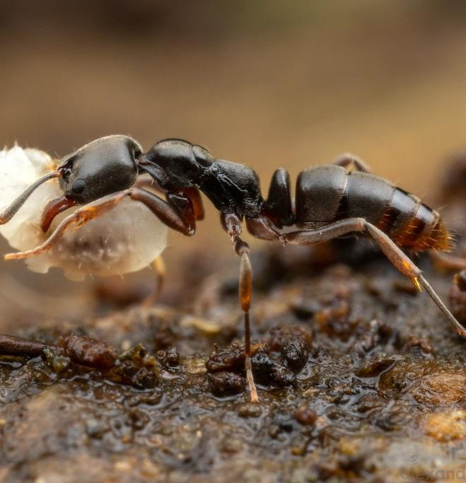
Background
Ants are great bioindicators and drivers of biodiversity¹
Invasive ants tend to be more competitive than native ants² and can form super colonies³
Brachyponera chinensis (Asian Needle Ant) and Solenopsis invicta (Red Imported Fire Ant) are invasive ants recently documented in NC savanna systems⁴
Longleaf pine savannas are biodiversity hotspots
Notes:
Ants are dominant arthropods in most ecosystems

Slide 4
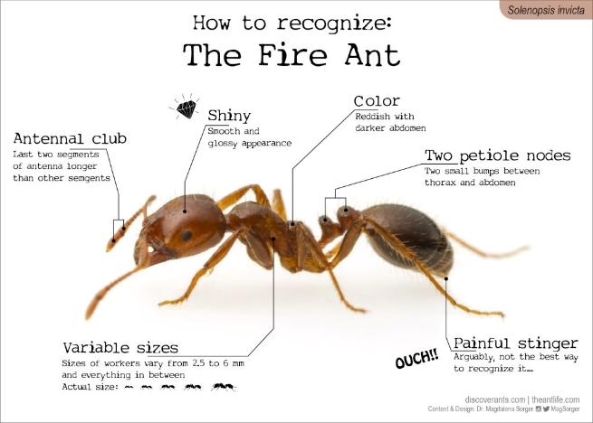
Solenopsis invicta
Red Imported Fire Ant (RIFA)
First detected in AL 1930s
Spread widely in urban, open habitats
Large mounds
Stings aggressively

Slide 5
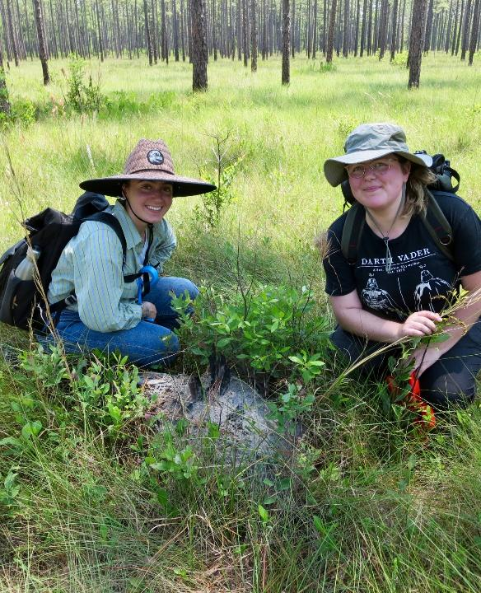
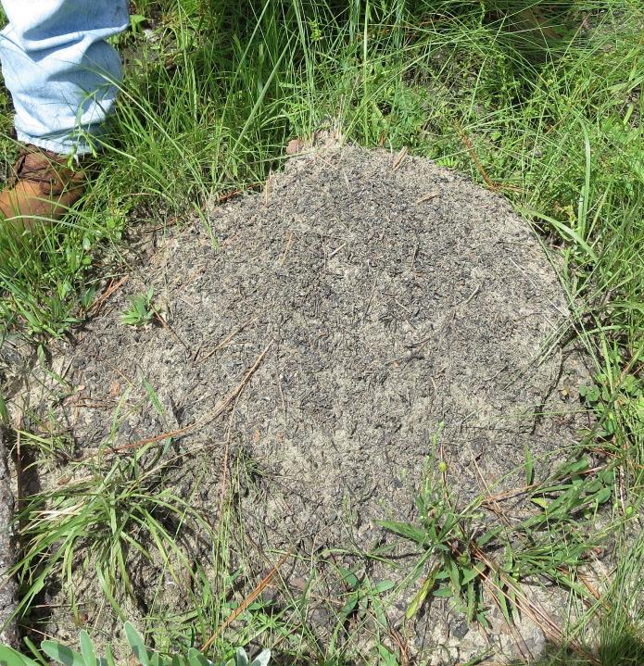

Slide 6
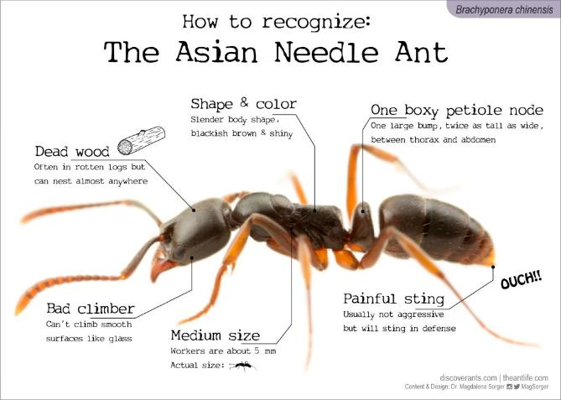
Brachyponera chinensis
Asian Needle Ant (ANA)
First detected in NC 1932^{5,6}
Nest in wooded habitats in logs and leaf litter
Natural or urban environments^{5,6}
Less responsive to baits-perform “tandem carrying”
Not aggressive, but sting is very painful
Notes:
https://mississippientomologicalmuseum.org.msstate.edu/Researchtaxapages/Formicidaepages/ant.publications/Brachyponera_chinensis_identifications.pdf

Slide 7
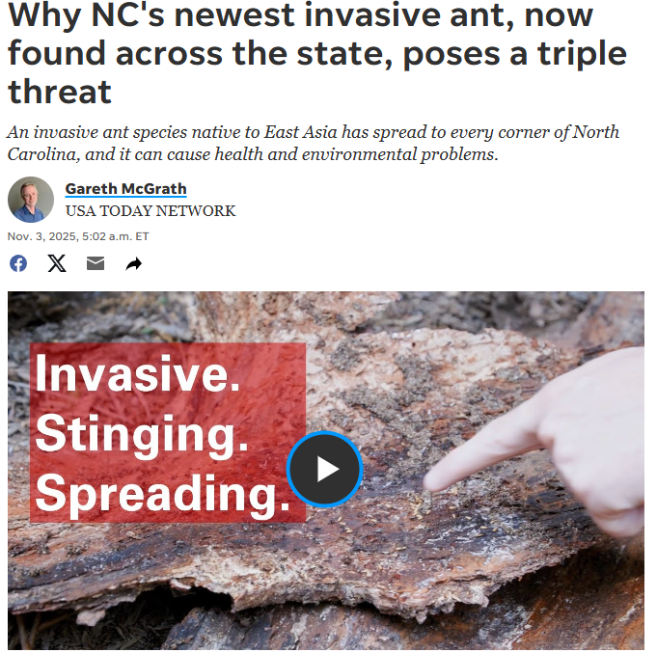
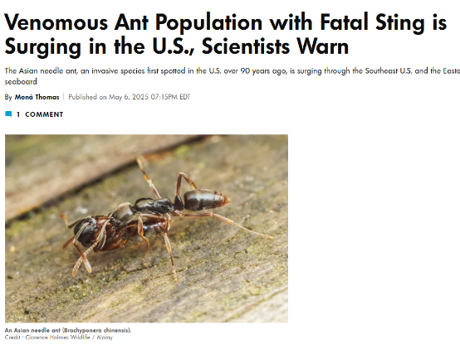
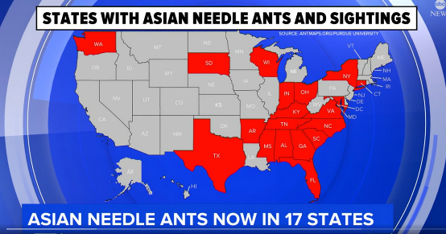
Notes:
https://www.fayobserver.com/story/news/local/2025/11/03/asian-needle-ant-poses-a-threat-to-humans-across-north-carolina/86828156007
https://people.com/venomous-asian-needle-ant-population-surges-scientists-warn-11728615

Slide 8
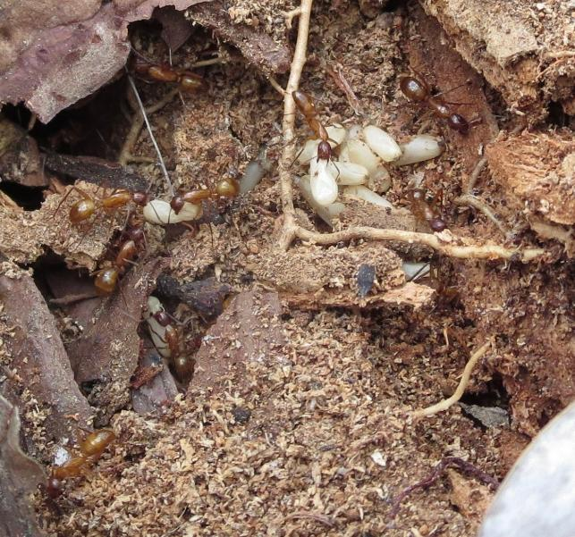
Project Objectives
Measure change in species richness and abundance of native ants
Monitor changes in invasive ant abundance.
Document nest density of the Red Imported Fire Ant (RIFA) and Asian Needle Ant (ANA)

Slide 9
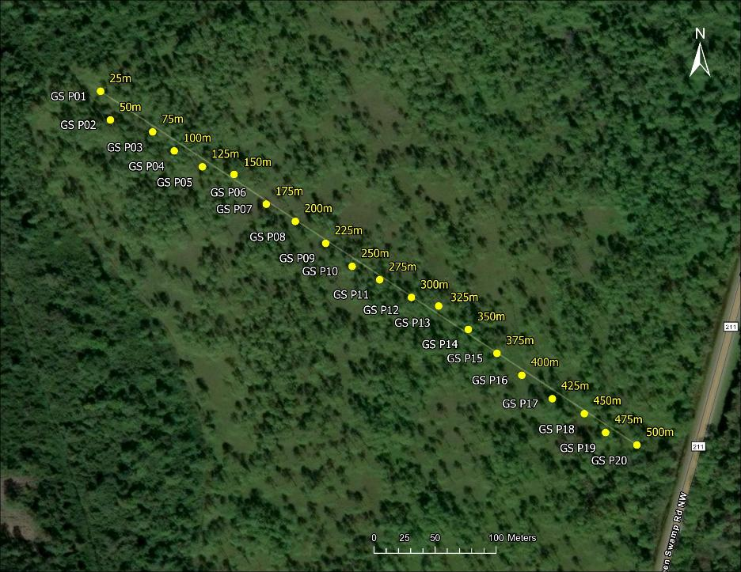
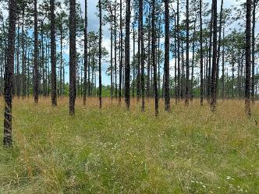
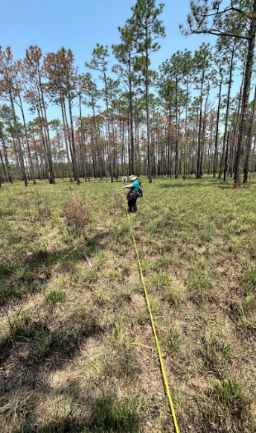
Methods
Green Swamp

Slide 10
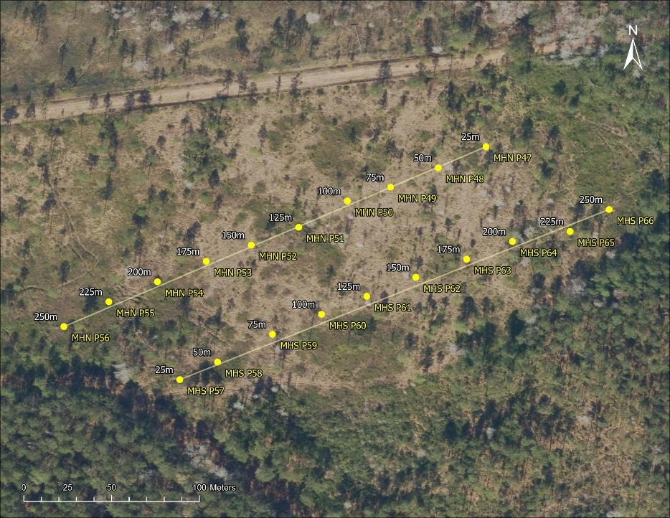
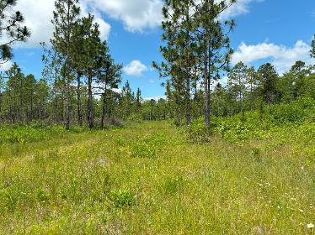
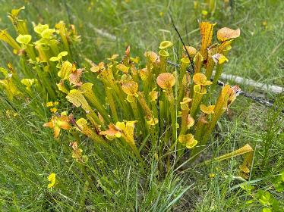
Methods
Myrtle Head

Slide 11
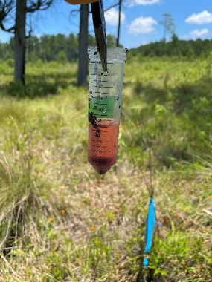
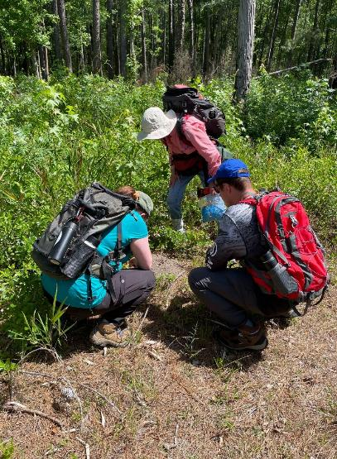
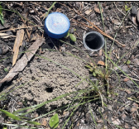
Methods
Pitfall Traps- 2017, 2022, 2023, 2024 & 2025 every 25 meters along transects.
Nest Density Surveys
  RIFA- 2017, 2022, 2023, 2025
  ANA- 2023

Slide 12
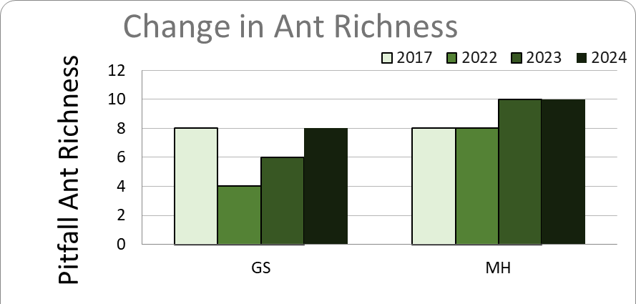
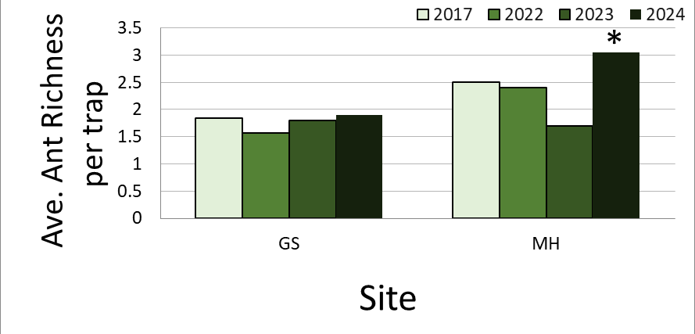
Results Ant Richness
GS- Decreased but recovered
MH- Experienced a recent increase (trap level)
Notes:
2017, 2023 GS Burn
2017, 2021, 2024 MH Burn

Slide 13
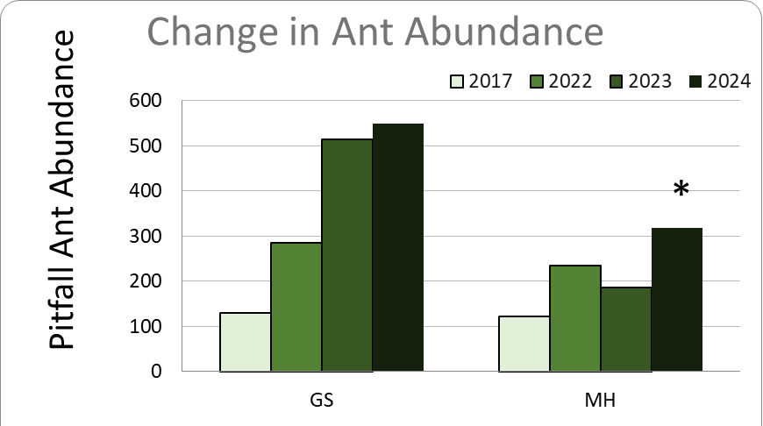
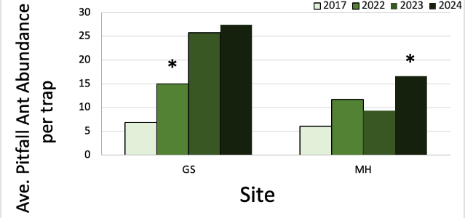
Results Ant Abundance
GS- increasing due to ANA
MH- Slower increase
Notes:
2017, 2023 GS Burn
2017, 2021, 2024 MH Burn

Slide 14
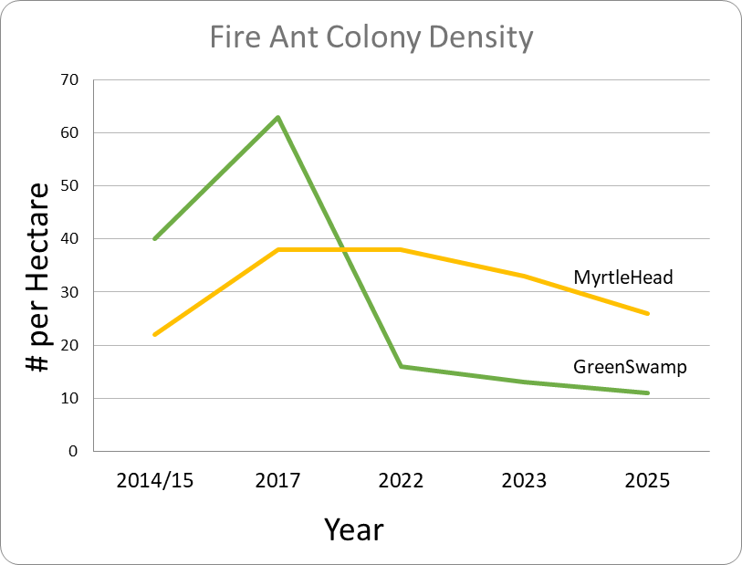
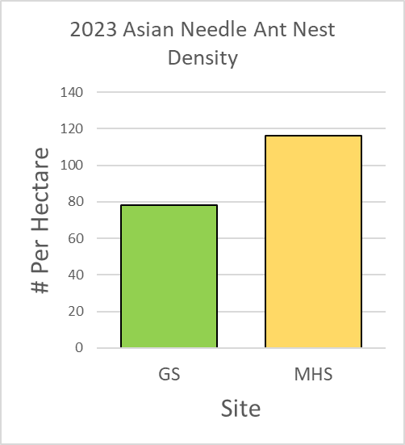
Results Nest Density
Decreasing RIFA nest density
Very high ANA nest densities
Notes:
You can see that the Fire ant densities are declining, peaking a few years ago. We only surveyed needle ant densities in one year, but, they are much higher than any of the fire ant densities we have documented. There’s a reason why we didn’t do the needle ant nest surveys in 2024 and 2025- it was a lot of work because- they were in pretty much every log out there!

Slide 15
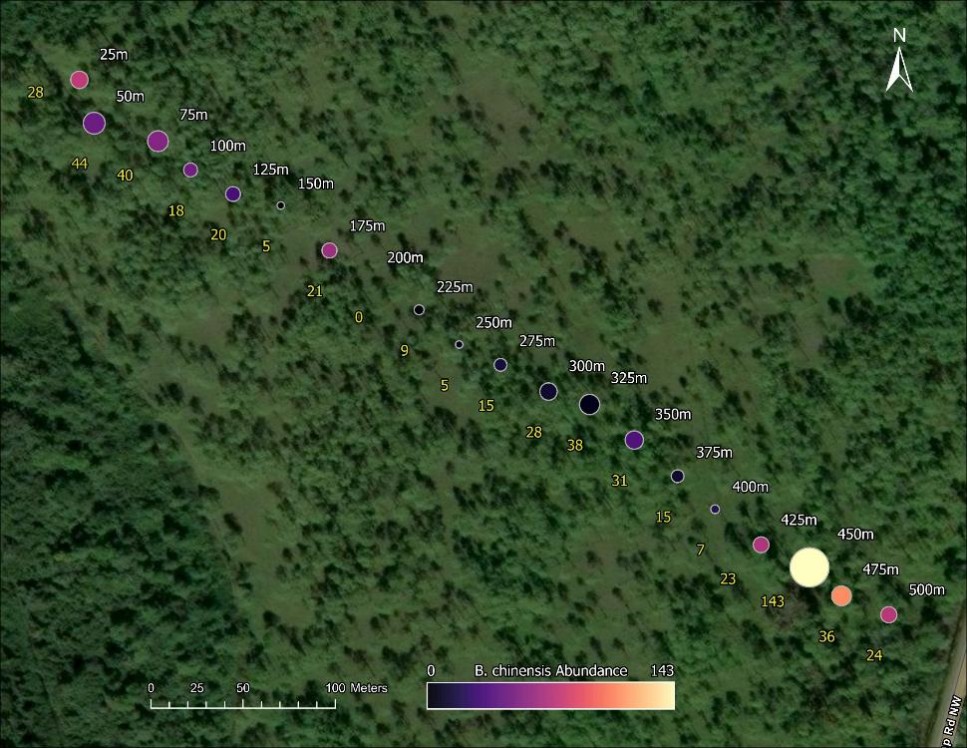
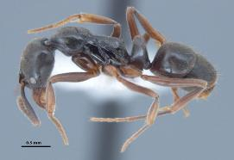
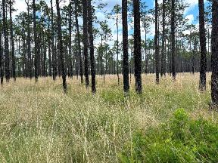
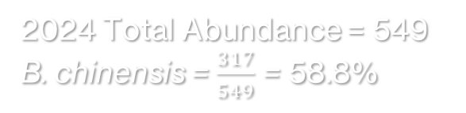
Green Swamp:
B. chinensis
2024 Total Abundance = 549
B. chinensis = $\frac{317}{549}$ = 58.8%
Circles proportional to total specimens collected along transect.
Color gradient: relative number of B. chinensis trapped at specific distance.

Slide 16
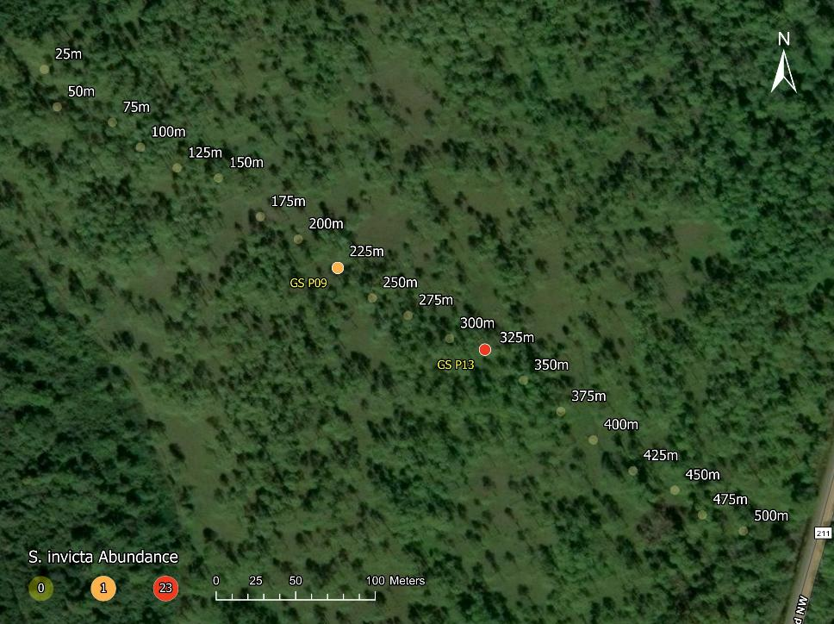
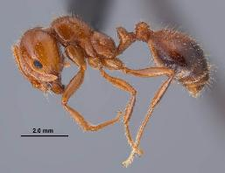
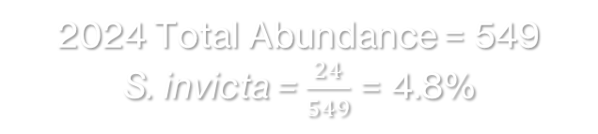
Green Swamp:
S. invicta
2024 Total Abundance = 549
S. invicta = $\frac{24}{549}$ = 4.8%
Found in only two locations
Part of transect with least amount of ANA
https://mississippientomologicalmuseum.org.msstate.edu/images/antphotos/Solenopsis_invicta/Solenopsis_invicta_majorwork2_sideRJW.jpg

Slide 17
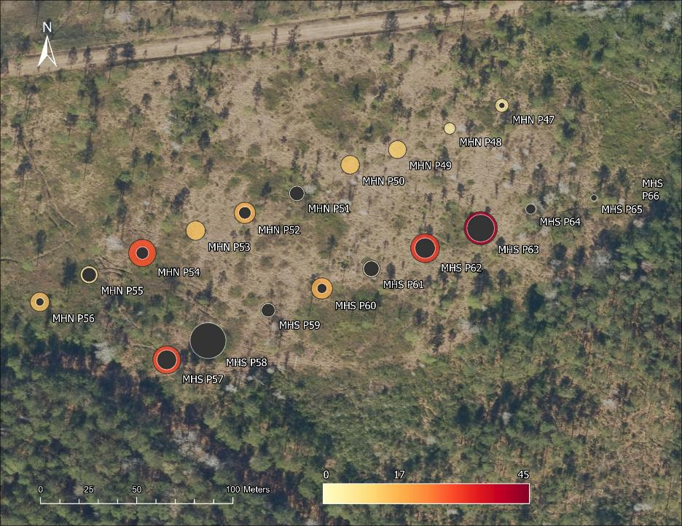
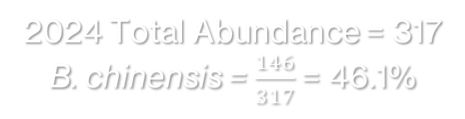
Myrtle Head:
B. chinensis
2024 Total Abundance = 317
B. chinensis = $\frac{146}{317}$= 46.1%
Black circles represent proportion of ANA
Almost half of the specimens found
Concentrated in S transect
Notes:
Black circles proportional to ANA specimens collected along transect.
Color gradient: Total ants trapped at specific distance.

Slide 18
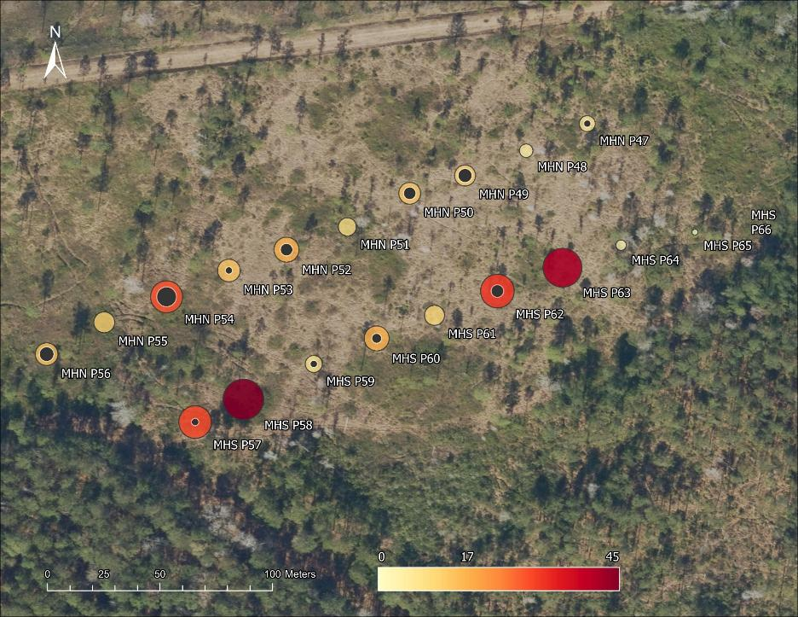


Myrtle Head:
S. invicta
2024 Total Abundance = 317
S. Invicta = $\frac{71}{317}$ = 22.4%
https://mississippientomologicalmuseum.org.msstate.edu/images/antphotos/Solenopsis_invicta/Solenopsis_invicta_queen3_sideRJW.jpg
Comprised about $20\%$ of collected specimens
Prevalent in N transect (Black circles)
Absent/ low in B. chinensis dominant locations

Slide 19
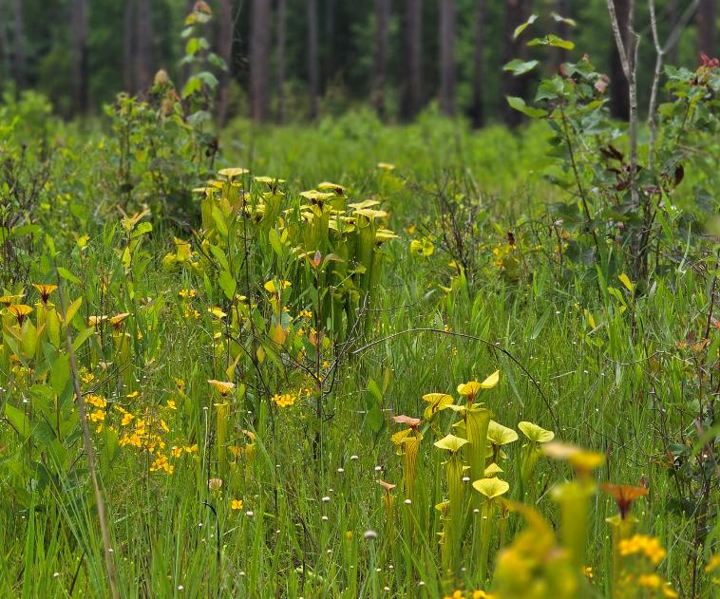
Conclusions
S. invicta has reached its peak
B. chinensis has much greater impact on ant communities
Correlation between presence of B. chinensis and S. invicta
    Competition?
    Microhabitats?
Ant community changes could cause negative impacts to the longleaf pine ecosystem
Notes:
For example, we no longer find seed dispersing ants in green swamp.

Slide 20
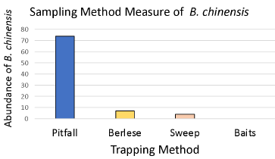
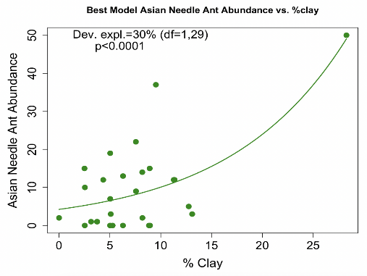
What can we do?
Continue Monitoring
  Additional members of the community
Special care in sites with:
  Clayey soils, significant woody debris
Management options⁷
  Avoid leaving felled trees
  Fire
Consider experimental trials

Slide 21
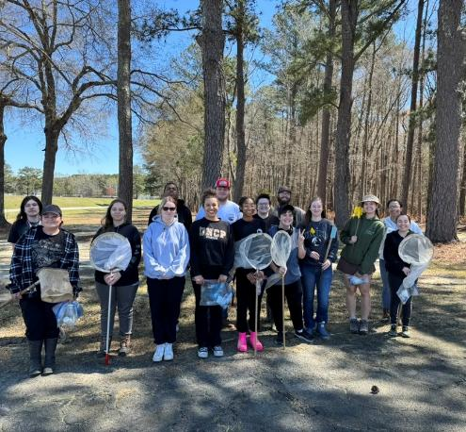
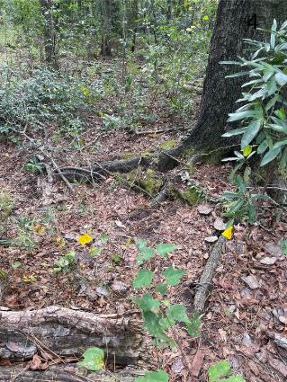
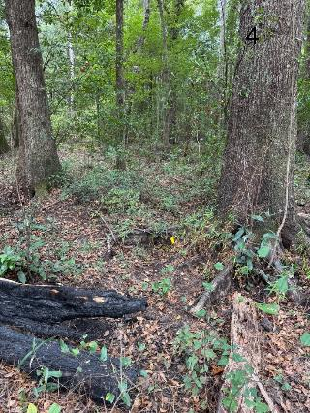
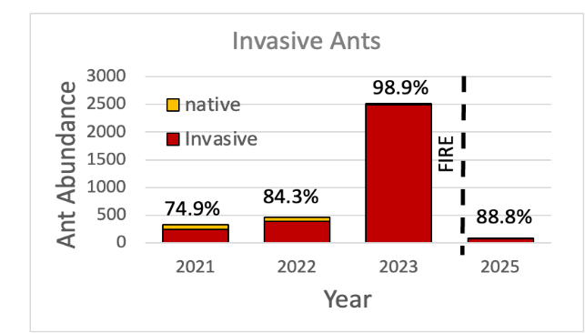
Lumbee Cultural Center Findings

Slide 22
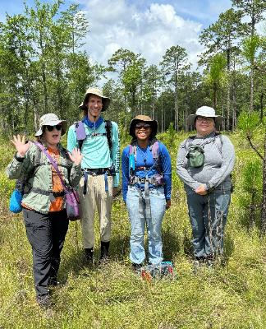



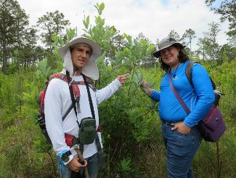

Acknowledgements
Kaitlin.Campbell@uncp.edu
Partnerships and Support: The Nature Conservancy, NC Wildlife Resources Commission, Research Initiative for Scientific Enhancement, Pembroke Undergraduate Research and Creativity Center
Field and Lab Researchers: Kinsley Adams, La-Teisha Allen, Briyana Dover, Aaron Hartman, Grace Herron, Bailey Hrobak, Hunter Ivey, Christina Limbert, Adeline Kelley, Lee Pate, Erika Rivera, Hannah Swartz, Zoe Whitehurst, Grant Wood, Noemi Yisra'EL

Slide 23
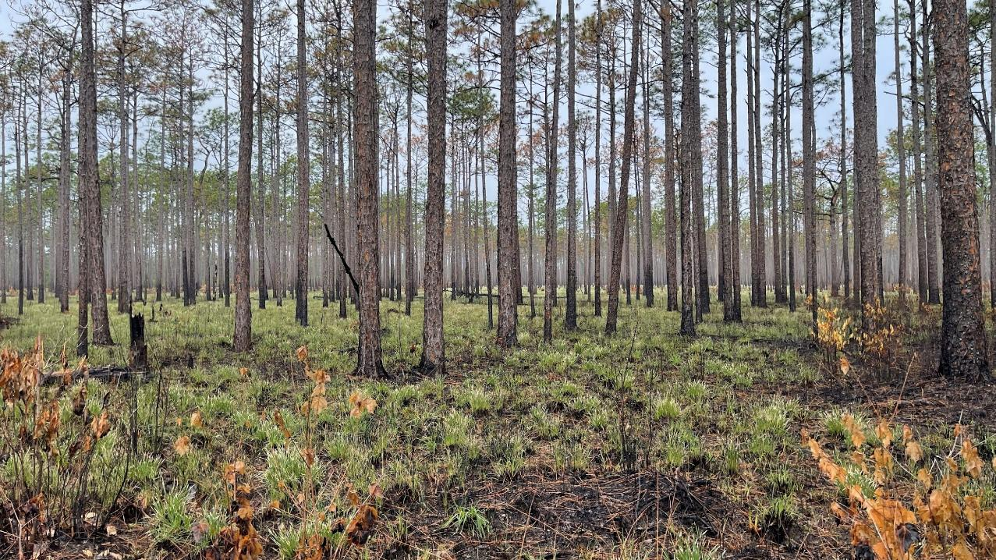
References
Majer, J.D. Ants: Bio-indicators of minesite rehabilitation, land-use, and land conservation. Environmental Management 7, 375–383 (1983). https://doi.org/10.1007/BF01866920
King, J.R. and Tschinkel, W.R. (2006). Journal of Animal Ecology. 75: 1370-1378.
Warren, R.J. et al (2020). Biological Invasions, 22: 813-825.
Erika Rivera, Kaitlin U. Campbell, Lisa Kelly & Hannah Swartz. How do invasive ants interact and impact ant communities within the longleaf pine savannas of North Carolina? Presented at the 17th annual Pembroke Undergraduate Research and Creativity symposium. April 4th, 2023.
Guénard, B., Wetterer, J. K., and MacGown, J. A. (2018) Florida Entomologist. 101: 649-656.
Smith, M. *1934 Ponerine ants of the genus Euponera in the United States. Annals of the Entomological Society of America 27: 557–564.
Campbell, J.W. et al. (2019) Ecosphere 10: e02547

