Slide 1
Longleaf Ecosystem Occurrence Database Surveys
Preliminary Results

Slide 2
LEO Surveys in the North Carolina LITS
The Longleaf Alliance, Florida Natural Area Inventory, and TNC
NC effort began at the end of August 2020
Assessing longleaf presence/absence and collecting data on forest conditions.
Aimed to visit 500 stands in each of the NC LITS
Primarily private lands, but select public/managed lands included

Slide 3
Survey Count by LIT Boundary
Site Count
Local Implementation Team Boundary

Slide 4
Distribution of Acres by Ecological Rank
Acres
Surveyor Ecological Rank

Slide 5
LEO Survey Summary
Ecological Rank | Site Count | Total Acres | Mean Stand Acreage
Excellent | 55 | 5688 | 103
Good | 167 | 11919 | 71
Fair | 318 | 17145 | 54
Low | 517 | 18711 | 36
Total | 1058 | 53464 | 51

Slide 6
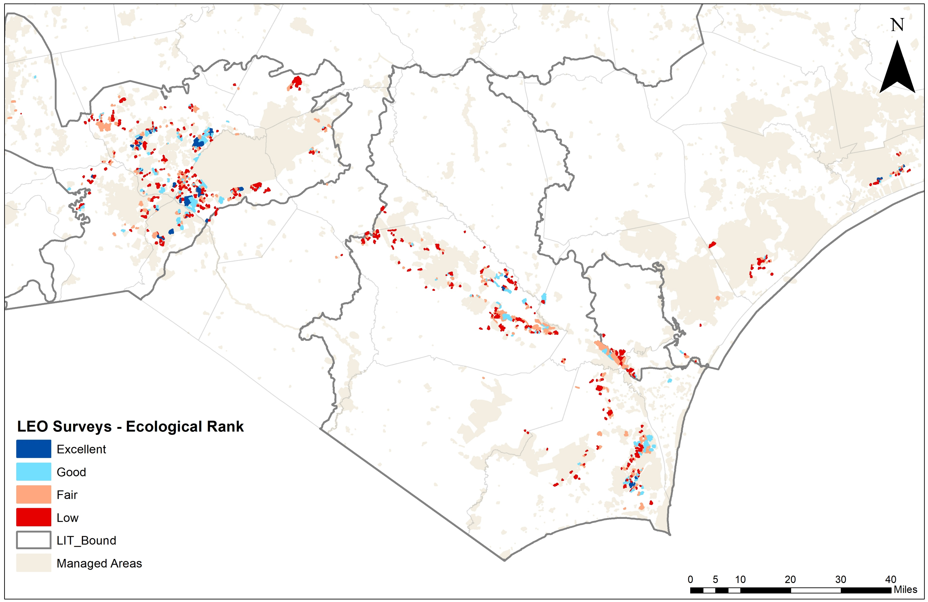

Slide 7
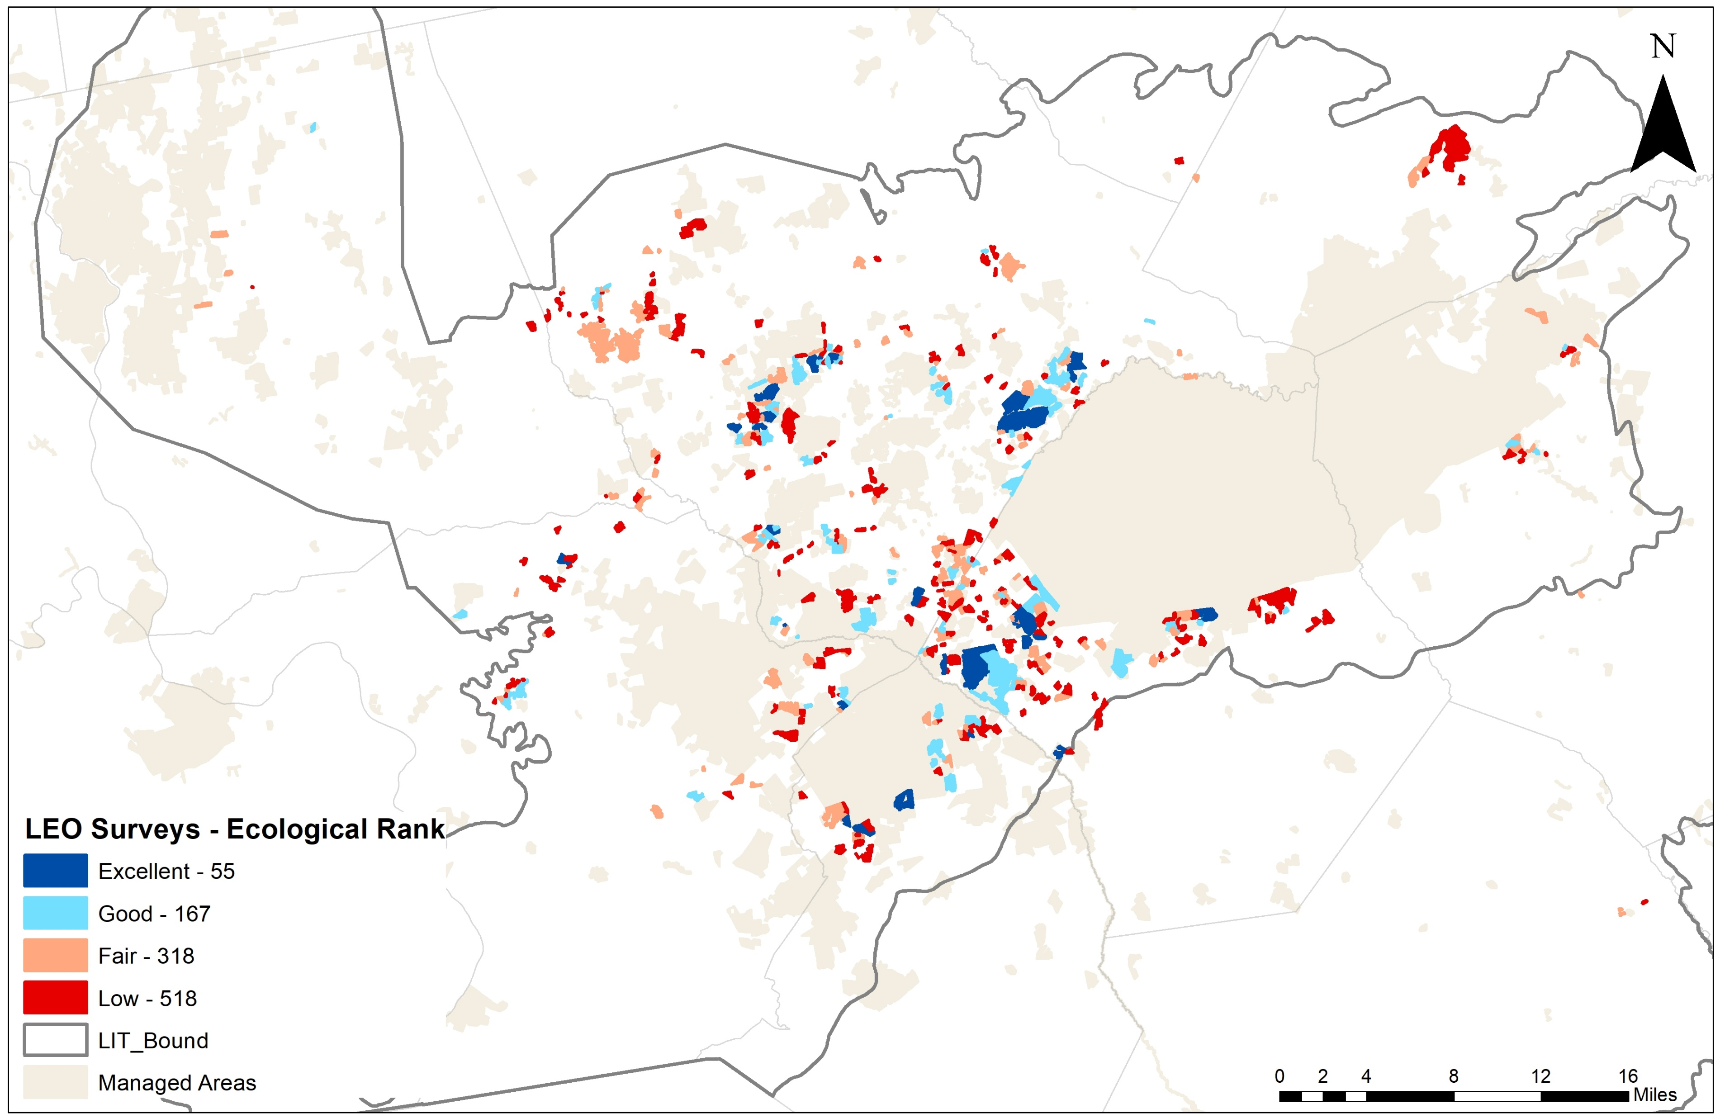

Slide 8
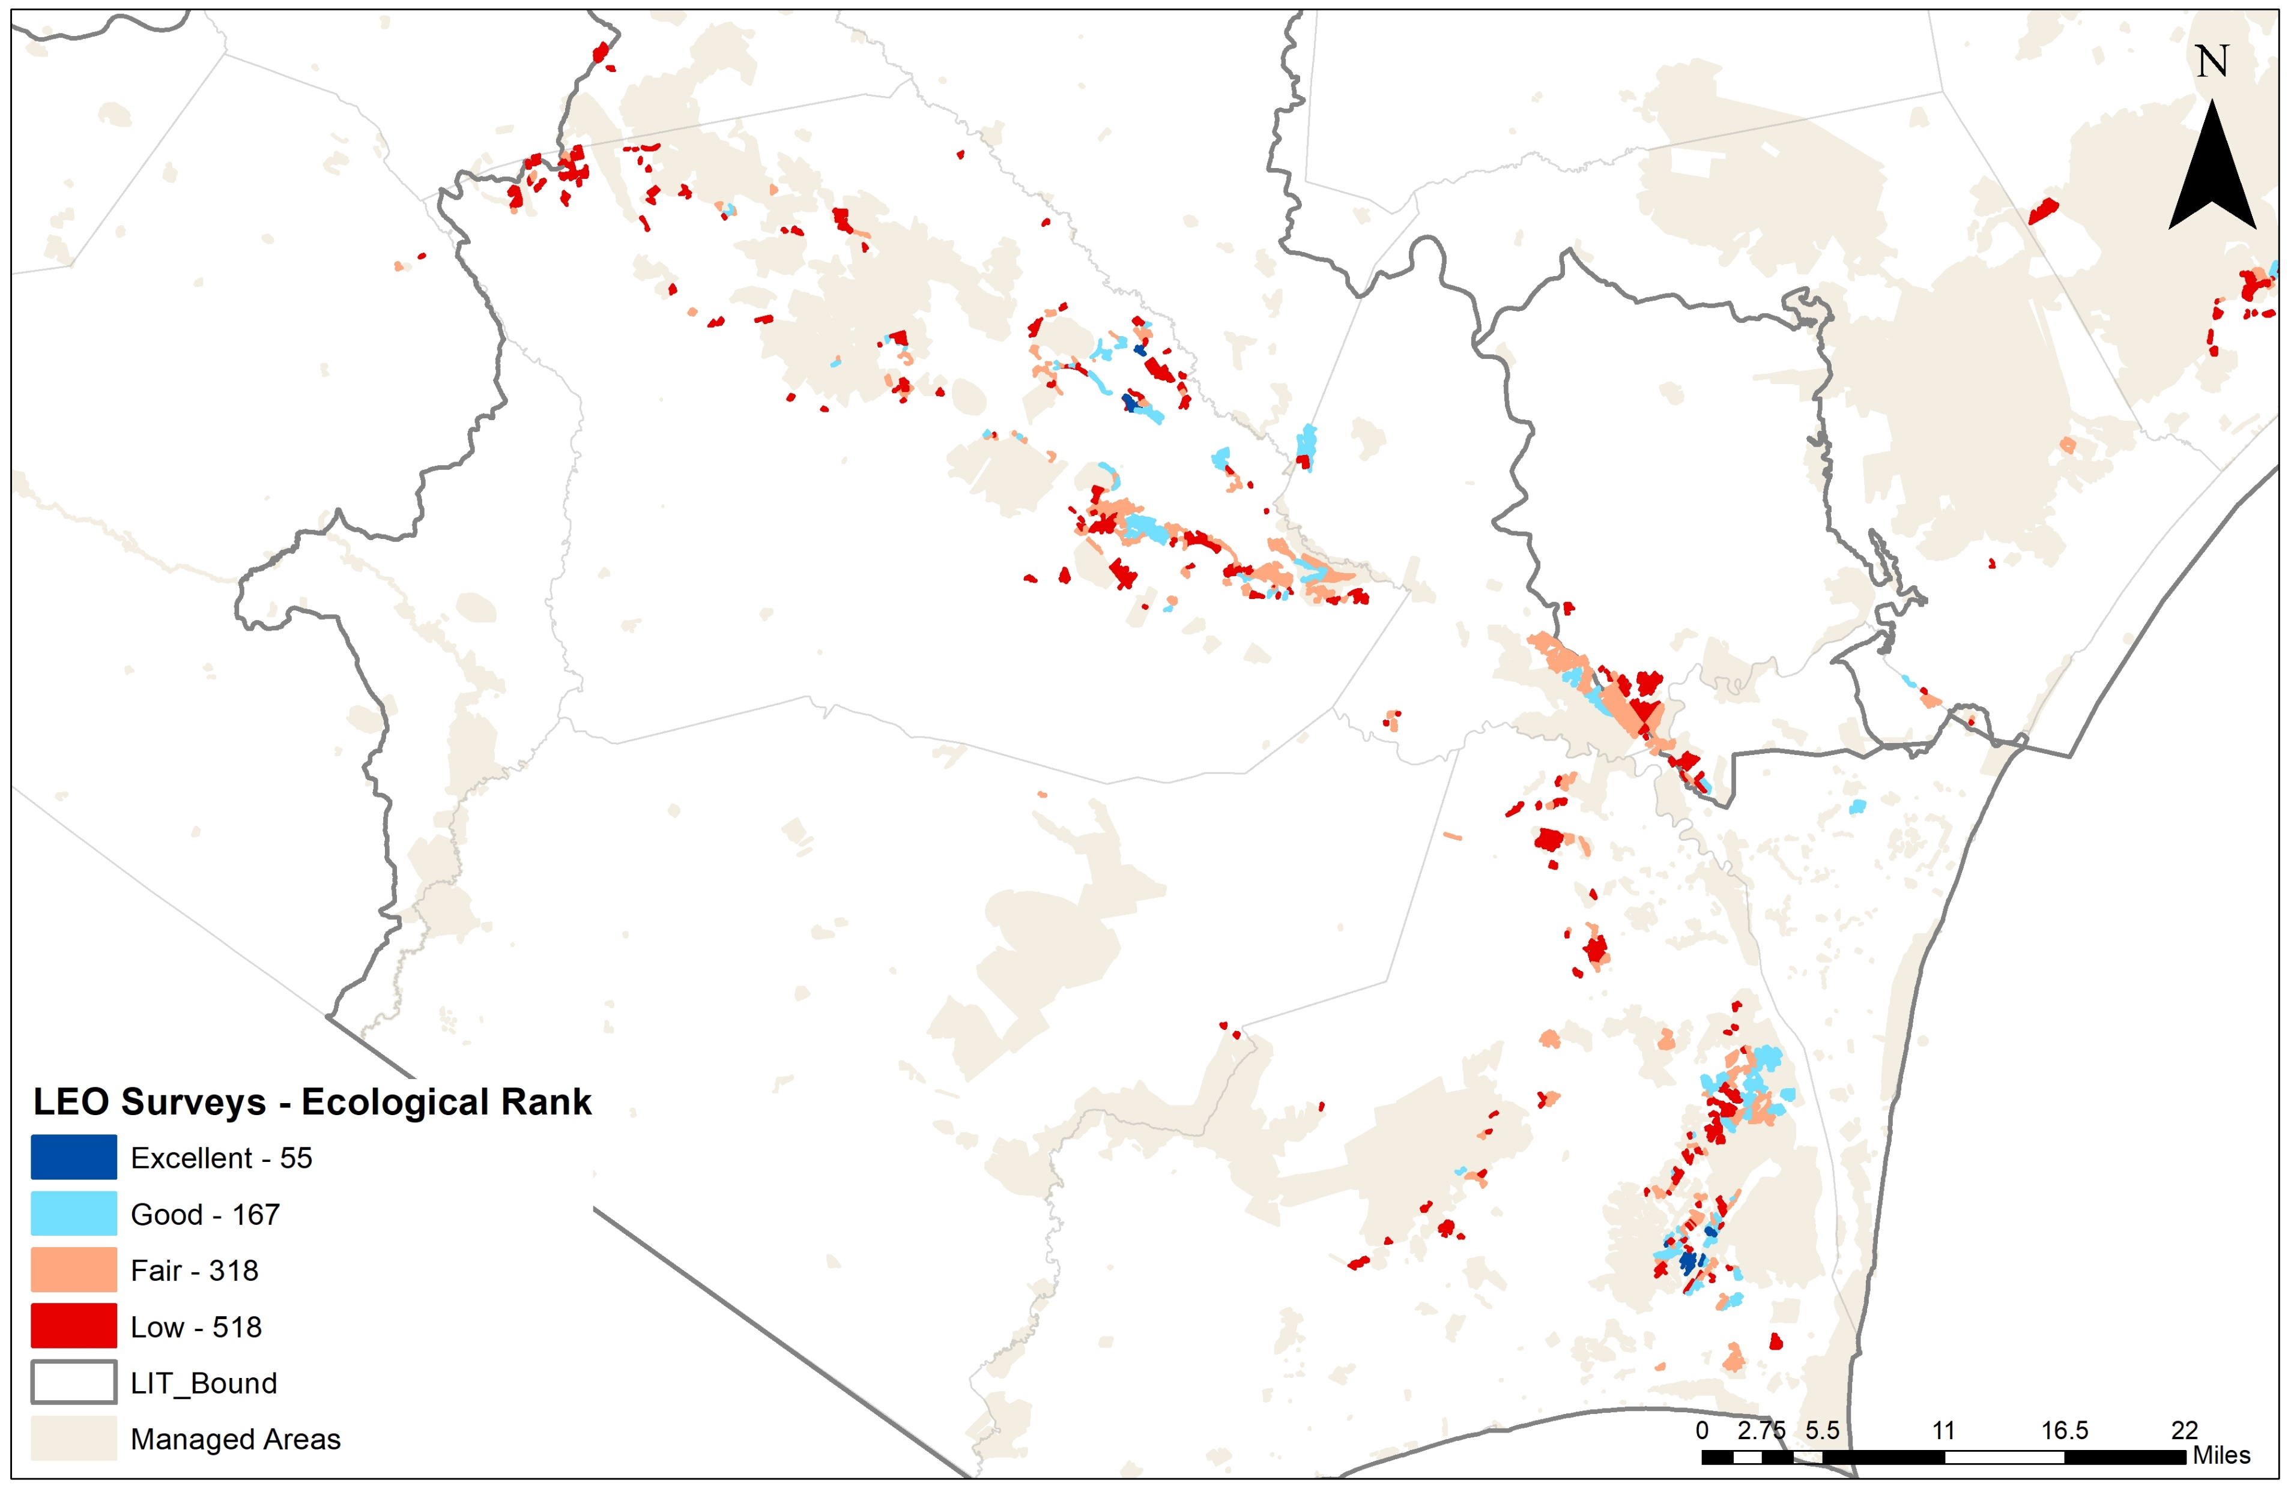

Slide 9
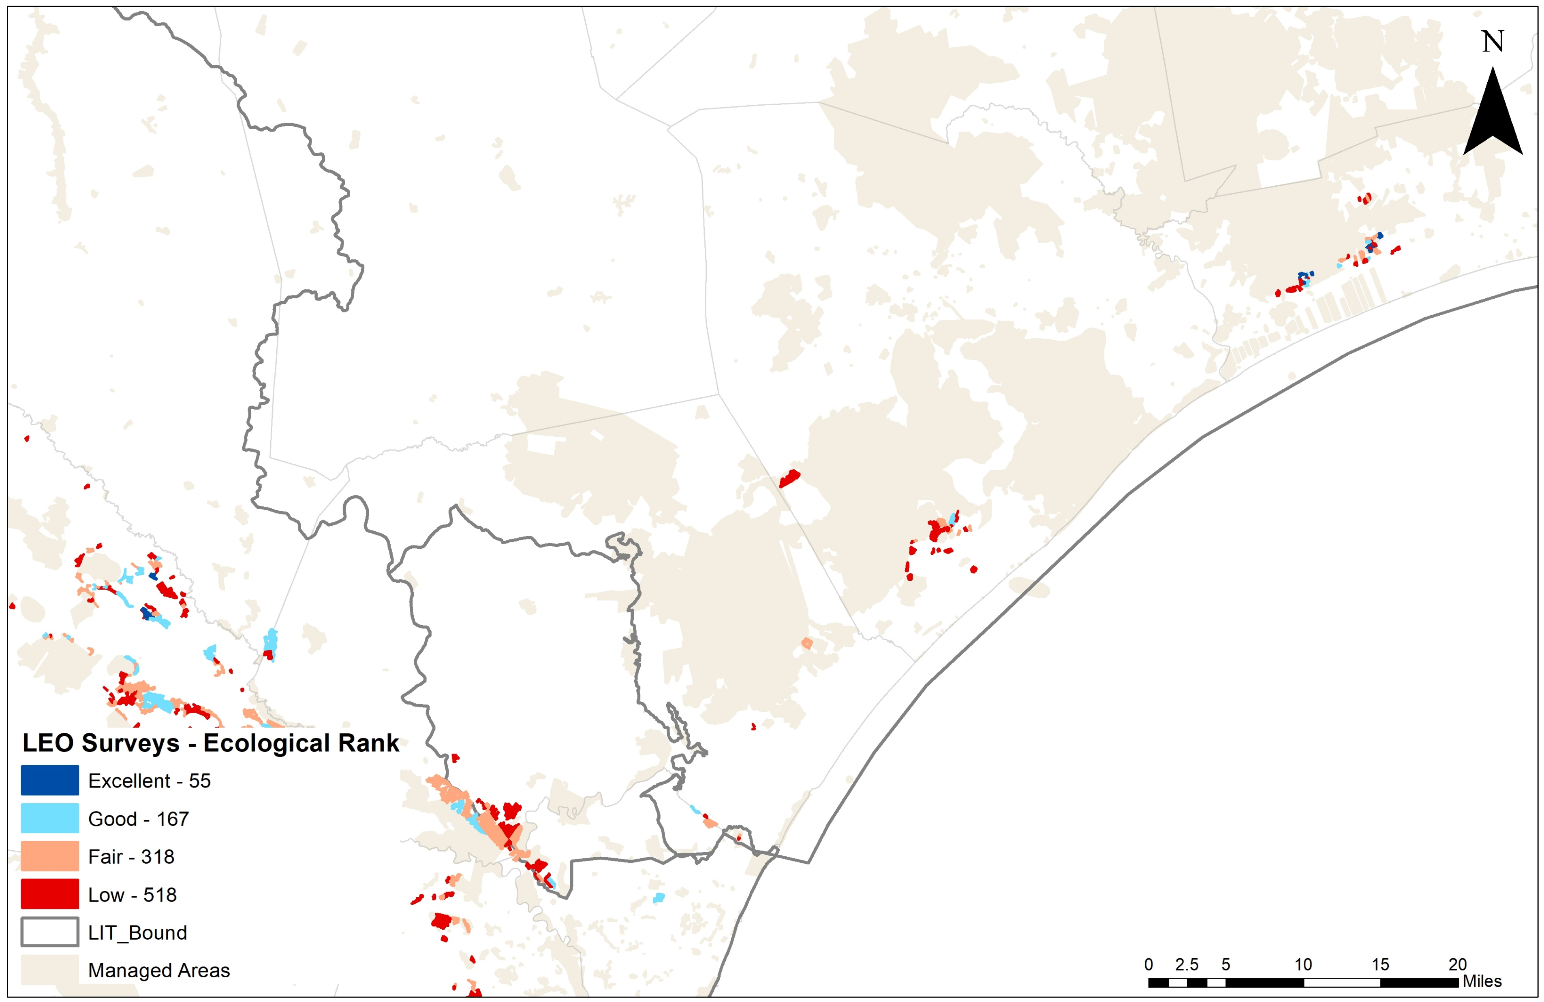

Slide 10
Success Stories
Corbett timber and Corbett Package Company (421 Sand Ridge)
Cape Fear Timber Company
Trask Farm, Brunswick County
Sleepy Creek Farms, Bladen County
Blue Farm
Walthour-Moss Foundation
Orton Plantation*

Slide 11
Next steps
Now working with a new NC Coastal Land Trust intern to complete surveys on CLT lands and easements in the Cape Fear Arch and Onslow Bight.
Wrapping up the Onslow Bight from now through late-March.
Data reporting
  Summarizing data
  Classifying condition class
  Landowner reports

