Slide 1

Town of Aberdeen Development Update
North Carolina Sandhills Conservation Partnership Meeting
June 10th, 2026

Slide 2
Aberdeen Growth
Currently ~9,800 residents (2024)
Projected ~11,000 by 2030
Attributed to:
  Base Realignment and Closure Program
    Increase in personnel @ Ft. Bragg/proximity
  Vacant land suitable for development
  DOT Projects
  Census Bureau estimates (2024)
    Moved to NC from out of state 300,000
    Moved to NC from out of the country 86,000

Slide 3
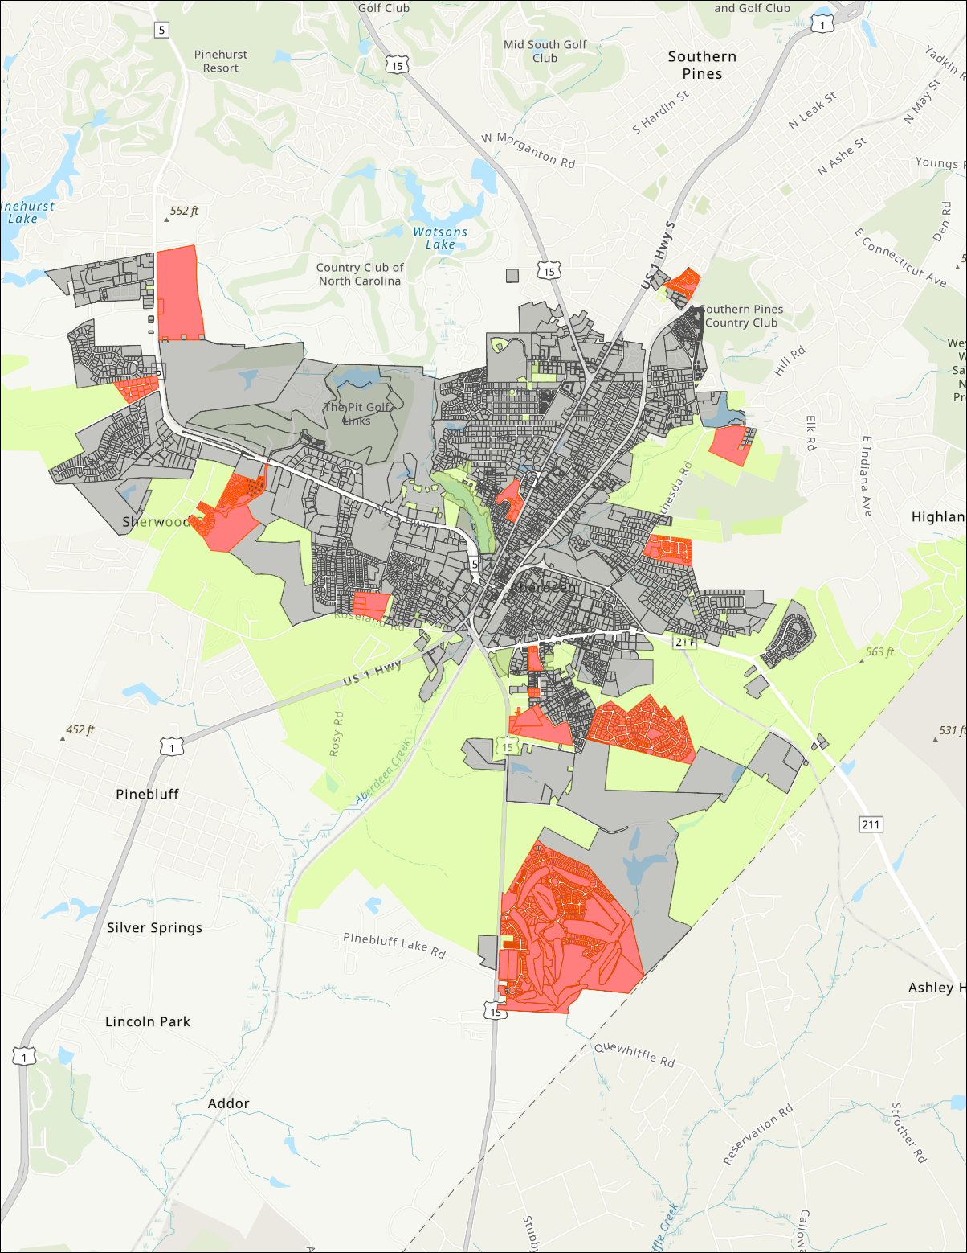
Residential
Active Projects Proposing approximately 2350 homes
Current inquiries proposing additional 400 homes

Slide 4
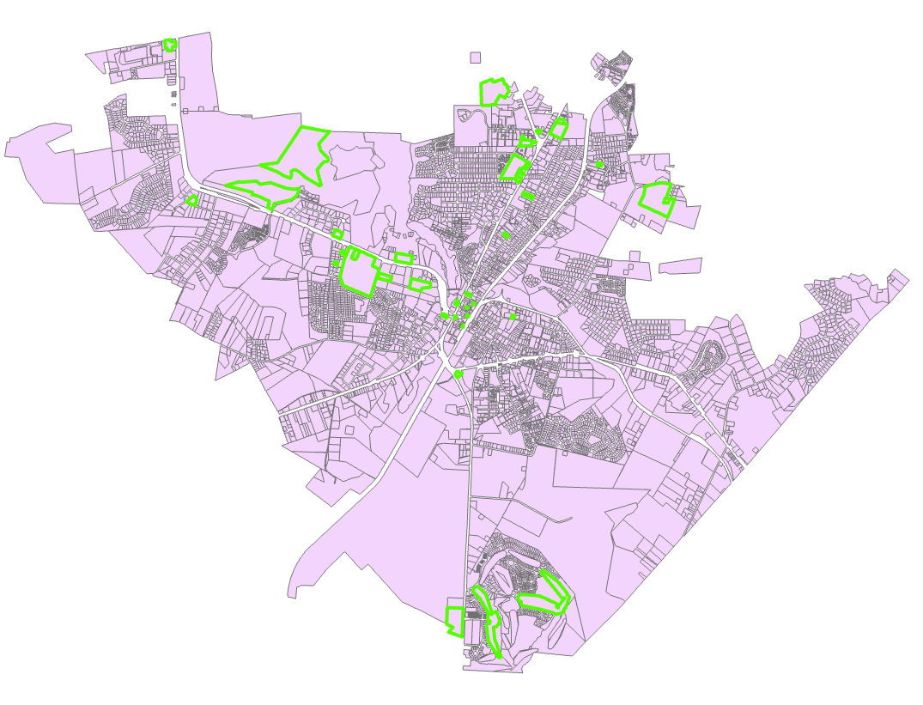
Commercial
Approximately 57 Commercial Development Projects between June 2025 and June 2026

Slide 5
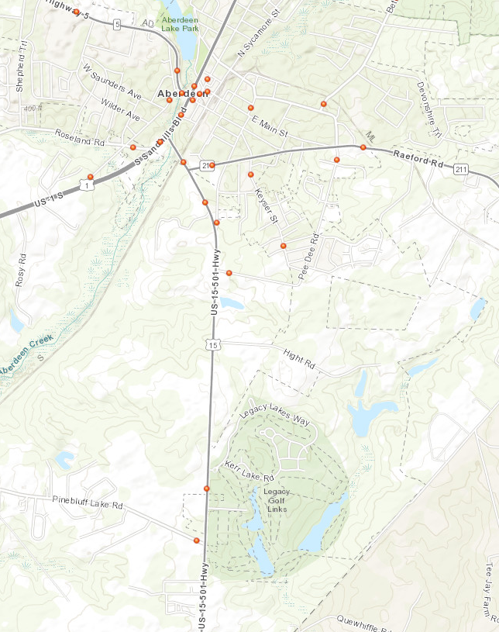
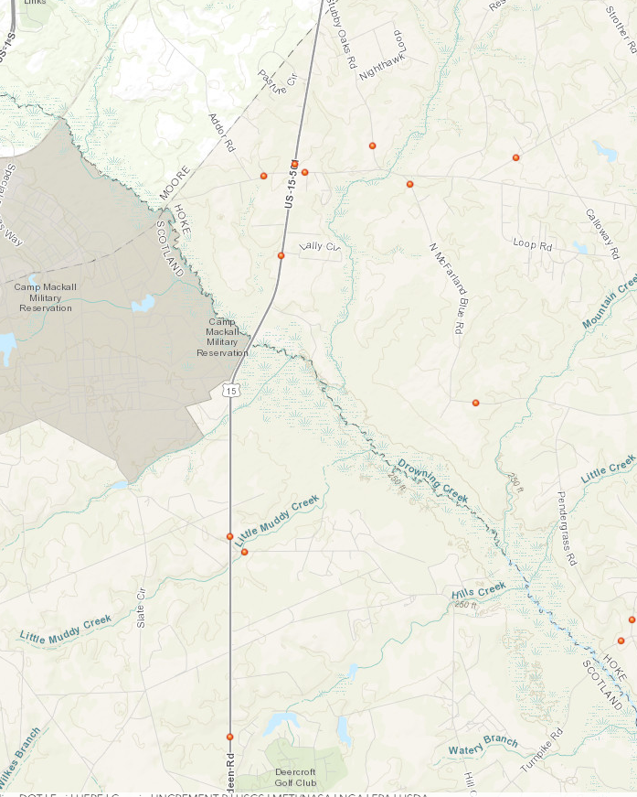
Challenges:
NCDOT Average Daily Traffic Data 2025
28,000
7,200
15,000
11,221
750
5,300
10,397

Slide 6
Challenges
Loss of rural/ag lands, greenspace/wildlife habitat fragmentation
Increased traffic challenges
Lack of incentive to develop with conservation mindset
Landscaping setbacks along hwys
Difficulty preserving character via tree preservation ordinances, etc.

Slide 7
Current Action
Conservation subdivisions
Amending UDO requirements
  Vegetative buffers
  Pollinator habitat
  Open/greenspace
Amending Watershed requirements
Updating stormwater requirements
Incorporating GGT (adopted in 2010) concepts into our UDO/development review
Incentive development

