Slide 1

Sandhills Survey (2025-2026)
David George

Slide 2
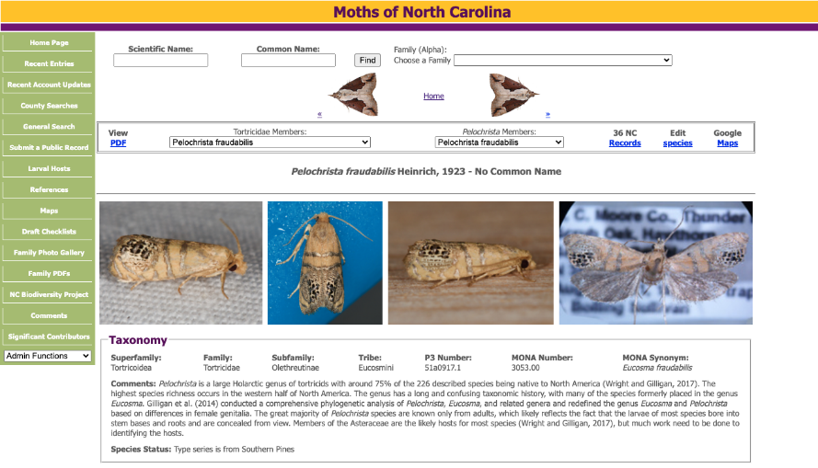

Slide 3
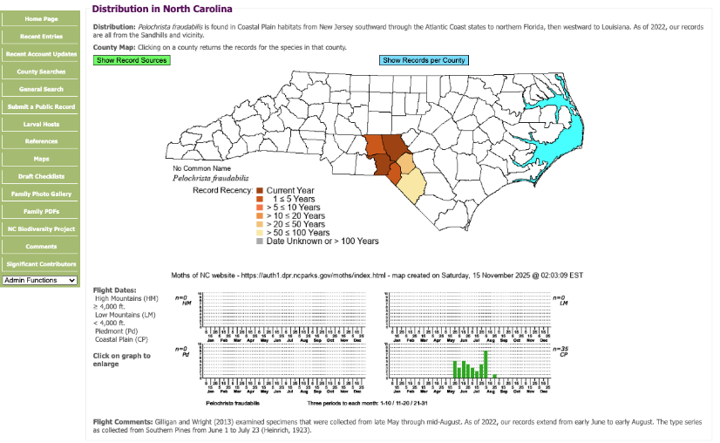

Slide 4
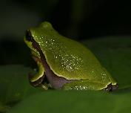
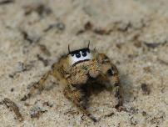
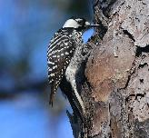
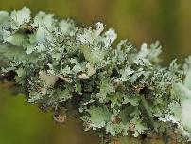
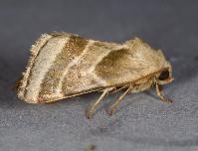
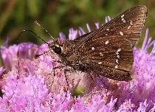
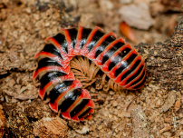
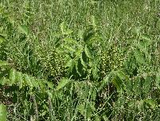
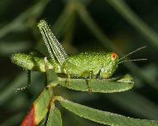

Amphibians, Birds, Butterflies, Centipedes, Crickets, Damselflies, Dragonflies, Grasshoppers, Lichens, Millipedes, Mosses, Moths, Spiders, Slime Molds, Treehoppers, Vascular Plants,
etc.

Slide 5
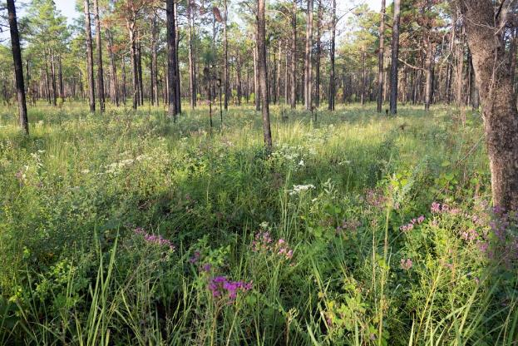
Bean Dip
(or Pea Swale)
Slight topographical depression
Clays trap moisture, resulting in mesic loamy soil
Very high diversity of plants and associated animals
Photo: Steve Hall
Sandhills Game Lands (Richmond County)

Slide 6
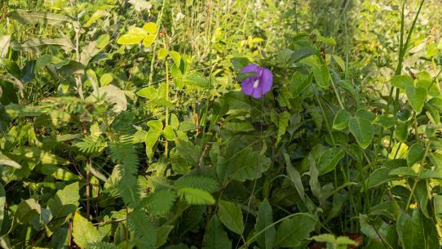
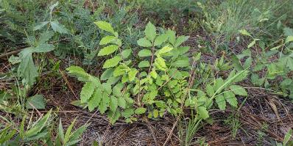
Dense herbaceous layer
Provides shelter and food for a very high diversity of animals
Exclusive or primary habitat of numerous rare plants and other species, including Federally Endangered Rhus michauxii
Photos:
Steve Hall

Slide 7
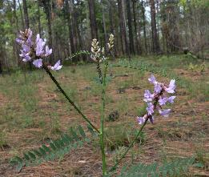
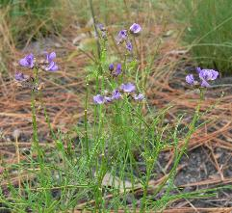
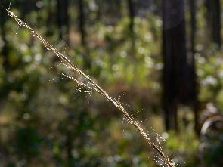
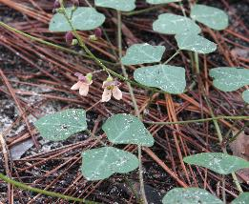
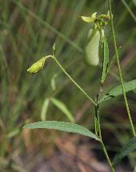
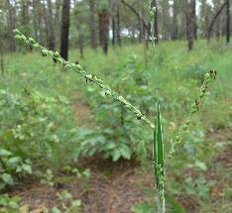
Astragalus michauxii
Orbexilum lupinellus
Aristida lanosa
Photos:
Bruce Sorrie
Phaseolus sinuatus
Crotalaria purshii
Paspalum bifidum

Slide 8
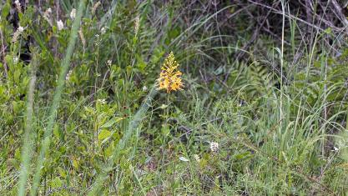
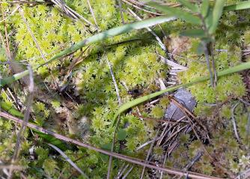
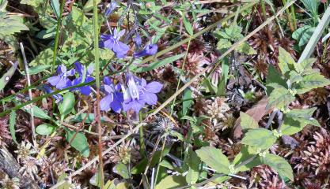
Sandhill Seep
Photos: Steve Hall

Slide 9
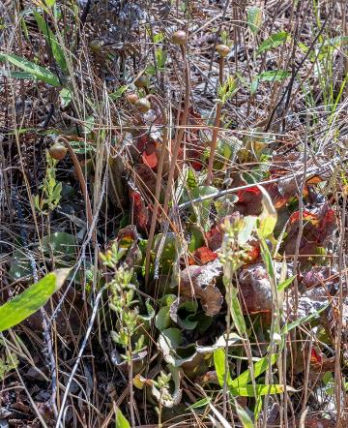
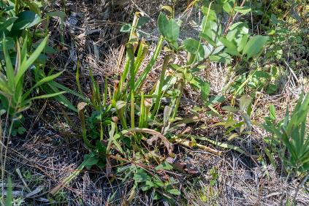
Sarracenia rubra
Sarracenia purpurea
Photos: Steve Hall

Slide 10
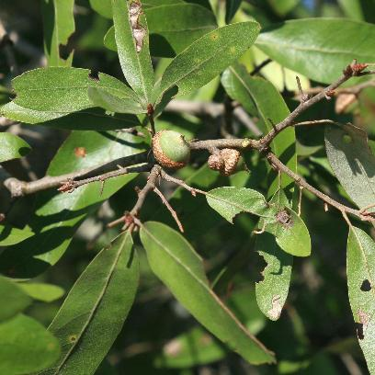
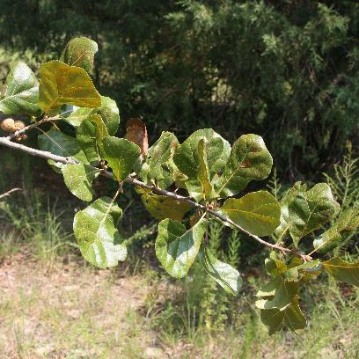
Bluejack Oak (Quercus incana)
Blackjack Oak (Quercus marilandica)
Photos: Bruce Sorrie

Slide 11
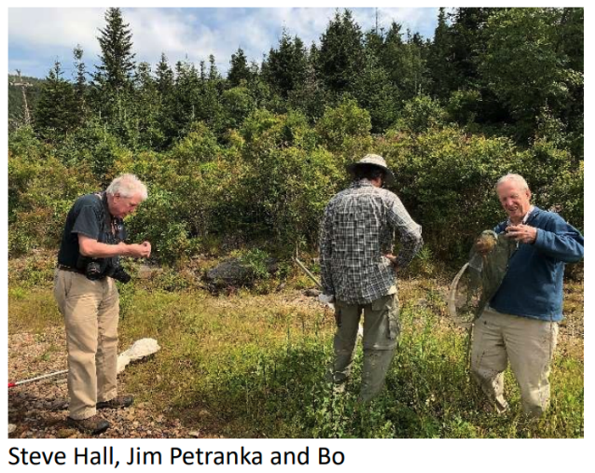
Bo Sullivan
(1940 - 2024)
Conducted moth surveys statewide, with particular emphasis on the Sandhills.
Bo’s taxonomic expertise and vast specimen collection were the foundation of our knowledge of moths in NC.
Founding member of the NC Biodiversity Project and the Moths of NC website.

Slide 12
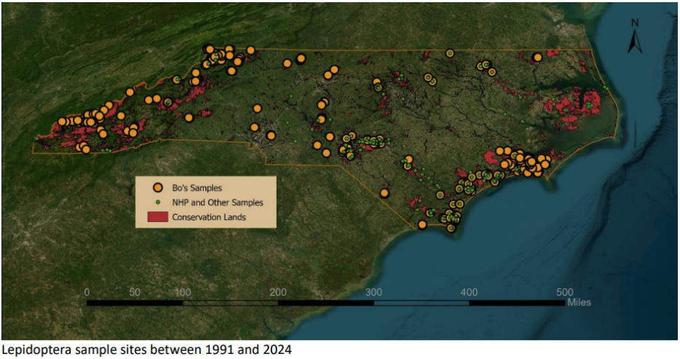

Slide 13
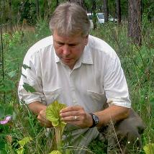

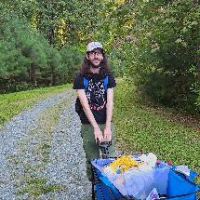
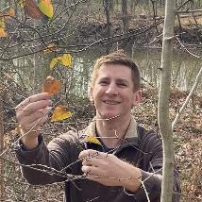
NC Biodiversity Project
Moth Survey
Steve Hall
Jim Petranka
Jeff Niznik
David George

Slide 14
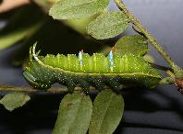
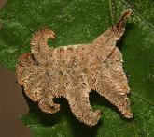
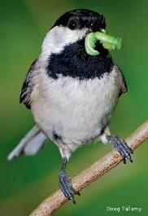
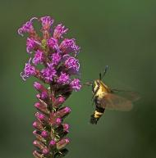
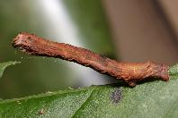
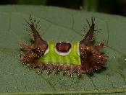
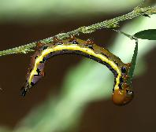
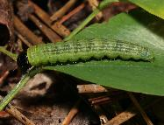
Why Moths?
Diversity
Ecological Importance
Ecological Indicators
Photos: David George, Doug Tallamy, USDA

Slide 15
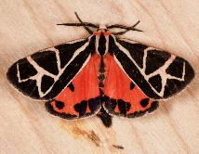
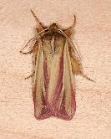
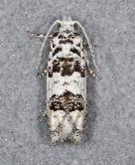
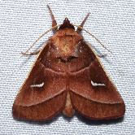
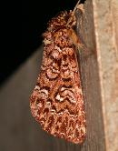
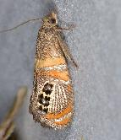
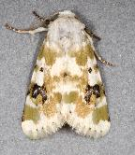
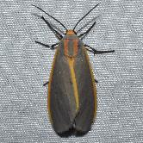
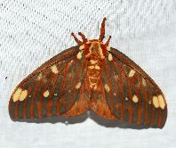
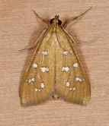





Slide 16
668 total species
8 species
new to NC
251 new
county records
Photos: Jim Petranka, David George, Jeff Niznik

Slide 17








State Record Species
Cenopis karacana
Chionodes emptor
Hellinsia citrites
Isophrictis n. sp. 1
Lesmone hinna
Nepotula secura
Pelochrista argentifurcatana
Walshia n. sp. near elegans
Photos: Jim Petranka, David George, Jeff Niznik

Slide 18



Schinia grandimedia
False Boneset Borer Moth
State Rank: S2S3
Major disjunct from Midwest populations
Very rare habitat and host plant specialist restricted to just 3 counties in NC Sandhills.
Photo: Jim Petranka
Moth Photographers Group

Slide 19


Schinia grandimedia
Brickellia eupatorioides
False Boneset
Photos: Jim Petranka, Bruce Sorrie

Slide 20


State Rank: S2S3
Host plant specialist feeds only on pitcher plant (Sarracenia) species
Found in Sandhill Seeps and coastal peatlands
At western extreme of range in NC
First record from Richmond County since at least 1938
Exyra semicrocea
Pitcher Plant Mining Moth
Photo: David George

Slide 21



Exyra semicrocea
Sarracenia rubra
Photos: David George, Bruce Sorrie

Slide 22





















22 species with S1 or S1S2 ranks
Photos: Jim Petranka, David George, Jeff Niznik

Slide 23

Comparison with recent Piedmont moth surveys
Site | Trips | Species | S1/S1S2
New Hope Bottomlands | 18 | 323 | 1
Mason Farm Biological Reserve | 11 | 389 | 1
Jordan Game Lands | 18 | 412 | 0
White Pines Nature Preserve | 20 | 804 | 6
Sandhills Game Lands | 13 | 668 | 22

Slide 24




Photos: Jeff Niznik, Jim Petranka

Slide 25






Species recorded in the Sandhills now considered historical (with year last seen in NC):
Sphinx drupiferarum (1908), Scythris charon (1916), Aristotelia callirrhoda (1923), Synanthedon refulgens (1930), Acrobasis elyi (1967), Haplochrois biminimmaculella (1967), Cisthene tenuifascia (1973), Catocala abbreviatella (1987), Schinia lucens (1987), Schinia bina (1994), Schinia septentrionalis (1994), Schinia carolinensis (2001), Erastria coloraria (2002), Lemmeria digitalis (2002), Trichordestra beanii (2002), Heliocheilus paradoxus (2003)
Photos: Bo Sullivan, Steve Hall, NC Insect Museum

Slide 26







Slide 27

Management Recommendations
Burn sites with bean dips and seeps frequently (~3 years)
Keep burn patches as small as possible to allow for refugia
Minimize fire breaks when possible
Maintain mature oak habitats by burning these areas less frequently
Time burning to minimize impact on rare species
Consider insects
Photo: The Nature Conservancy

Slide 28



Continued Monitoring
Surveys
Rapid site assessments
Sampling before and after burning

Slide 29


State Rank: S1
State and Federal Endangered Species
Associated with bean dips and seeps in the Sandhills
Highly fire-dependent
Apparently now remaining in NC only within Fort Bragg (Hoke, Cumberland Co.)
Schwalbea americana
American Chaffseed
Photo: Bruce Sorrie

Slide 30


Now considered historical in NC
Formerly associated with highly fire-dependent grasslands
Last known population in Croatan National Forest apparently lost in a fire in 2009
Atrytone arogos
Arogos Skipper
Photo: Jeff Pippen

Slide 31


State Rank: [SH]
Last observed in NC in 1904 and considered to be extirpated from the state prior to this record from the bean dip at Sandhills Game Lands
Associated with prairie habitats in the Midwest
Eucosma giganteana
Giant Eucosma
Photo: Jim Petranka

Slide 32



Catocala jair
Jair Underwing
State Rank: S2
First NC records since 2009
Larvae feed on xerophytic oaks (including Turkey Oak)
Apparently declining in NC with loss of habitat
Photos: David George, Bo Sullivan

Slide 33



Hellinsia citrites
State Rank: [S1]
First state record
Larva reared from Brickellia eupatorioides - the first confirmed host record for the species
Photos: Jeff Niznik, David George

Slide 34



Baptisia cinerea
Gray-hairy Wild Indigo
?
Photos: Jeff Niznik, Bruce Sorrie

Slide 35


Pococera baptisiella
State Rank: [S1S2]
Only 2 site records in NC (other at Carvers Creek - Sandhills Access)
First confirmed host record in NC
Photo: Jeff Niznik

Slide 36

Host Database
2274 host records for 884 species
28% of species found in NC

Slide 37

All photos produced by NC Biodiversity Project members, except where noted. Image Authors: David George, Steve Hall, Jeff Niznik, Gary Perlmutter, Jim Petranka, John Petranka, Jeff Pippen, Bruce Sorrie, Bo Sullivan
The material in this presentation can be freely used for educational purposes by the terms of the Creative Commons Attribution license. However, please consider the sensitive nature of these species and habitats when deciding how to share this content.

