Slide 1
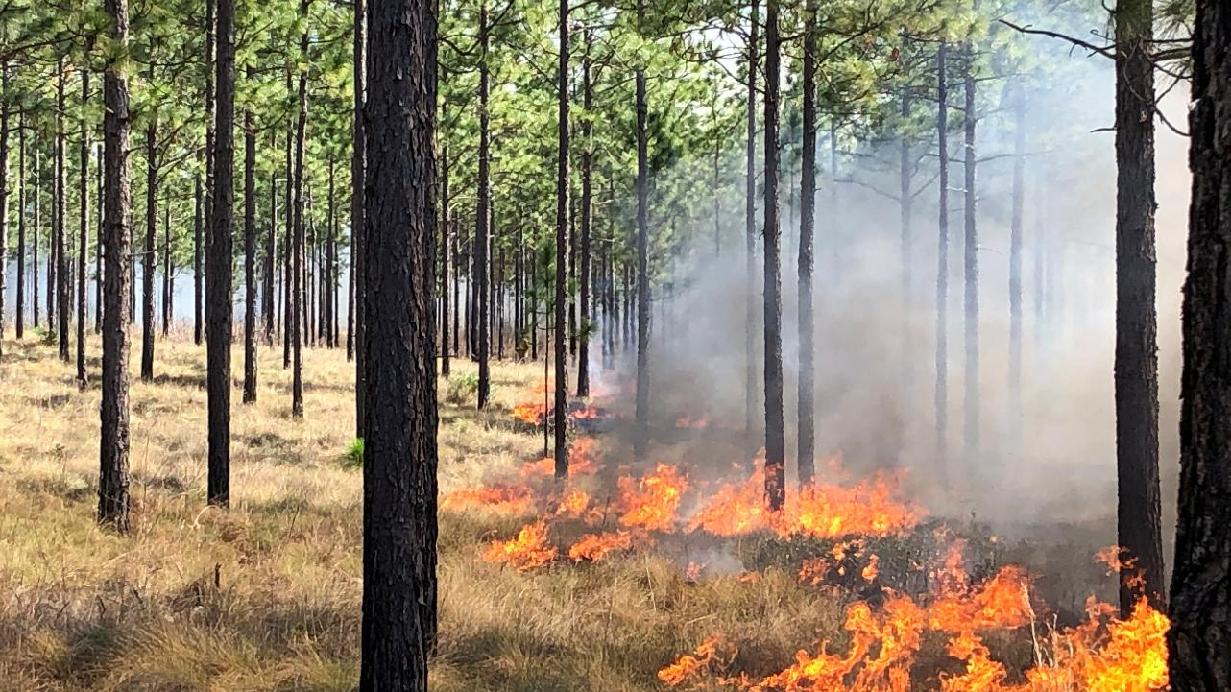
Carolina Sandhills Corridor Analysis
Lydie Costes
December 2025

Slide 2
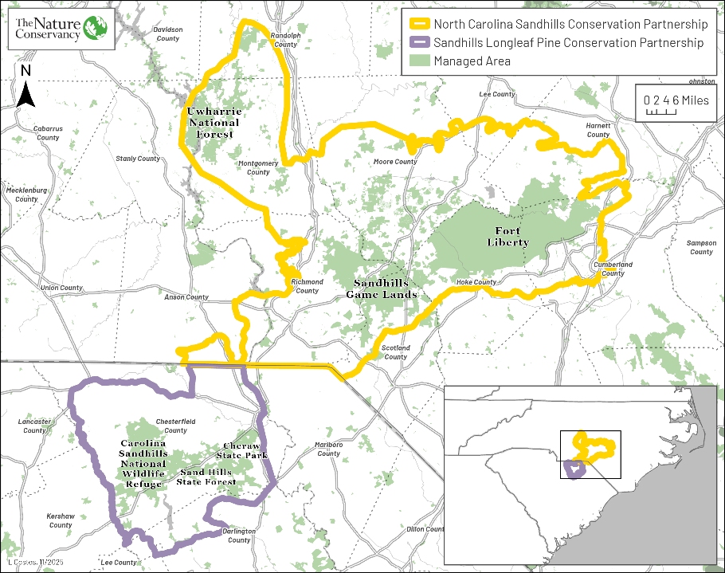
NCSCP & SLPCP

Slide 3
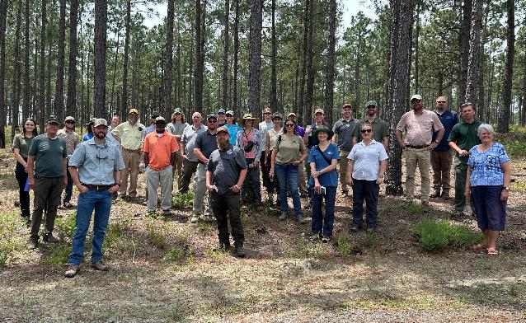
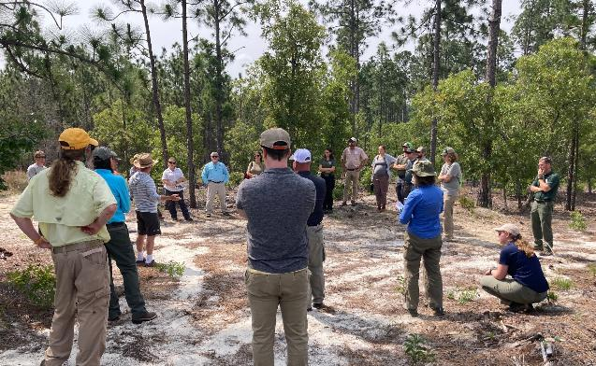
Joint Meeting in June 2025
Discussed differing strategies and methods for collaboration
Identified interest in connecting the two geographies

Slide 4
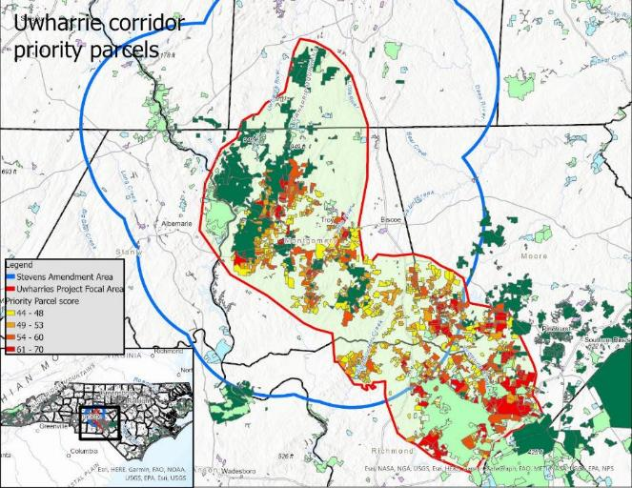
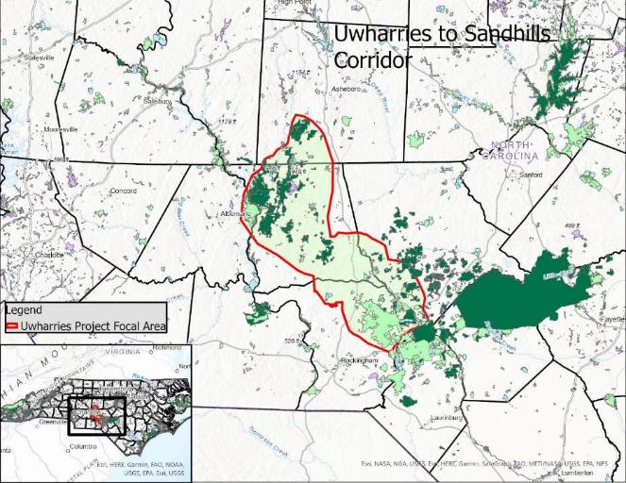
Inspiration: Uwharries Corridor Analysis
Goal:
  Create a 25,000+ acre patch of connected, fire-managed pine habitat in Uwharries with “stepping stones” of habitat connecting this patch to conservation lands in Sandhills
Implementation includes:
  Ember Alliance burn crew
  Dedicated pot of EQIP funding
  Technical guidance for landowners through Quail Forever
  Outreach and support through the SPBA

Slide 5
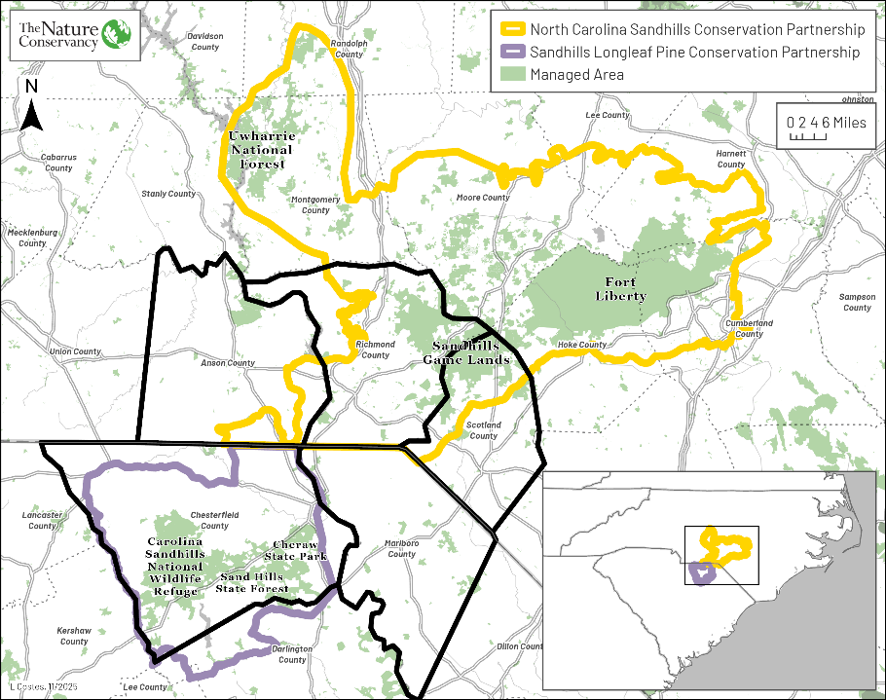
Area of Interest

Slide 6
Criteria
North Carolina | South Carolina
Parcel Size | Parcel Size
Distance from Managed Areas | Distance from Managed Areas
TNC RCN: Terrestrial Resilience | TNC RCN: Terrestrial Resilience
LLP Soil Suitability | LLP Soil Suitability
NHP Natural Areas*/EOs | NHP EOs
LLP High Quality Habitat* | Longleaf Suitability Analysis
*These datasets are not available for SC.

Slide 7
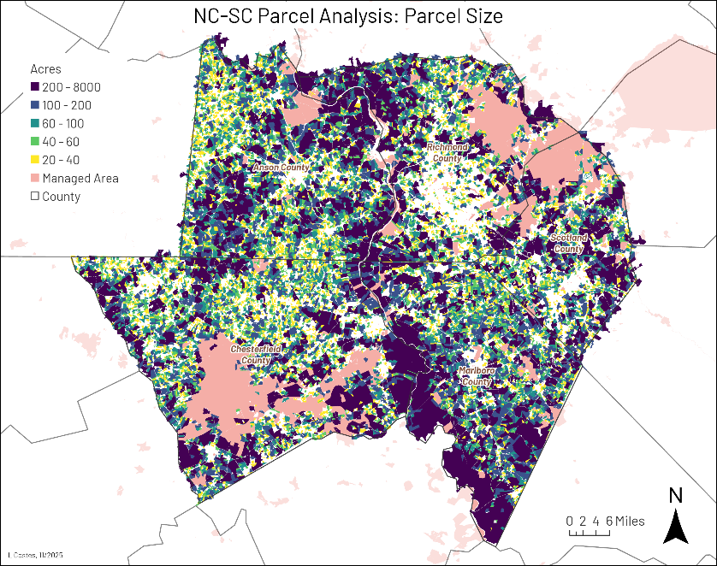

Parcel Size

Slide 8
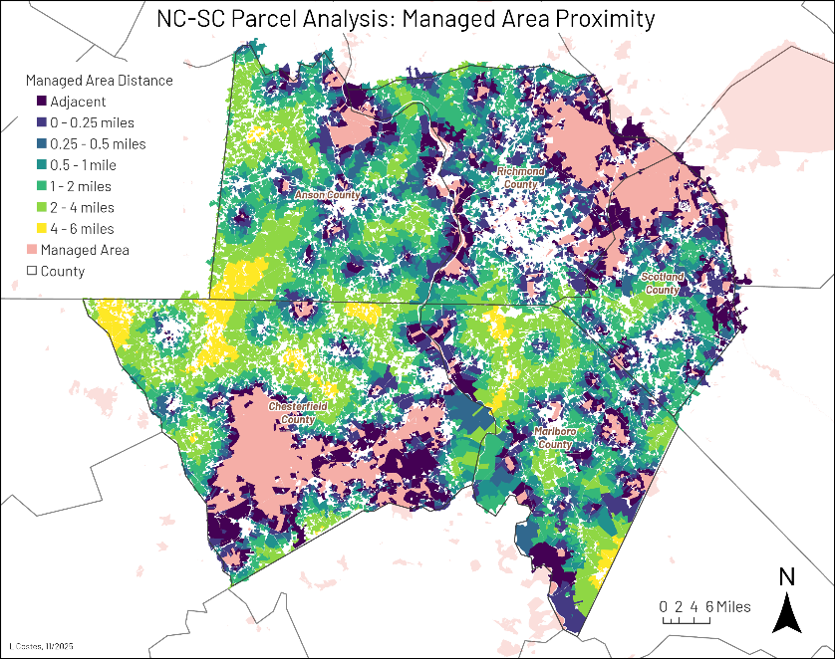
Managed
Area Proximity

Slide 9
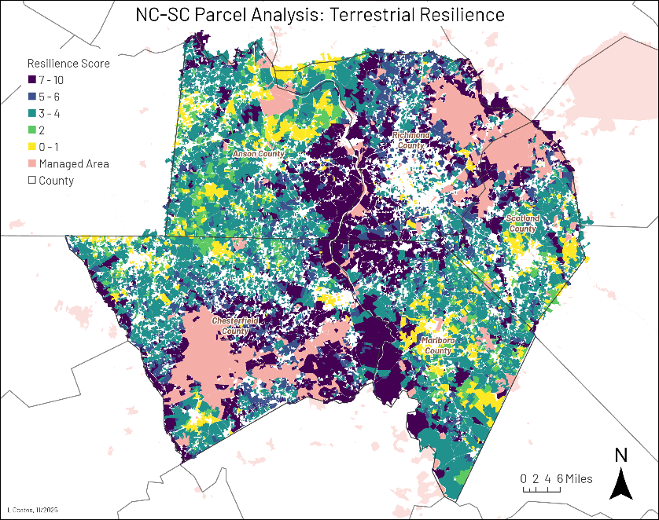
Terrestrial Resilience

Slide 10
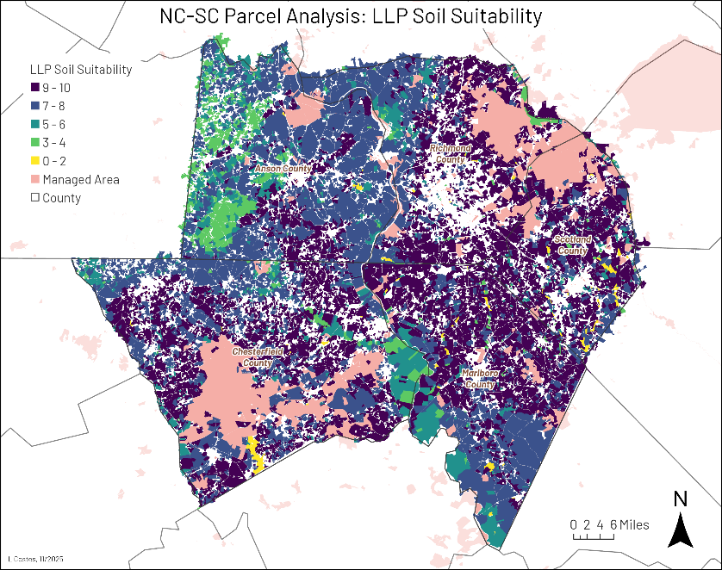
Soil Suitability

Slide 11
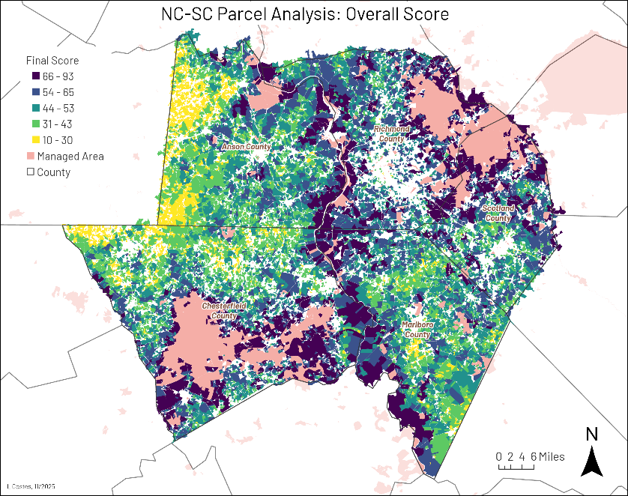
Final Scores

Slide 12
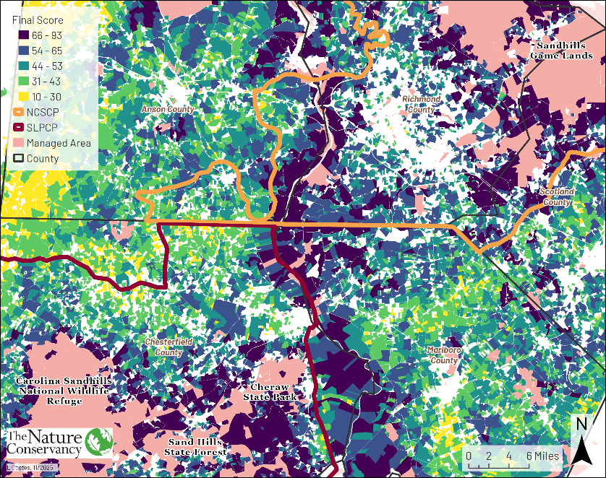
Zooming in…
Notes:
Following the Pee Dee River is a clear corridor. Upland pathways less apparent. Laurinburg presents a challenge – potential pathways to the south or north
Mention the need to expand partnership boundaries if this is to become a focus. Need to evaluate whether capacity and priorities allow for this, or whether additional collaborations could make it feasible (Sara Cerv – Ruffed Grouse Society & American Woodcock Society)

Slide 13
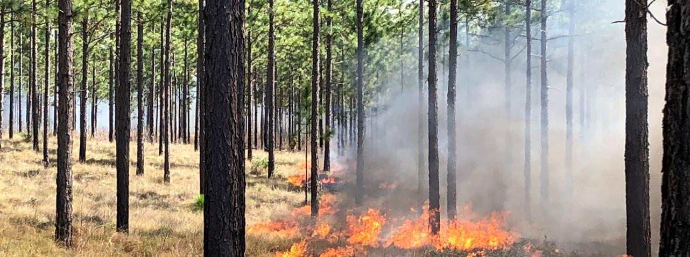
To access the dataset, email me: lydie.costes@tnc.org
Special thanks to Jessie Jordan, Ryan Bollinger, and Jeff Marcus for their contributions to this analysis, and to Charles Babb for facilitating the collaboration with South Carolina. And all our conservation partners who expressed interest in this corridor!

