Slide 1
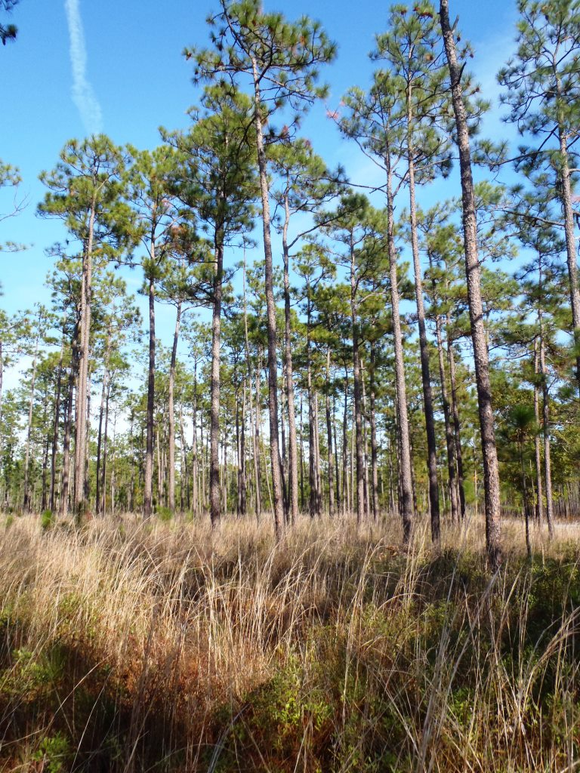
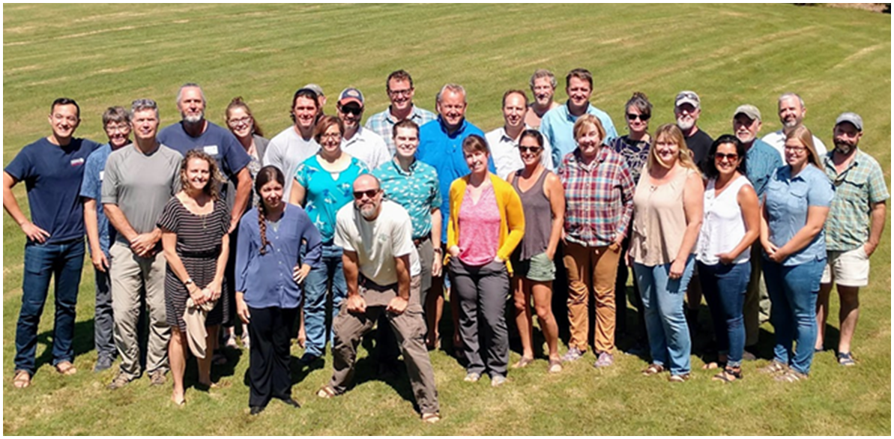
Creating a Range-wide Action Map
Ultimate Desired Goal:
To conserve a network of appropriately scaled and representative longleaf forests containing biodiversity, healthy fire management, and natural resilience allowing species to adapt to climate impacts and thrive.
3/30/21
Notes:
- Large team behind this with representatives from all 9 states.
An Asset Map is a depiction of what is important; for LLPWS, it identifies what we consider the most critical places for longleaf pine conservation.

Slide 2
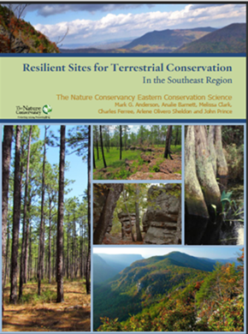
TNC’s Resilient and Connected Network
Project headed by Mark Anderson
Resilient: in a changing climate, those parts of the landscape with greater Landform Diversity and Local Connectedness will be more likely to retain greater species diversity
Landform Diversity within an ecoregion:
    Diversity of soils
    Topography
    Wetland density
  Local Connectedness
    Larger areas of natural landcover
Connected: permeability of the landscape to accommodate large scale species movement
  Climate Flow Zones
  Climate Corridors
Resilient and Connected Landscapes (conservationgateway.org)

Slide 3
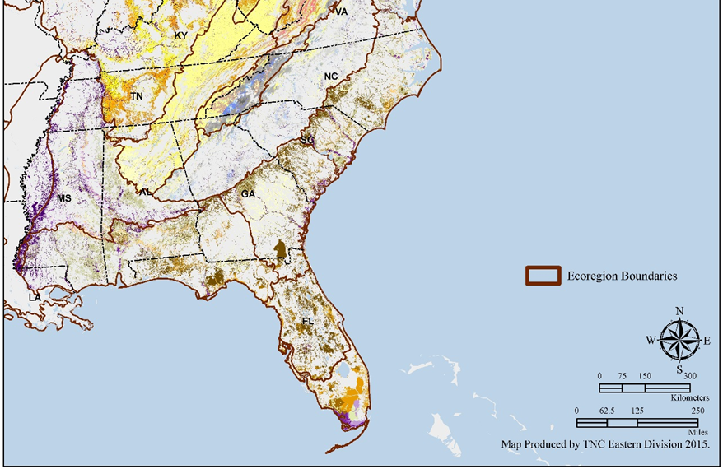
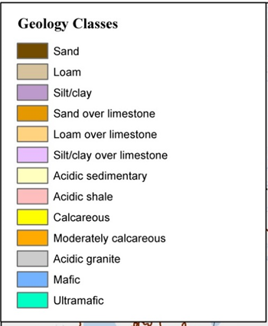
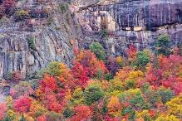
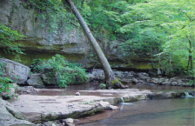
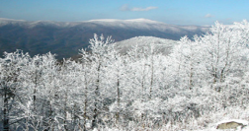
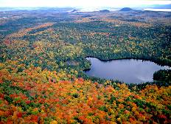
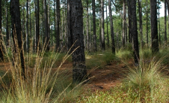
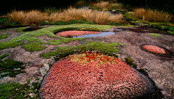
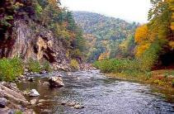
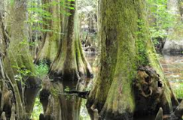
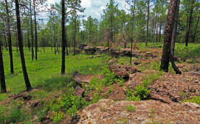
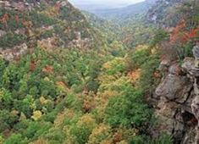
Landform Diversity
Sites with the most microclimates and connectedness relative to its geophysical setting
100 acre
Sand over Limestone
Coarse sand

Slide 4
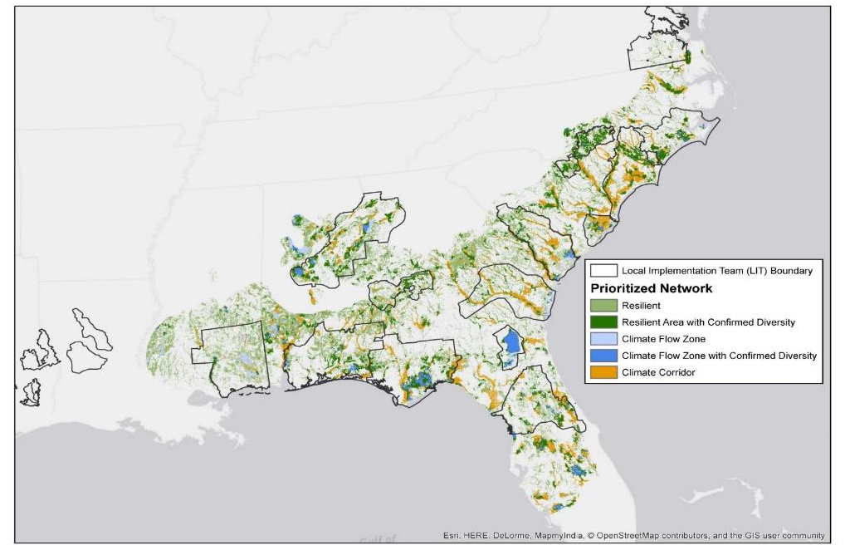
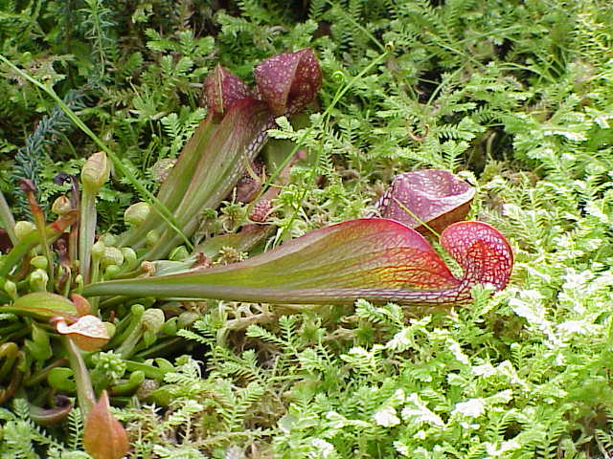
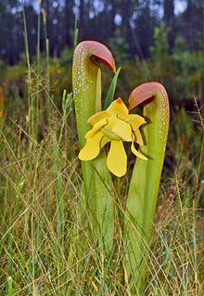
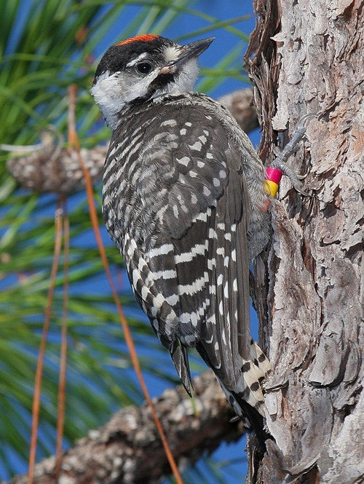
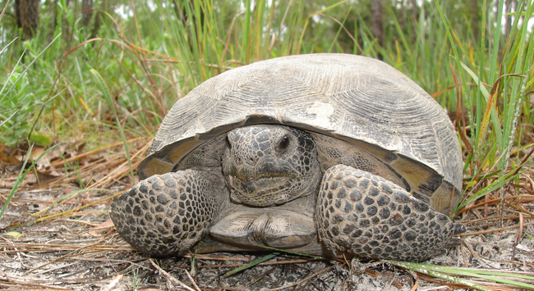
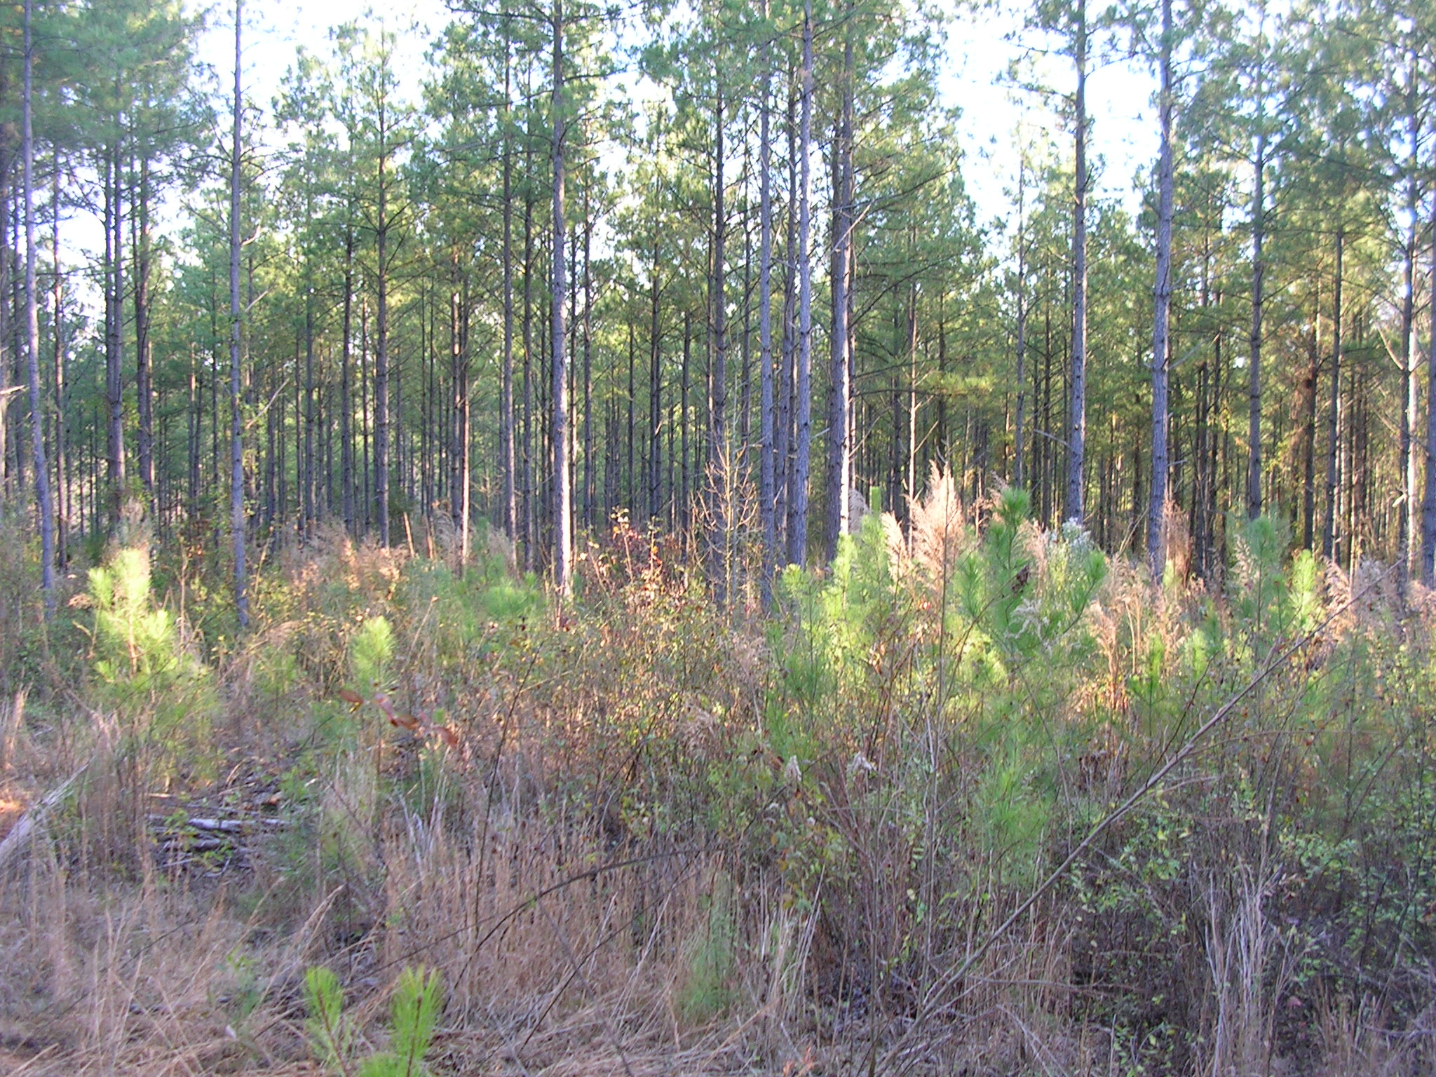
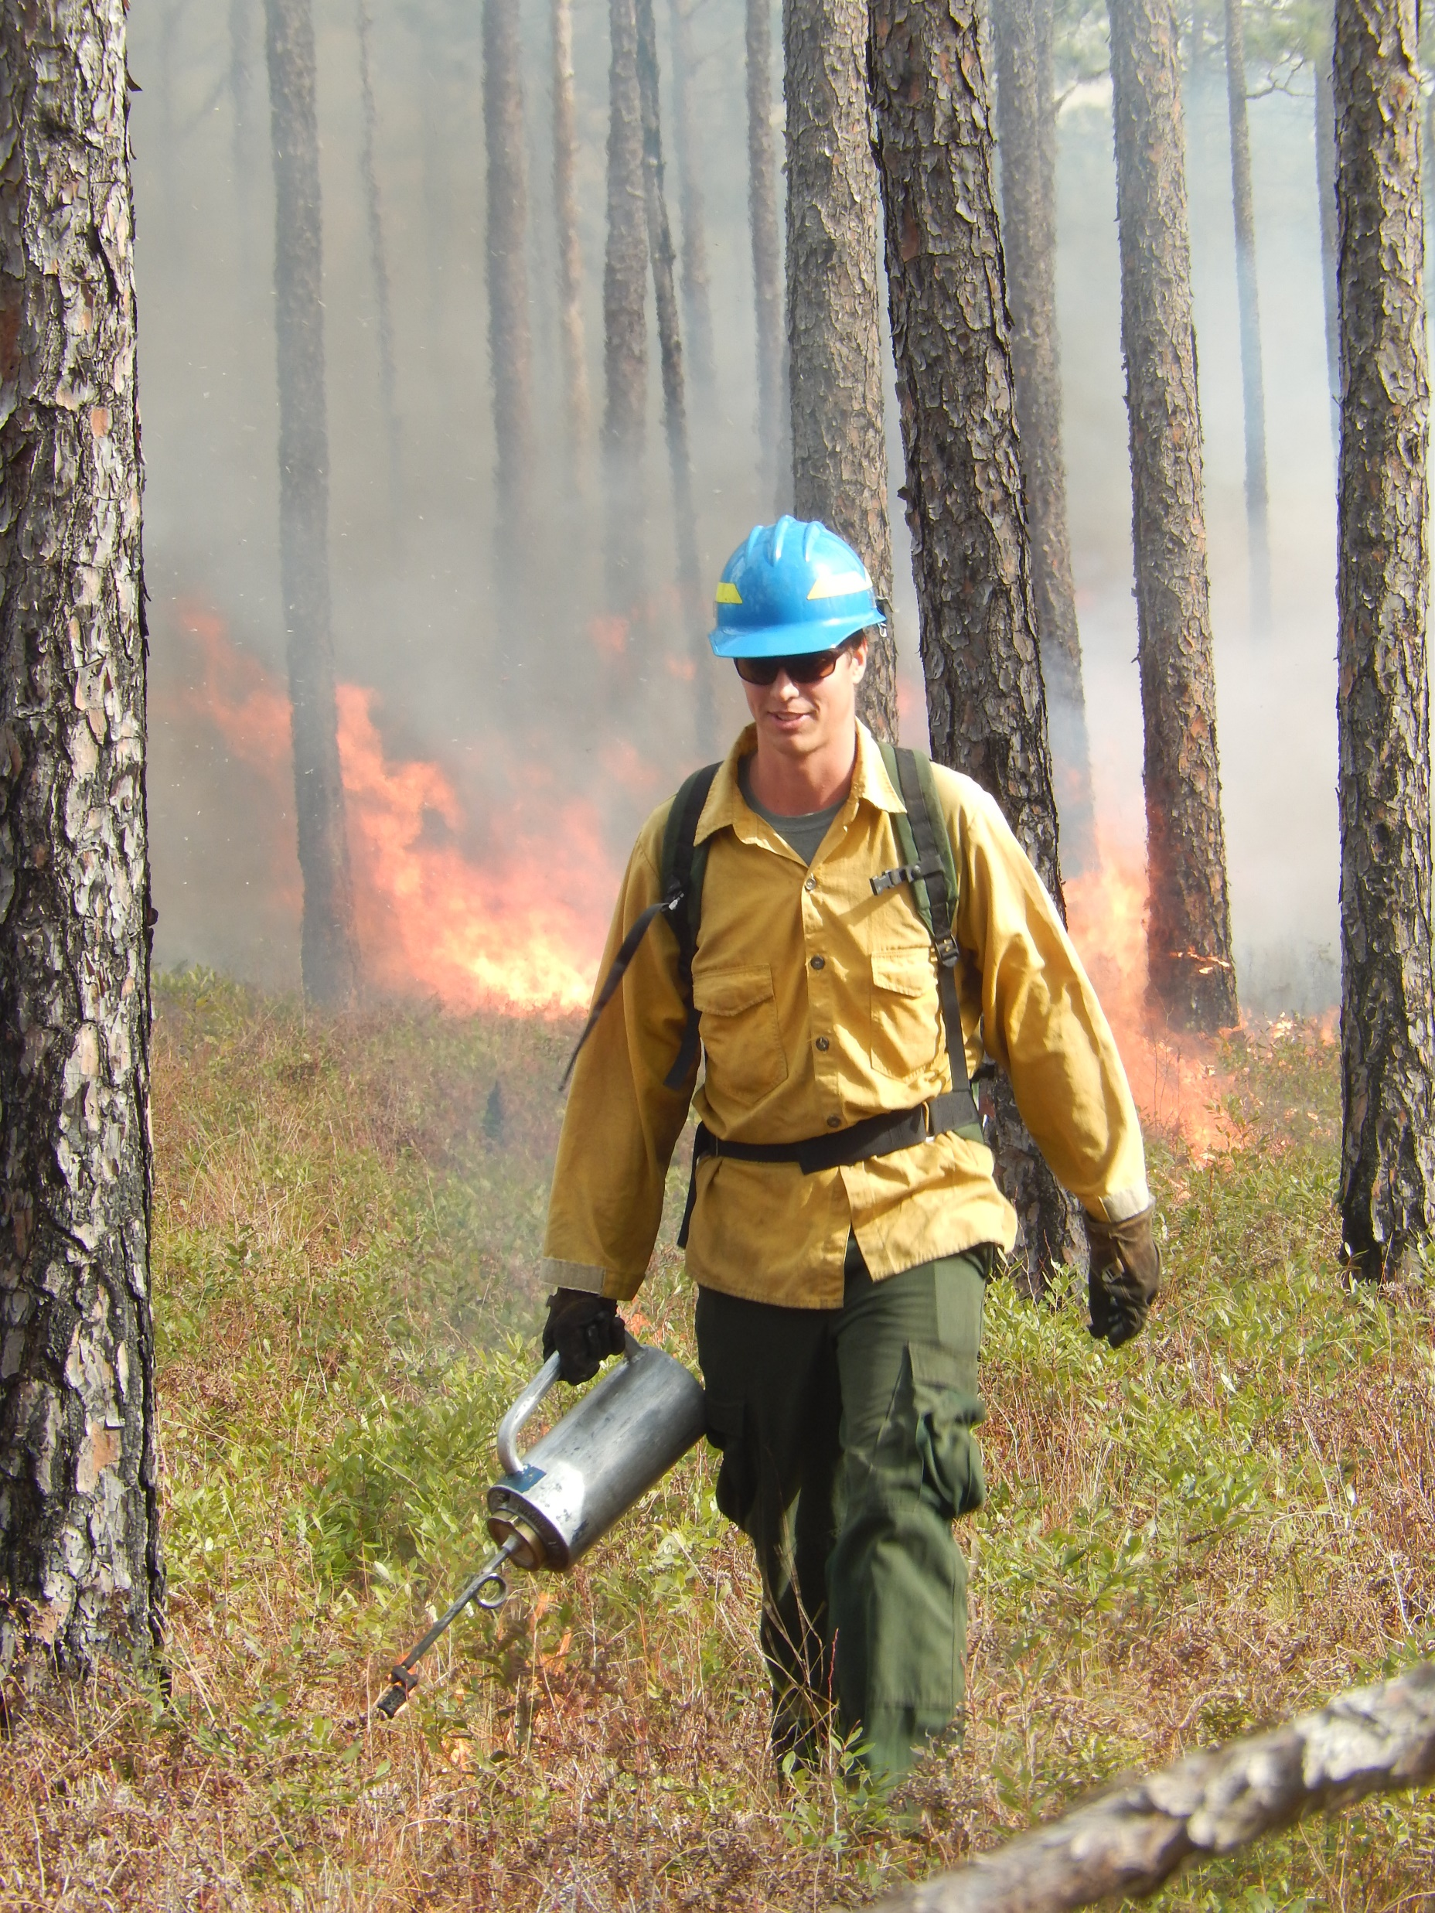
Resilient and Connected Network by Longleaf Historic Range
Species Capture (in the network 23%)
85%
78%
51%
28%
Dataset: National Biomass and Carbon Dataset for the year 2000” (Kellnsdorfer 2012) and Forest Biomass (NBCD2000).
Dataset: Forests to Faucets (USFW 2012)
Notes:
RCN importance and evolution to use RCN as the underpinning of our Protect Land and Water plan and LLPWS
JEFF TO EDIT

Slide 5
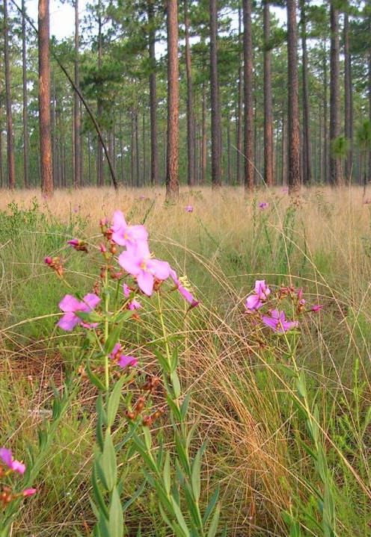
Data Layers/Inputs
Longleaf Priority Areas
Valuing Industrial Forest in Terrestrial Resilience
Climate Corridors/Flow Zones from RCN
Intactness: Natural Land Cover Blocks
Layers weighted & combined = Longleaf Asset Map
Meadowbeauty on Sandhills
Game Land, NC- Jeff Marcus
Notes:
Simplify and use same words on each map layer slide.
Analie to speak to this.

Slide 6
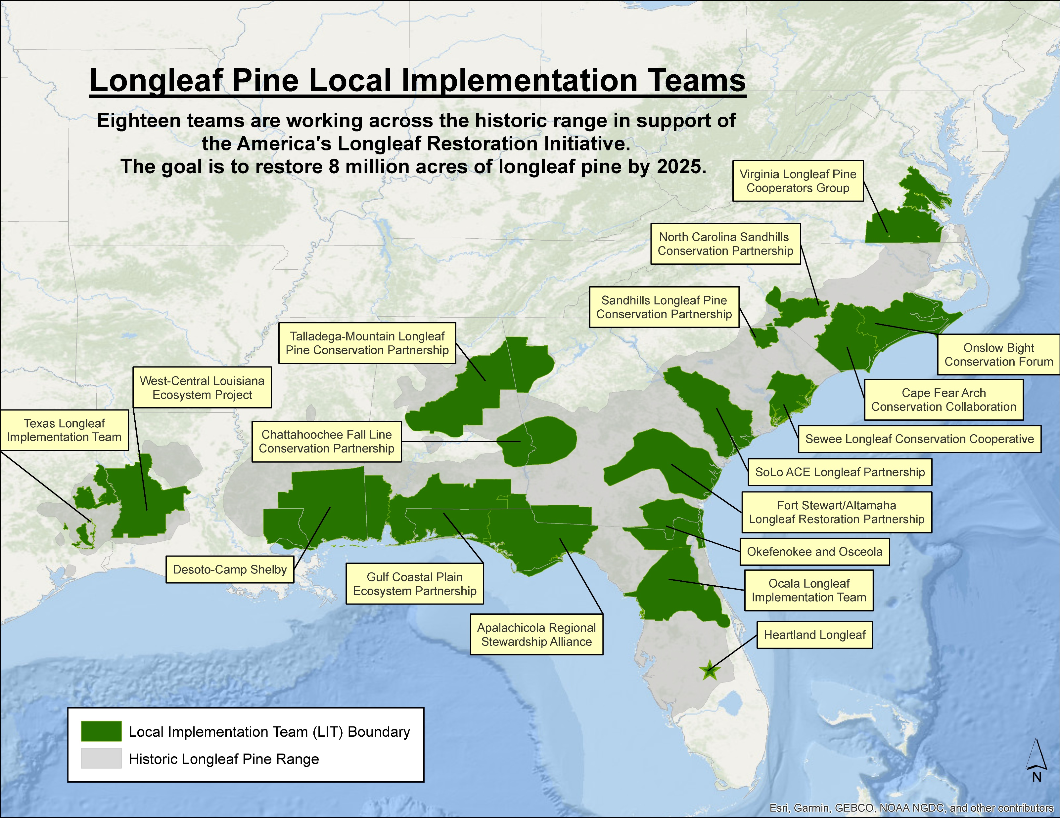

Current Local Implementation
Teams
America’s Longleaf Restoration Initiative
Notes:
In order to carry out effective longleaf restoration a large partnership was formed around 2009 which helped create the foundation for funding and collaboration across land ownership. There are 18 local collaboratives across the range, TNC leads 11 of them and accomplishes work in all of them in one way or another.

Slide 7
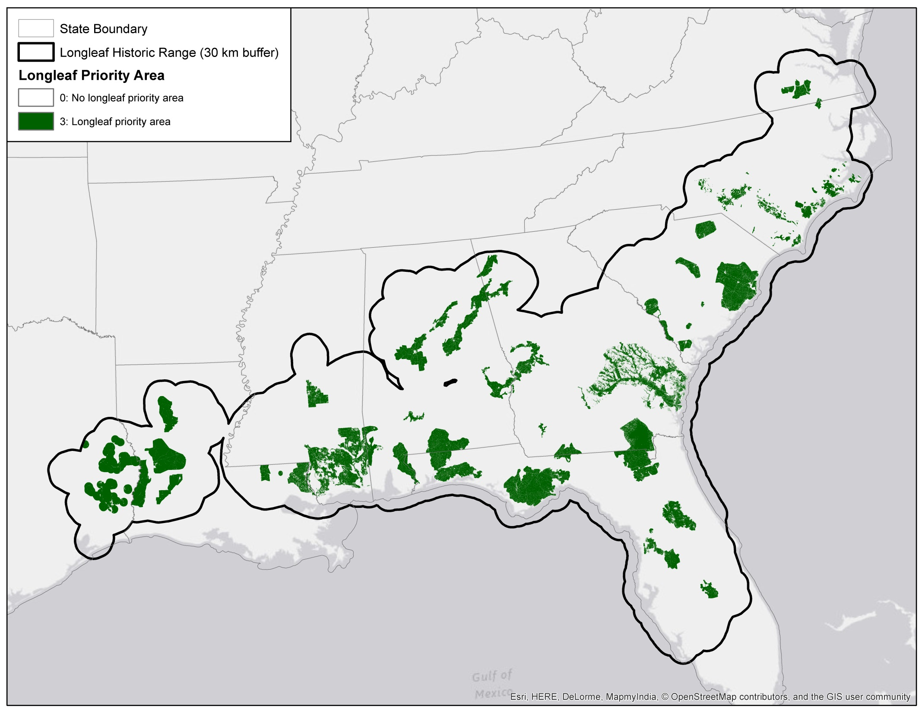
Longleaf Priority Areas

Slide 8
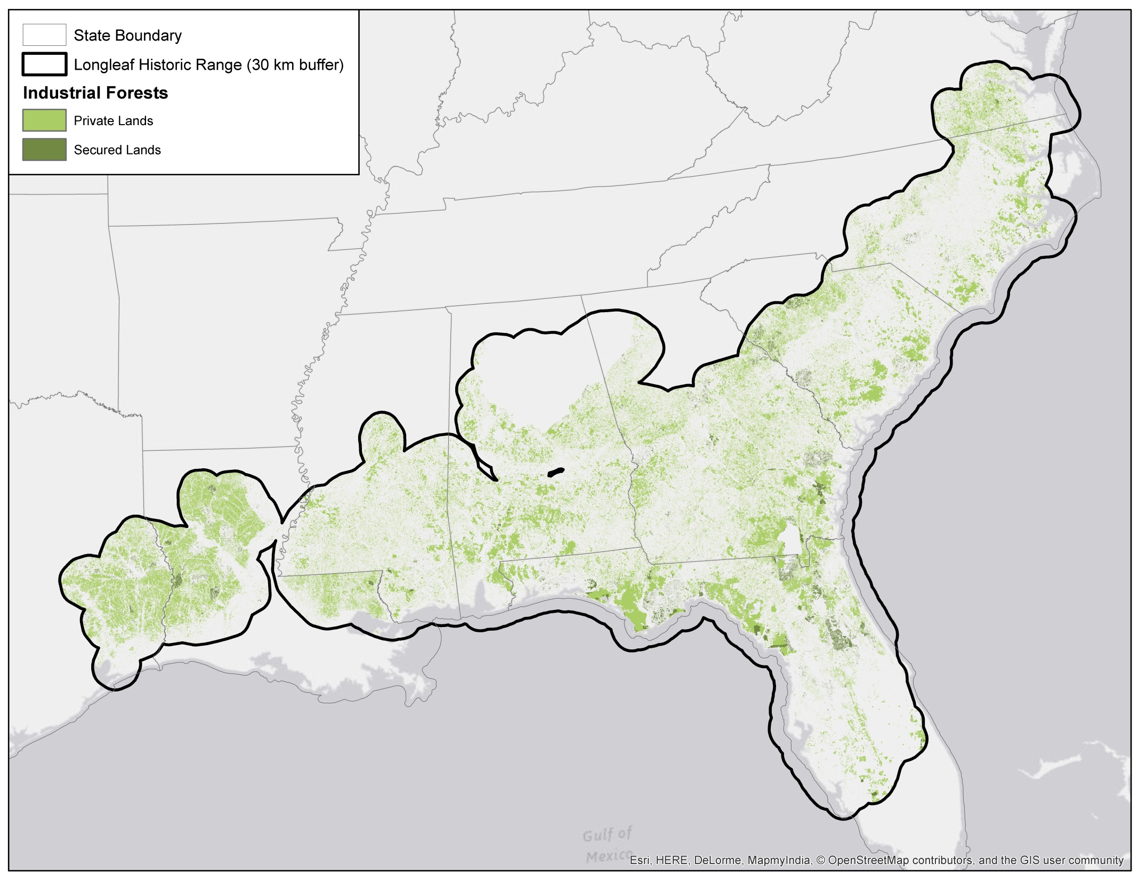
Industrial Forest Lands

Slide 9
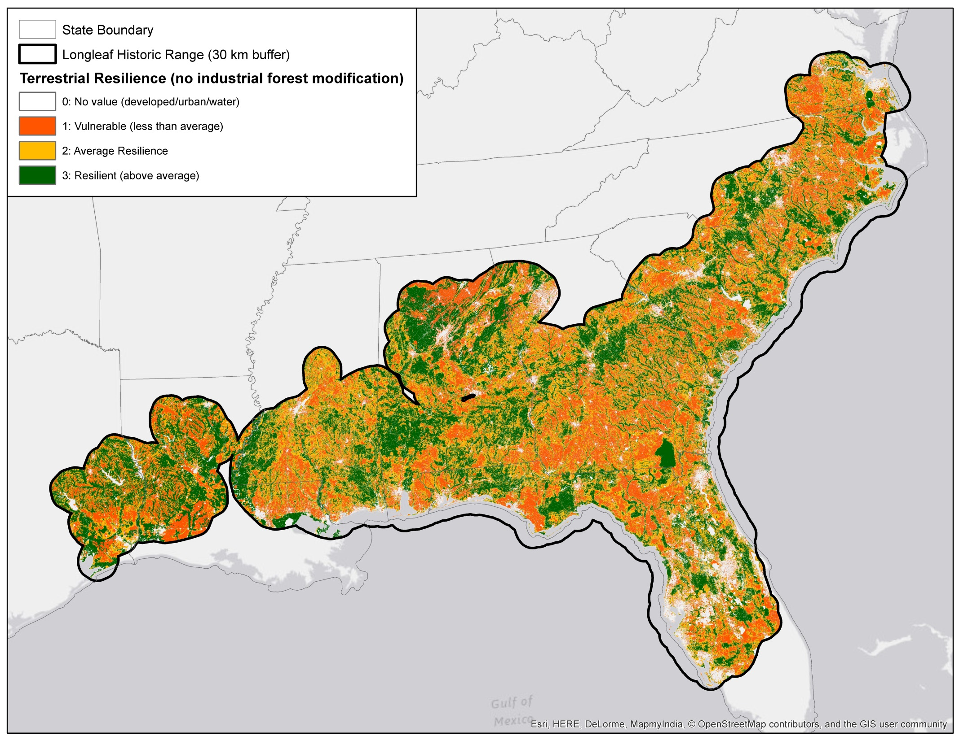
Terrestrial Resilience Values

Slide 10

Terrestrial Resilience Values with Industrial Forest Modification

Slide 11
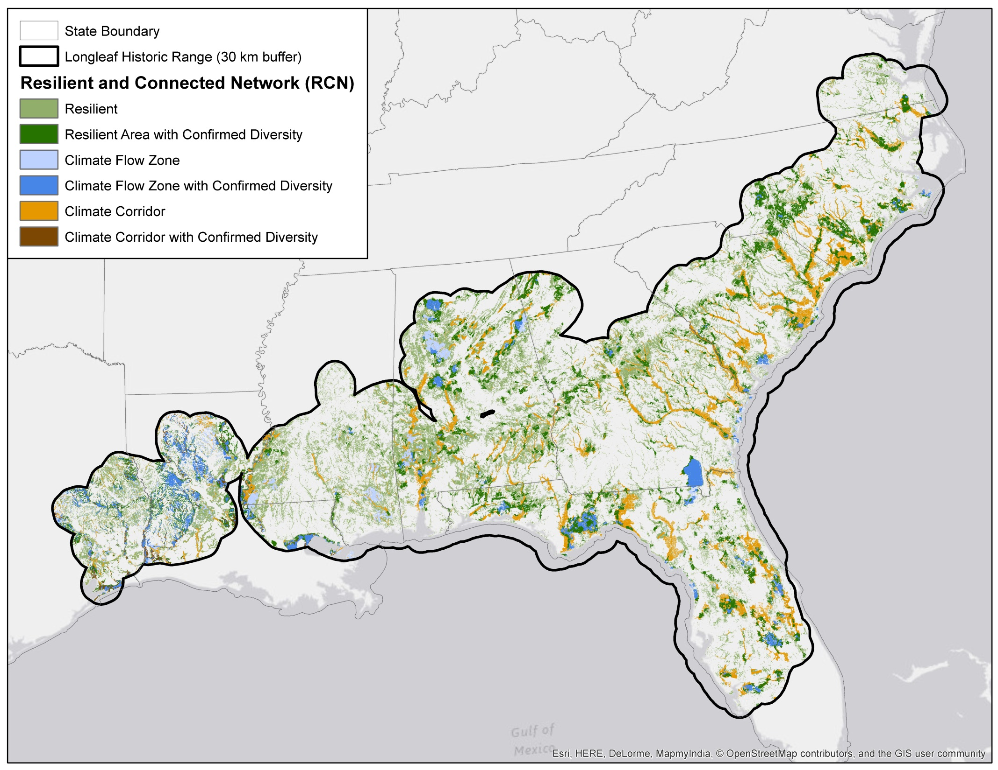
Resilient & Connected Network (RCN)

Slide 12
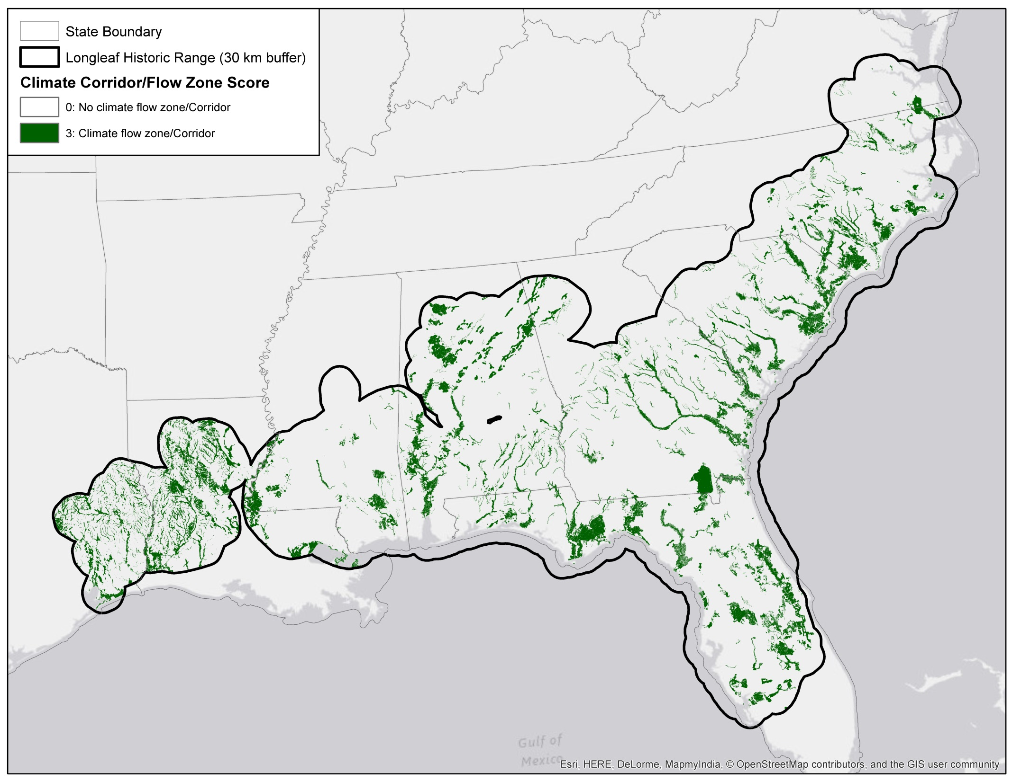
Climate Corridor/Climate Flow Zones
from RCN

Slide 13
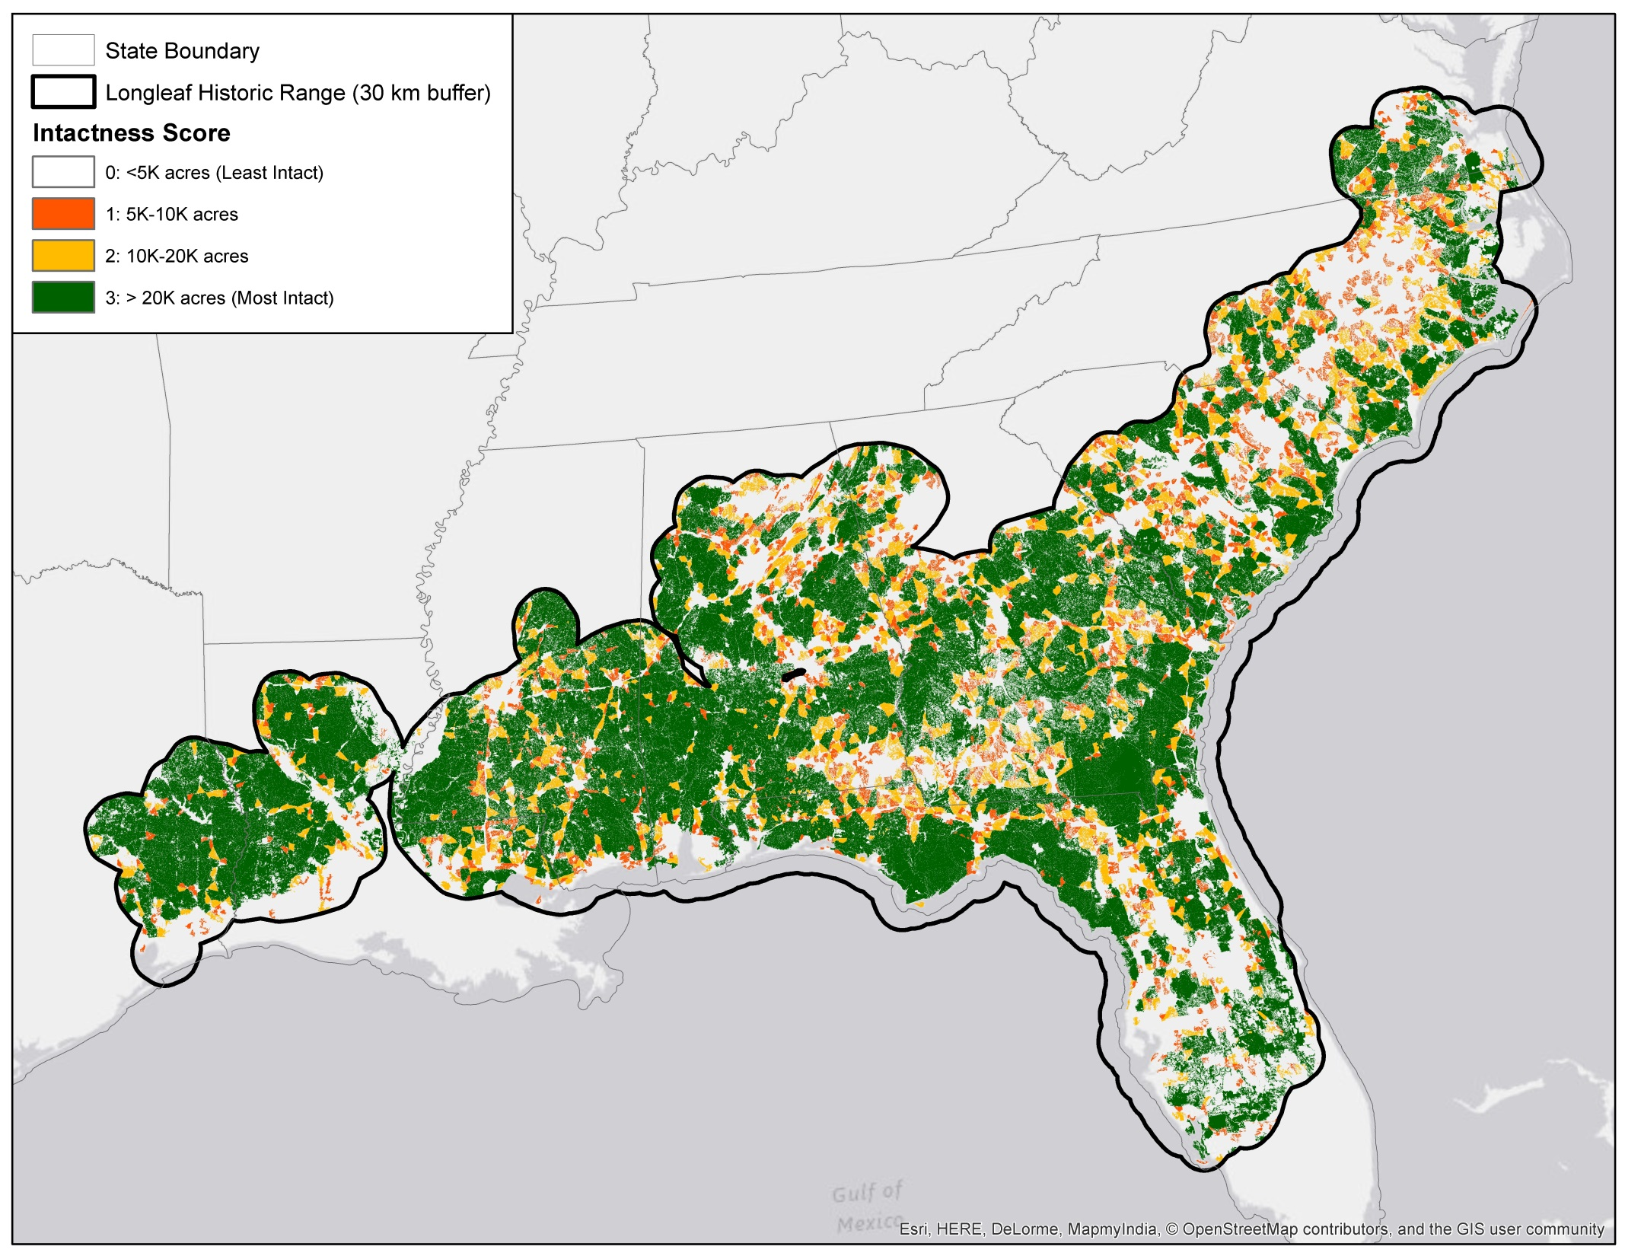
Intactness: Natural Land Cover Blocks

Slide 14
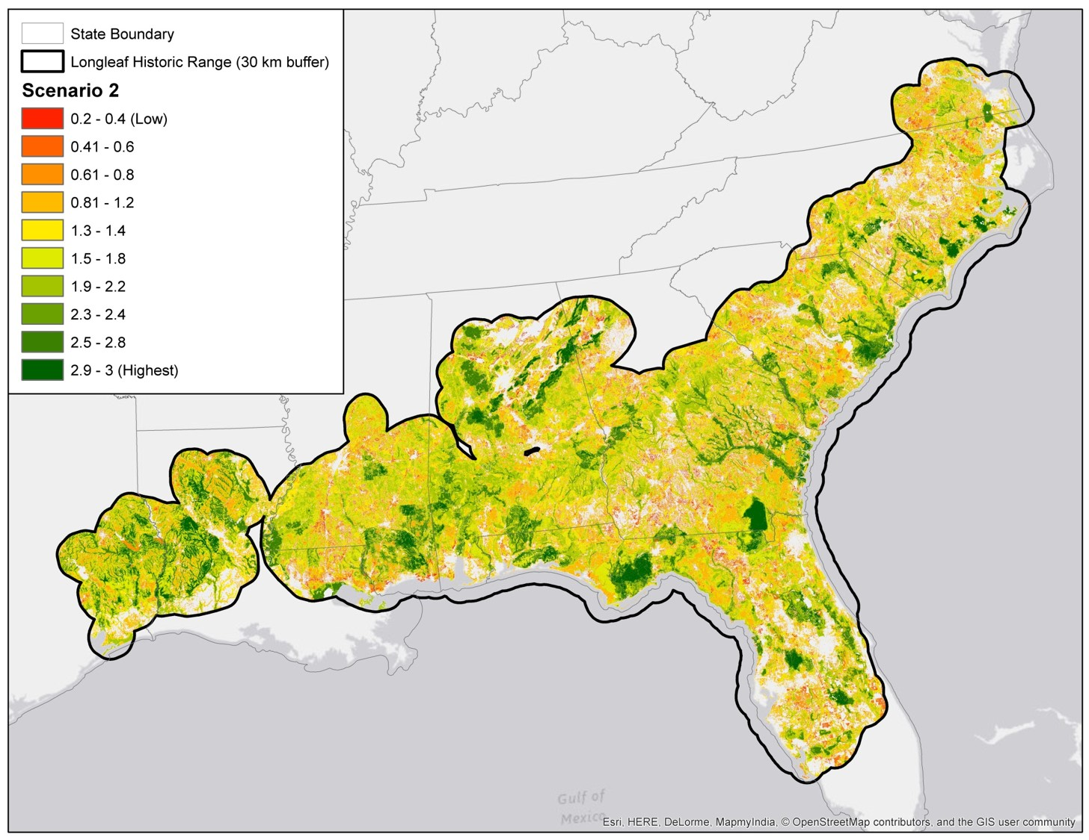
Longleaf Resilience Score
The most resilient areas for
longleaf pine forest conservation
in the face of a changing climate.
(least resilient)
(most resilient)
LLPWS Asset Map
Notes:
Final Map
Spatial representation of what we value and what we want = asset map.

Slide 15
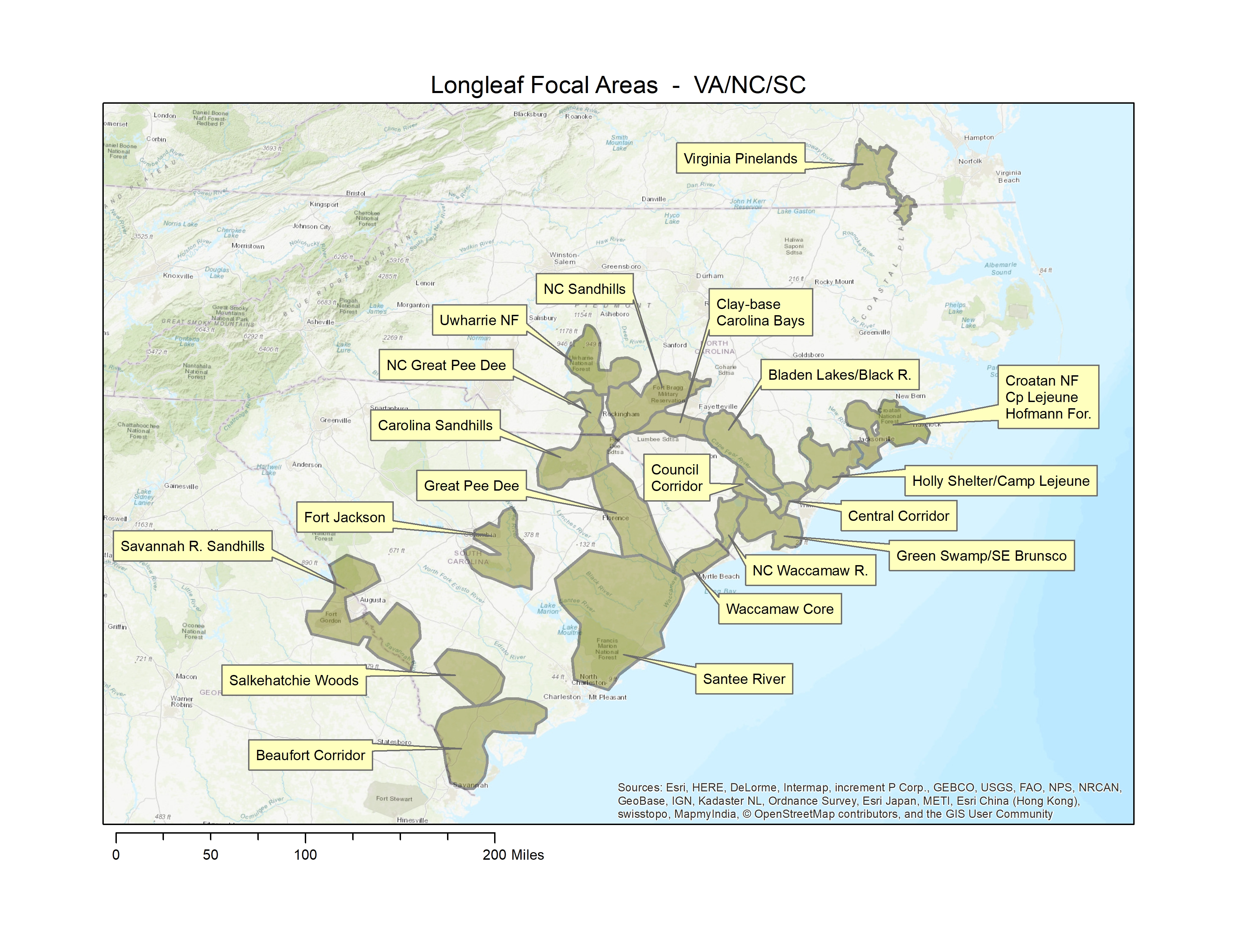

Slide 16
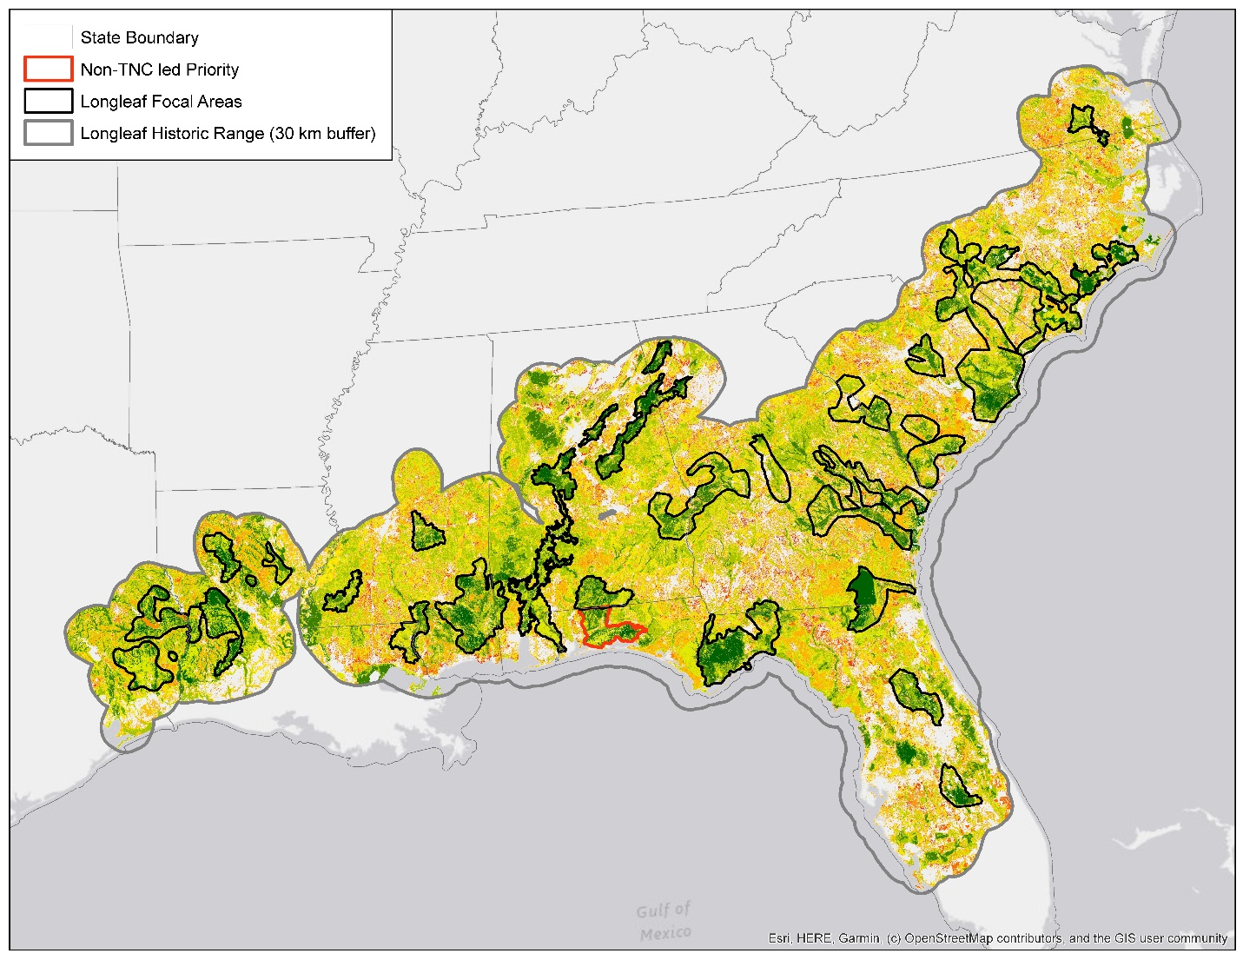
LLPWS Focal Areas
Most important areas for TNC to work to conserve a network of appropriately scaled and representative longleaf forests containing biodiversity, healthy fire management, and natural resilience allowing species to adapt to climate impacts and thrive.
  Total acreage of TNC focal areas: 32,212,700
Notes:
-Focal Areas are places where TNC should implement or influence conservation over the next 8-10 years. Answers the question "where should we work over the next 10 years."
- describe what is in the focal areas, why some green and others not.
- other teams focused on continental connectivity. address how LLPWS approached this.

