Slide 1
Legume-rhizobia symbiosis as a tool to enhance restoration success
Alyssa L. Young
alyoung6@uncg.edu
@Alyssa_Young3

Slide 2
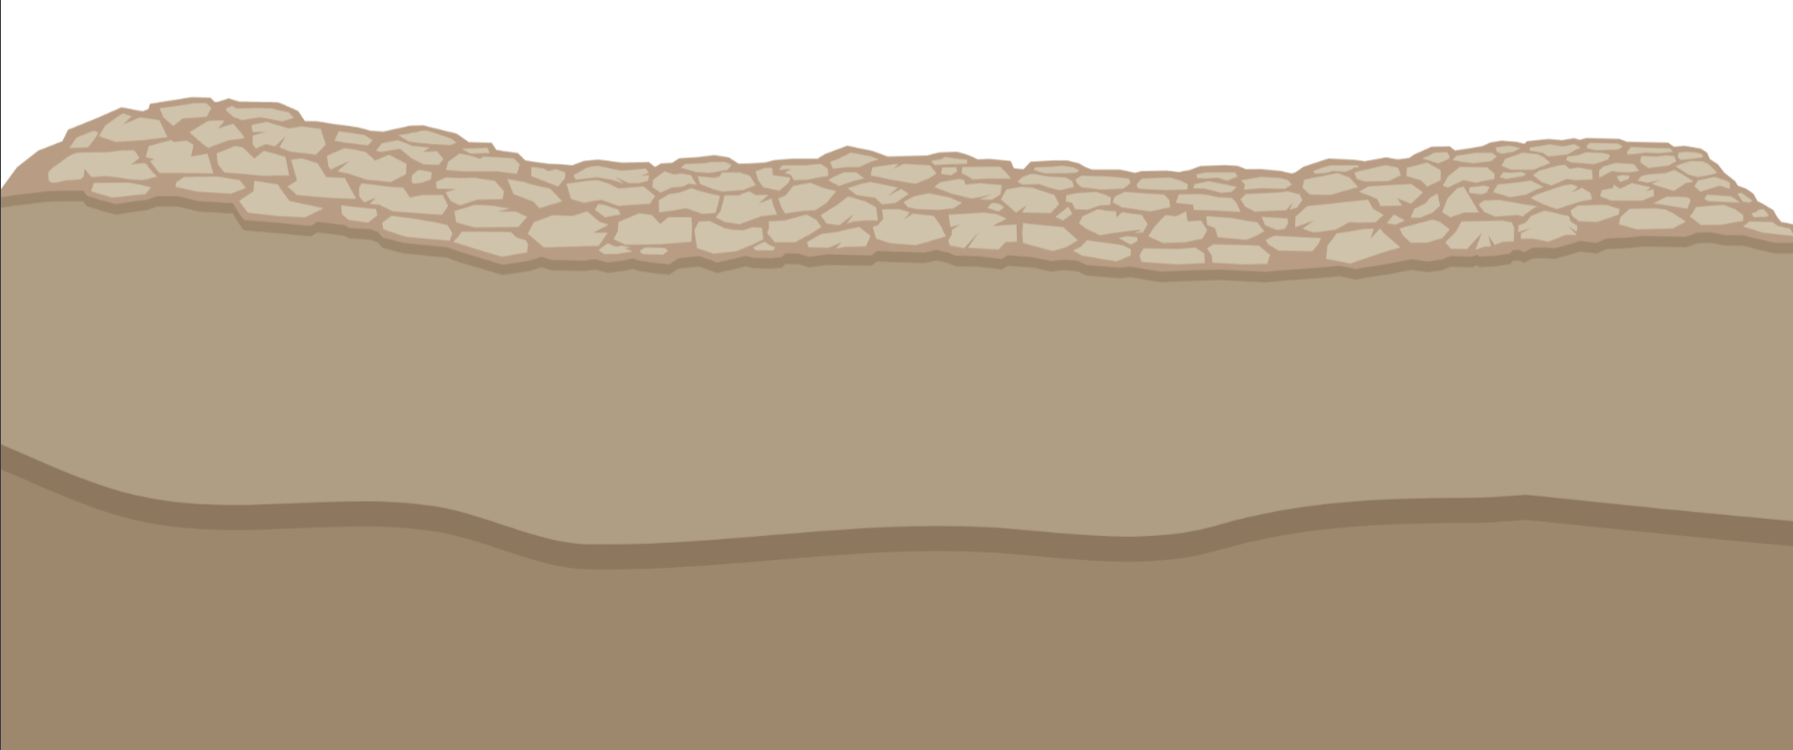
soil microorganisms are key drivers of
litter decomposition
plant growth
biogeochemical processes
nutrient cycling

Slide 3
Atmospheric N
(N₂)
78%
Nitrogen-fixing soil bacteria = rhizobia
Ammonium
(NH₄⁺)

Slide 4
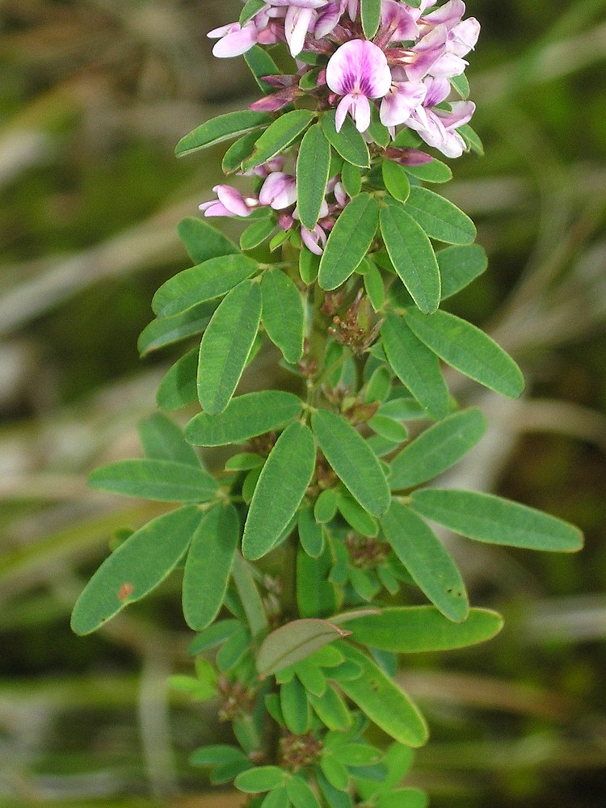
Symbiotic N-fixation (SNF)
Bacteria (rhizobia) live in legume root nodules and fix atmospheric N
In exchange, legumes provide sugars produced during photosynthesis to rhizobia

Slide 5
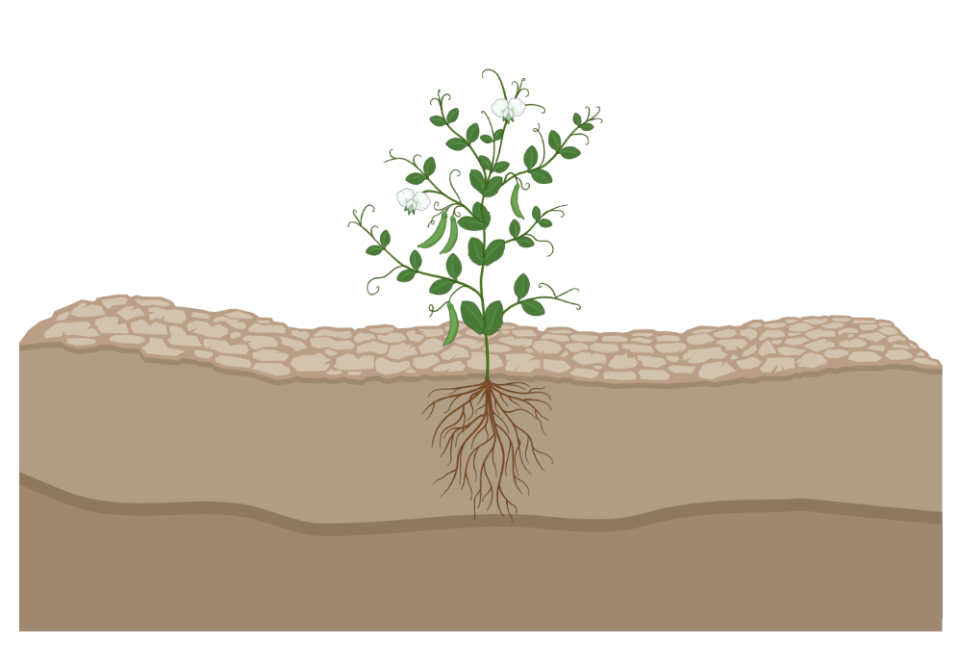
Legume-Rhizobia Symbiosis
Flavonoids
Rhizobia
nod factors

Slide 6
Importance of Nitrogen: N-fixation

Slide 7
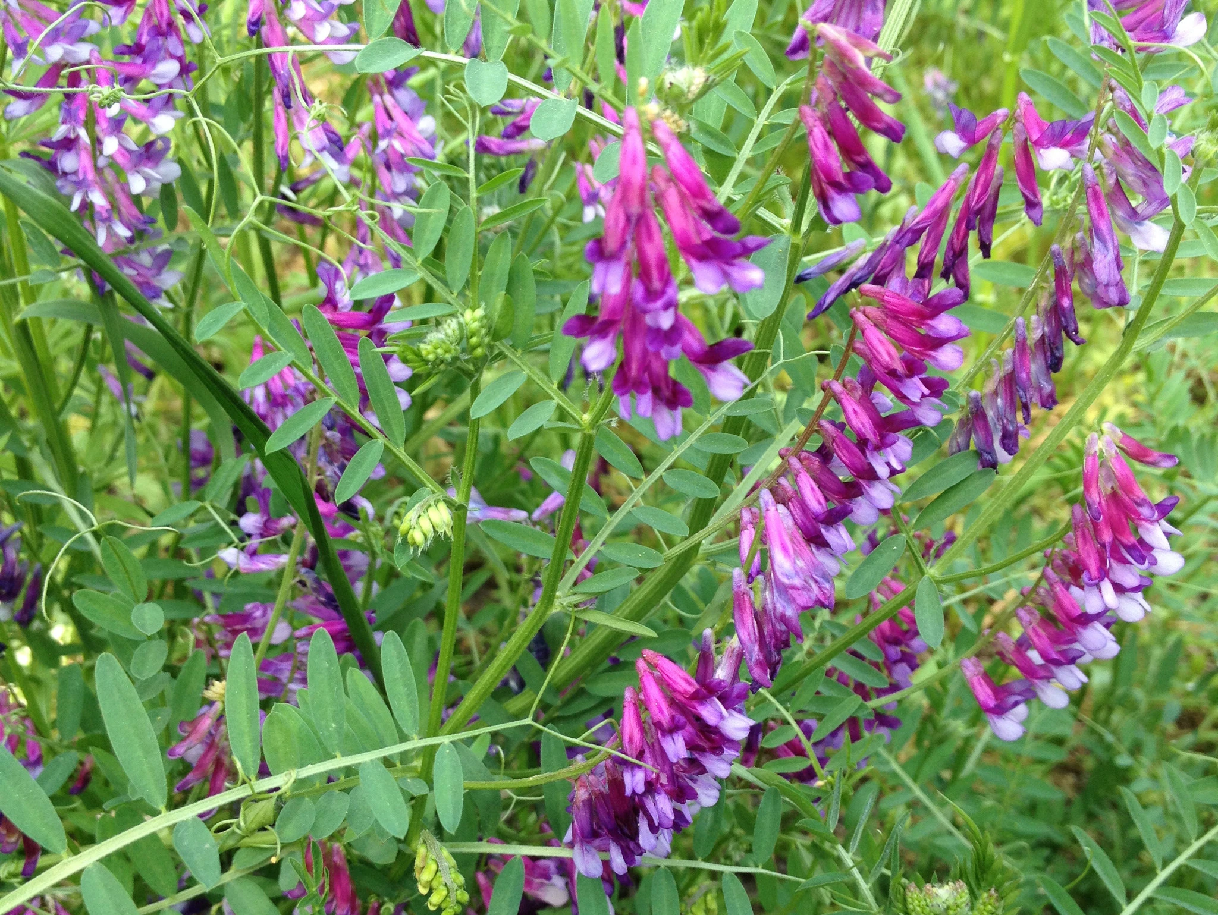
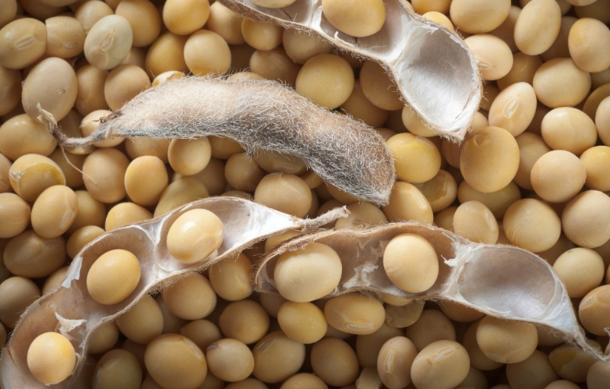
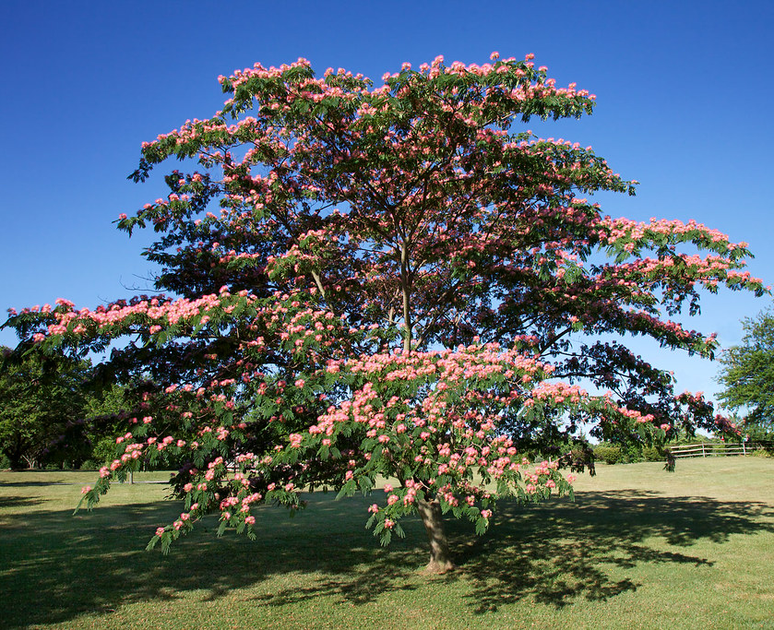
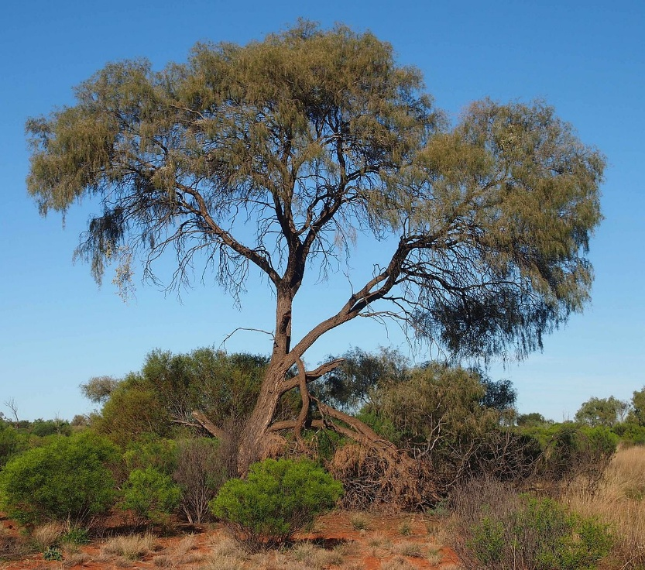
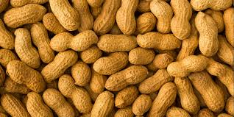
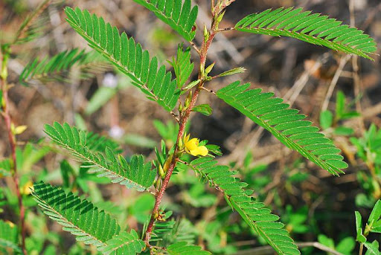
Examples of Legumes
Vetch
Soybean
Mimosa
Soybean
Rhizobia inoculations increase Soybean yield more so than Nitrogen fertilizations!
Acacia
Peanuts
Partridge Pea
Applicable in other systems rich in non-crop legumes?

Slide 8
Degraded LLP often:
Unburned
Low grass cover
Low diversity
Post Fire: Lower in nitrogen than normal
Purple = historic range
Red = current range

Slide 9
Legume-rhizobia symbiosis as a biofertilizer?

Slide 10
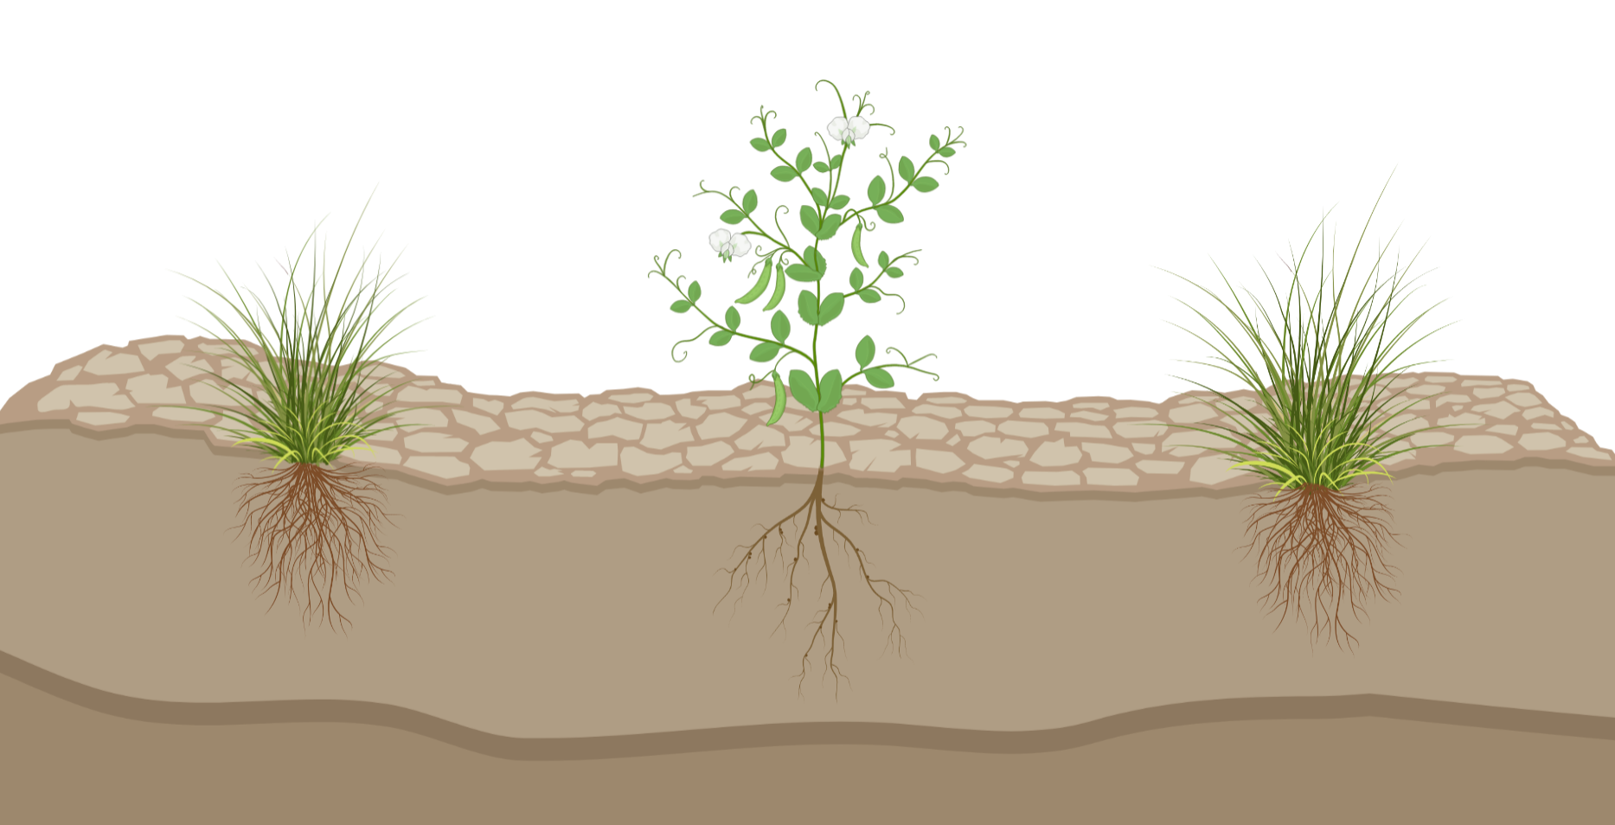
Atmospheric N
(N₂)
+ N
+ N
+ N
+ N
Ammonium
(NH₄⁺)
+ N
+ N

Slide 11
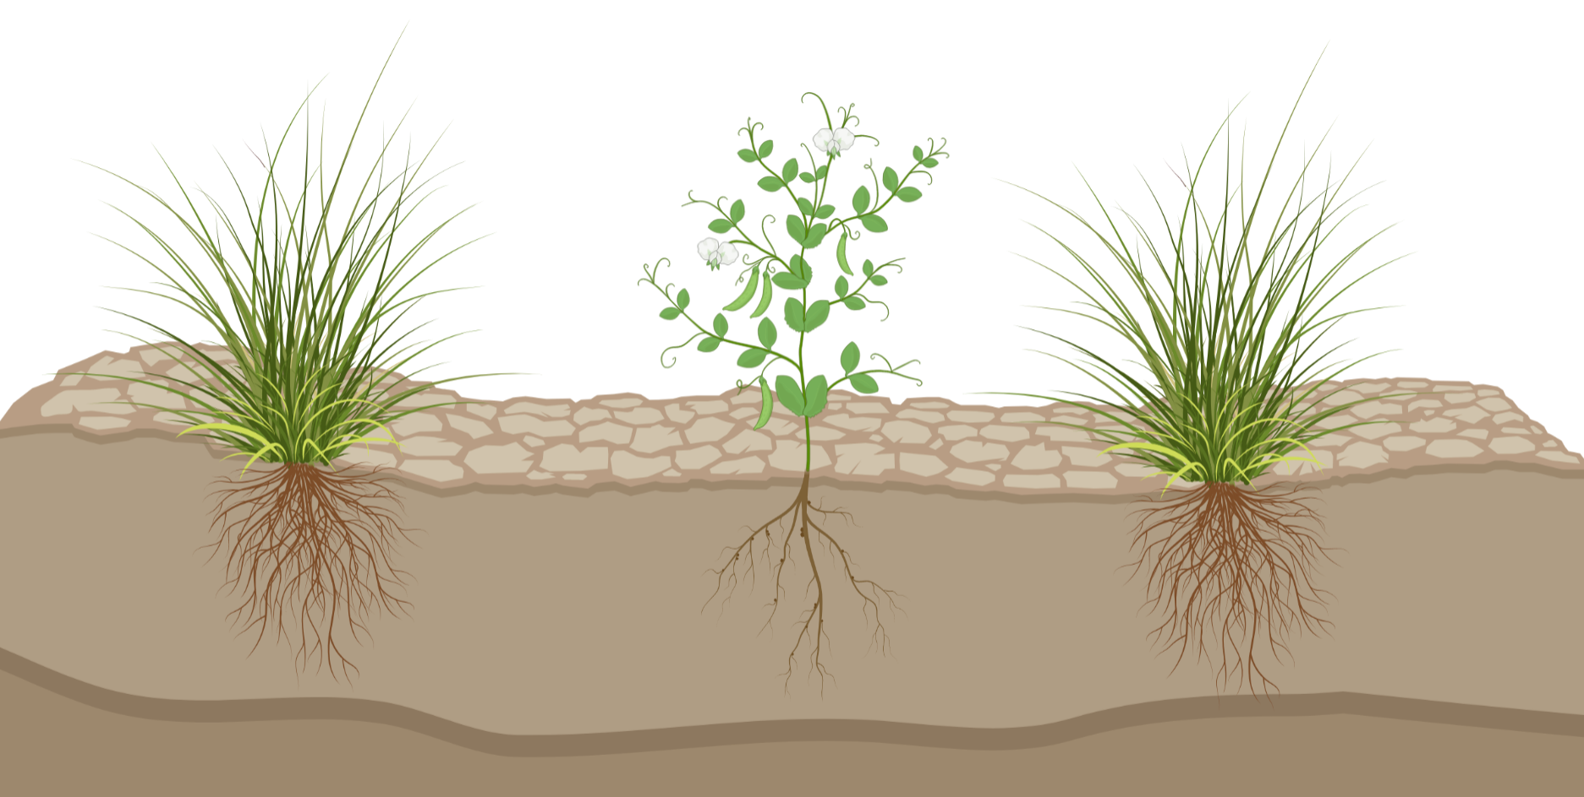
Increased productivity of
legumes (forage)
grasses (fire)
+ N
+ N
+ N
+ N
Ammonium
(NH₄⁺)
+ N
+ N

Slide 12
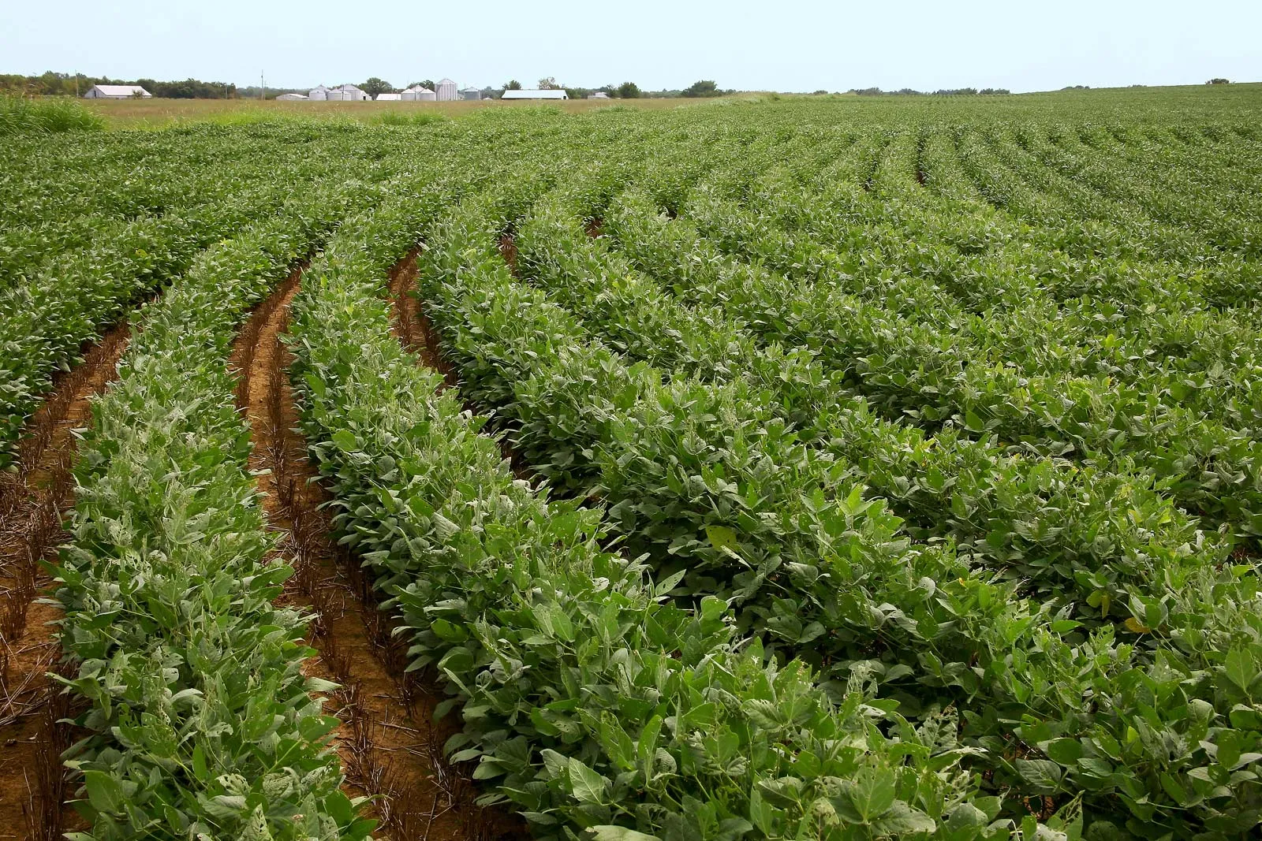
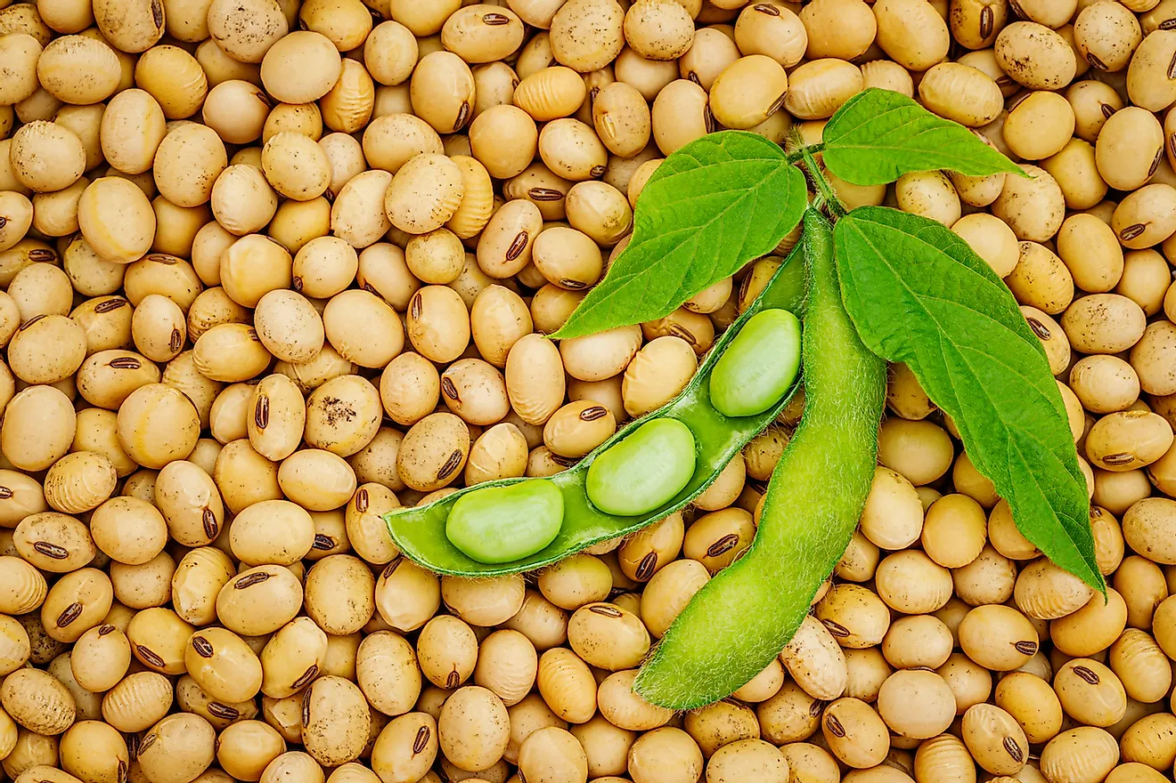
Legume-rhizobia symbiosis underperforming in LLP savannas?
Fire regulates nutrient cycling
2-183 kg N ha⁻¹ yr⁻¹
NITROGEN
NITROGEN
Imposes a resource constraint!
Loss of 17-33 kg N ha⁻¹ yr⁻¹
SNF returned little N
Input of 0.04-0.88 kg N ha⁻¹ yr⁻¹
^{Tierney et al. 2019}

Slide 13
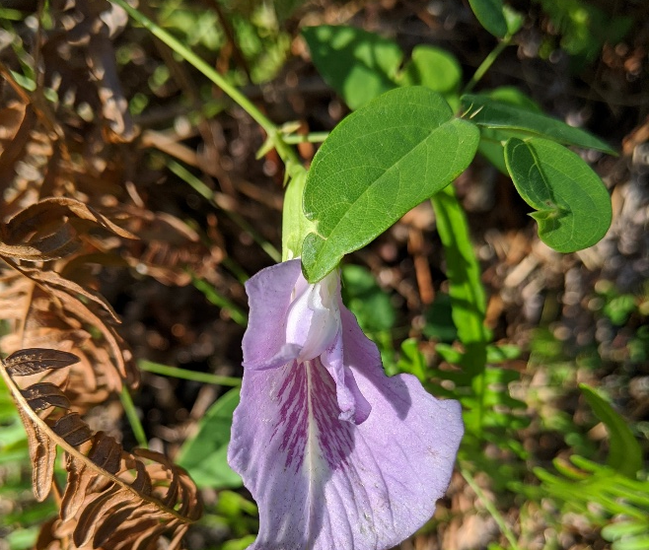
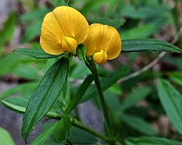
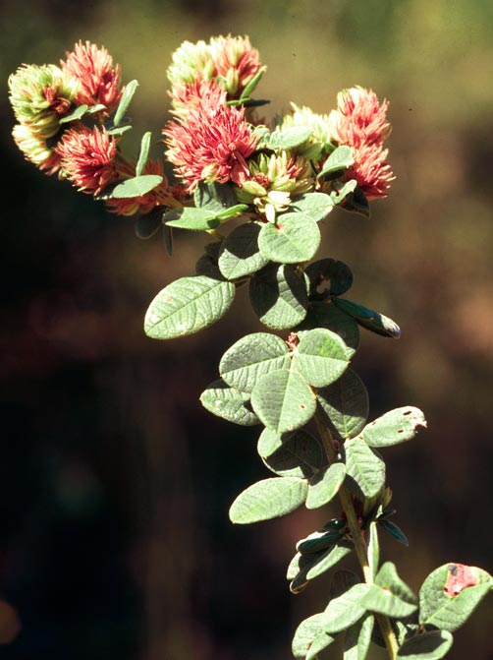
Can this symbiosis be enhanced for restoration?
NITROGEN
NITROGEN

Slide 14
Overall Objective
Investigate which biotic and abiotic factors influence rates of SNF in LLP savannas

Slide 15
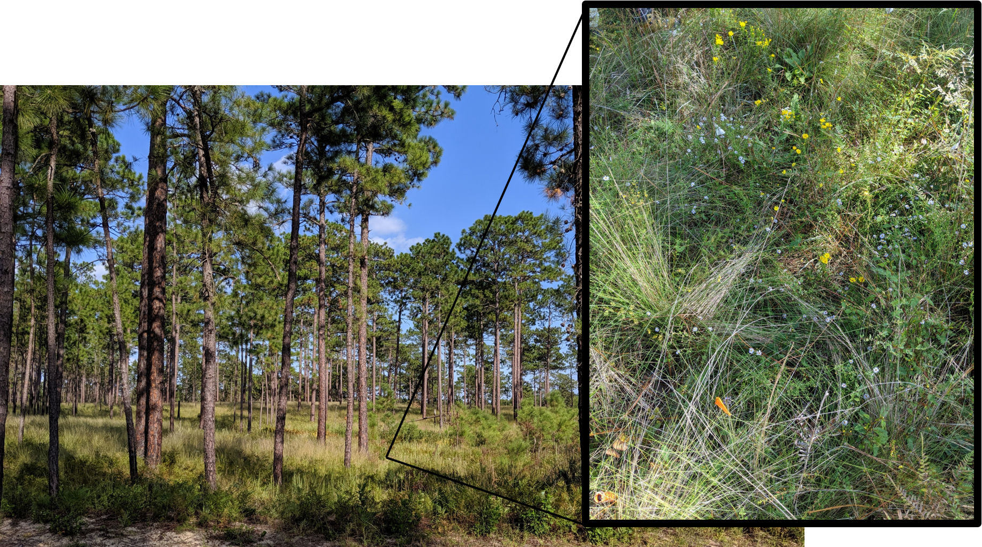
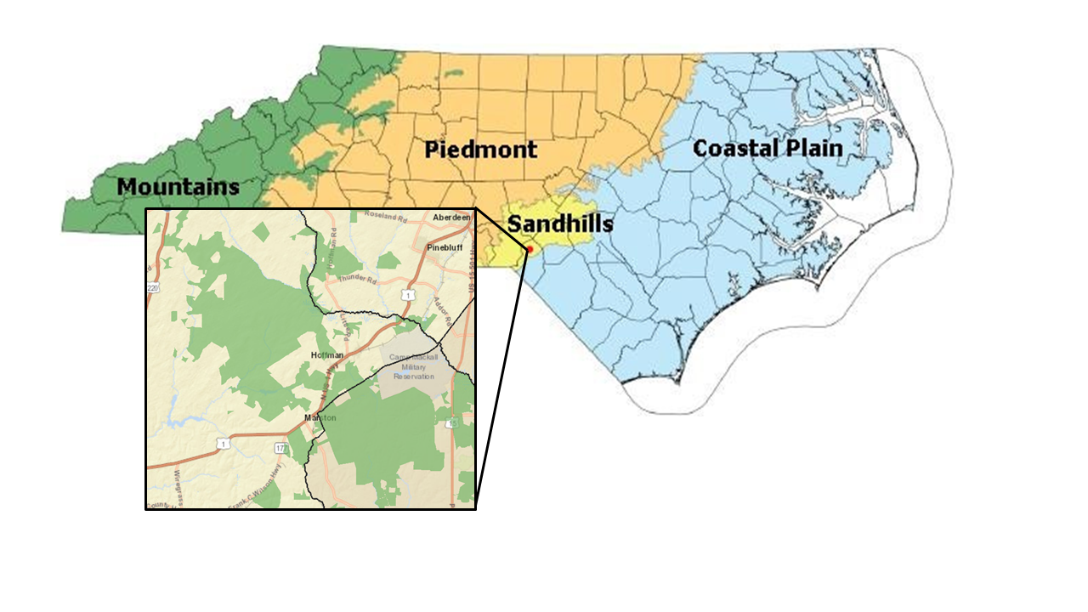
North Carolina Longleaf Pine Savanna

Slide 16
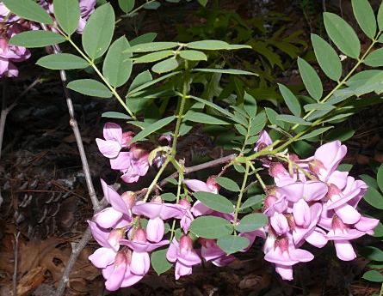
10 individuals
X
4 legume species
X
3 field sites
Lespedeza hirta: perennial herb
Chamaecrista nictitans: annual herb
Robinia nana: perennial shrub
Galactia regularis: perennial vine

Slide 17
ABIOTIC VARIABLES
Soil Total N (ppm)
Soil NO₃⁻ (ppm)
Soil NH₄⁺ (ppm)
Soil Moisture (% VWC)
Soil Temperature (°C)
Light Availability (PAR)
N-FIXATION
Acetylene Reduction Assays:
Ethylene Produced (pmol/hour/nodule)
BIOTIC VARIABLES
Plant Volume (cm³)
Specific Leaf Area (cm²/mg)
Legume Aboveground Biomass (g)
Legume Belowground Biomass (g)
Distance (mm) to Other Legumes
Surrounding Plant Community
5 Nearest Neighbors
Leaf % C
Leaf % N
Nodule Size
Nodule Color
Nodule #
Nodule Weight (mg)

Slide 18
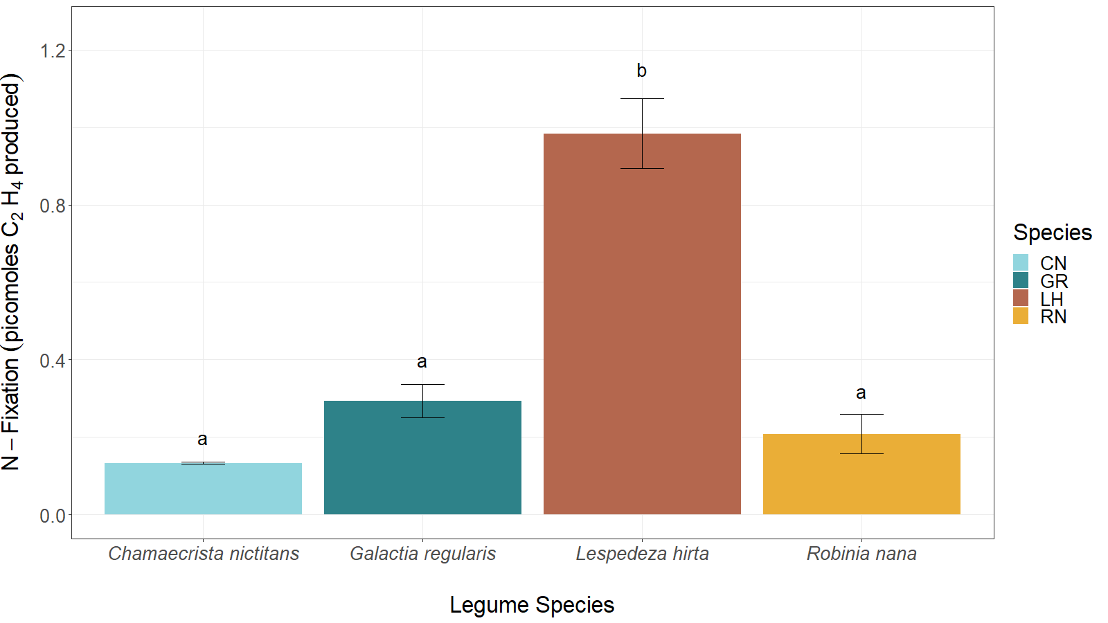
Some legume species fix more N than others!
To determine predictors of this:
Path analyses

Slide 19
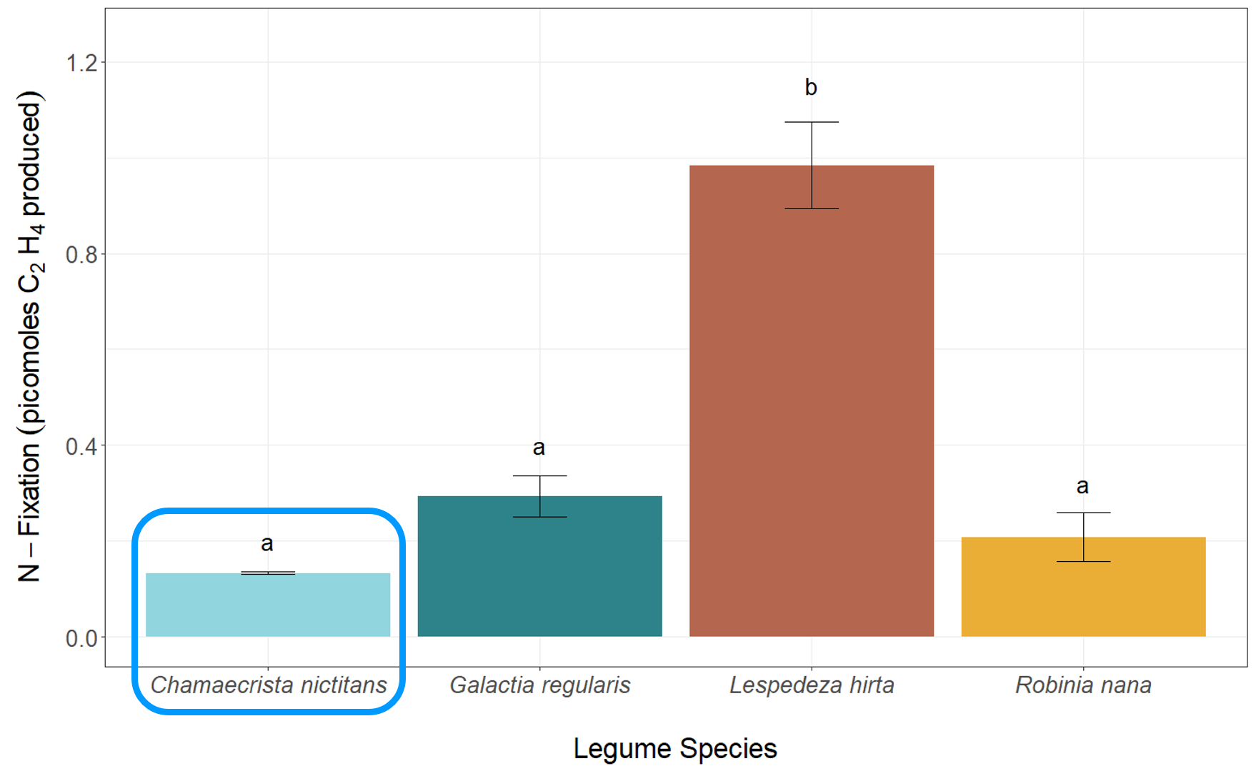
Chamaecrista nictitans: annual herb
Abiotic - Soil
(PC 1)
Soil Total N & NH₄ = N-fixation
0.129**
Biomass = N-fixation
Leaf % N
Nodule Weight = N-fixation
Legume Aboveground Biomass
0.442**
R²=0.26
N-Fixation
Surrounding Plant Community (NMDS1)
-0.400**
-0.339*
Nodule #/Plant
0.470**
Nodule Number = N-fixation
Total Nodule Weight/Plant
Aristida stricta = N-fixation
Model
χ² = 20.785, d.f. = 16, P = 0.187

Slide 20
Abiotic – Soil (PC 1)
Leaf %N
Legume Aboveground Biomass
N-Fixation
Surrounding Plant Community (NMDS1)
Nodule #/Plant
Total Nodule Weight/Plant

Slide 21
ABIOTIC VARIABLES
Soil Total N (ppm)
Soil NO₃⁻ (ppm)
Soil NH₄⁺ (ppm)
Soil Moisture (% VWC)
Soil Temperature (°C)
Light Availability (PAR)
N-FIXATION
Acetylene Reduction Assays:
Ethylene Produced (pmol/hour/nodule)
BIOTIC VARIABLES
Plant Volume (cm³)
Specific Leaf Area (cm²/mg)
Legume Aboveground Biomass (g)
Legume Belowground Biomass (g)
Distance (mm) to Other Legumes
Surrounding Plant Community
5 Nearest Neighbors
Leaf % C
Leaf % N
Nodule Size
Nodule Color
Nodule #
Nodule Weight (mg)
Extracted rhizobia DNA from each nodule to connect rates of N-fixation with a specific rhizobia!!

Slide 23
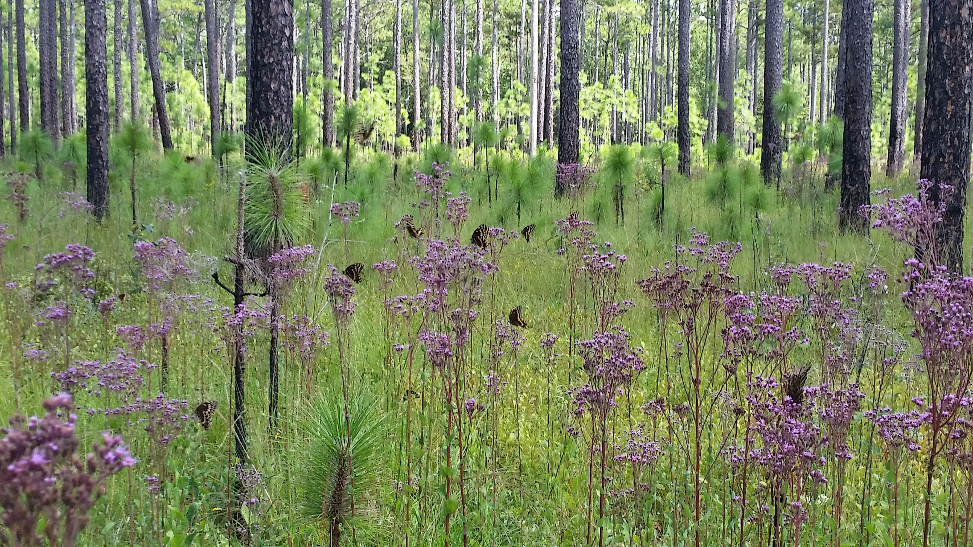
Acknowledgements
Koerner Lab at UNCG

