Slide 1
Partnership Updates
Julian Wilson
Longleaf Program Coordinator
NC Forest Service
Julian.Wilson@ncagr.gov
March 9, 2022

Slide 2
Who we are
The mission of the North Carolina Longleaf Coalition is to promote the maintenance and restoration of North Carolina’s longleaf pine ecosystem, including its cultural and economic values, by forming a collaborative network of diverse stakeholders to provide strategic leadership across the historic range while also supporting local restoration activities.
NCFS, USFS, USFWS, NC WRC, NC State Parks, SERPPAS, NCSU, Consulting Forester (currently True North), The Nature Conservancy, NRCS, and DoD (currently vacant)
America’s Longleaf Restoration Initiative Range-wide Accomplishment Report https://americaslongleaf.org/resources/2020-range-wide-accomplishment-report/

Slide 3
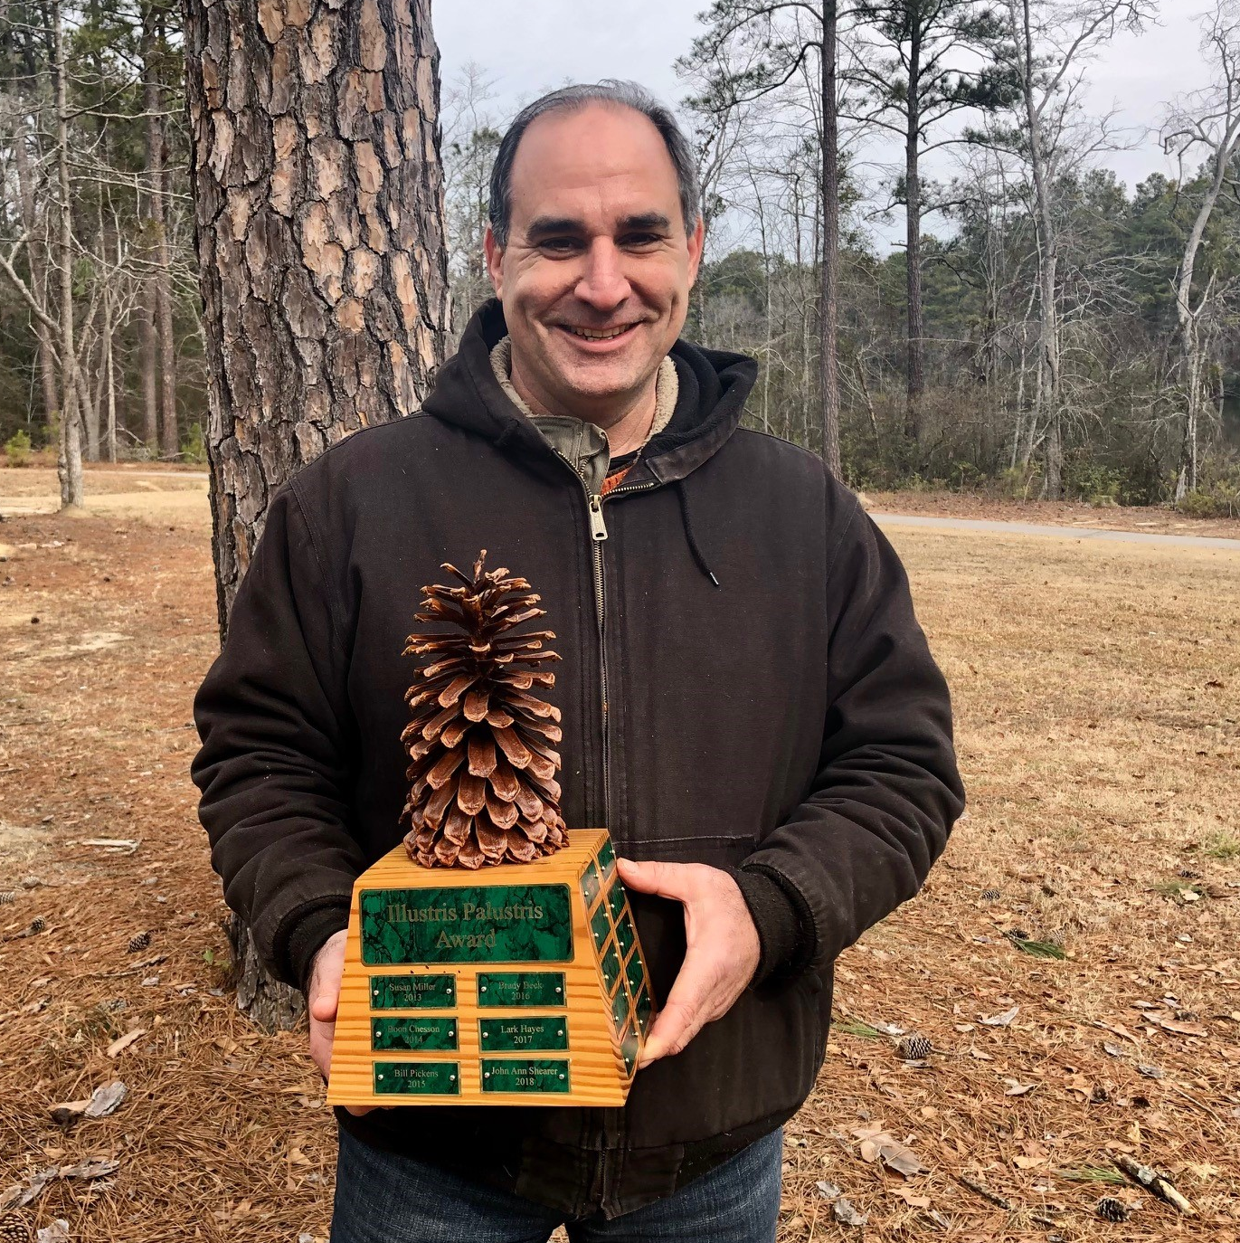
Congratulation to Jeff Marcus, winner of the 2021 Illustris Palustris Award!

Slide 4
Submit a nomination for the 2022 Illustris Palustris Award
Nominations are OPEN for 2022
Submit nominations to julian.wilson@ncagr.gov
Nomination form can be found on the NC Longleaf Coalition website https://www.nclongleaf.org/awards.html
Please submit by August 19, 2022

Slide 5
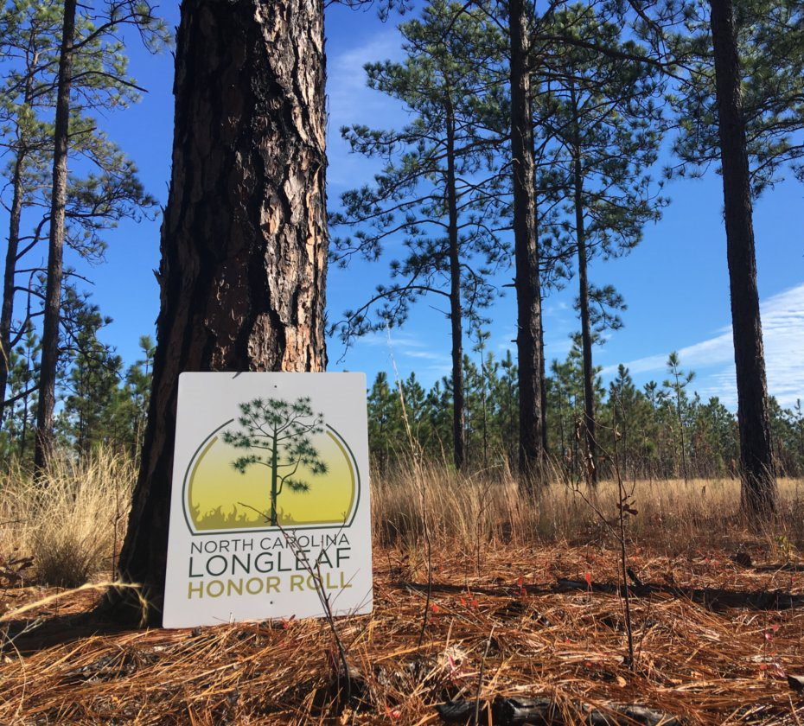
Longleaf Honor Roll
13 completed landowner recognitions; 6 landowners approved and awaiting scheduling (COVID delays)
Over 1700 acres of longleaf recognized across 11 counties (Jones, Hoke, Richmond, Moore, Wake, Anson, Harnett, Bladen, Brunswick, Scotland, and Montgomery)
To qualify:
1. Have a forest management plan
2. Actively manage longleaf with prescribed burning
3. Implement BMPs to reduce negative impacts from pine straw harvesting
Nomination form is available on NC Longleaf Coalition website. Nominations and approvals occur on a rolling basis.

Slide 6
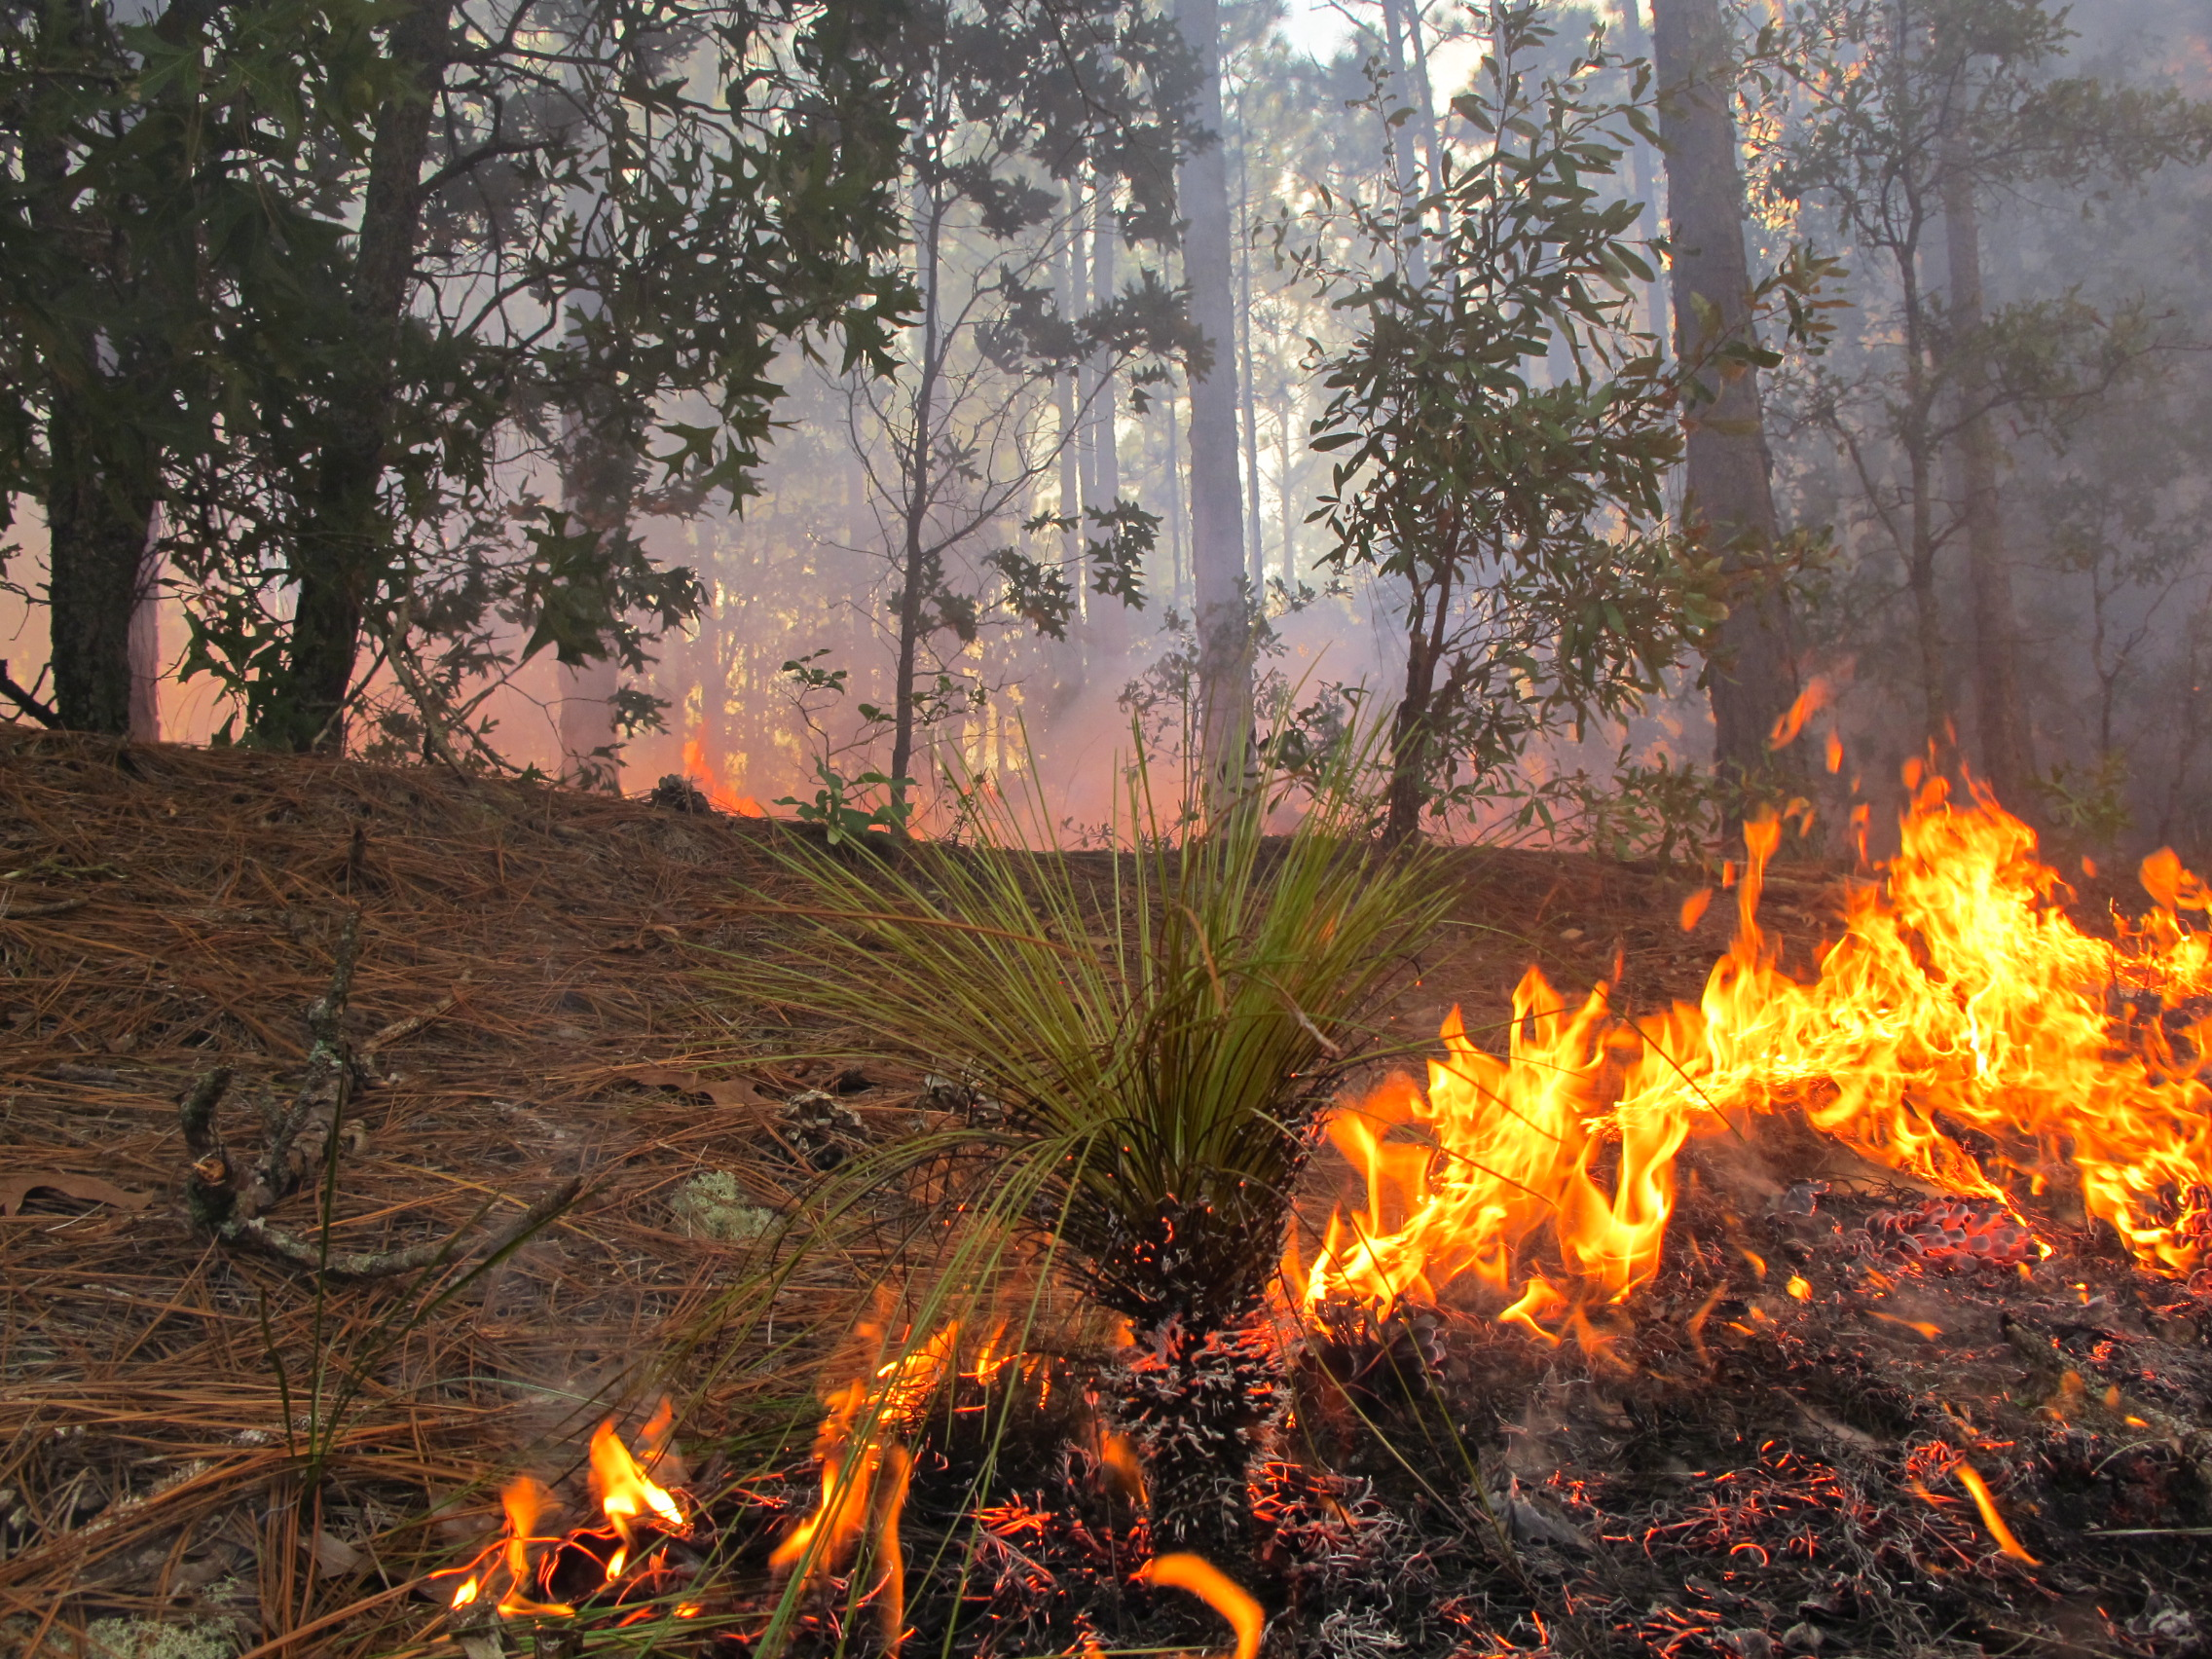
New Opportunity for Prescribed Burn Funding
New cost-share funding opportunity for private landowners through NCFS – time-limited funding for approximately 2 years
More information can be found at:
NC Forest Service > Managing Your Forest > Financial Assistance > Prescribed Burning Cost-Share Program https://www.Ncforestservice.Gov/managing_your_forest/burncostshare.Htm
Burns do not have to be administered by NCFS to qualify but must be completed by April 30, 2023. Silvicultural, hazard reduction, and wildlife habitat burning practices are eligible

Slide 7
Submit a Champion Tree Nomination
Have a longleaf pine you think might qualify?
Also seeking winners in other categories: tallest, widest spread, largest in county, etc.
Nomination form can be found on the NCFS website under Urban Forestry

Slide 8
Save the Date: Upcoming Longleaf Events
Early April
Bladen Lakes PBA Meeting in Pender County – “speed dating” meeting with various agencies, date/time TBD
23 Apr.
Party for the Pine, Fire for the Forest at the Boyd Tract of Weymouth Woods
14 May
Harris Lake County Park Longleaf Festival – will be a mixture of in-person and virtual opportunities
15–16 June
Longleaf Academy Herbicides 201 at NC State Extension Center in Elizabethtown
8 Oct.
Fire in the Pines Festival at Halyburton Park in Wilmington – online content and activities throughout the week
25–28 Oct.
14th Biennial Longleaf Alliance Conference at the Hotel Ballast in Wilmington
May
Certified Burner course postponed from April to early- or mid- May. Details coming soon.
Early Oct.
Certified Burner training tentatively first week in October
Early Dec.
Certified Burner training tentatively first week in December

Slide 9
Longleaf Academy: Herbicides 201
June 15-16, 2022, in Elizabethtown, NC
Information on other academies can be found at https://longleafalliance.org/upcoming-events/
Now - Virtual Longleaf Foundations (through December 31)
March 29-31 in Buena Vista, GA - Fire & Longleaf 201
April 5 in Evergreen, AL – Converting Loblolly to Longleaf Over Time
April 12-14 in Lufkin, TX – Longleaf 101

Slide 10
Next NC Longleaf Coalition Meeting is May 18th, 2022
Additional information and resources from the NC Longleaf Coalition can be found at https://nclongleaf.org/
Julian Wilson
Longleaf Program Coordinator
NC Forest Service
Julian.Wilson@ncagr.gov
(office) 919-857-4815
(cell) 919-604-2443
Notes:
Next meeting will likely be in person in Raleigh

